Slide 1

Integrating BIRT
Jason Weathersby, BIRT PMC

Slide 2

Agenda
API Overview
OSGi Startup and Engine Creation
Report Engine API
Design Engine API
Using the DE API within the RE API
Deployment Scenarios
Common BIRT Extensions

Slide 3
High Level BIRT Architecture
1
Report Designer
Report Engine
Eclipse
Report
Designer
Eclipse
DTP
ODA
Chart
Designer
Eclipse
WTP
Data
Transform.
Services
Charting
Engine
5
2
5
3
HTML
PDF
DOC
XLS
Print
PS
CSV
Generation
Services
Presentation
Services
Report Design Engine
4
XML
Report
Design
Data
Report
Document
Data

Slide 4
BIRT Pipeline with respect to the APIs
Report
Designer
Chart Builder
Report Engine
Design
Engine
Chart
Engine
Optional Java Events
JavaScript Events
Paginated HTML
PDF
CSV
WORD
XLS
PostScript
RptDesign
XML
Design File
Generation Phase
Presentation Phase
Report Engine
RptDocument
Report
Document
optional
Example Web Viewer Contains

Slide 5
BIRT API OSGi Startup
Platform Class
  Used to startup required BIRT Plugins.
  Uses OSGi.
  Needed by both the DE API and the RE API
  Uses a PlatformConfig class to configure the startup.
  DesignConfig and EngineConfig extend the PlatformConfig.
  PlatformContext Class Determines location of Plugins.
  Factory used to create DesignEngine or ReportEngine

Slide 6
setPlatformContext( IPlatformContext )
Used to locate the OSGi Plugins.
PlatformConfig
setBIRTHome( location )
Set the location of the BIRT Plugins
setOSGiArguments( String[] )
Used to configure OSGi.
Extends
Extends
EngineConfig
Configure BIRT
Implements
IEngineConfig
DesignConfig
Configure BIRT
Implements
IDesignConfig
setLogConfig( location, level )
Set logging variables (null for location will not create a file).
setResourceLocator( IResourceLocator )
Used to build your own resource locator
setAppContext( HashMap )
Can be used to add Java Objects for scripting.
setResourcePath( ResourceLocation )
Used to retrieve resources – Libs, Images, etc.
setResourceLocator( IResourceLocator )
Used to build your own resource locator
setTempDir( location )
birt.data.engine.memcachesize (default 10M)
setMaxRowsPerQuery( rows )
Maximum Rows to Retrieve

Slide 7
Platform
Used to startup OSGi and create Factory Objects. Static methods.
Startup
Start the Platform
Shutdown
Stop the Platform
createFactoryObject
Launch a plugin that implements the FactoryService Extension
DesignEngineFactory
Design Engine API
ReportEngineFactory
Report Engine API
Optionally implement your own IPlatformContext
DataEngineFactory
Data Engine API
DataAdapterFactory
Data Apater API
Model to Data
OSGILauncher
Startup
IPlatformContext
Location=getPlatform()
PlaformConfig: EngineConfig/DesignConfig
PlatformFileContext
PlatformServletContext
Default PlatformContext
Looks for Plugins in BIRT_HOME
Looks for javax.servlet.context.tempdir
Creates platform directory in tempdir
Uses getResourcePaths for /WEB-INF/platform to locate plugins
Copies plugins and configuration to the tempdir/platform directory

Slide 8
Platform Startup Code for DE and RE API
Design Engine Sample
IDesignEngine engine = null;
DesignConfig config = new DesignConfig( );
config.setBIRTHome("C:/birt/birt-runtime-2.2.0m5rc/birt-runtime-2_2_0/ReportEngine");
try{
Platform.startup( config );
IDesignEngineFactory factory = (IDesignEngineFactory) Platform
.createFactoryObject( IDesignEngineFactory.EXTENSION_DESIGN_ENGINE_FACTORY );
engine = factory.createDesignEngine( config );
}catch( Exception ex){
ex.printStackTrace();
}
Report Engine Sample
IReportEngine engine=null;
EngineConfig config = new EngineConfig;
config.setBIRTHome("C:/birt/birt-runtime-2.2.0m5rc/birt-runtime-2_2_0/ReportEngine");
try{
Platform.startup( config );
IReportEngineFactory factory = (IReportEngineFactory) Platform
.createFactoryObject( IReportEngineFactory.EXTENSION_REPORT_ENGINE_FACTORY );
engine = factory.createReportEngine( config );
}catch( Exception ex){
ex.printStackTrace();
}

Slide 9
Report Engine API
Used to Generate Report Documents.
Used to Generate Report Output (PDF, HTML, Paginated HTML,WORD, XLS, Postscript)
Engine Creates task to implement operations.
One or Two Phase operation (Run Task then Render Task or RunAndRenderTask)
DataExtraction Task for retrieving Data from a report document.
ParameterDetails Task for retrieving Parameter information, including dynamic and cascading information.

Slide 10
Report Engine Task
EngineConfig
Set configuration variables such as Engine Home and Log configuration
Open Report Design and Documents. Create Engine Task.
ReportEngine
Generate one or more tasks
GetParameterDefinitionTask
Retrieve Parameters and their properties
RunAndRenderTask
Does not support Pagination, TOC, Bookmarks.
DataExtractionTask
Extract Data from Report Document
RunTask
RenderTask
Generate Paginated HTML, XLS, PDF Document, Postscript, XLS
RptDesign
XML
Design File
RptDocument
Report
Document
RptDesign
XML
Design File
RptDocument
Report
Document
RptDesign
XML
Design File
RptDocument
Report
Document
Retrieve TOC and Bookmarks

Slide 11
Simple RE API Process
EngineConfig config = new EngineConfig( );
config.setBIRTHome("C:/birt-runtime/ReportEngine");
IReportEngine engine = null;
try{
Platform.startup( config );
IReportEngineFactory factory = (IReportEngineFactory) Platform
.createFactoryObject( IReportEngineFactory.EXTENSION_REPORT_ENGINE_FACTORY );
engine = factory.createReportEngine( config );
}catch( Exception ex){
}
IReportRunnable design = null;
design = engine.openReportDesign(“TopNPercent.rptdesign");
IRunAndRenderTask task = engine.createRunAndRenderTask(design);
HTMLRenderOption options = new HTMLRenderOption();
options.setOutputFileName("output/resample/TopNPercent.html");
options.setOutputFormat("html");
task.setRenderOption(options);
task.run();
ReportEngine
Create the report engine.
openReportDesign(report)
Open Design
createRunAndRenderTask(design)
Create an Engine Task.
HTMLRenderOptions()
Set rendering options.
setRenderOptions(options)
Set the task render options.
run()
Run and Render the report.

Slide 12
Report Engine Important Methods
ReportEngine
Reporting Task – One Engine Supports Multiple Task
openReportDesign()
Seven Open methods that include support for Filename, InputStream, and ResourceLocator.
openReportDocument()
Six Open methods that include support for Filename, IDocArchiveReader, and ResourceLocator.
changeLogLevel(newlevel )
New Logging Level..
EngineTask
createGetParameterDefinitionTask
Used to retrieve Parameter information.
createRunTask
Used to create a rptdocument from a rptdesign.
createRenderTask
Used to render a rptdocument to an output format.
createDataExtractionTask
Used to extract report data from a rptdocument.
createRunAndRenderTask
Used to execute a rptdesign and produce an output in the selected format.

Slide 13
EngineTask Important Methods
EngineTask
Base Class for all Task.
setLocale().
Set Locale for the Report.
setAppContext().
Modify Application Context for the task.
setParameterValue(Parameter Name, Parameter Value).
Set individual Parameter.
setParameterValues(HashMap map).
Set all parameters for the report.
validateParameters().
Verifies proper parameter types.
close().
Close the task and release resources.
cancel().
Cancel a running task. Requires new Thread. Does not cancel actively running Queries.
getStatus().
Get the status of the currently running task. Not Started, Running, Succeded, Failed, Cancelled.

Slide 14
RunAndRenderTask Important Methods
RunAndRenderTask
Execute a rptdesign and emit an output.
run().
Executes the report design and produces the selected output.
setRenderOptions(IRenderOptions).
Setup Render Options for the Task.

Slide 15
RunTask Important Methods
RunTask
Execute a rptdesign and create a rptdocument.
run(String path).
Run the task and output the rptdocument to the path location. Can be folder.
run(IDocArchiveWriter).
IDocArchiveWriter Allows the user to implement a writer to output the report document.
setPageHandler(IPageHandler)
Allows setting a callback on each HTML page generation. Progressive Viewing.

Slide 16
RenderTask Important Methods
RenderTask
Render a rptdocument to an output.
render().
Render the output. Set RenderOptions first.
setRenderOptions(IRenderOptions).
Setup Render Options for the Task.
setBookmark(Bookmark).
Renders the page that contains the Bookmark.
setInstanceId(InstanceID).
Renders the page that contains the Instance Id.
setPageNumber(PageNumber).
Renders the page specified by PageNumber.
setPageRange(PageRange).
Renders the page range.

Slide 17
GetParmeterDefinitionTask Important Methods
GetParameterDefinitionTask
Retrieve report parameter details.
getParameterDefns(boolean Indclude groups).
Returns a collection of the report parameter definitions.
getParameterDefn(ParameterName).
Returns a IParameterDefnBase for the given parameter. See Report parameter details.
getSelectionList(ParameterName).
Used to retrieve values for a parameter that are either dynamic or static.
getSelectionListForCascadingGroup(GroupName, Object array). -Iterative call
Used to retrieve values for a cascaded parameter. Object array contains nothing for first level, 1 value for second level. etc
evaluateQuery( parameterGroupName)
Used prior to getting the selection list for cascaded parameter. Caches result set in memory.
getDefaultValues( )
Returns HashMap of all parameters with there default values (ParamName –Value Pair).
getParameters() getParameter(ParameterName)
Used to retrieve report parameter handles

Slide 18
Report Parameter Details
IParameterDefnBase
Base interface for all Parameters.
getParameterType()
Returns the type of parameter eg (Filter, List, Table, Group or Scalar)
getTypeName()
Returns Type Name listed above.
getHelpText()
Help Text for the Parameter
getPromptText()
Prompt Text for the Parameter
getHandle()
Handle to parameter design
IScalarParameterDefn
Scalar Parameter Definition.
IParameterGroupDefn
Parameter Group Definition.
getDataType
Parameter Data Type (Float, String etc).
IScalarParameterDefn
Scalar Parameter Definition.
IScalarParameterDefn
Scalar Parameter Definition.
getDisplayFormat
Parameter formatting.
IScalarParameterDefn
Scalar Parameter Definition.
IScalarParameterDefn
Scalar Parameter Definition.
allowBlank()
Can a blank parameter value be used.
See Parameters example for more details.

Slide 19
DataExtractionTask Important Methods
DataExtractionTask
Retrieve data from a report document. These are result sets from a bound element not a dataset.
getResultSetList()
ArrayList of all data bound elements. Hint Name elements such as tables to make it easier.
selectResultSet(resultSetName)
Set the data element you wish to extract.
setInstanceID(InstanceID)
Set Instance ID of the data element to extract. Easier to use selectResultSet
selectColumns(String[])
Select the columns you wish to extract.
setFilters(IFilterDefinition[])
Set simplistic filters on the resultset to cull returned data.
extract()
Extract the results returns IExtractionResults, which has methods for getting the metadata and results.

Slide 20
RenderOptions
Used to Configure Report Output location and format.
Plugin must exist that emits the chosen format.
Used by RunAndRender and Render Tasks.
IRenderOption options = new RenderOption();
options.setOutputFormat("html");
options.setOutputFileName("output/customers.html");
if( options.getOutputFormat().equalsIgnoreCase("html")){
HTMLRenderOption htmlOptions = new HTMLRenderOption( options);
htmlOptions.setImageDirectory("output/image");
htmlOptions.setHtmlPagination(false);
}
task.setRenderOption(options);

Slide 21
IRenderOption
Base interface for Rendering Reports
setBaseURL(UrlString).
Used to prepend URL to action handler.
setOutputFileName(Filename).
Output to specific filename.
setOutputFormat(FormatString).
Output to format. Eg pdf, html
setOutputStream( OutputStream).
Renders to the OutputStream.
setSupportedImageFormats(FormatString).
Set the image formats that the render supports.eg “PNG;GIF;JPG;BMP;SVG”.
setActionHandler(IHTMLActionHandler).
Implement an Action Handler to handle hyperlinks or use the default.
setImageHandler(IHTMLImageHandler).
Implement an Image Handler to handle reading and writing images.
IPDFRenderOption
Specific PDF rendering options
IHTMLRenderOption
Specific HTML rendering options
setEmbededFont(boolean).
Specify whether fonts should be embedded in the output.
setImageDirectory(Directory).
Set the directory that the engine will store images.
setFontDirectory(Directory).
Specify location of fonts.
setBaseImageURL(String).
Prepend uri to images. Must be ServerImageHandler or Your own.
setEmbeddable(boolean).
Remove HTML and Body tags.

Slide 22
HTML Image and Hyperlink Management
HTMLImageHandler
Class used to handle writing image files for a report output.
HTMLCompleteImageHandler
File Based Image Management.
HTMLServerImageHandler
Allows Creating images in a directory and prepending the img src attribute with a URL.
Write your Own
HTMLActionHandler
Class used to handle building URLs generated from the hyperlink editor.
Write your Own

Slide 23
Design Engine API
Used to Generate/Modify Report Designs, Templates and Libraries.
Can be used in conjunction with the RE API to modify designs on the fly.
Can be used within BIRT Script to modify designs on the fly.
Create and delete report elements.
Put report elements into slots.
Get and set parameter values.
Retrieve metadata from report elements, properties and slots.
Undo/Redo
Semantic Checks on report designs.

Slide 24
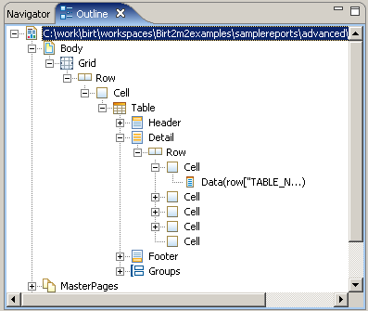
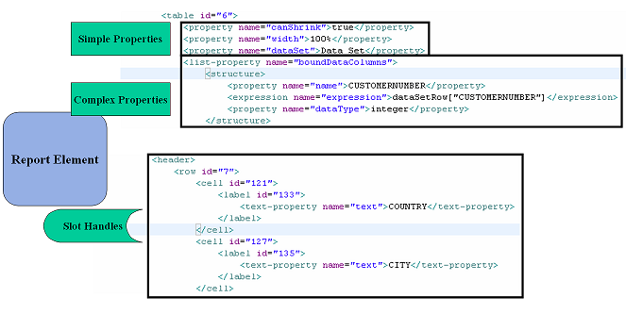
BIRT Elements
Elements – Report Objects such as Table, Label, Style etc.
Properties – Modify the Element state and often support inheritance. Discussed in ROM specification. Simple and Complex properties.
Slots – Describes element - container relationships. For example a Report element contains slots for Data Sources, Data Sets, Report Body, etc. Represented by SlotHandle.

Slide 25
Simple DE API Process
DesignConfig config = new DesignConfig( );
config.setBIRTHome("C:/birt/birt-runtime-2.2.0m5rc/birt-runtime-2_2_0/ReportEngine");
IDesignEngine engine = null;
try{
Platform.startup( config );
IDesignEngineFactory factory = (IDesignEngineFactory) Platform
.createFactoryObject( IDesignEngineFactory.EXTENSION_DESIGN_ENGINE_FACTORY );
engine = factory.createDesignEngine( config );
}catch( Exception ex){
ex.printStackTrace();
}
SessionHandle session = engine.newSessionHandle( ULocale.ENGLISH ) ;
ReportDesignHandle design = session.createDesign( );
ElementFactory factory = design.getElementFactory( );
GridHandle grid = factory.newGridItem( null, 2 , 1 );
design.getBody( ).add( grid );
design.saveAs( "output/desample/sample.rptdesign" );
DesignEngine
Create the Design Engine.
newSessionHandle(Locale)
DesignSession used to create reports, libs, etc
createDesign()
Returns a ReportDesignHandle.
getElementFactory()
Returns ElementFactory to Create Report Elements.
getBody()
Returns SlotHandle use add to add new report element.
DessignSession.saveAs()
Save Report Design.

Slide 26
SessionHandle keys
SessionHandle
Class used to create and modify report content. Can be used to open many designs.
openModule().
Four methods open a module. Support for InputStream or Filename. Does not matter if Lib or RptDesign.
openLibrary().
Six methods for opening a Lib. Support for Base URL, Filename and InputStream. URL is used for relative resources.
openDesign().
Six methods for opening a rptdesign. Support for Base URL, Filename and InputStream. URL is used for relative resources.
createDesign(). createDesign(ReportName)
Create a new report design. Returns a ReportHandle. Used in creating a template as well.
createLibrary().
Create a new library. Returns a LibraryHandle
createLibraryFromTemplate().
Create a new library based on a rpttemplate (Must be a lib). Returns a LibraryHandle
createDesignFromTemplate().
Create a new report design based on a rpttemplate (Must be a Report). Returns a ReportHandle
setResourceFolder(String).
Location of resources.
setResourceLocator(IResourceLocator).
Set your own resource locator.

Slide 27
ROM Report Object Model Handles
Add Elements to Slots.
Drop Element from report.
Getter/Setter for names, properties and styles.
Saving the module.
findElement, findDataSet, etc.
getDataSets, getParameters, Embedded Images, etc.
Configuration Variables.
DesignElementHandle
Base class for all report elements.
getDefn to get Element Definition for slots etc.
ModuleHandle
Provides most of the common design functions.
getThemes and importCssStyles
Scripts getBeforeFactory, initialize, setBeforeRender.
SlotHandles suchas getBody.
LibraryHandle
Handle to a Library.
Scripts setOnCreate, getOnPageBreak, etc.
Set simple specific properties like setWidth, setBookmark.
DataBinding calls setDataSet and getColumnBindings.
Parameter Binding using paramBindingsIterator.
ReportDesignHandle
Report Design Handle.
Abstract class. Comments and CustomXML.
ReportElementHandle
NonVisual Elements.
get and setResultSetColumn.
get and setHelpText.
ReportItemHandle
Visual Elements. Includes Data, Position and Style
LabelHandle
Handle to a Label Element
Scripts.
getContent. SlotHandle for contents.
DataItemHandle
Handle to a Data Element
CellHandle
Handle to a Cell.

Slide 28
Properties, Slots and Structures Sample
ElementDetailHandle
Base Class Property Handles, Slot Handles, Structure Handles.
ValueHandle
getPropertyDefn - IElementPropertyDefn.
SimpleValueHandle
Abstract Class - getValue commands. AddItem used to add to list.
MemberHandle
Member of structure.
PropertyHandle
Top level property can reference a struct List.
StructureHandle
Complex Properties (struct).
FilterConditionHandle
Element Filter Condition
ComputedColumnHandle
Computed Column Handle
StyleRuleHandle
Handle to Element Style
SlotHandle
Use Add Method to add content.
getContents (DE List)
getCount
HighlightRuleHandle
Highlight Rule Handle

Slide 29
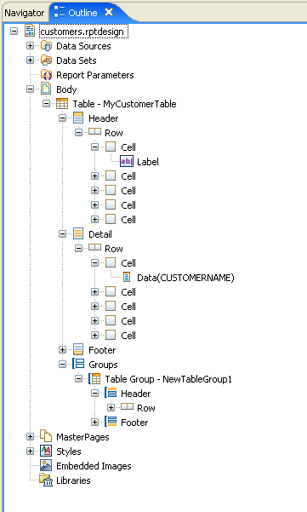
ReportItemDetails Example
<table name="MyCustomerTable" id="6">
<list-property name="highlightRules">
<structure>
<property name="operator">ge</property>
<property name="backgroundColor">#FF0000</property>
<expression name="testExpr">row["CREDITLIMIT"]</expression>
<expression name="value1">0</expression>
</structure>
</list-property>
<property name="width">100%</property>
<property name="dataSet">Data Set</property>
<list-property name="boundDataColumns">
<structure>
<property name="name">CUSTOMERNUMBER</property>
<expression name="expression">dataSetRow["CUSTOMERNUMBER"]</expression>
<property name="dataType">integer</property>
</structure>

Slide 30
ElementFactory
Used to create new Report Elements. Use container SlotHandle.add.
Produces
SlotHandle
DesignElementHandle.
Cast to specific handle
SlotHandle
LabelHandle label1 = elementFactory.newLabel("Label1" );
label1.setText("Customer");
CellHandle cell = (CellHandle) tableheader.getCells( ).get( 0 );
cell.getContent( ).add( label1 );
<cell id="6">
<label name="Label1" id="7">
<text-property name="text">Customer</text-property>
</label>
</cell>

Slide 31
StructureFactory
Used to create new structures (complex xml). Use PropertyHandle on container to add to list.
Produces
HighlightRule hr = structFactory.createHighlightRule();
hr.setOperator(DesignChoiceConstants.
MAP_OPERATOR_GT);
hr.setTestExpression("row[\"CustomerCreditLimit\"]");
hr.setValue1("100000");
hr.setProperty(HighlightRule.
BACKGROUND_COLOR_MEMBER, "blue");
PropertyHandle ph = th.getPropertyHandle(StyleHandle.
HIGHLIGHT_RULES_PROP);
ph.addItem(hr);
<list-property name="highlightRules">
<structure>
<property name="operator">gt</property>
<property name="backgroundColor">blue</property>
<expression name="testExpr">row["CustomerCreditLimit"]</expression>
<expression name="value1">100000</expression>
</structure>
</list-property>

Slide 32
Calling the DE API from the RE API/Report Script
RE API Code
IReportRunnable design = null;
//Open the report design
design = engine.openReportDesign("Reports/TopNPercent.rptdesign");
ReportDesignHandle report = (ReportDesignHandle) design.getDesignHandle( );
report.findElement(“table1”).drop();
beforeFactory Script
reportContext.getReportRunnable().
designHandle.getDesignHandle().
findElement("table1").drop();

Slide 33
BIRT Deployment Scenarios
APIs (DE API, CE API, RE API)
BIRT Tag
Libs
Chart Tag
Libs
Custom Servlet
Web Viewer
Web Viewer
Plugin
J2EE AS
RCP Application
Standalone Application
Paginated HTML, PDF, XLS, WORD, PostScript, TOC, Bookmarks, CSV

Slide 34
ReportEngineService.java For Viewer Engine Details.
WebViewerExample
logs
The default location for BIRT logs.
scriptlib
Location for class files used in a Scripted Data Source.
report
Default location of Report Designs
webcontent
birt
ajax
JavaScript files used with the Viewer
pages
JSP Fragments used to build the Viewer
The Viewer example uses a PlatformServletContext.
So by default the plugins are searched for in WEB-INF/platform.
images
Images used by the Viewer
styles
CSS files used by the Viewer
WEB-INF
lib
Location for BIRT required Jars.
platform
plugins
BIRT required runtime plug-ins.
configuration
Location for OSGi configuration files.

Slide 35
Use Singleton to launch Design or Report Engine. Start Platform on Servlet Startup and shutdown Platform on Servlet destroy.
Servlet Example – See Dynamic Report Example
YourServletExample
logs
The default location for BIRT logs.
report
Default location of Report Designs
images
Use PlatformServletContext
Default location for report images
WEB-INF
lib
Location for BIRT required Jars. Copy from Runtime.
platform
plugins
BIRT required runtime plug-ins. Copy from runtime.
configuration
Location for OSGi configuration files. Copy from runtime.

Slide 36
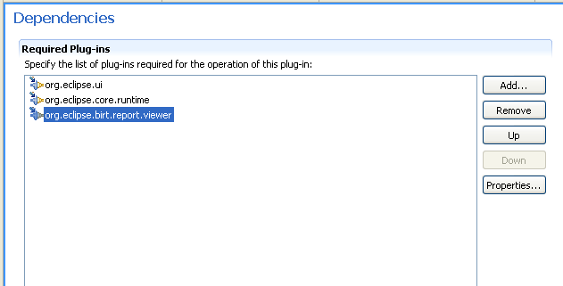
WebViewer Utility Class see RCPViewer Example
WebViewer.display()
See Example for Options.
Used with external browser or SWT Browser Widget.

Slide 37
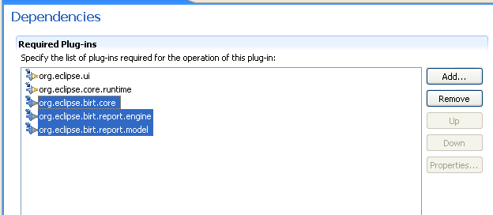
Using the RE/DE API Plugins in an RCP application
Do not set BIRT Home and use engines as normal.
See RCPEngine Example.
Uses SWT Browser Widget.

Slide 38
Common BIRT Extensions
Data Tool Extension Tasks
  Open Data Access ODA – new sources of data – New Project Wizard
  DriverBridge - enhance existing ODA drivers
  ODA UI - create new user interface – New Project Wizard
BIRT Extension Points
  Aggregates – Create new BirtScript Total functions
  Report Items – Add items to the report palette
  Emitters – Allow output in new formats
  Charts – Create new types of charts

Slide 39
Questions?
Webinar on Actuate Usage of BIRT www.actuate.de/BIRT-OnlineSeminar-2
BIRT Book set giveaway drawing at Actuate Booth.
Birtworld.blogspot.com
www.eclipse.org/birt

