Slide 1
Introduction to Business Intelligence and Reporting Tools 2.2
Jason Weathersby
BIRT Evangelist, Actuate Corp.
jweathersby@actuate.com
Notes:
Standard template for internal and external Rational presentations. If internal presentations are confidential, please add: “IBM Confidential” to the slide masters.
Select: View / Master / Slide Master and add “IBM Confidential”

Slide 2
Agenda
BIRT Project = Business Intelligence and Report Tools Project
Introduction
Components and High Level Architecture
Release 2.2 Themes
Release 2.2 Feature Review
A Look at the Project Roadmap – What's Next?

Slide 3
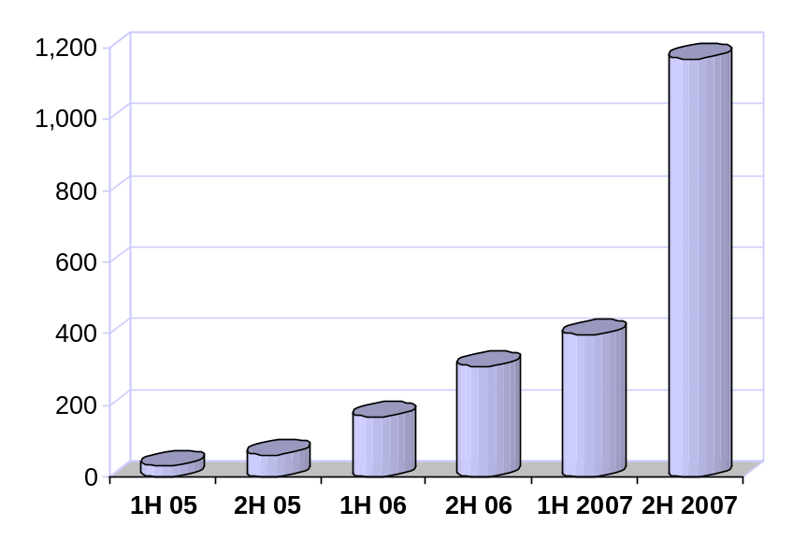
Open Source Reporting: Eclipse BIRT
Open source initiative as part of the Eclipse Foundation
Founded, organized and led by Actuate
Project launched in October, 2004
Over 2 Million Downloads
as of Dec, 2007
Project Goals
Next generation reporting technology
Eclipse-based Report Designer
Web-centric design metaphor
Open Source with rapid adoption
Standards based & highly extensible
Open XML design format
Build community and ecosystem
Downloads (1,000s)

Slide 4
BIRT Project Users
Audience
Features
Easy Complex
Report Developers Drag & Drop authoring, charting
Advanced Report Developers Scripting, Script API
Runtime Integration Developers BIRT Viewer and Engine APIs
Report Design Integration Design Engine API
Extension Developers BIRT Extension Points
Core Development Eclipse Development, Open Source

Slide 5
High Level BIRT Architecture
Report Designer
Report Engine
Eclipse
Report
Designer
Eclipse
DTP,
WTP,…
Chart
Designer
Custom
Designer
Data
Transform.
Services
Charting
Engine
HTML
PDF
Excel
Word
PowerPoint
PostScript
…
Generation
Services
Presentation
Services
Report Design Engine
XML
Report
Design
Data
Report
Document
Data

Slide 6
Project Timeline Leading Up to BIRT 2.2
Sep, 2004 | BIRT Project proposal accepted, and project launched
Feb, 2005 | 1.0 Preview Release: Eclipse Report Designer, Report Engine, Chart Engine
Jun, 2005 | 1.0 Release: Eclipse Report Designer, Report Engine, Chart Engine
Dec, 2005 | 2.0 Release: Support for a wide variety of common report types
Jun, 2006 | 2.1 Release: Advanced parameters, ability to join data sets, …
Jun, 2007 | 2.2 Release: Crosstabs, …
Jun, 2008 | 2.3 Release: JavaScript Debugger, Graphical SQL Editor

Slide 7
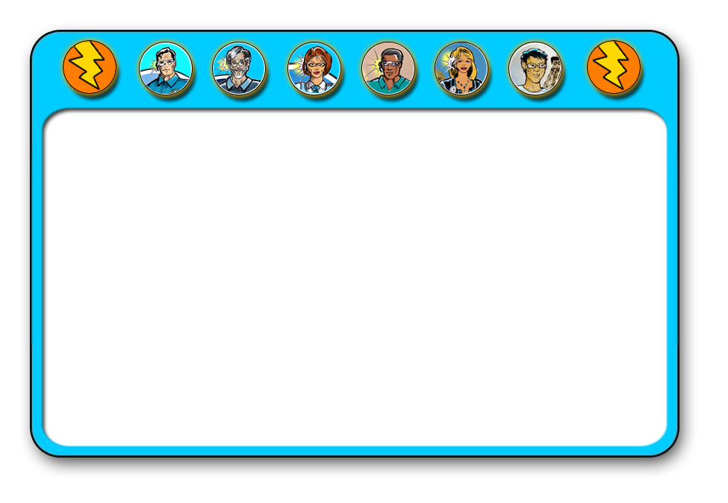
DEMO
A Walk Around the Designer

Slide 8
Eclipse BIRT 2.2
Part of Eclipse “Europa” simultaneous release
Released on June 27, 2007, simultaneously with 20 other Eclipse projects
BIRT 2.2 Themes
Support for a wider range of report types and easier report development
New chart types and more control over charts
New output formats to common office tools
New data sources and improved data access
Easier application integration and extension development

Slide 9
New Report Types & Easier Report Development
Dynamic Crosstab Support
New Aggregation Builder
Layout Preference
Link to External CSS files
Ability to use Styles in highlight rules
Style support for Table of Contents
Report Parameter Changes
Property Editor Enhancements
New Advanced Properties
XML Source Editor Enhancements

Slide 10
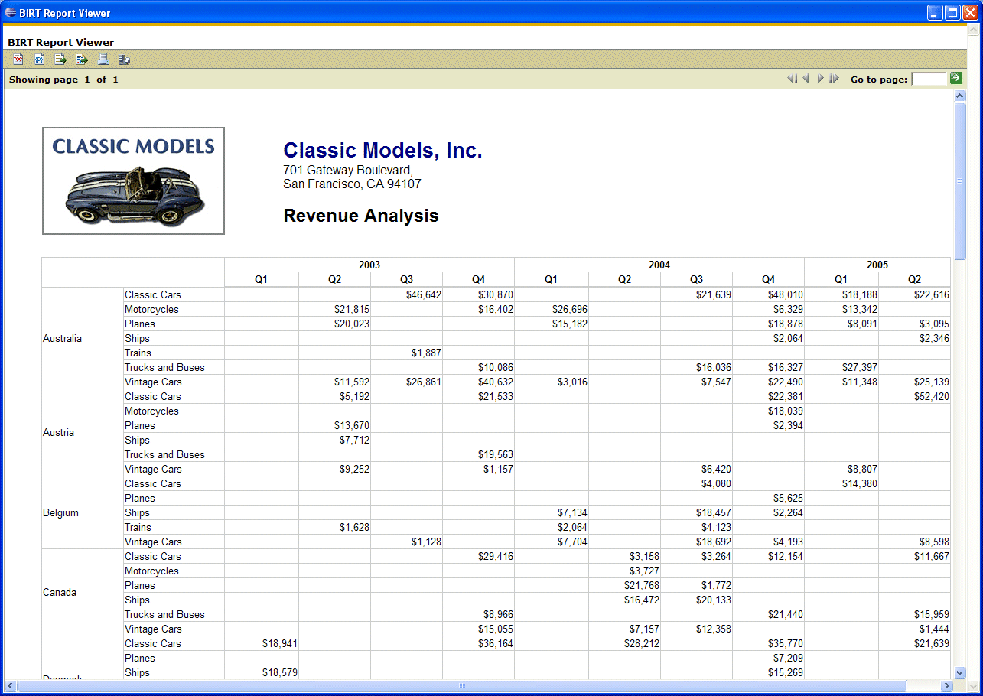
Crosstab Reports

Slide 11
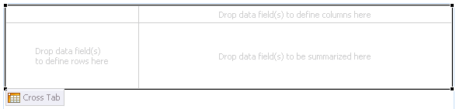
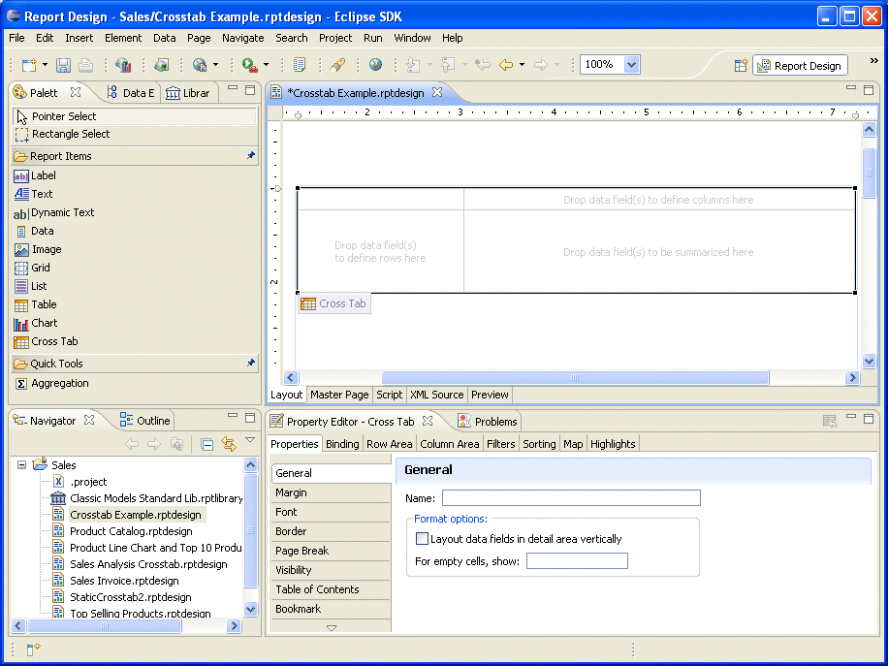
Crosstab Report Item
Dynamic Crosstab Support
  New Report Item on palette
  Drag and drop creation
  Multiple level support
  Built on cube engine
  …powerful aggregation, levels, …
Quickly and Easily Incorporate Crosstabs in BIRT Reports

Slide 12
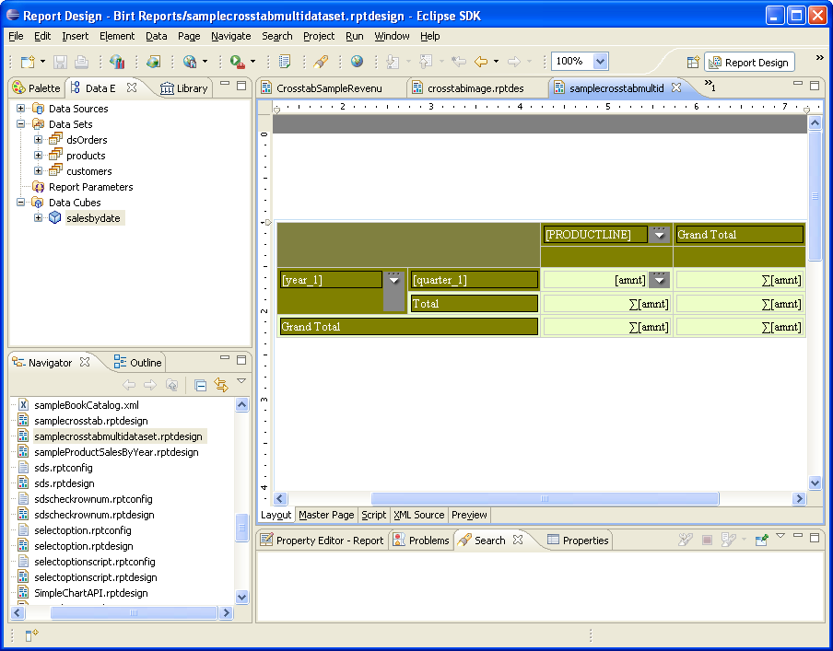
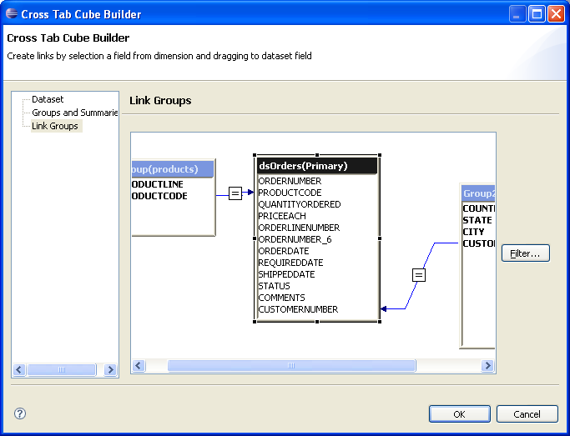
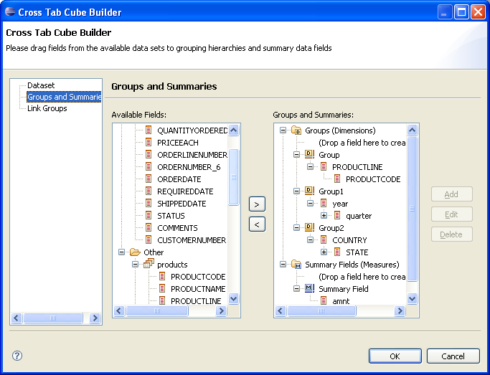
Demo BIRT Cross Tab Report

Slide 13
DEMO
Building a Crosstab Report

Slide 14
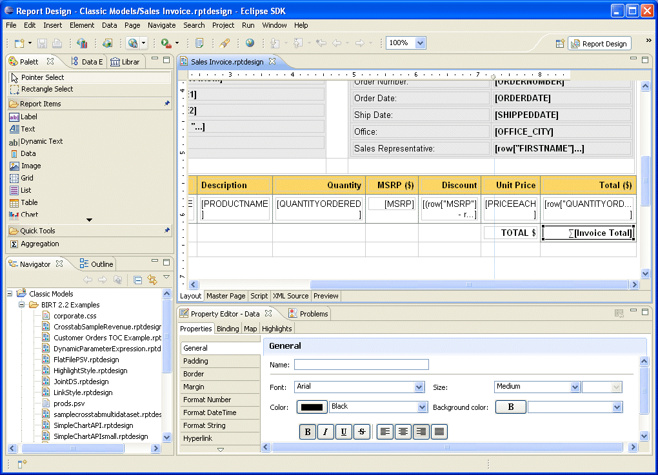
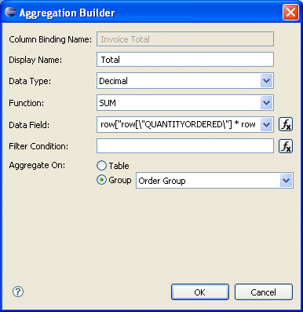
Aggregation Builder
Easy creation of aggregates in a report

Slide 15
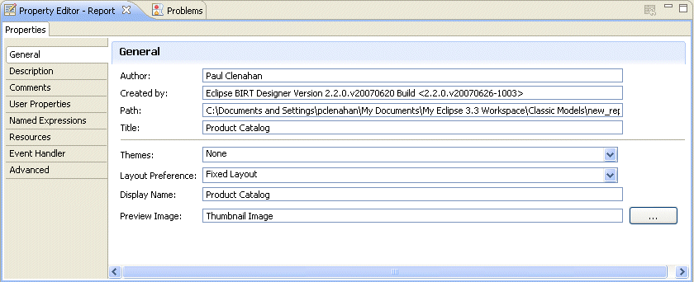
Layout Preference: Fixed Layout
Report formatting follows sizes for each control regardless of display window size
Good for reports where a more precise layout is required
Default is “Auto Layout” (same behavior as BIRT 2.1)

Slide 16
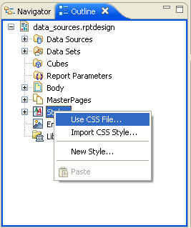
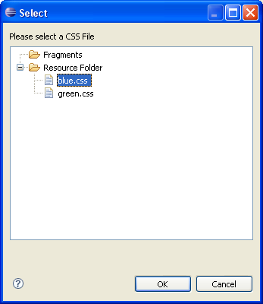
Link To External Cascading Style Sheets
External Style Sheet Support
  Easily reference existing Style Sheets
  Automatically reflects latest style

Slide 17
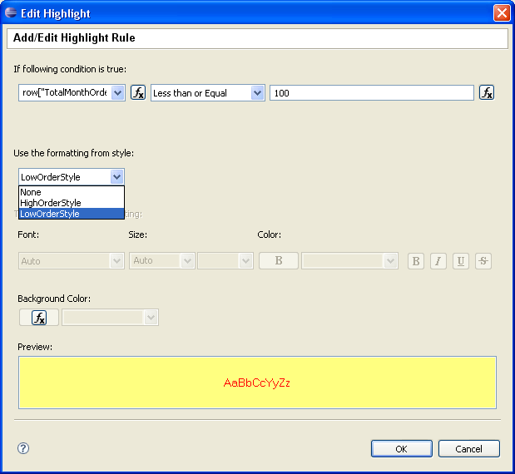
Conditional Highlight Rules Support Styles
Highlight Rules Now Support Styles
  No need to set specific fonts, etc.
  Leverage Style Sheet support

Slide 18
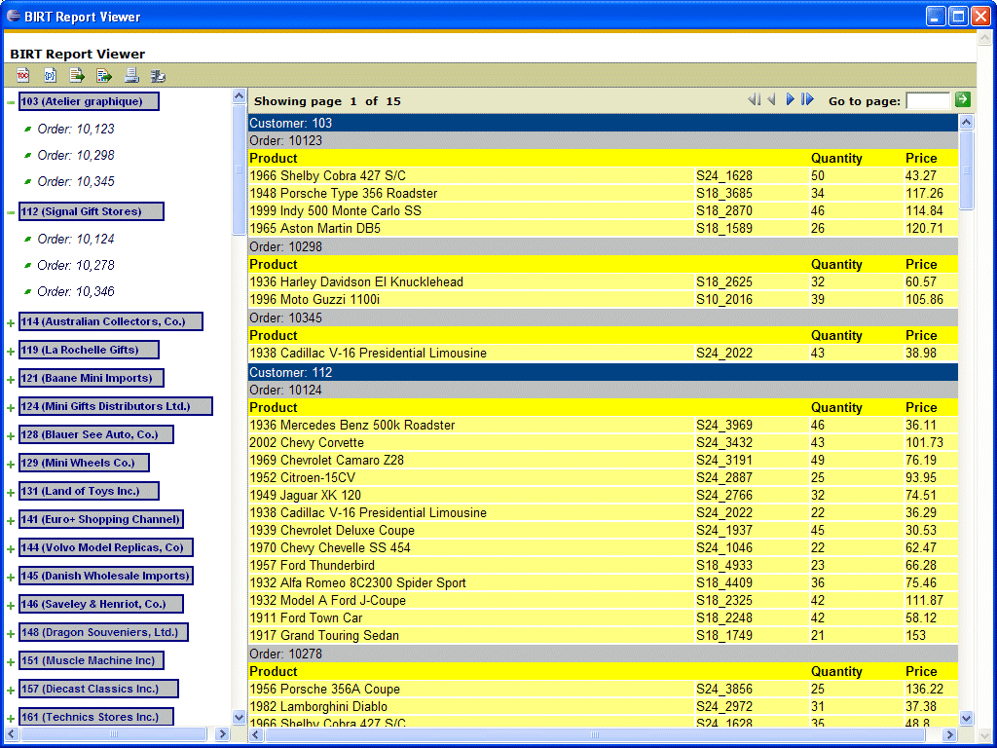
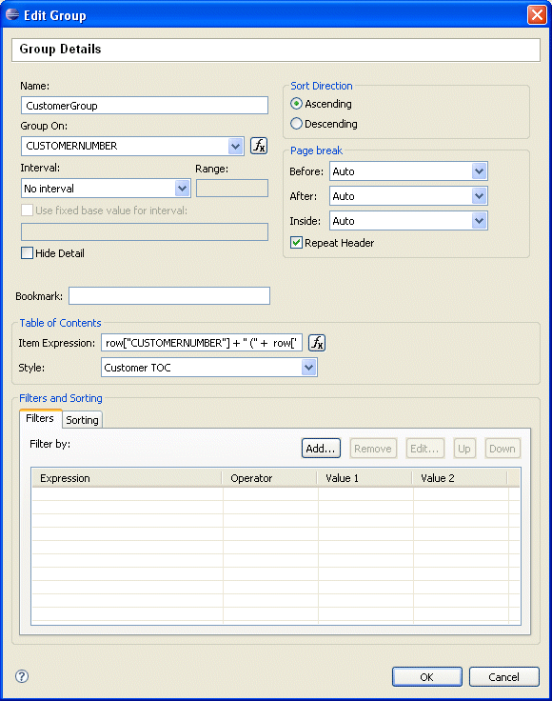
Style Support for Table of Contents
Set Styles for each level of TOC
Leverage Style Sheet support

Slide 19
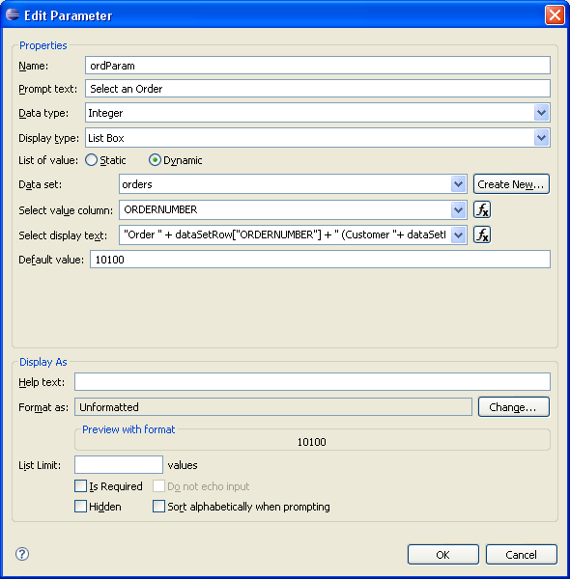
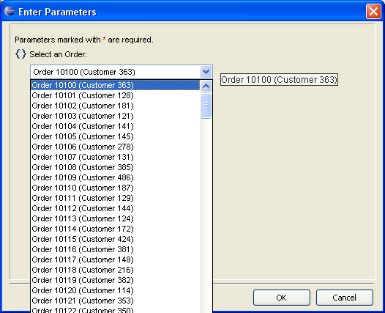
Parameter Values support Expressions
Use Expressions in Parameter Display Text
Allows use of user friendly prompts

Slide 20
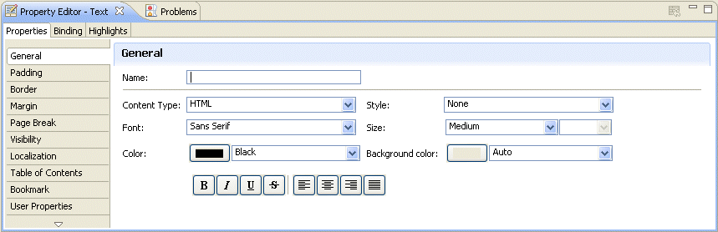
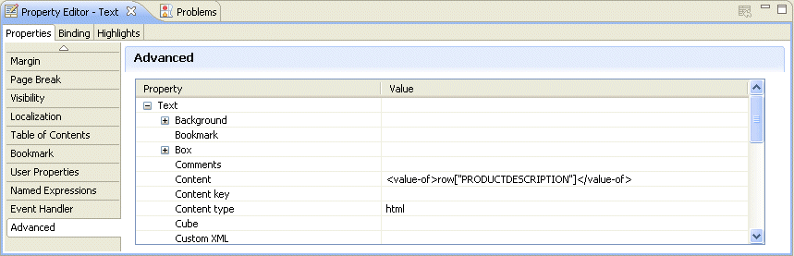
Property Editor Improvements
Latest Eclipse Properties Style
New Advanced Properties

Slide 21
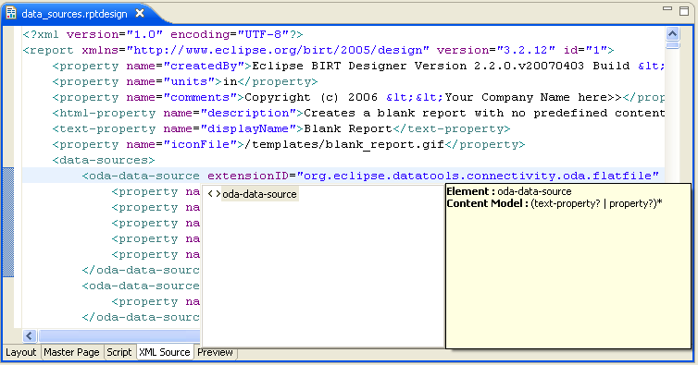
XML Report Design Source Editor
Leverages WTP Editor

Slide 22
New Chart Types and More Chart Control
New Chart Types
Improvements to Existing Charts
New simple chart API

Slide 23
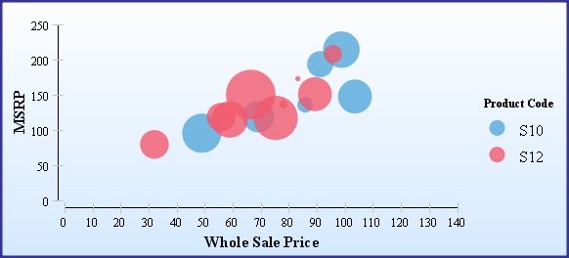
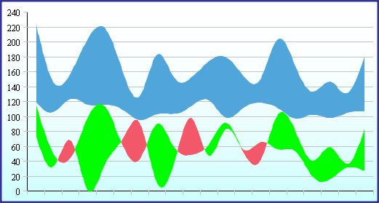
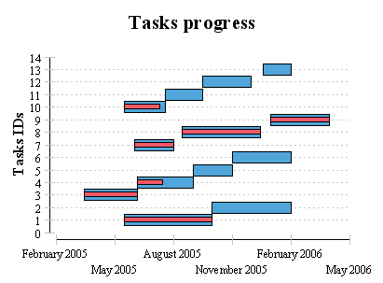
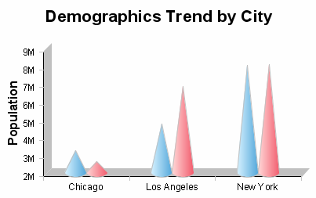
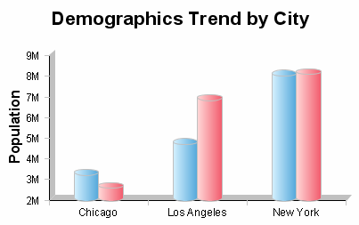
New Chart Types
Bubble Chart
Difference Chart
Gantt Chart
Cone Riser Chart
Tube Riser Chart
Plus…better error support; improved label control, linear time scales for bar and line series, …

Slide 24
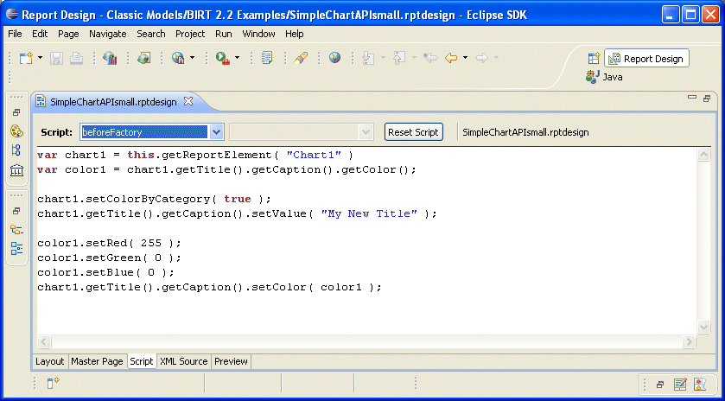
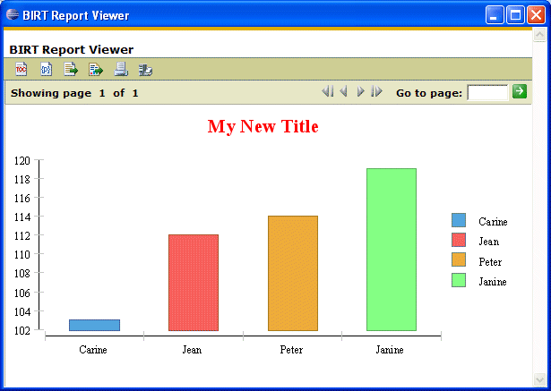
Simple Chart API
Easy programmatic control of chart elements from within the report design

Slide 25
DEMO
Chart Scripting

Slide 26
New Output Formats
XLS Emitter
Word Emitter
PPT Emitter
Postscript Emitter

Slide 27
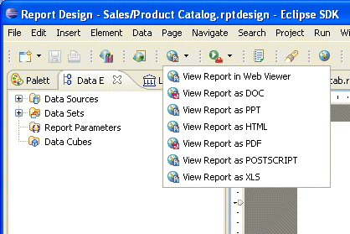
New Output Formats for Office Applications
New Output Formats
  Microsoft Excel
  Microsoft Word
  Microsoft PowerPoint
  PostScript

Slide 28
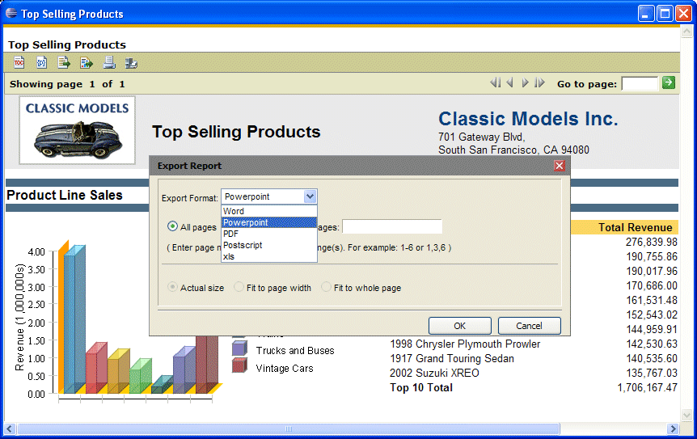
Export Report from Viewer

Slide 29
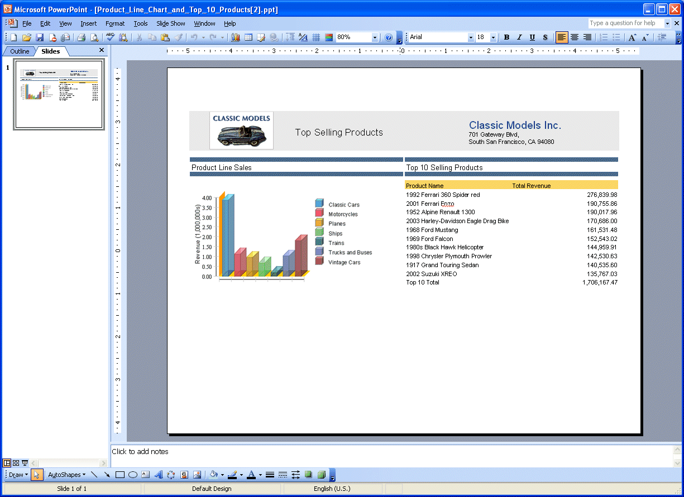
Example: Output to PowerPoint
Native PowerPoint
Editable

Slide 30
New Data Sources and Improved Data Access
Web Service ODA
Flat File Data Source Updates
Joint Data Set Improvement
Dynamic Connection Profiles

Slide 31
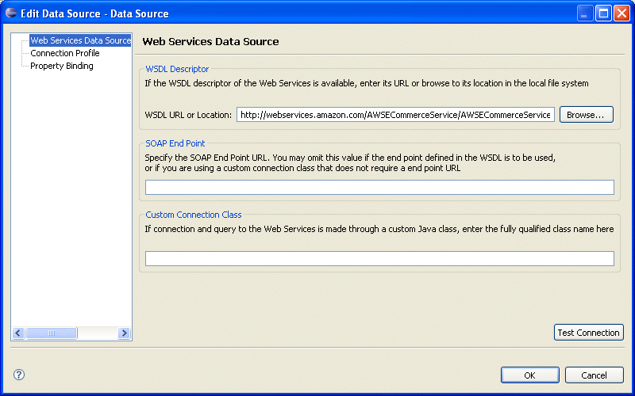
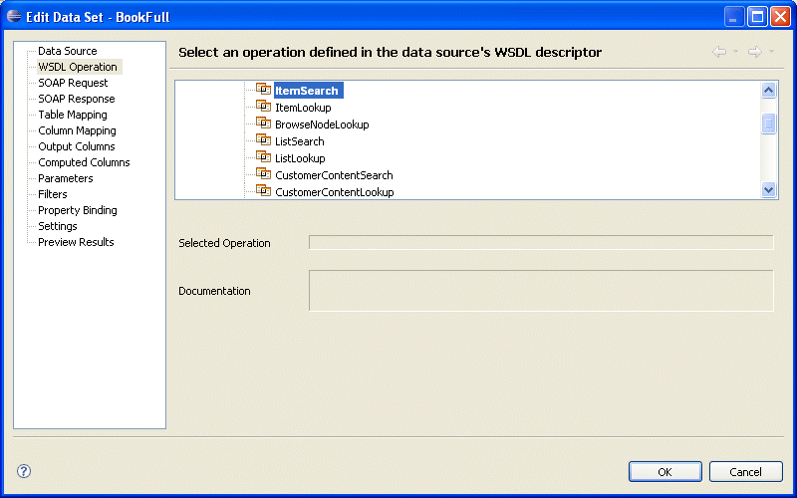
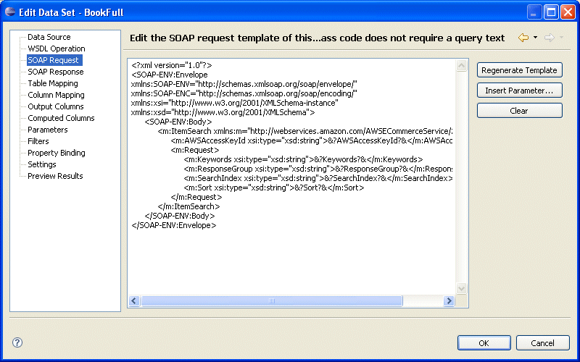
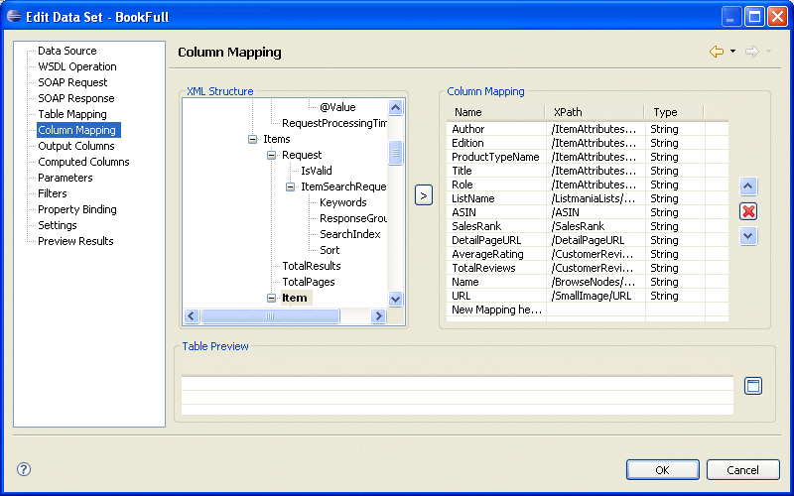
New Web Service Data Source

Slide 32
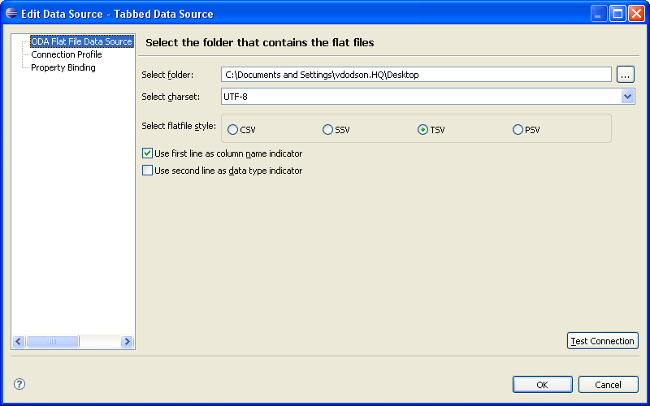
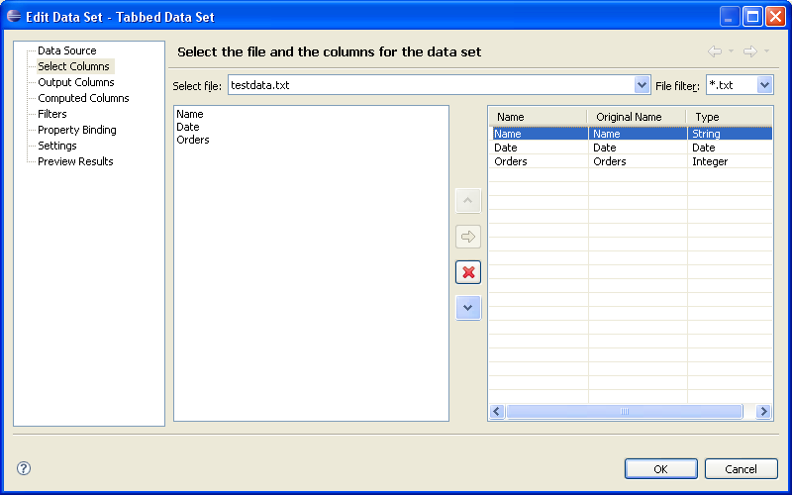

Flat File Improvements
New File Formats Supported
  Semi-colon Separated Values (SSV)
  Tab Separated Values (TSV)
  Pipe (|) Separated Values (PSV)

Slide 33
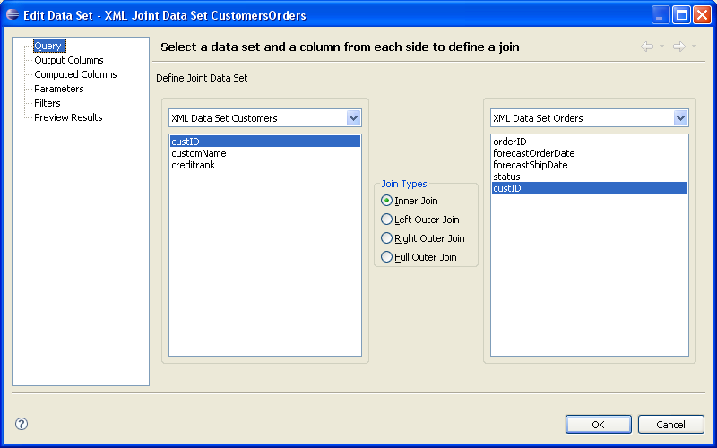
Full Outer Join in Joint Data Set

Slide 34
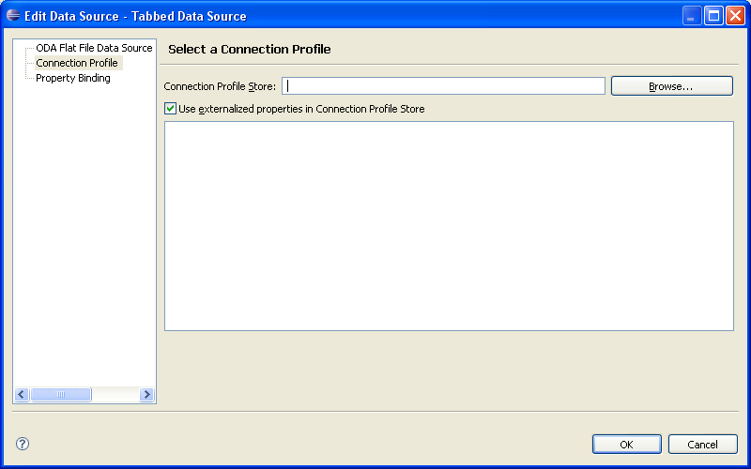
Connection Profile Linking

Slide 35
Easier Application Integration & Extension Development
BIRT Web Project Wizard
BIRT Tag Library
BIRT Chart Deployment
Open Data Access (ODA) Project Wizards
Application Context access from Web Viewer

Slide 36
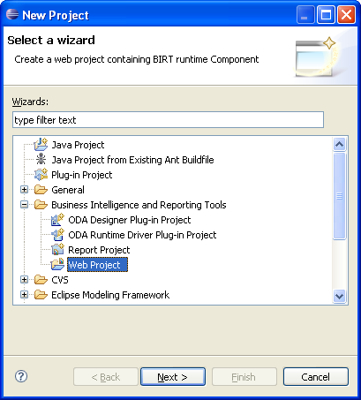
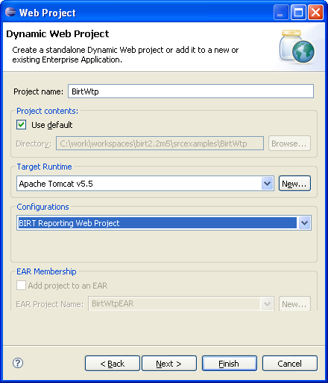
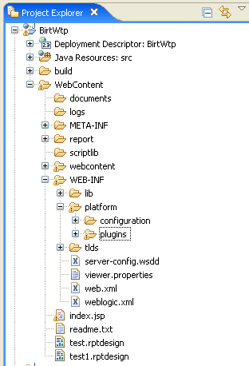
BIRT Web Project Wizard
Easy Deployment of BIRT Applications
  Automated publishing to application servers
  Leverage J2EE perspective for debugging etc.

Slide 37
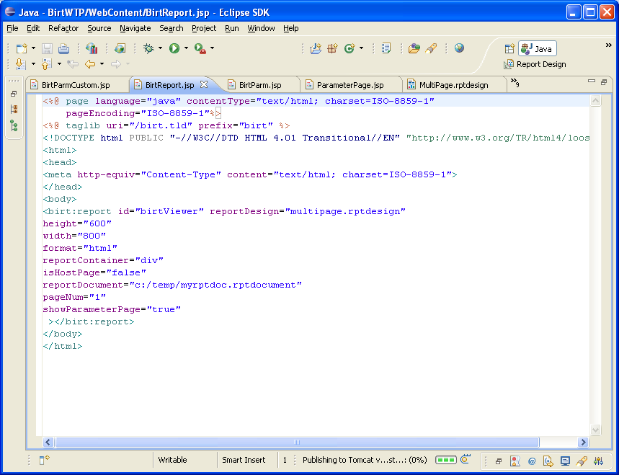
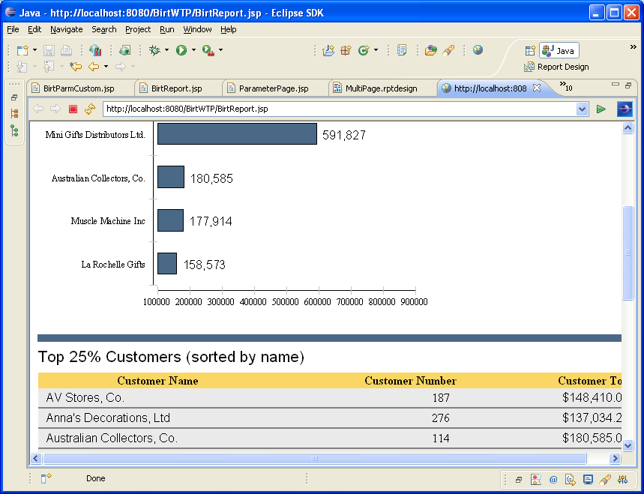
BIRT Tag Libraries

Slide 38
Web Viewer Tag Libraries
Birt.tld
viewer
Used to display the complete Viewer inside an IFRAME. This tag allows you to use /frameset and /run mappings.
Used to display the report inside an IFRAME or DIV tag. This tag allows you to use /preview mapping and does not create a rptdocument. The AJAX Framework is not used.
report
param
Used to set parameter values when using the viewer or report tags. This tag must be nested within the viewer or report tag.
Used to launch BIRT Parameter dialog or to create a customized parameter entry page. Can be used with the /frameset, /run, or /preview mappings to launch viewer after parameters are entered.
parameterPage
Used within a parameterPage tag to retrieve pre-generated HTML for specific parameter control types such as radio, checkbox, dynamic or cascaded parameters.
paramDef

Slide 39
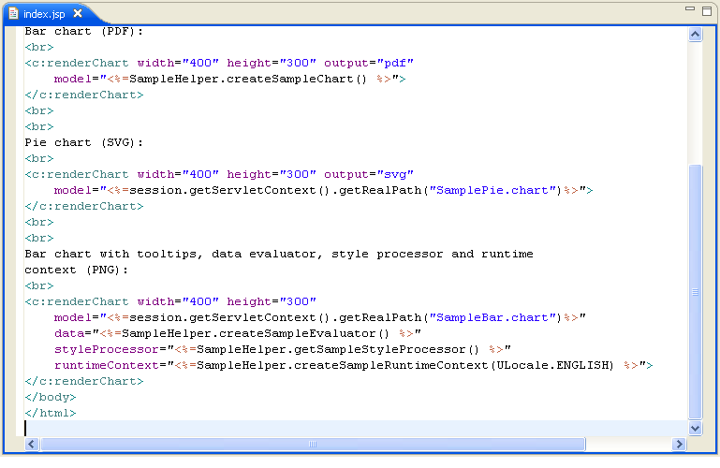
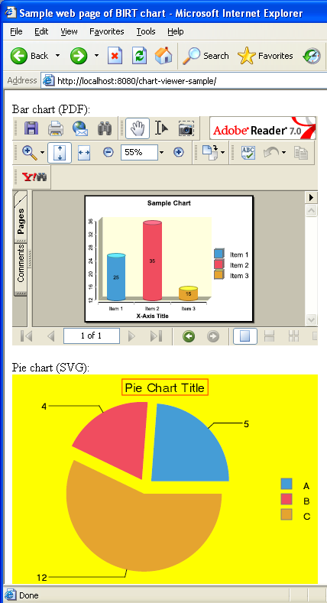
Chart JSP Tag Library and Servlet

Slide 40
DEMO
Deployment and Tag Lib examples

Slide 41
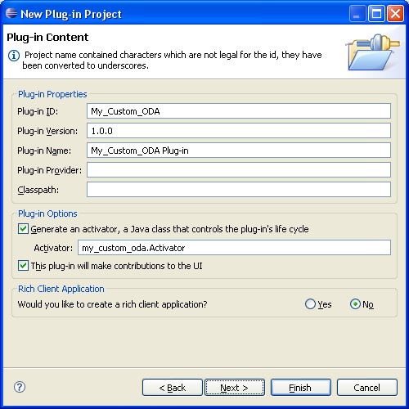
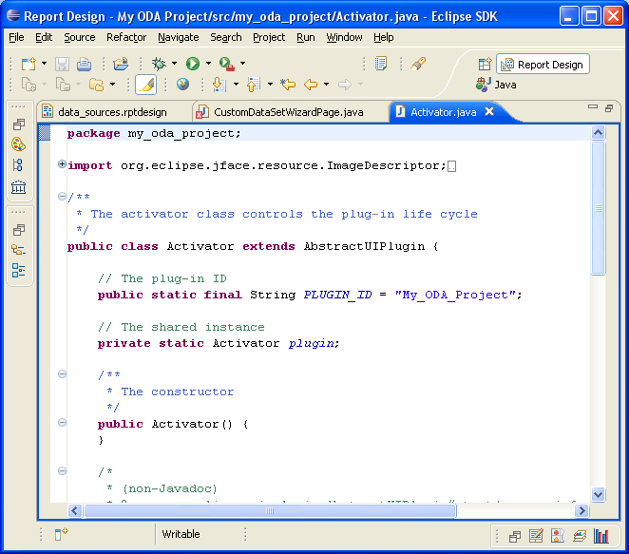
ODA Project Wizard

Slide 42
BIRT 2.2: Learning More
Report Examples View
New Chart Examples View

Slide 43
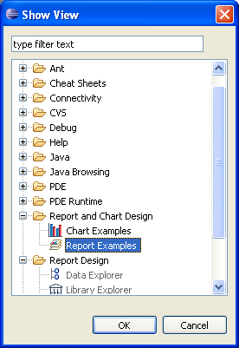
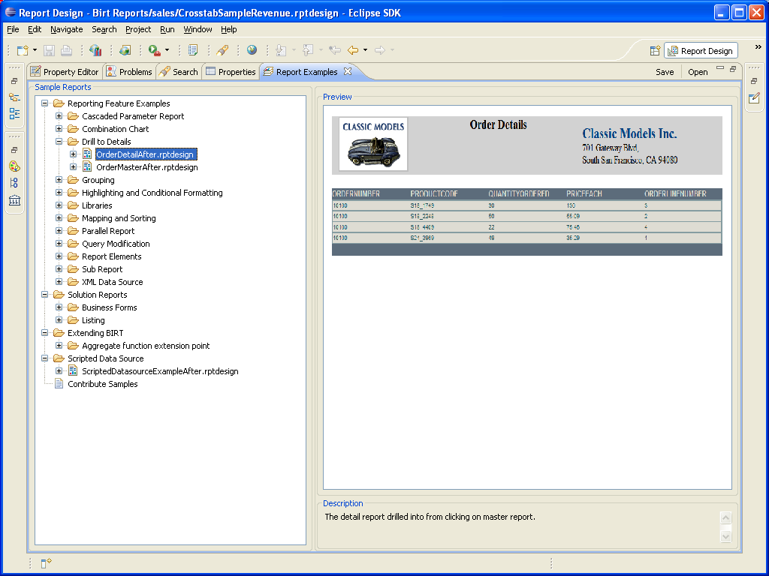
Report Examples View

Slide 44


Chart Examples View

Slide 45


Chart Examples View w/Example Code

Slide 46



New and Updated Publications
Second Edition
Revised and Updated
Second Edition
Revised and Updated
New Book

Slide 47

Eclipse BIRT 2.3
Part of Eclipse “Ganymede” Simultaneous Release Targeted for June 2008
Planning is in progress as part of Eclipse open source community
  Draft Development Plan is published at http://www.eclipse.org/birt
  Bugzilla shows all work scheduled for the BIRT 2.3 release
Candidate projects include:
Crosstab / OLAP Enhancements
Cube filtering on measures
Computed Column support
Scripting
Charts
Use of style Themes in charts
Improved auto layout of labels
SQL Editing
Powerful Visual SQL Editor
Formatting
Support additional CSS styles
Widow / Orphan support
Debugging
JavaScript Debugger

Slide 48



BIRT 2.3 Highlights

Slide 49
DEMO
BIRT 2.3 Features

Slide 50
Eclipse BIRT 2.2 Summary
Support for a wider range of report types and easier report development
New chart types and more control over charts
New output formats to common office tools
New data sources and improved data access
Easier application integration and extension development
Open Source BIRT Report 2.2 New Features
Dynamic Crosstab Support New Aggregation Builder Layout Preference Link to External CSS files Ability to use Styles in highlight rules Style support for Table of Contents Report Parameter Changes Property Editor Enhancements New Advanced Properties XML Source Editor Enhancements | New Chart Types Improvements to Existing Charts New simple chart API XLS Emitter Word Emitter PPT Emitter Postscript Emitter Web Service ODA Flat File Data Source Updates | Joint Data Set Improvement Dynamic Connection Profiles Application Context access BIRT Web Project Wizard BIRT Tag Library BIRT Chart Deployment ODA Project Wizards Report Examples View New Chart Examples View

Slide 51

BIRT Exchange Community Site
Centralized Knowledge Hub for BIRT Developers
Access Downloads, Demos, Tutorials, Tips & Techniques, Documentation, …
Easy for users to contribute content, share knowledge
Enables developers to be more productive and build applications faster
www.birt-exchange.com
Find
Search, Sort
Rate, Comment
Download
Documentation
Software
Share Knowledge
Reports, Code, Tips
Forums

Slide 52
QUESTIONS

Slide 53
THANK
YOU
Learn more at:
IBM Rational software
IBM Rational Software Delivery Platform
Process and portfolio management
Change and release management
Quality management
Architecture management
Rational trial downloads
Leading Innovation Web site
developerWorks Rational
IBM Rational TV
IBM Rational Business Partners
© Copyright IBM Corporation 2008. All rights reserved. The information contained in these materials is provided for informational purposes only, and is provided AS IS without warranty of any kind, express or implied. IBM shall not be responsible for any damages arising out of the use of, or otherwise related to, these materials. Nothing contained in these materials is intended to, nor shall have the effect of, creating any warranties or representations from IBM or its suppliers or licensors, or altering the terms and conditions of the applicable license agreement governing the use of IBM software. References in these materials to IBM products, programs, or services do not imply that they will be available in all countries in which IBM operates. Product release dates and/or capabilities referenced in these materials may change at any time at IBM’s sole discretion based on market opportunities or other factors, and are not intended to be a commitment to future product or feature availability in any way. IBM, the IBM logo, the on-demand business logo, Rational, the Rational logo, and other IBM products and services are trademarks of the International Business Machines Corporation, in the United States, other countries or both. Other company, product, or service names may be trademarks or service marks of others.

