Slide 1

Deploying the BIRT Engine
Jason Weathersby
BIRT Evangelist
Actuate Corporation

Slide 2

Agenda
BIRT Overview
BIRT Report Engine API
BIRT Design Engine API
Deploying BIRT
BIRT Deployment Wizard and the BIRT Viewer
BIRT Tag Library
Custom Servlet
RCP Deployment

Slide 3
High Level BIRT Architecture
1
Report Designer
Report Engine
Eclipse
Report
Designer
Eclipse
DTP
ODA
Chart
Designer
Eclipse
WTP
Data
Transform.
Services
Charting
Engine
5
2
5
3
HTML
PDF
DOC
XLS
Print
PS
CSV
PPT
Generation
Services
Presentation
Services
Report Design Engine
4
XML
Report
Design
Data
Report
Document
Data
Notes:
Architecturally, BIRT consists of 2 main components – a graphical designer and a runtime. The designer uses the DE API, the DTP ODA code, integrates WTP, and the GUI part of the charting component to produce an XML report design file. This file feeds into the runtime which is the RE that takes the design, at runtime figures out where the data comes from, what to do with the data, transform it, etc. and create a transient report file called the report document. This is then presented out in various formats such as HTML or PDF. The runtime includes the chart runtime component.
Additionally, the DE api can also be used to develop your own designer if you don’t like the BIRT designer.

Slide 4
Agenda
BIRT Project = Business Intelligence and Reporting Tools Project
    BIRT APIs

Slide 5
BIRT Pipeline with respect to the APIs
Report
Designer
Chart Builder
Report Engine
Design
Engine
Chart
Engine
Optional Java Events
JavaScript Events
Paginated HTML
PDF
CSV
WORD
XLS
PostScript
PPT
RptDesign
XML
Design File
Generation Phase
Presentation Phase
Report Engine
RptDocument
Report
Document
optional
Example Web Viewer Contains

Slide 6
Platform Startup
Platform
Used to startup OSGi and create Factory Objects. Static methods.
Startup
Start the Platform
Shutdown
Stop the Platform
createFactoryObject
Launch a plugin that implements the FactoryService Extension
DesignEngineFactory
Design Engine API
ReportEngineFactory
Report Engine API
Optionally implement your own IPlatformContext
OSGILauncher
Startup
IPlatformContext setPlatformContext
String Location=getPlatform()
PlaformConfig: EngineConfig/DesignConfig
PlatformFileContext
PlatformServletContext
Default PlatformContext
Looks for Plugins in BIRT_HOME
Looks for javax.servlet.context.tempdir
Creates platform directory in tempdir
Uses getResourcePaths for /WEB-INF/platform to locate plugins
Copies plugins and configuration to the tempdir/platform directory

Slide 7
Platform Startup Code for DE and RE API
Design Engine Sample
IDesignEngine engine = null;
DesignConfig config = new DesignConfig( );
config.setBIRTHome("C:/birt/birt-runtime-2.2.0m5rc/birt-runtime-2_2_0/ReportEngine");
try{
Platform.startup( config );
IDesignEngineFactory factory = (IDesignEngineFactory) Platform
.createFactoryObject( IDesignEngineFactory.EXTENSION_DESIGN_ENGINE_FACTORY );
engine = factory.createDesignEngine( config );
}catch( Exception ex){
ex.printStackTrace();
}
Report Engine Sample
IReportEngine engine=null;
EngineConfig config = new EngineConfig;
config.setBIRTHome("C:/birt/birt-runtime-2.2.0m5rc/birt-runtime-2_2_0/ReportEngine");
try{
Platform.startup( config );
IReportEngineFactory factory = (IReportEngineFactory) Platform
.createFactoryObject( IReportEngineFactory.EXTENSION_REPORT_ENGINE_FACTORY );
engine = factory.createReportEngine( config );
}catch( Exception ex){
ex.printStackTrace();
}

Slide 8
Report Engine API
Used to Generate Report Documents.
Used to Generate Report Output (PDF, HTML, Paginated HTML,WORD, XLS, Postscript)
Engine Creates task to implement operations.
One or Two Phase operation (Run Task then Render Task or RunAndRenderTask)
DataExtraction Task for retrieving Data from a report document.
ParameterDetails Task for retrieving Parameter information, including dynamic and cascading information.

Slide 9
Report Engine Task
EngineConfig
Set configuration variables such as Engine Home and Log configuration
Open Report Design and Documents. Create Engine Task.
ReportEngine
Generate one or more tasks
GetParameterDefinitionTask
Retrieve Parameters and their properties
RunAndRenderTask
Does not support Pagination, TOC, Bookmarks.
DataExtractionTask
Extract Data from Report Document
RunTask
RenderTask
Generate Paginated HTML, XLS, PDF Document, Postscript, XLS
RptDesign
XML
Design File
RptDocument
Report
Document
RptDesign
XML
Design File
RptDocument
Report
Document
RptDesign
XML
Design File
RptDocument
Report
Document
Retrieve TOC and Bookmarks

Slide 10
Simple RE API Process
EngineConfig config = new EngineConfig( );
config.setBIRTHome("C:/birt-runtime/ReportEngine");
IReportEngine engine = null;
try{
Platform.startup( config );
IReportEngineFactory factory = (IReportEngineFactory) Platform
.createFactoryObject( IReportEngineFactory.EXTENSION_REPORT_ENGINE_FACTORY );
engine = factory.createReportEngine( config );
}catch( Exception ex){
}
IReportRunnable design = null;
design = engine.openReportDesign(“TopNPercent.rptdesign");
IRunAndRenderTask task = engine.createRunAndRenderTask(design);
HTMLRenderOption options = new HTMLRenderOption();
options.setOutputFileName("output/resample/TopNPercent.html");
options.setOutputFormat("html");
task.setRenderOption(options);
task.run();
ReportEngine
Create the report engine.
openReportDesign(report)
Open Design
createRunAndRenderTask(design)
Create an Engine Task.
HTMLRenderOptions()
Set rendering options.
setRenderOptions(options)
Set the task render options.
run()
Run and Render the report.

Slide 11
REAPI examples
REAPI Examples

Slide 12
Design Engine API
Used to Generate/Modify Report Designs, Templates and Libraries.
Can be used in conjunction with the RE API to modify designs on the fly.
Can be used within BIRT Script to modify designs on the fly.
Create and delete report elements.
Put report elements into slots.
Get and set parameter values.
Retrieve metadata from report elements, properties and slots.
Undo/Redo
Semantic Checks on report designs.

Slide 13
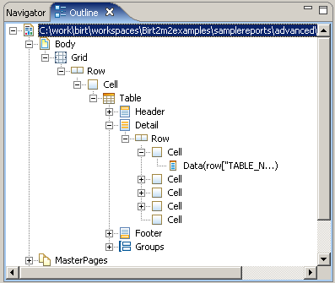
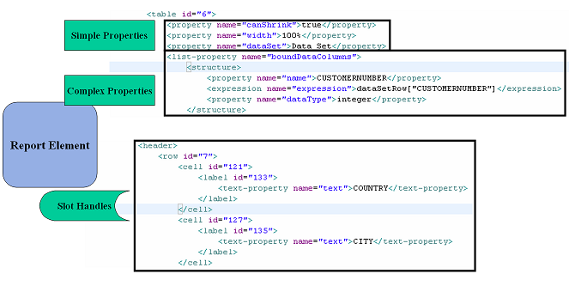
BIRT Elements
Elements – Report Objects such as Table, Label, Style etc.
Properties – Modify the Element state and often support inheritance. Discussed in ROM specification. Simple and Complex properties.
Slots – Describes element - container relationships. For example a Report element contains slots for Data Sources, Data Sets, Report Body, etc. Represented by SlotHandle.

Slide 14
Simple DE API Process
DesignConfig config = new DesignConfig( );
config.setBIRTHome("C:/birt-runtime/ReportEngine");
IDesignEngine engine = null;
try{
Platform.startup( config );
IDesignEngineFactory factory = (IDesignEngineFactory) Platform
.createFactoryObject( IDesignEngineFactory.EXTENSION_DESIGN_ENGINE_FACTORY );
engine = factory.createDesignEngine( config );
}catch( Exception ex){
}
SessionHandle session = engine.newSessionHandle( ULocale.ENGLISH ) ;
ReportDesignHandle design = session.createDesign( );
ElementFactory factory = design.getElementFactory( );
GridHandle grid = factory.newGridItem( “mygrid”, 2 , 1 );
design.getBody( ).add( grid );
design.saveAs( "output/desample/sample.rptdesign" );
DesignEngine
Create the design engine.
newSessionHandle(Locale)
DesignSession used to create reports, libs, etc
createDesign()
Returns a ReportDesignHandle.
getElementFactory()
Returns ElementFactory to Create Report Elements.
getBody()
Returns SlotHandle use add to add new report element.
DessignSession.saveAs()
Save Report Design.

Slide 15
ElementFactory
Used to create new Report Elements. Use container SlotHandle.add.
Produces
SlotHandle
DesignElementHandle.
Cast to specific handle
LabelHandle label1 = elementFactory.newLabel("Label1" );
label1.setText("Customer");
CellHandle cell = (CellHandle) tableheader.getCells( ).get( 0 );
cell.getContent( ).add( label1 );
<cell id="6">
<label name="Label1" id="7">
<text-property name="text">Customer</text-property>
</label>
</cell>
SlotHandle

Slide 16
StructureFactory
Used to create new structures (complex xml). Use PropertyHandle on container to add.
Produces
HighlightRule hr = structFactory.createHighlightRule();
hr.setOperator(DesignChoiceConstants.
MAP_OPERATOR_GT);
hr.setTestExpression("row[\"CustomerCreditLimit\"]");
hr.setValue1("100000");
hr.setProperty(HighlightRule.
BACKGROUND_COLOR_MEMBER, "blue");
PropertyHandle ph = th.getPropertyHandle(StyleHandle.
HIGHLIGHT_RULES_PROP);
ph.addItem(hr);
<list-property name="highlightRules">
<structure>
<property name="operator">gt</property>
<property name="backgroundColor">blue</property>
<expression name="testExpr">row["CustomerCreditLimit"]</expression>
<expression name="value1">100000</expression>
</structure>
</list-property>

Slide 17
Calling the DE API from the RE API/Report Script
RE API Code
IReportRunnable design = null;
//Open the report design
design = engine.openReportDesign("Reports/TopNPercent.rptdesign");
ReportDesignHandle report = (ReportDesignHandle) design.getDesignHandle( );
report.findElement(“table1”).drop();
beforeFactory Script
reportContext.getReportRunnable().
designHandle.getDesignHandle().
findElement("table1").drop();
Simple DE API exist for use in script as well. See example.

Slide 18
DEAPI examples
DEAPI Examples

Slide 19
Agenda
BIRT Project = Business Intelligence and Reporting Tools Project
    BIRT Deployment

Slide 20
BIRT Deployment Scenarios
APIs (DE API, CE API, RE API)
BIRT Tag
Libs
Chart Tag
Libs
Custom Servlet
Web Viewer
Web Viewer
Plugin
J2EE AS
RCP Application
Standalone Application
Paginated HTML, PDF, XLS, WORD, PostScript, TOC, Bookmarks, CSV

Slide 21
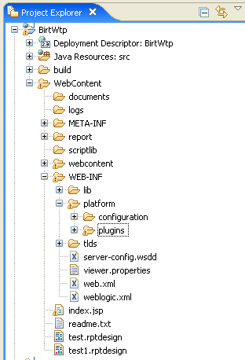
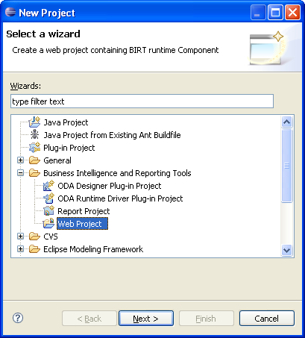
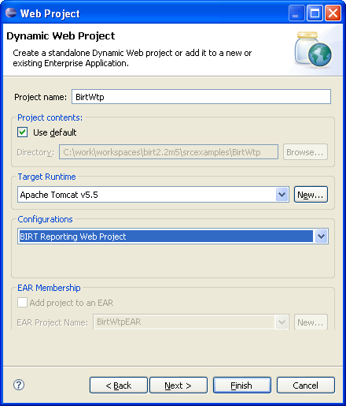
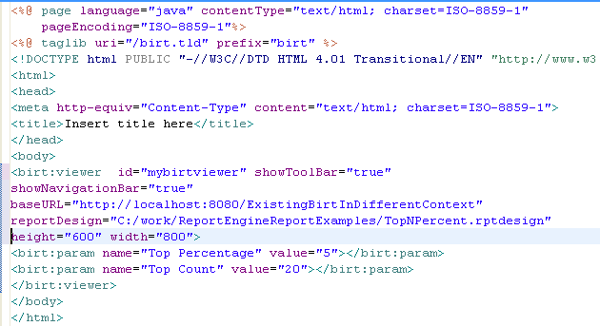
BIRT Web Project

Slide 22
Web Viewer Servlet Mappings
Web Viewer Servlet Mappings
frameset
Use this mapping to launch the complete AJAX based report viewer. Contains toolbar, navbar and table of contents features. Run and Render task are separated. This option will also create a rptdocument file.
run
Use this mapping to launch the viewer without the navbar, toolbar or table of contents. This mapping uses the RunAndRender task to create the output and does not support pagination and does not create a rptdocument. This mapping does use the AJAX framework to allow cancelling a report.
preview
This mapping is used to RunAndRender a report directly to an output format, or to render an existing rptdocument directly to an output format. It does not use the AJAX framework, but will launch a parameter entry dialog.
parameter
This mapping is used by the designer to create a rptconfig file, when selecting the preview tab for a report that contains parameters and should not be used externally.
download
Used internally by the viewer (frameset) when extracting the results in csv format. Should not be used externally. Hidden form created in BirtSimpleExportDataDialog.js and submitted to Servlet to process.

Slide 23
BIRT WebViewer Structure
WebViewerExample
logs
The default location for BIRT logs.
scriptlib
Location for class files used in a Scripted Data Source.
report
Default location of Report Designs
webcontent
birt
ajax
JavaScript files used with the Viewer
pages
JSP Fragments used to build the Viewer
images
Images used by the Viewer
styles
CSS files used by the Viewer
WEB-INF
lib
Location for BIRT required Jars.
platform
plugins
BIRT required runtime plug-ins.
configuration
Location for OSGi configuration files.

Slide 24
Web Project Demo
Example using the Web Project

Slide 25
WebViewer Tag Libraries
Birt.tld
viewer
Use this tag to display the complete Viewer inside an IFRAME. This tag allows you to use /frameset and /run mappings.
report
Use this tag to display the report inside an IFRAME or DIV tag. This tag allows you to use /preview mapping and does not create a rptdocument. The AJAX Framework is not used.
param
Use this tag to set parameter values when using the viewer or report tags. This tag must be nested within the viewer or report tag.
parameterPage
Use this tag to launch the BIRT Parameter dialog or to create a customized parameter entry page. This tag can be used with the /frameset, /run, or /preview mappings to launch the viewer after the parameters are entered.
paramDef
Use this Tag within a parameterPage tag to retrieve pre-generated HTML for specific parameter control types such as radio, checkbox, dynamic or cascaded parameters.

Slide 26
BIRT Tag Library Deployment
Automatically deployed if using a Web Project or by deploying the Web Viewer Example
Can Deploy Tag Library in separate context by:
  Copy birt.tld to your /WEB-INF/tlds directory.
  Copy com.ibm.icu_3.6.1v20070417.jar, viewerservlets.jar, modelapi.jar, coreapi.jar to your web-inf/lib directory. Add the following to the web.xml of your application.
  <jsp-config>
  <taglib>
  <taglib-uri>/birt.tld</taglib-uri>
  <taglib-location>/WEB-INF/tlds/birt.tld</taglib-location>
  </taglib>
  </jsp-config>
  Use baseURL attribute to point to BIRT Context:
  <birt:report id="1" baseURL="/BirtWTP" isHostPage="false" reportDesign="test.rptdesign"></birt:report>

Slide 27
Tag Library Demo
Example Tag Library Usage Demo

Slide 28
Custom Servlet Deployment
Use Singleton to launch Design or Report Engine. Start Platform on Servlet Startup and shutdown Platform on Servlet destroy.
YourServletExample
logs
The default location for BIRT logs.
report
Default location of Report Designs
images
Use PlatformServletContext
See example
Default location for report images
WEB-INF
lib
Location for BIRT required Jars. Copy from Runtime.
platform
plugins
BIRT required runtime plug-ins. Copy from runtime.
configuration
Location for OSGi configuration files. Copy from runtime.

Slide 29
Custom Servlet Demo
Example Servlet using the Report Engine

Slide 30
RCP Deployment
Using the BIRT Plugins in Eclipse based applications

Slide 31
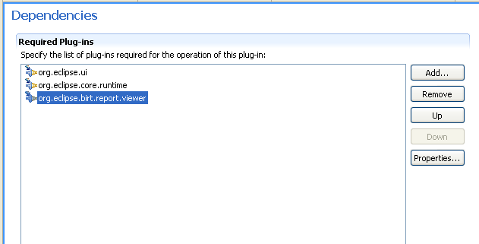
WebViewer Utility Class see RCPViewer Example
WebViewer.display()
See Example for Options.
Used with external browser or SWT Browser Widget.

Slide 32
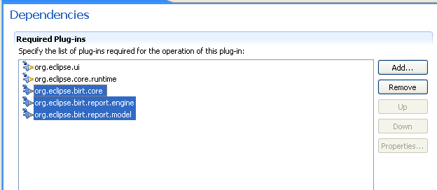
Using the RE/DE API Plugins in an RCP application
Do not set BIRT Home and use engines as normal.
See RCPEngine Example.
Uses SWT Browser Widget.

Slide 33
Questions?
Resources
  BIRT-Exchange.com (Examples shown in this ppt).
  BirtWorld.blogspot.com
  Eclipse.org/birt
  Eclipse Birt News Group

