Slide 1
BIRT: The Eclipse Reporting Framework
Krishna Venkatraman
Product Management, Actuate Corporation

Slide 2
Agenda
BIRT Overview and Architecture
BIRT Feature Set
BIRT Integration and Customization
Ways to get engaged

Slide 3
BIRT Overview & Architecture

Slide 4
Report Development Strategy
Telecom Statement Online and Printed
Product Order Invoice
Defect Tracking
Financial Budget Reports
Bank Account Transaction List
Utility Bill
Deviation from Service Level Objectives
Web Site Traffic Analysis
Network Outages Frequency
Shipping Manifest
Assets Under Management
Product Sales Reporting
Sales Commission Reports
Daily Work Order Task List
Reporting needs are widespread
Typically report design an afterthought; hand coding/JSP coding
In UAT or production, users demand more
An extensible framework is required for handling reporting needs
  Relational & non-relational data sources
  Sorting, aggregation and calculations on data
  Professional presentation of information
BIRT fits needs well

Slide 5
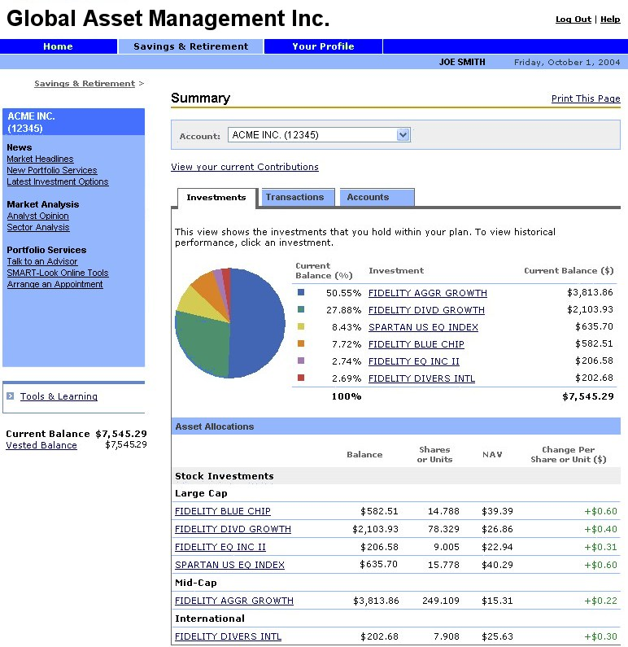
Example: Financial Web Site
Site Navigation
Print Report
News & Promotions
Investment Report

Slide 6
Reporting in BIRT
BIRT Initial
Focus
Operational Reporting
Ad hoc Query & Reporting
Analytics/OLAP/Data Mining
In Reality, this is a Continuum:
Typical Characteristics:
Operational reports
Developer creates reports
Very easy end user access
Highly formatted
Multiple output formats
No end user training needed
Data access can be complex
Simple ad hoc exploration of data
Business user creates reports
Fairly easy to use
Typically limited formatting
Interactive
Minimal training
Semantic layer hides complexity
Complex “Slice and Dice” of data
Business user creates reports
More complex to use
Minimal formatting
Very interactive
Requires training
Semantic layer/data cubes

Slide 7
BIRT Users & Benefits
Minimizes Eclipse developer training
Increase dev. productivity
Lower costs
Managers
Focused on $, developer productivity
End user satisfaction
Nice looking reports
Nice looking reports
Content as HTML and PDF
End
Users
Java
Dev
Report
Dev
Designs reports using Eclipse-based designer
Embed pre-designed reports in application
Creates report libraries & templates
Uses report facilities provided by Java developer
Uses RCP based report designer
Creates & uses report libraries & templates
Saves calories vs. JSP/Java
Minutes vs. days for HTML, vs. weeks for PDF
Minutes to modify as user requirements change
Iterative development gets the right reports quicker

Slide 8
High Level BIRT Architecture
Eclipse
Report
Designer
Custom
Report
Designer…
Report Engine
Custom
Services…
Data Transform.
Services
Charting
Services
1
3
HTML
PDF
Print
2
Report Design Engine
Generation
Services
Presentation
Services
RTF,
XML,
Excel…
Data
XML
Report
Design
Report
Document
Data

Slide 9
BIRT Features

Slide 10
Report Designer Features
Fully integrated with Eclipse
WYSIWYG Editor
Integrated Chart Wizard
Styles
Wizards for guided development
Report outline
Preview within report designer for iterative development
Palette of report components – Text & HTML, data, images, tables, grids, lists, labels
Sorting, grouping, filtering, conditional highlighting, mapping
Scripting in JavaScript
Hyperlinking
Data sources: POJO’s, JDBC, CSV

Slide 11
Report Designer Features – New in BIRT 2.0
Report Component Libraries
Report Templates
Import CSS, themes
Handle CLOB & BLOB
Scripting in Java
Cascading & dynamic report parameters
Bookmarks
Table of Contents
Report paging
Direct XML source editor for report design
Multi-pass processing (top N/bottom N)
Data Sources: XML
Call stored procedures
Runtime data source binding - switching from dev to test to production

Slide 12

Report Engine Features
Engine API allows integration of BIRT runtime into Java app
Java class libraries for generating reports from design
Report output is HTML, PDF
Interactive Viewer
Context pass through to data source
New in BIRT 2.0

Slide 13
Chart Features
Out-of-the-box integration with BIRT report designer
Extensive types of charts: Bar, line, area, pie, scatter, stock, meters, including 3D
Output formats supported: Java: SWING, SWT; Images: PNG GIF, GIF, JPG, BMP; Vector Graphics: SVG
Formatting options for chart elements such as axes, series, and legends
Scripting control using Java or JavaScript allows customization of chart output
Java library to allow Java developers to embed charting functionality into their applications
New in BIRT 2.0

Slide 14

BIRT in Action!

Slide 15
BIRT Integration & Customization

Slide 16
API Overview
Report Designer
Report Viewer
Design Engine API
Report Engine API
Open Data Access
XML
Report
Design
HTML
PDF
Chart UI API
Chart Engine API
Report
Doc
Notes:
BIRT Integration Framework
Allows Java developers to build functionality into their apps
API’s provide programmatic methods for:
Design Engine: manipulate XML designs
Report Engine: integrate runtime viewing of BIRT reports
Chart Engine: integrate charting services into reports

Slide 17
Extension Point Overview
Extensibility is a key principle for the BIRT project
Data source extensibility
  Application specific design-time query builders
  Custom design-time & run-time data access
Custom business logic extensibility
  Incorporate complex business logic scripting
  Access existing and new Java code
Visualization extensibility
  Build new visual data presentation ‘widgets’
  Extend charting with new chart types; new output formats
Rendering reports for output
  Target report output for specific devices & formats

Slide 18
Deployment Options
Paginated HTML, PDF, TOC, Bookmarks, CSV
Eclipse Plugin
J2EE AS
Web Viewer
Web Viewer
Java Application
ReportEngine
ReportEngine
ReportEngine
RptDesign
XML
Design File
RptDocument
Report
Document
Notes:
Standalone Java application
Standalone web application deployed in servlet containers e.g. Tomcat
BIRT Designer preview executes runtime engine in embedded Tomcat
Engine API allows integration of BIRT runtime into Java app

Slide 19
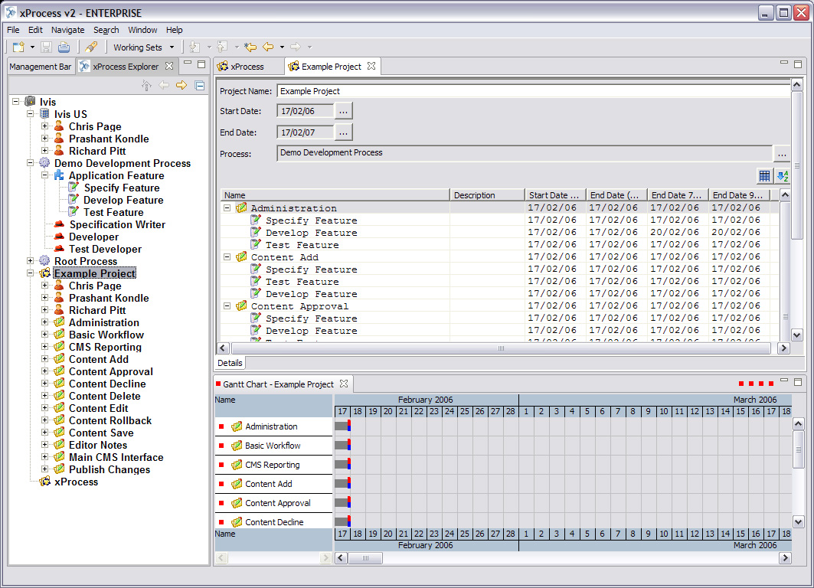
A Real World Example – Ivis Technologies
Ivis Technologies - leading provider of operational improvement software products
xProcess - premier process improvement and project execution environment
  Capture & create processes
  Generate project plans
  Continuous process improve
http://www.ivis.com
Notes:
xProcess.jpg – is a shot of xProcess in project management ’mode’ showing the project details screen, the gantt chart and the xProcess explorer tree with all of the elements within xProcess.
We have two kinds of reports: built-in and customer-generated. For the built-in reports we are using the standard BIRT report designer, installed in our eclipse development environment.
For customer generated reports we plan to wrap the report designer in a feature so that customers can add a report design environment to their standard xProcess (we do not anticipate that all users will want report design capability). Any reports they generate will become available in addition to our default set. If they are working in a multi-user setting, xProcess will handle the distribution of the reports so all users connected to the same repository will have the report designs copied (and updated) locally.
A important point to note here is that we have generated libraries with datasets in that are preconfigured for our customers – we have done all the scripting for them.as of right now there are 7-8, the final build will have at least 10 (possibly more, schedule willing)
We call the engine runtime within our application, and launch an appropriate viewer. All reports are local to the user.
We don’t require an app server. We call the report engine ourselves locally.

Slide 20
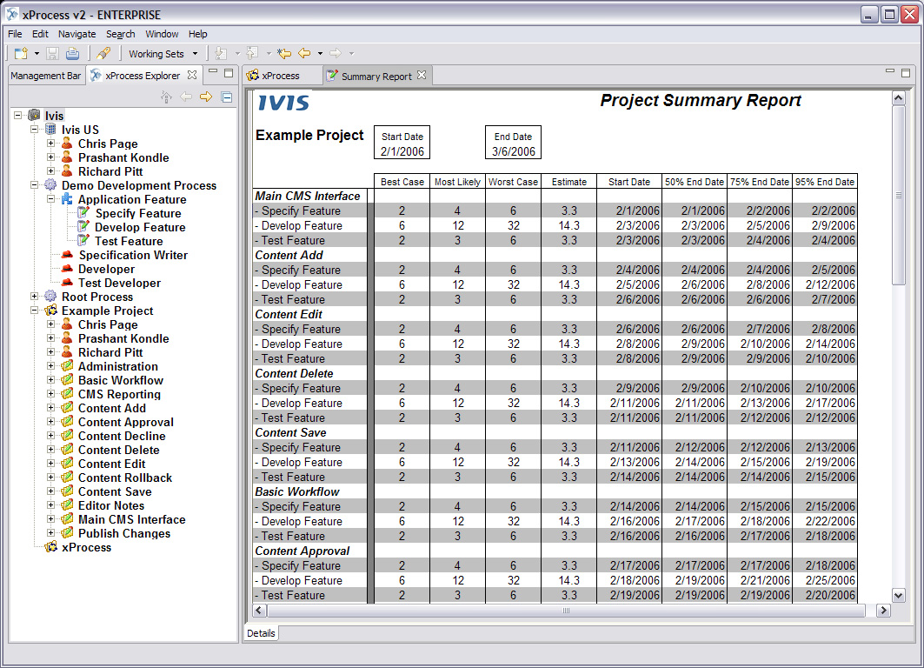
A Real World Example – Ivis Technologies
xProcess embeds BIRT
  BIRT designer for built in reports
  Customer built wrap DE API
  Report lib => ~10 data sets
  Runtime launched from xProcess
Project Summary Report provides snapshot of a project at any time
Notes:
Summary Report.jpg – is a simple summary report we’re including with xProcess to give a snapshot of the project at any given moment.
xProcess.jpg – is a shot of xProcess in project management ’mode’ showing the project details screen, the gantt chart and the xProcess explorer tree with all of the elements within xProcess.
We have two kinds of reports: built-in and customer-generated. For the built-in reports we are using the standard BIRT report designer, installed in our eclipse development environment.
For customer generated reports we plan to wrap the report designer in a feature so that customers can add a report design environment to their standard xProcess (we do not anticipate that all users will want report design capability). Any reports they generate will become available in addition to our default set. If they are working in a multi-user setting, xProcess will handle the distribution of the reports so all users connected to the same repository will have the report designs copied (and updated) locally.
A important point to note here is that we have generated libraries with datasets in that are preconfigured for our customers – we have done all the scripting for them.as of right now there are 7-8, the final build will have at least 10 (possibly more, schedule willing)
We call the engine runtime within our application, and launch an appropriate viewer. All reports are local to the user.
We don’t require an app server. We call the report engine ourselves locally.

Slide 21
Ways to Get Engaged in BIRT
As a user of BIRT technology
  Testing BIRT and providing feedback in the process of using it
As an active member of the BIRT community
  Developing tutorials, examples, etc.
  Active in the BIRT newsgroup
As a developer of extensions
  Extending BIRT through the standard extension points
    Data sources; new charts; new output formats; …
  Could be for the open source community, could be for internal use
As a developer in existing BIRT code
  Need to get involved through the Eclipse development model
Proposing/leading a new project under the BIRT umbrella

Slide 22
The BIRT Community
Project Committers
  Actuate (http://www.actuate.com)
  Innovent Solutions (http://www.innoventsolutions.com)
  IBM (http://www.ibm.com)
BIRT pages on Eclipse web site
  http://www.eclipse.org/birt
  Download BIRT and walk through a tutorial
Active feedback and comments in the BIRT newsgroup
  news://news.eclipse.org/eclipse.birt
Participate through the Eclipse development process
  See http://www.eclipse.org > Projects

Slide 23
BIRT Users & Benefits
Java developer
  Designs reports using Eclipse-based designer
  Embed pre-designed reports in application
  Creates report libraries & templates
  Provide “guided” report design capabilities in application
Report developer
  Uses report facilities provided by Java developer
  Uses RCP based report designer
  Creates & uses report templates
Java & Report Developers
  Saves calories vs. JSP/Java
  Fully integrated into the Eclipse environment
  Minutes vs. days for HTML, vs. weeks for PDF
  Minutes to modify as user requirements change
  Iterative development gets the right reports quicker
End-Users
  Nice looking reports
  Content as HTML and PDF
Managers
  Minimizes Eclipse developer training

