Slide 1
Crash-Course in Contributing to Open Source Projects
(with some specific instructions to sklearn)
Andreas Müller
Gitter: https://gitter.im/scikit-learn/wimlds

Slide 2
Environment
If you don’t have a working python installation, install anaconda.
If you don’t want to install the scikit-learn development version in your main environment, create a separate environment (with conda or virtualenv):
conda create -n sklearndev numpy scipy matplotlib
pytest sphinx cython ipykernel
source activate sklearndev
conda install -c conda-forge sphinx-gallery

Slide 3
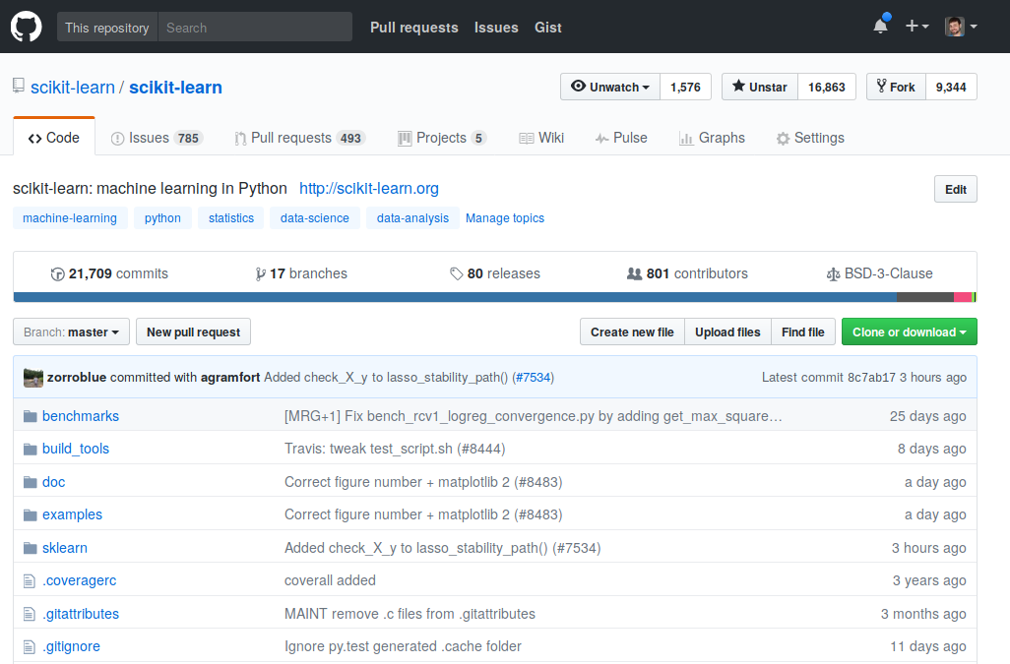
Fork sklearn on github
https://github.com/scikit-learn/scikit-learn

Slide 4
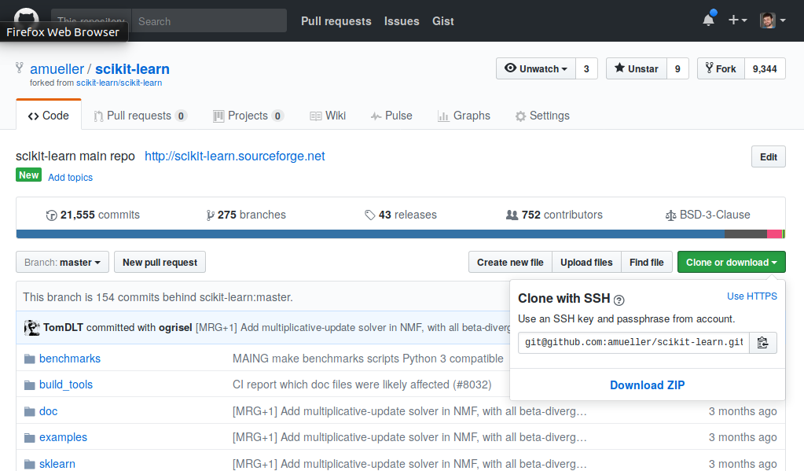
Clone the Fork
use https
If you don’t have ssh keys set up, use https!
Add main scikit-learn repo as remote called “upstream”:
git remote add upstream https://github.com/scikit-learn/scikit-learn.git

Slide 5
Build and run tests!
Easiest way:
cd scikit-learn
pip install -e .
Will overwrite existing installations!

Slide 6
Starting on Issues
Go to https://github.com/WiMLDS/nyc-2019-scikit-sprint/projects/1
Comment on issue saying “I’m working in this”.
Update local master branch from main sklearn repo (git pull upstream master).
Fetching someone else’s PR:
git fetch https://github.com/theirusername/reponame.git theirbranch:ourbranch
Create feature branch
git checkout -b <branchname>
Commit changes to branch, run tests
pytest sklearn
(or individual test files)
Run flake8 on changed files

Slide 7
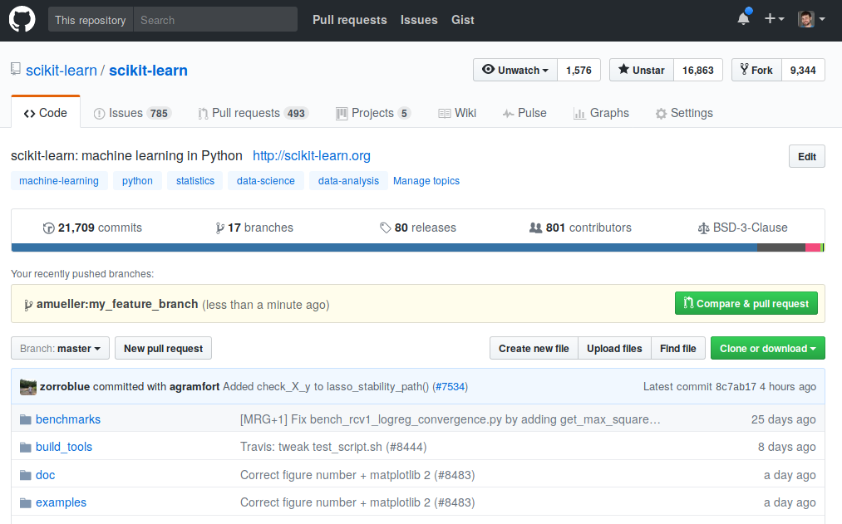
Creating a PR
Push changes to your fork
git push origin <branchname>
Create PR using github UI:

Slide 8
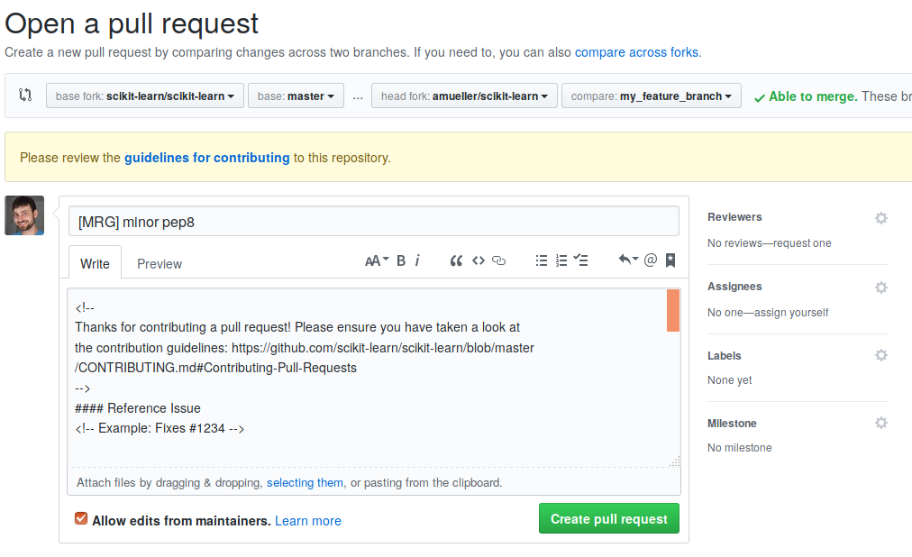
Describing PR
[WIP] = work in progress
[MRG] = ready to merge

Slide 9
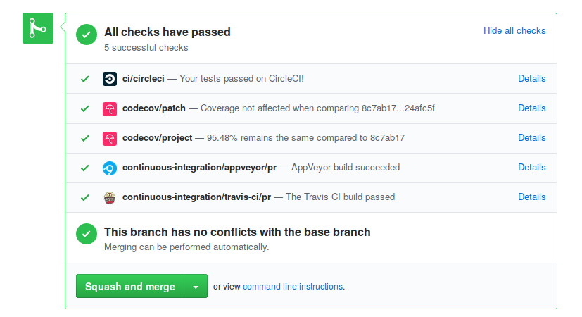
Regression tests
Are mandatory! For everything (except documentation changes)!
Make sure continuous integration passes:

Slide 10
What’s next?
Wait for reviews (be patient).
Address review comments in the same branch.
Pushing to your fork will update the PR
Reviewers will “approve” PR or change title to [MRG + 1]
You need two approvals for a merge.

Slide 11
Finding Issues
Check “need contributor”, “easy” and “sprint” issues.
Something unclear in the docs? Fix it!
Can’t fix something that’s unclear? Open an issue!
Problem that you keep running into: Open an issue!
Find stalled PRs (the author didn’t address reviews for ~>1 month) and continue them!
https://github.com/WiMLDS/nyc-2019-scikit-sprint/projects/1

Slide 12
Reviewing
You can review PRs and issues!
Some bugs are not confirmed. See if you can confirm them and under what conditions?
You can review documentation PRs for language and whether they are clear to you.
You can review code changes on whether they address the issue (might be a bit tricky).
Don’t be afraid to ask clarifying questions!

Slide 13
Final words
Pick something TRIVIALLY SIMPLE as the first contribution.
You can do the cool stuff afterwards!
There might be interesting issues that are not appropriately tagged.

Slide 14
Thank you for your help!
Enjoy!

