Slide 1
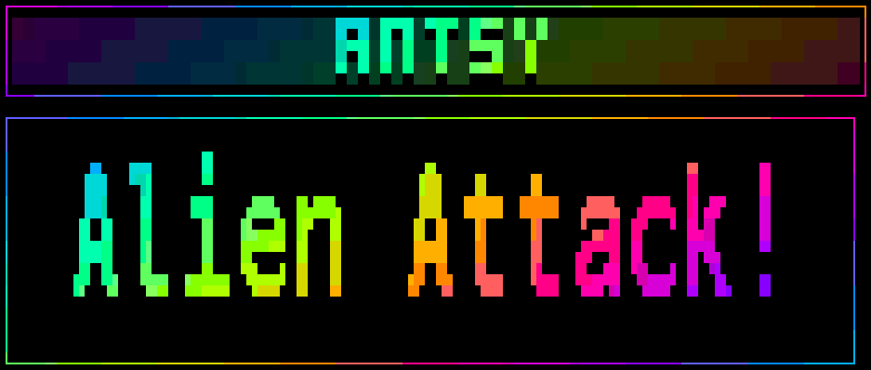
Notes:
My game is called Antsy Alien Attack! So yes, I’ve written
an indie triple A game in Bash.
The alliteration was my daughters idea, the play on words
was my wifes.

Slide 2
The plot
The year is 2138.
Notes:
So, what is the game about.
Arbitrary future date to set the scene. Tick!

Slide 3


The plot thickens
Planet Earth is under attack by aliens, and they're antsy!
Notes:
Yes, it’s earth versus aliens with no back story as to why
the aliens are attacking. Tick!

Slide 4


More 80s game tropes
You're a mercenary with a state of the art space fighter and a gun for hire.
Notes:
Mercenary. Tick!
Space ship. Tick!
Weapons. Tick!
The scene is set.

Slide 5
Game mechanics
Earn money for each alien destroyed
Financial penalties for aliens that escape
Efficient use of lasers is rewarded
Collect power-ups to enhance your ship
Kill! Slay! Destroy! Annihilate!
Notes:
Blank

Slide 6
Raiden?
Maybe? Lets see how we got on...
Notes:
Listeners of the Ubuntu Podcast will know I am a fan of
racing games. After racers, my next favourite genre is
shoot ‘em ups.
Shoot ‘em up aficionados may have noticed my plot, and
player ships, are somewhat similar to Raiden; the 1990
coin-op.

Slide 7
Danmaku (弾幕}

Slide 8
The game engine
Hardware interrupt trap for the game loop
  Via a subshell
256 colour ANSI frame buffer
  Fast delta updates via a pseudo `blitter`
ANSI sprite engine
  Collision detection & overlays
  Animators, keyframing and colour-cycles
Multi-threaded sound effects
  Including sound effect chaining
XBOX 360 and Steam Controller support
  Simultaneous 2-player action!
Stateful configuration
Notes:
Blank

Slide 9
Learnings
case two times faster than if elif else fi
ANSI is harder than you think
echo -e > tput > printf
Arithmetic comparisons are fast
  if ((THING == 1)); then is faster than
  if [ ${THING} -eq 1]; then
Bash has C style loops
  for ((LOOP=0; LOOP < TOTAL; LOOP++)); do
I never knew ((TOTAL++)) was a thing
  Or ((TOTAL+=5)) or ((TOTAL+=MORE))
Px437 IBM VGA Regular is best font!
Notes:
Blank

Slide 10

The code
https://wimpysworld.io/antsy-alien-attack
Notes:
Blank

Slide 11
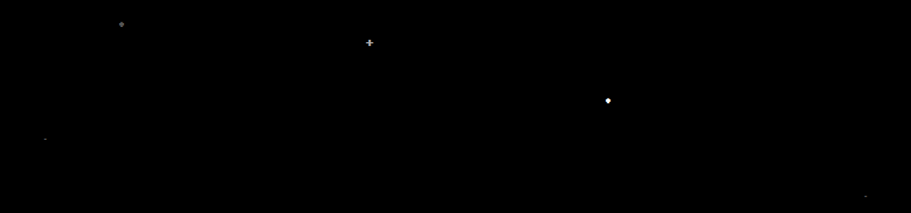



Thank you!
Notes:
Blank

