Slide 1
There and Back Again
or what I did on my holidays

Slide 2
My “holidays”
A two-week research retreat in Greece
To do the research presented in this talk
  Developing algorithms
  Proofs
  Coding
  Write-up

Slide 3
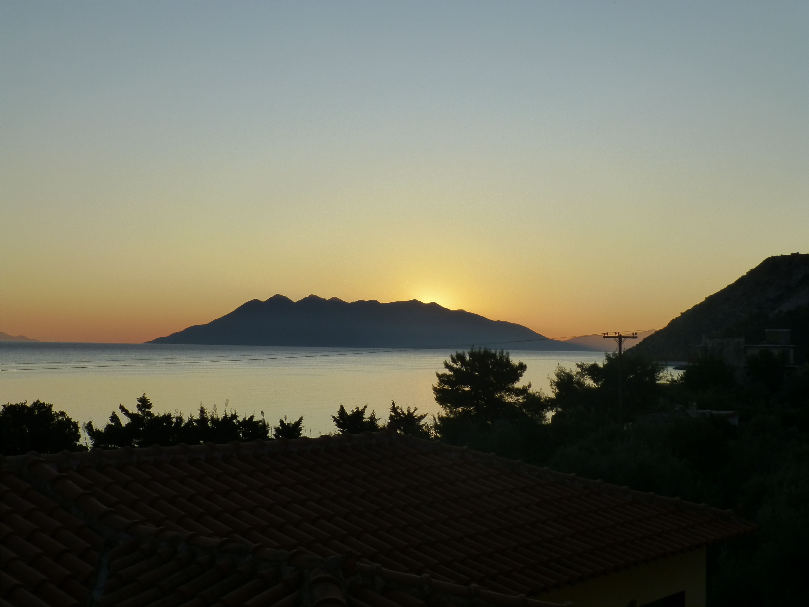

Slide 4
﻿Reducing the memory utilisation of automatically parallelised stencil-based legacy scientific code
Wim Vanderbauwhede
Cristian Urlea

Slide 5
What?

Slide 6
What?
Reducing memory footprint of legacy code
  In particular scientific code in Fortran
  E.g. weather simulations
When deployed on GPUs
Part of automatically parallelising compiler

Slide 7
Why?

Slide 8
Why?
Fortran is still very widely used
Scientific computations need a lot of memory
GPUs have limited RAM
Code is often written in a very memory-inefficient way but manual rewrite is too hard, in particular for stencil code.

Slide 9
Fortran is still very popular
Google Scholar: 40,000 citations mention Fortran in 2009-2019
Most of these are still Fortran-77

Slide 10
Fortran is still very popular

Slide 11
There is potential
E.g. calculation of velocity in the Large Eddy Simulator for Urban Flows
Uses 30 arrays; 27 could be eliminated

Slide 12
How?

Slide 13
How?
Whole-program analysis
Program transformations
  In particular, rewrite rules
Source-to-source compilation

Slide 14
Prelude
Starting from Fortran 77 source code
  Modernise and normalise (Fortran 95)
  Make accelerator-ready (remove globals)
  Auto-parallelise (loop dependency analysis)
  At this point we can emit OpenCL for GPU

Slide 15
Prelude
OpenCL kernel code
  Every loop nest becomes a kernel
  Kernels are either map or fold
  Can still access arrays by index
Scalarise the kernels
  No array accesses
  Requires stencil identification

Slide 16
The Fortran 77 program has now been transformed into a form that can be expressed in a pure functional language

Slide 17
Enter TyTraCL

Slide 18
TyTraCL
A pure functional language
For use as intermediate representation language for program analysis and transformation
We use Haskell concrete syntax for convenience

Slide 19
TyTraCL Types
Vector of n elts of type a
vi :: Vec (n::Int) a
Same but for stencils
si :: SVec (k::Int) a
Scalar functions
fmap,i :: Scalar a,b => a -> b
ffold,i :: Scalar a,b => a -> b -> a

Slide 20
TyTraCL Primitives
﻿map: As in Haskell but on Vec rather than []
  map :: (a -> b) -> Vec n a -> Vec n b
fold: Haskell's foldl but on Vec rather than []
  fold :: (a -> b -> a) -> a -> Vec n b -> a
maps: Ordinary map but only works on SVec
  maps :: (a -> b) -> SVec k a -> SVec k b
stencil: ﻿Replaces every element of the vector with the stencil
  stencil :: Svec k Int → Vec n a -> Ve n (Svec k a)

Slide 21
TyTraCL Primitives
﻿zipt/unzipt: As in Haskell but takes a tuple as arg
  zipt :: (…,Vec n a_{i},…) -> Vec n (…,a_{i},…)
  unzipt :: Vec n (…,a_{i},…) -> (…,Vec n a_{i},…)
applyt: Apply a tuple of functions to a tuple of values
  applyt :: (…,a_{i} -> b_{i},…) -> (…,a_{i},…) -> (…,b_{i},…)
elt: Get an element from a tuple by index
  elt :: (i::Int) -> (…,a_{i},…) -> a_{i}

Slide 22
TyTraCL Primitives
﻿○: As in Haskell
fcomp: Variant of ﻿○ to allow map/fold composition
fcomp :: (a -> b -> a) -> (b -> c) -> (a -> c -> a)
scomb: To combine stencils
scomb :: (Svec k₁ a) -> (Svec k₂ a)
-> Svec k₁ (Svec k₂ a)

Slide 23
data Expr =
-- Left-hand side:
Scalar VE DType Name | Const Int | Tuple [Expr] | Vec VE Expr
-- Right-hand side:
| SVec Size Expr
| ZipT [Expr]
| UnzipT Expr
| Elt Int Expr | PElt Int -- partially applied Elt
| Map Expr Expr -- map f v
| Fold Expr Expr Expr -- fold f acc v
| Stencil Expr Expr -- stencil s v
| Function Name [Expr] -- 2nd arg is list of non-map/fold args
| Id Name [Expr] – identity
| ApplyT [Expr] -- applyt (f1,f2)
| MapS Expr Expr -- maps s f
| Comp Expr Expr | FComp Expr Expr
| SComb Expr Expr -- scomb s1 s2

Slide 24
type Name = String
type Size = Int
data VE = VI | VO | VS | VT | VDC
data DType =
DInteger
| DReal
| DSVec Int DType -- to encode SVecs
| DTuple [DType] -- to encode Tuple
| DDC -- Don't Care

Slide 25
Preparatory transformations
Stencil detection
Scalarisation
Argument grouping
﻿Key transformation of stencil-based nested loops

Slide 26
Stencil detection
﻿There is more than one read access to the array
At least one of these accesses has a non-zero offset
The set of offsets is fixed for all iterations of the loop
All points in the array are processed in order, i.e. the loop iterators loop over a contiguous range
There can be no write access to the array.

Slide 27
Stencil detection
s :: SVec k Int
s = [Δ₁ … Δ_{k}]
v_{in} :: Vec n a
v_{s} :: Vec n SVec k a
v_{s} = stencil s v_{in}
f :: SVec k -> b
v_{out} :: Vec n b
v_{out} = map f v_{s}

Slide 28
Scalarisation
Scalarisation is textual substitution, e.g. v(i+1) => v_ip1
scalarVarName = filter (/= ' ') (
map \c -> case c of
'(' -> '_'
',' -> '_'
'+' -> 'p'
'-' -> 'm'
'*' -> 't'
')' -> ' '
) arrayAccess

Slide 29
Intermediate vector removal
﻿Intermediate vectors
  might be present in the original code,
  or ﻿may occur because of the need for stencils.
The former case is simply a matter of β reduction
The latter is the focus of this work
First the easy part

Slide 30
Intermediate vector removal (I)
The easy part
  AST normalisation: rewrite so that all LHS expressions in the AST are of the form (Vec … ) or (Scalar … ).
  Intermediate vector removal: ﻿remove
    all vectors Vec VT and Vec VS,
    also Vec VO on the RHS,
  by recursive substitution, starting from the last expression in the list.
  The resulting AST has only Vec VO (or Scalar) in the LHS, and the RHS expressions only contain Vec VI.

Slide 31
Intermediate vector removal (I)
At this point one could think the work is done: there are no intermediate vector expressions left in the AST.
However, we have only removed the names, not the need for storage of intermediate expressions.
To remove the need for storage, we need to remove the intermediate expressions.
That is the hard part.

Slide 32
Intermediate vector removal (II)
The hard part
  Rewrite rules
  Fusing stencils
  Decomposition into ANF
  Generating intermediate function definitions

Slide 33
Aim of the rewrite rules
The aim of the rewrite rules is to rewrite the AST so that it terminates with an expression which contains at most a single map, as the outer function.
The map can depend on zero or more fold expressions

Slide 34
Rewrite rules
We can formally prove that the following set of rules meets the aim:
map f₂ (map f₁ v) = map (f₂ . f₁) v -- Map-Map
fold f₁ acc (map f₂ v) = fold (f₁ `fcomp` f₂) acc v -- Fold-Map
stencil s₁ (map f₁) = map (maps f₁) (stencil s₁) -- Stencil-Map
zipt (map f₁ v₁, map f₂ v₂,…, map f₁ v₁,…)
= map (applyt (f₁,f₂,…, f_{i},…)) (zipt (v₁, v₂,…, v_{i},…)) -- ZipT-Map
v = map id v -- Map-Id
(elt i) . unzipt . (map f v) = map ((elt i) . f) v – Elt-UnzipT-Map

Slide 35
Fusing stencils
A stencil will operate on an expression consisting only of input vectors, zipt and stencil.
A stencil operating on a stencil expression can per definition be rewritten as a single stencil using of scomb:
﻿stencil s₂ (stencil s₁ v₁) = stencil (scomb s₂ s₁) v₁ -- SComb
﻿stencil s₂ (zipt (v₁,v₂)) =
zipt (stencil s₂ v₁, stencil s₂ v₂) -- Stencil-ZipT

Slide 36
The result
﻿At this stage the TyTraCL program has been transformed to meet our objective:
  stencils operate only on input vectors, and
  there is a sequence of dependent folds with at most a single map operation.
Conceptually, the map operation consumes a stream of input vectors, creating stencils as required, an applies to this composite stream a composite scalar function which performs the actual computations.
The program is now an ordered list of expressions, each of which:
  represents a self-contained loop nest, and
  can depend upon any of the previous expressions.

Slide 37
Decomposition into ANF
﻿The next step is to transform the program into a form suitable for emitting code in an imperative language such as Fortran or C.
A suitable representation for this purpose is Administrative Normal Form (ANF)
I use a variant with single let with all bindings in order of dependency, rather than a series of nested let-expressions with a single binding.

Slide 38
Decomposition into ANF
﻿The algorithm is quite straightforward. We create new names to bind all sub expressions in an expression (i.e. the RHS element in the TyTraCL AST) using a running counter, the type of the sub expression and the name of the output vector to which the expression is bound.
The algorithm traverses the AST in bottom-up fashion and effectively replaces every node with a list of let bindings for its sub-expressions. The result is a lists of lists which has the correct order for imperative computation.

Slide 39
Decomposition into ANF
MapS, ApplyT, Comp and FComp calls are replaced by named functions, e.g. for MapS:
MapS _ _ -> let f_expr = Function new_fname [] in …
Stencil expressions are replaced by a new VS vector
Stencil (SVec _ ) v_exp -> let
var = Vec VS new_svec_expr in …
All other sub-expressions are left unchanged

Slide 40
Decomposition into ANF
To ensure that there is only one binding for each unique expression, we keep track of the bindings using a Map.
We test if an expression is in the map.
  If it is, do nothing,
  If it is not, we check if it is in a map of the original bindings.
    if yes, we remove it from original bindings, and add it to the new bindings, and add the new binding to the AST
    if not, then it's a new binding, we add it to the new bindings, and add the new binding to the AST

Slide 41
Intermediate function definitions
﻿To generate imperative code from this representation, the final challenge is to generate the definitions for the intermediate functions.
Given the signatures of the original functions and the expressions representing the abstract syntax of the intermediate functions, we need a set of rules to infer the signatures and logic.

Slide 42
Intermediate function definitions
Inferring the signatures is straightforward as we have the types of the original functions and the higher-order functions
Once we have the signatures, we can generate the Fortran definitions using the semantics of the higher-order functions

Slide 43
Fortan/OpenCL C code generation
Because of the structure of TyTraCL, the main program will consists of a number of stages.
All but the last stage are Fold operations.
The last stage is a Fold or Map operation.
For each stage we generate a loop iterating over an array index and calling the stage subroutine.

Slide 44
Fortan/OpenCL C code generation
The stage subroutine contains
  definitions of stencil patterns
  stencil creation code
  calls to all mapped/folded functions
    there can be more than one of they do not depend on each other

Slide 45
Fortan/OpenCL C code generation
We need to generate code for all higher-order functions:
maps ::(a -> b) -> SVec k a -> SVec k a
applyt :: Tup k (…,a_{i} -> b_{i},…) -> Tup k (…,a_{i},…)
-> Tup k (…,b_{i},…)
comp :: (b -> c) ->(a -> b) ->(a -> c)
fcomp ::(c -> b -> c) ->(a -> b) ->(c -> a -> c)
elt :: (i::Int) -> Tup k (…,a_{i},…) -> a_{i}

Slide 46
Fortan/OpenCL C code generation
Fortran does not have higher-order functions, so we generate the result of the partial function application.
The semantics are quite simple:
  maps calls the subroutine on every stencil point
  applyt is simply a set of unrelated applications
  comp and fcomp pass the output of the first call as input to the second call via a temporary variable
  elt only performs one call out of a tuple of calls

Slide 47
subroutine test1(v_0,v_3)
integer, dimension(500), intent(In) :: v_0
integer, dimension(500), intent(Out) :: v_3
integer, dimension(500) :: v_1, v_2
integer :: i
do i=1,500
v_1(i) = 2*v_0(i) ! f1
end do
do i=1,500
if (i>1 .or. i<500) then
v_2(i) = v_1(i-1)+2*v_1(i)+v_1(i+1)) ! f2
end if
end do
do i=1,500
if (i>1 .or. i<500) then
v_3(i) = 2*(v_2(i+1)-v_2(i-1))+v_2(i) ! f3
end if
end do
end subroutine test1
v_0 :: Vec 500 Int
v_3 :: Vec 500 Int
f3 :: SVec 3 Int -> Int
f2 :: SVec 3 Int -> Int
f1 :: Int -> Int
main :: (Vec 500 Int) -> (Vec 500 Int)
main v_0 =
let
v_1 = map f1 v_0
s1 = [-1,0,1]
v_s_1 = stencil s1 v_1
v_2 = map f2 v_s_1
s2 = [-1,0,1]
v_s_2 = stencil s2 v_2
v_3 = map f3 v_s_2
in
v_3

Slide 48
ast :: TyTraCLAST
ast = [
( Vec VT (Scalar VDC DInt "v_1"), Map (Function "f1" []) (Vec VI (Scalar VDC DInt "v_0")) )
,(Vec VS (SVec 3 (Scalar VDC DInt "v_s_1" )) , Stencil (SVec 3 (Scalar VDC DInt "s1"))
(Vec VT (Scalar VDC DInt "v_1")))
,( Vec VT (Scalar VDC DInt "v_2"), Map (Function "f2" []) (Vec VS (SVec 3(Scalar VDC DInt "v_s_1"))) )
,(Vec VS (SVec 3 (Scalar VDC DInt "v_s_2" )) , Stencil (SVec 3 (Scalar VDC DInt "s2"))
(Vec VT (Scalar VDC DInt "v_2")))
,( Vec VO (Scalar VDC DInt "v_3"), Map (Function "f3" []) (Vec VS (SVec 3(Scalar VDC DInt "v_s_2"))) )
]
functionSignaturesList = [
("f1", [Tuple [],Scalar VDC DInt "v_0",Scalar VDC DInt "v_1"]),
("f2", [Tuple [],SVec 3 (Scalar VDC DInt "v_s_1"),Scalar VDC DInt "v_2"]),
("f3", [Tuple [],SVec 3 (Scalar VDC DInt "v_s_2"),Scalar VDC DInt "v_3"])
]
stencilDefinitionsList = [("s1" , [-1,0,1] ), ("s2" , [-1,0,1] )]
mainArgDeclsList = [
("v_0" , MkFDecl "integer" (Just [500]) (Just In) ["v_0"] )
, ("v_3" , MkFDecl "integer" (Just [500]) (Just Out) ["v_3"] )
]

Slide 49
Conclusions

