Slide 1
Reducing the memory utilisation of legacy scientific code
Wim Vanderbauwhede

Slide 2
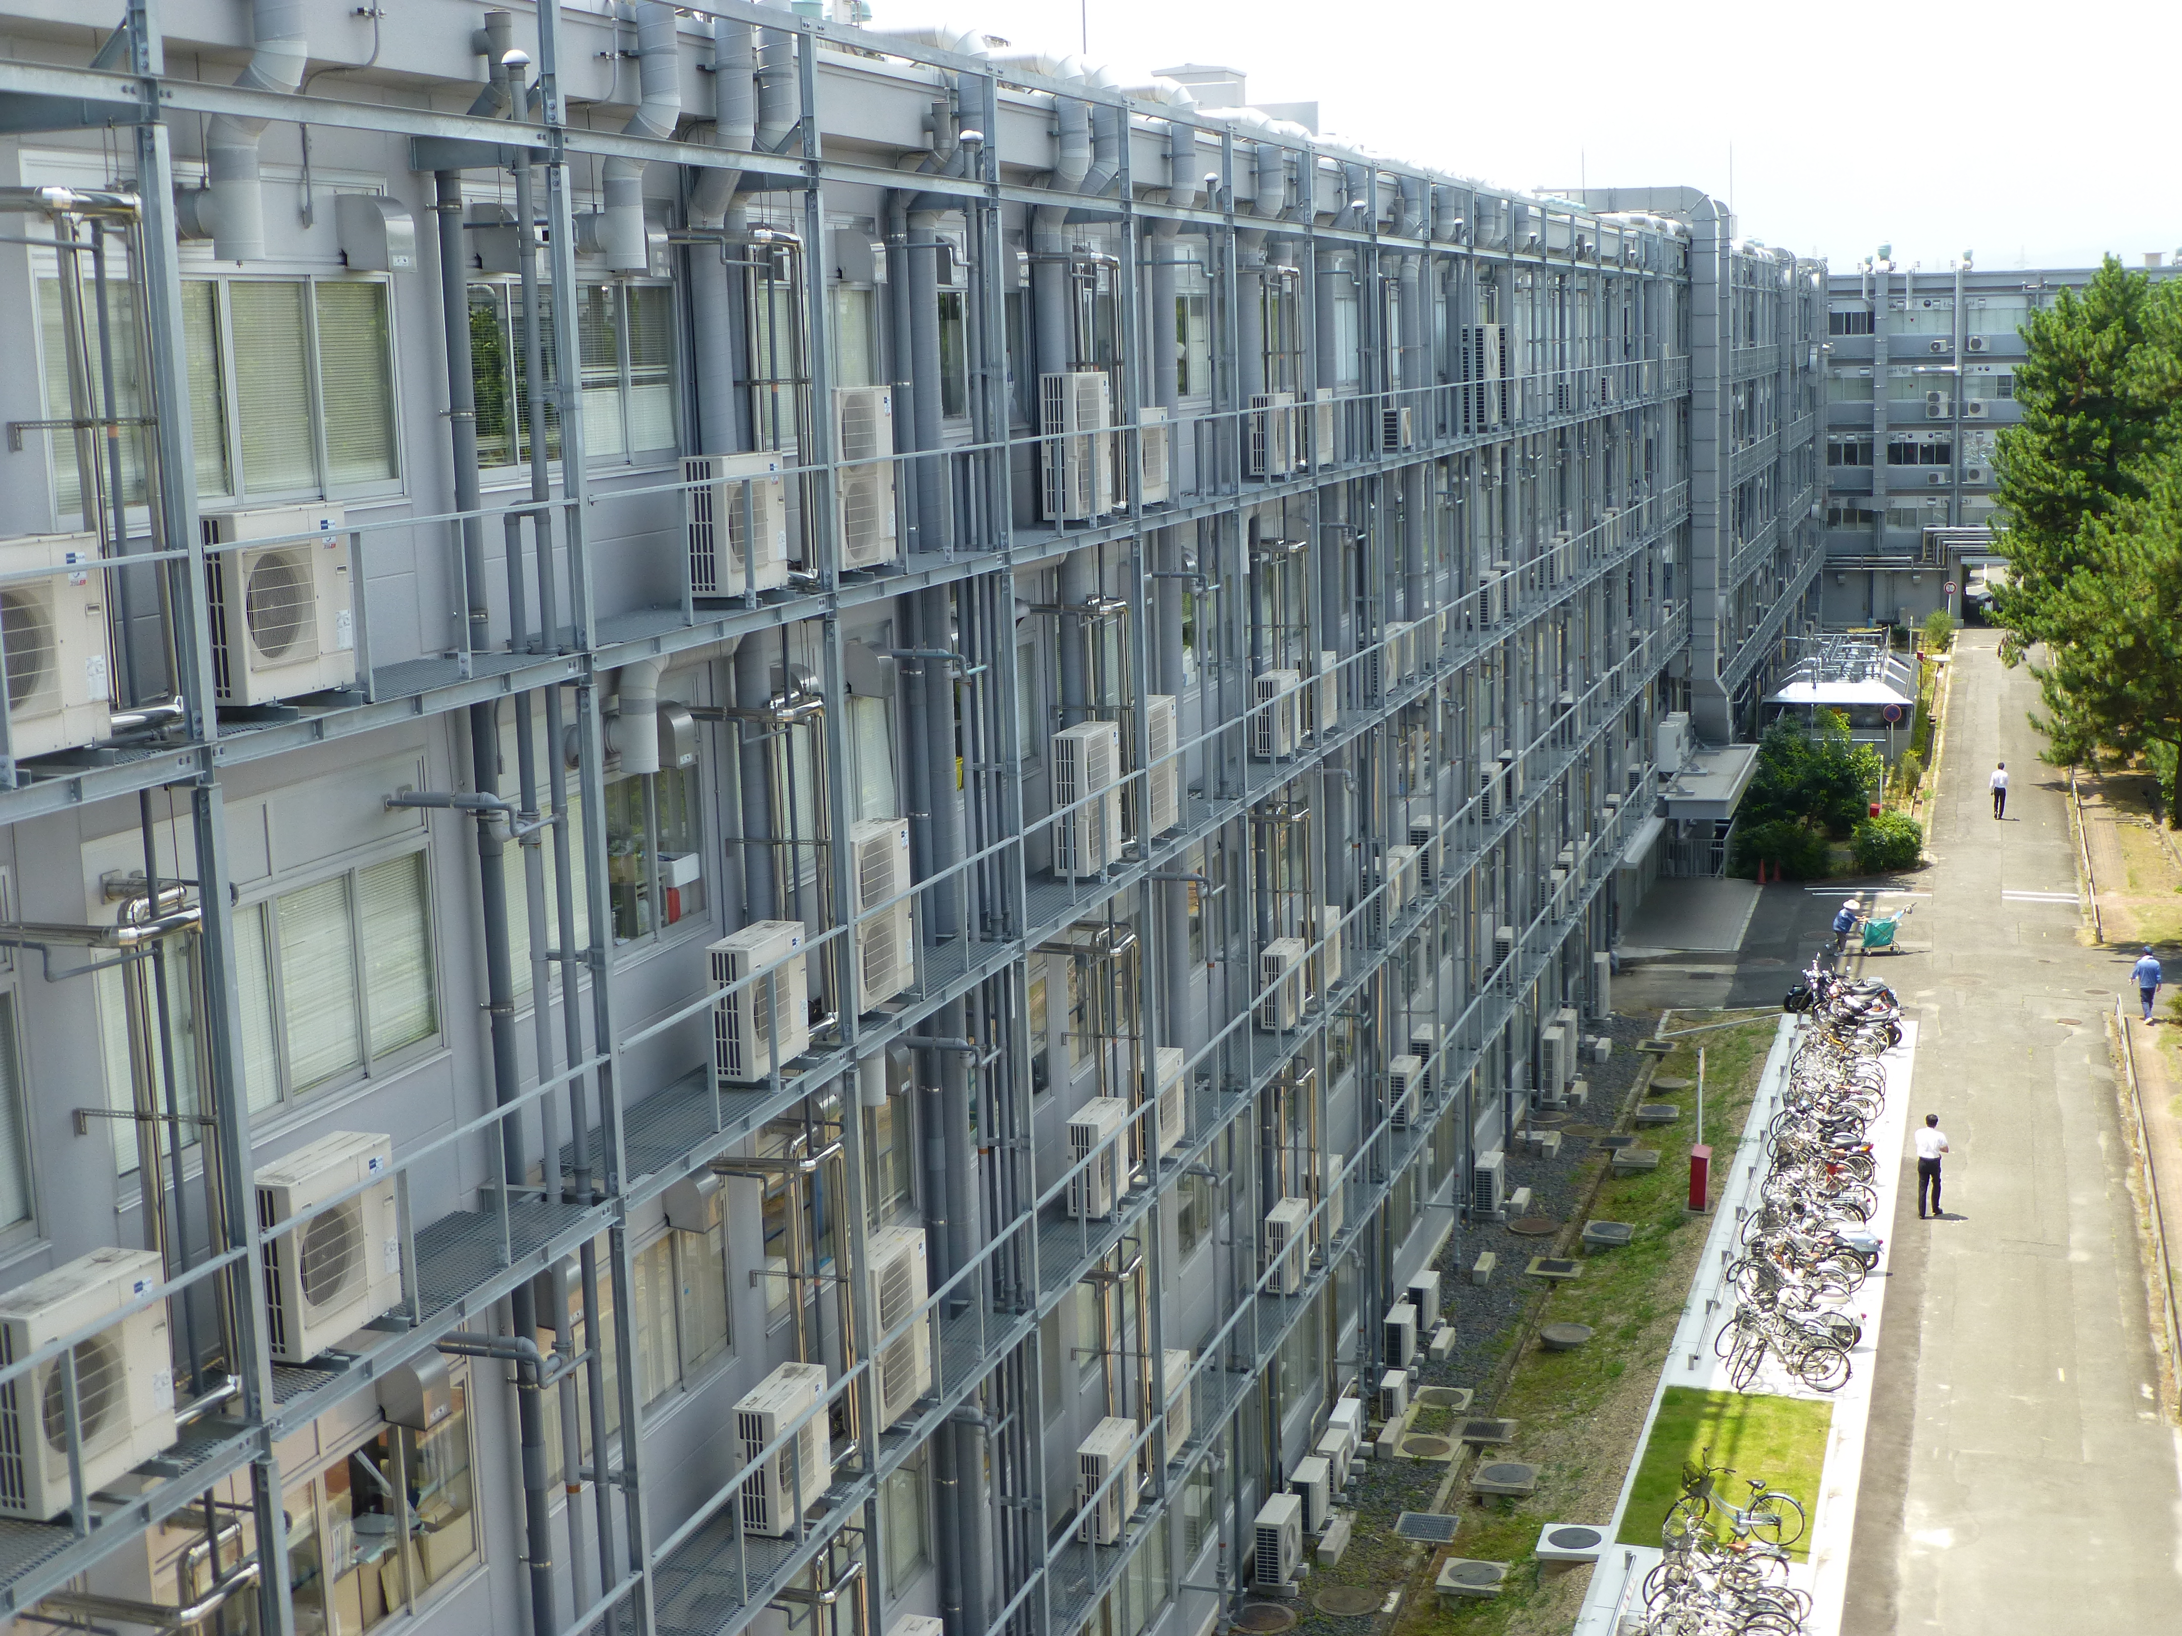
introduction

Slide 3
Introduction
“Legacy code”: a lot of scientific code is still being developed in Fortran, and in terms of features most of this code is effectively FORTRAN 77.
Manual porting of such code to parallel platforms, GPUs, FPGAs etc. is beyond the grasp of most domain scientists (too expensive).
Our aim is to develop the tools and techniques to entirely automate this porting effort: automatically parallelise legacy scientific code in FORTRAN 77 for GPUs, FPGAs, manycores and even supercomputers.
So that more scientists can benefit from access to accelerators and parallel systems for their research.

Slide 4
In defense of Fortran
Outside the scientifc community, Fortran has a poor reputation: considered old, ugly, dead, ...
Yet most code running on supercomputers is still Fortran.
Fortran is a higly suitable domain-specific language for expressing array-based scientifc problems.
It is easy to learn for non-programmers.
It is also very fast and relatively easy to parallelise.

Slide 5
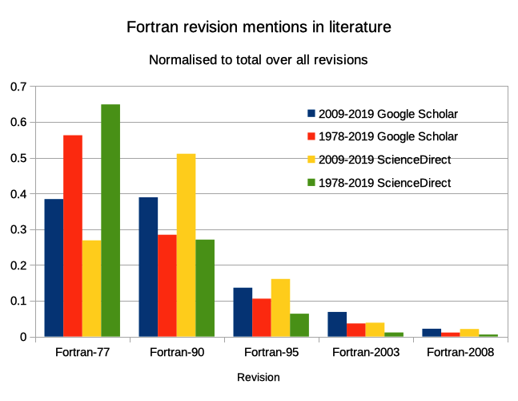

Slide 6
Source-to-source compilation
So I think scientists should keep on writing single-threaded Fortran to express their science
Compilers should take care of turning this code into optimised, parallelised code for all kinds of platforms.
These are compilers that emit source code instead of binaries, hence called source-to-source compilers.

Slide 7
Focus of this talk
An algorithm to reduce the memory utilisation of stencil-based scientific code, implemented in a source-to-source compiler.
Result is reduced memory usage and reduced memory access.
Allows increased problem size, higher resolution and/or improved performance.

Slide 8
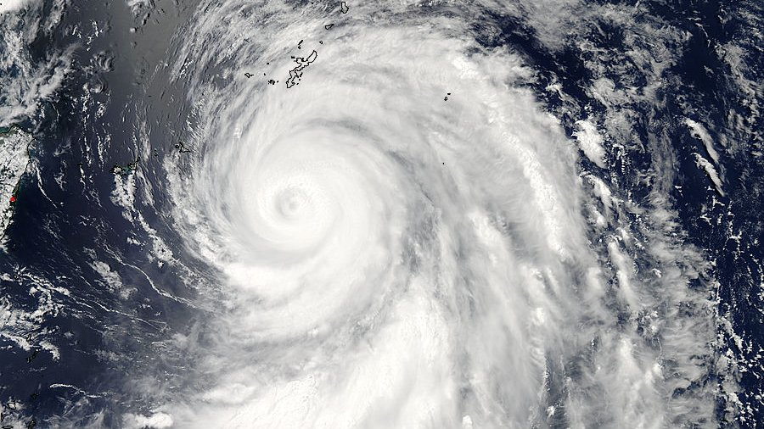
weather simulation
<Hurricane>

Slide 9
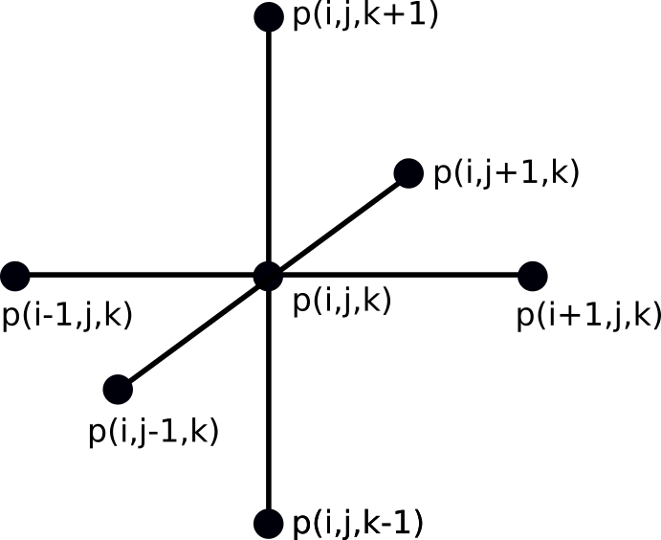
Stencil computation
Used to discretise calculus
Typically to solve partial differential equations
For example in computational fluid dynamics (weather & climate simulation)

Slide 10
Memory bottleneck
For stencil codes, memory requirements are often the bottleneck. Specifically the performance is often limited by memory bandwidth.
Reducing memory utilisation allows faster simulation of larger problems or with higher resolution.
Many of the arrays used in typical simulation code are intermediate arrays, especially in the case of stencil computations.

Slide 11
Static memory allocation
As the have no operating system, accelerators like GPUs and FPGAs use static memory allocation.
Memory for intermediate arrays has to be allocated before a kernel runs and for the lifetime of all kernels that need access to this memory.
Quite different from e.g. temporary arrays in a subroutine call, where the compiler can allocate the memory at need using the dynamic allocation facility of the operating system.

Slide 12
Large Eddy Simulator for Urban Flows
Simulates hurricanes over urban areas. Inputs are pressure and wind speed.
Calculates values at each point of a cube of atmosphere (called the “domain”) with very small time steps (ms) and very high resolution (m).
To simulate e.g. 4x8km, the cube contains 1000x2000x100 points.
Every physical value is stored in a 3-D array of floating point numbers, so in this case each array is about 763MB.

Slide 13
Large Eddy Simulator for Urban Flows
Performs the following actions at every time step:
  Set initial boundary conditions for wind velocity and pressure (4 arrays).
  Calculate the turbulent flow: based on the velocity, calculate the convection components and from this calculates the force fields (37 arrays).
  Integrate the force fields over time using Adams-Bashfort (6 arrays).
  Solve the Poisson equation for the pressure using Successive Over-Relaxation (6 arrays)

Slide 14
Turbulent flow calculation
In the original code, uses 37 arrays.
Of these 37 arrays, only 3 are actual inputs to the calculation and 3 are computed outputs.
Our memory reduction approach eliminates the 31 intermediate arrays entirely.
This allows to increase the domain to 10x20km or increase the resolution from 4 m to 1.6 m.

Slide 15
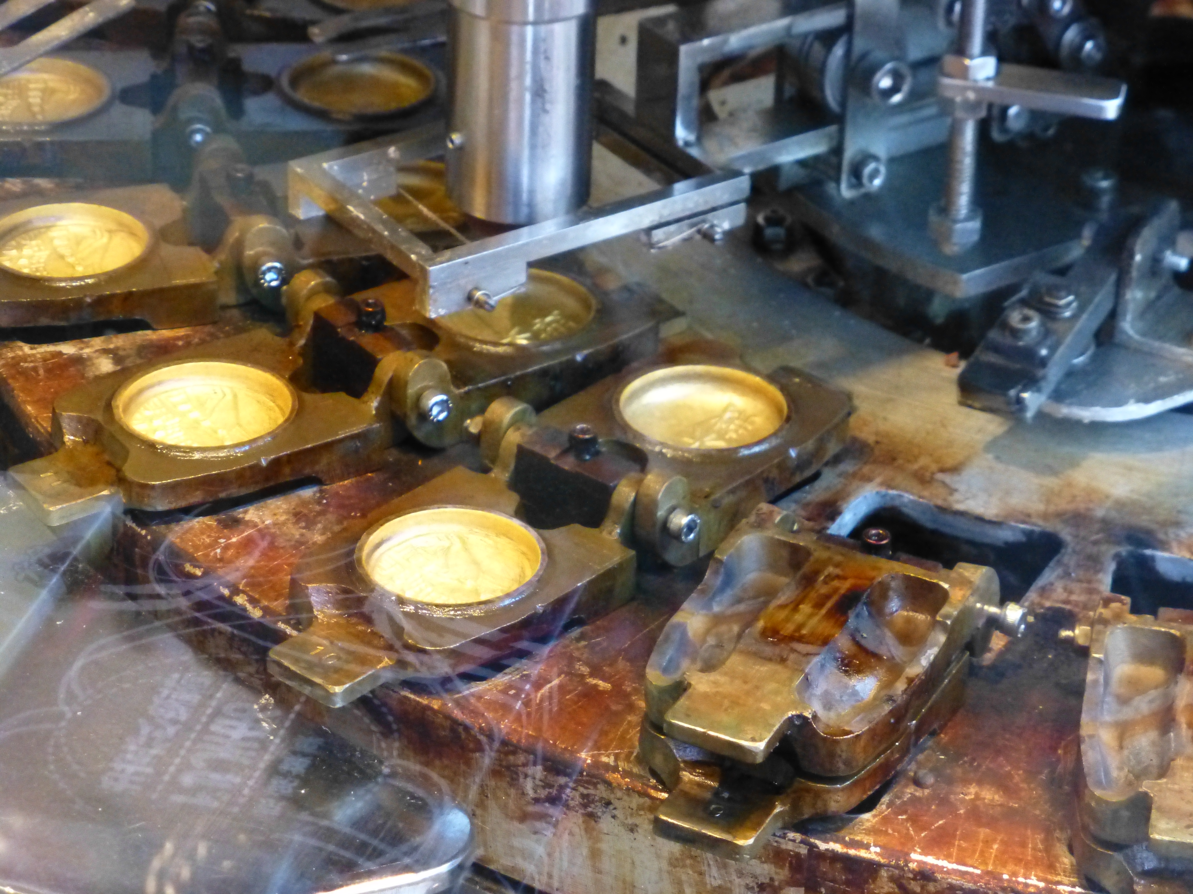
program transformation
<cookie cutter>

Slide 16
Automated program transformation
We have developed a compilation chain which can automatically transform legacy scientific code into GPU- and FPGA- accelerated variants.
For this work we make use of this compilation chain to transform the original code into a form that can be analysed for memory reduction.
In particular, the code is refactored to remove global variables (COMMON in Fortran) and the loops are analysed in terms of map and fold higher-order functions.
We have demonstrated the effectiveness of this approach for GPU acceleration.

Slide 17
The TyTraCL intermediate language
Motivated by the goal of accelerating code on FPGAs, we have developed a domain-specific functional language, TyTraCL.
TyTraCL is used in our compilation chain as an intermediate language which expresses the program as as dataflow graph.
This allows formal reasoning and and provably correct transformation of the code.

Slide 18
TyTraCL properties
A domain-specific, pure, strict functional dataflow language.
Syntactically a subset of Haskell with vectors of fixed size as in Idris.
CL stands for “Coordination Language”: not a general purpose language, but specifically designed to express scientific code as dataflow graphs.

Slide 19
Example: 2-D Shallow Water Simulation
-- Vector type declarations
etan_0 :: Vec SZ Float
acc_0 :: Float
etan_avg_0 :: Float
wet_0 :: Vec SZ Int
eps_0 :: Float
eta_1 :: Vec SZ Float
-- Kernel type declarations
shapiro_reduce_19 :: Float -> Float -> Float -> Float
shapiro_map_25 :: (Float,Float) -> (SVec 5 Int,SVec 5 Float) -> Float
shapiro_map_24 :: (Float,Float) -> (SVec 5 Int,SVec 5 Float) -> Float
reduce_18 :: Float -> SVec 2 Float -> Float
dyn_map_39 :: Float -> (SVec 2 Float,SVec 2 Float,Int) -> Float
-- Main program type declaration
main :: (Vec SZ Float,Float,Float,Vec SZ Int,Float) -> (Vec SZ Float)

Slide 20
Example: 2-D Shallow Water Simulation
main (etan_0,acc_0,etan_avg_0,wet_0,eps_0) =
let
s1 = [0,1006] -- stencil definition
etan_s_0 = stencil s1 etan_0 -- stencil application
acc_1 = fold reduce_18 acc_0 etan_s_0 -- reduction
etan_avg_1 = fold (shapiro_reduce_19 acc_1) etan_avg_0 etan_0
s4 = [1,502,503,504,1005]
etan_s_2 = stencil s4 etan_0
s5 = [1,502,503,504,1005]
wet_s_1 = stencil s5 wet_0
eta2_local_1 = map (shapiro_map_25 (eps_0,etan_avg_1)) (zipt (wet_s_1,etan_s_2))
s7 = [2,1004]
eta2_local_s_0 = stencil s7 eta2_local_1
eta_1 = map (dyn_map_39 acc_1) (zipt (eta2_local_s_0,wet_0))
in
eta_1

Slide 21
Key elements of TyTraCL
Primitives: sized vectors, stencils, higher-order functions and kernel functions
Every operation applies a higher-order function to a kernel function and a vector, e.g.
v_out = map f v_in
In Python this would be
v_out = list(map(f, v_in))

Slide 22
Key elements of TyTraCL
The higher-order functions are map, fold and stencil
  map applies a function to every element of a vector, independent of the other elements
  fold (aka reduce) combines all elements of a vector, e.g. a sum or product
  stencil takes a vector and a list of relative indices and creates a new vector of tuples by taking the elements corresponding to the indices for every element in the array. For example:
  v_s = stencil [-1,1] v
  will take the elements at v[i-1] and v[i+1]
  In Python this would be
    v_s = [([i-1],[i+1]) for i in range(len(v))]

Slide 23
TyTraCL semantics
TyTraCL can be viewed as a subset of Haskell with strict execution.
  This means that every map call can be considered to return a new list, and therefore memory for this list will need to allocated.
  In this view, a stencil of k points will require k times the memory allocation of the original vector.
However, TyTraCl can also be viewed as a streaming language.
  This means that a map call consumes the elements of the input vector as a stream and the result is immediately passed on to the next call.
  In this view, the stencil call creates a new stream of stencils around every given point in the original stream.
  To do so it buffers the stream until all elements of the stencil are in the buffer.
  A crucial observation here is that there is no need for additional buffering if we create a stencil from an input vector, as they are stored in the main memory.
Although both views are computationally equivalent, implementation of the stream-based view will require considerably less memory than the strict vector-based view.

Slide 24

from imperative to functional
<temple>

Slide 25
From imperative to functional
Fortran 77 is a statement-based, imperative language.
Global variables are very common
So at first sight not functional at all
And yet we can transform it into a pure functional language, TyTraCL

Slide 26
Transforming Fortran into TyTraCL
First make the Fortan code pure and type safe
Find loop nests that can become maps or folds
Create a kernel function for the loop body
Detect and extract the stencils
Scalarise the kernel function

Slide 27
Transforming Fortran into TyTraCL
! original code
subroutine f_loop(a, v_in, v_out)
real, intent(in) :: a
real, dimension(isz), intent(in) :: v_in
real, dimension(isz), intent(out) :: v_out
integer :: i
do i=1,isz
v_out(i)=a*(v_in(i-1)+v_in(i+1))/2
end do
end subroutine f_loop
mappable loop
factor out body as kernel
stencil: s = [-1,+1]

Slide 28
Transforming Fortran into TyTraCL
! kernel code
subroutine kernel(a, v_in, v_out)
real, intent(in) :: a
real, dimension(isz), &
intent(in) :: v_in
real, dimension(isz), &
intent(out) :: v_out
v_out(i) = &
a*(v_in(i-1)+v_in(i+1))/2
end subroutine kernel
! kernel loop code
subroutine kernel_loop(a, v_in, v_out)
real, intent(in) :: a
real, dimension(isz), &
intent(in) :: v_in
real, dimension(isz), &
intent(out) :: v_out
integer :: i
do i=1,isz
call kernel(a,v_in,v_out)
end do
end subroutine kernel_loop

Slide 29
Transforming Fortran into TyTraCL
! scalarised kernel code
subroutine kernel_scal(a, v_in_im1, v_in_ip1, v_out)
real, intent(in) :: a,v_in_im1, v_in_ip1
real :: v_out
v_out=a*(v_in_im1+v_in_ip1)/2
end subroutine kernel_scal
-- TyTraCL code
s = [-1,1]
sv_in = stencil s v_in
v_out = map (kernel_scal a) sv_in
scalarised:
array accessese replaced by scalar variables

Slide 30

intermediate vector removal
<maybe a nice cloud>

Slide 31
Intermediate vector removal: the easy part
Our is to eliminate intermediate vectors from the TyTraCL code.
These may occur because of the need for stencils; or they might be present in the original code.
  If an intermediate vector is present in the original code, we have e.g.
  v_1 = map f_1 v_0
  v_2 = map f_2 v_1
and we can replace v_1 with its definition.
  v_2 = map f_2 (map f_1 v_0)

Slide 32
Intermediate vector removal: the easy part
If there is a stencil, because of the way it is inferred, it can either occur between a map and a map or between a map and a fold, e.g.
v_1 = map f_1 v_0
v_1s = stencil s_1 v_1
v_2 = map f_2 v_1s
or
v_1 = map f_1 v_0
v_1s = stencil s_1 v_1
acc_2 = fold f_3 acc_0 v_1s

Slide 33
Intermediate vector removal: the easy part
After substitution of the vectors with their definitions these expressions will become:
v_2 = map f_2
(stencil s_1 (map f_1 v_0))
acc_2 = fold f_2 acc_0
(stencil s_1 (map f_3 v_0))
Thus we can always remove the intermediate vectors of stencils.

Slide 34
Intermediate vector removal: the hard part
Although all intermediate vectors have been removed, this removal so far is purely in terms of the occurrences in the source code.
If we ran the program, it would still require memory for implicit temporary vectors. This is because an intermediate expression, e.g. a stencil, will require additional memory. For example:
v_2 = map f_2 (stencil s_1 (map f_1 v_0))
The output of the map operation is a new vector, as is the output of the stencil operation.
Note that a fold does not require additional memory as it returns a scalar.

Slide 35
Intermediate vector removal: the hard part
What we would need is a program that consists of a single map (and maybe some folds).
Such a program would consist of a single scalar function, so it would not need to allocate any memory for intermediate vectors
That means that any stencils should be created directly from the input vectors (i.e. from main memory).
So this is our goal.

Slide 36
TyTraCL program rewrite rules
map f_2 (map f_1 v) = map (f_2 . f_1) v -- Map-Map
fold f_1 acc (map f_2 v) = fold (f1 `fcomp` f2) acc v -- Fold-Map
stencil s_1 (map f_1) = map (maps f_1) (stencil s_1) -- Stencil-Map
zipt (map f_1 v_1, map f_2 v_2, ..., map f_i v_i, ...) -- ZipT-Map
= map (applyt (f_1,f_2, ..., f_i, ...))
(zipt (v_1, v_2, ..., v_i, ...))
v = map id v -- Map-Id
(elt i) . unzipt . (map f v) = map ((elt i) . f) v -- Elt-UnzipT-Map

Slide 37
TyTraCL program rewrite rules
Applying these rewrite rules to any TyTraCL program, always terminates with an expression which contains only a single map, as the outer function.
In other words, any program will be of the form
  a_1 = fold f_1 a_0_1 v_in_1
  a_2 = fold f_2 a_0_2 v_in_2
  v_out = map (f_3 a_1 a_2) v_in_3

Slide 38
Some details: fusing stencils
A stencil will operate on an expression consisting only of input vectors, zipt and stencil. A stencil operating on a stencil expression can per definition be rewritten as a single stencil using of scomb:
stencil s_2 (stencil s_1 v_1) = stencil (scomb s_2 s_1) v_1 -- SComb
A stencil operating on a zipt expression can be rewritten as a zipt operating on a tuple of stencil expressions:
stencil s_2 (zipt (v_1,v_2)) = zipt (stencil s_2 v_1,stencil s_2 v_2) -- Stencil-ZipT

Slide 39
So far, so good
At this stage the TyTraCL program has been transformed to meet our objective:
  stencils operate only on input vectors;
  there is a sequence of dependent fold operations with at most a single map operation.
Conceptually, this means that the map operation consumes a stream of input vectors, creating stencils as required, an applies to this composite stream a composite scalar function which performs the actual computations.
So all intermediate vectors have been removed!
The next challenge is to emit Fortran code from this transformed TyTraCL program.

Slide 40
Final form of the TyTraCL program
The program is now an ordered list of expressions which each represent a self-contained loop nest, and which in principle can depend upon any of the previous expressions.
As map and fold expressions can depend on results from earlier fold expressions, and folds always consume the entire vector, the folds are executed in dependency order.
In the final imperative code, the entries in this list are ordered to ensure that executing them sequentially satisfies the dependencies.
The next step is to transform the program into a form suitable for emitting code in an imperative language such as Fortran or C.

Slide 41
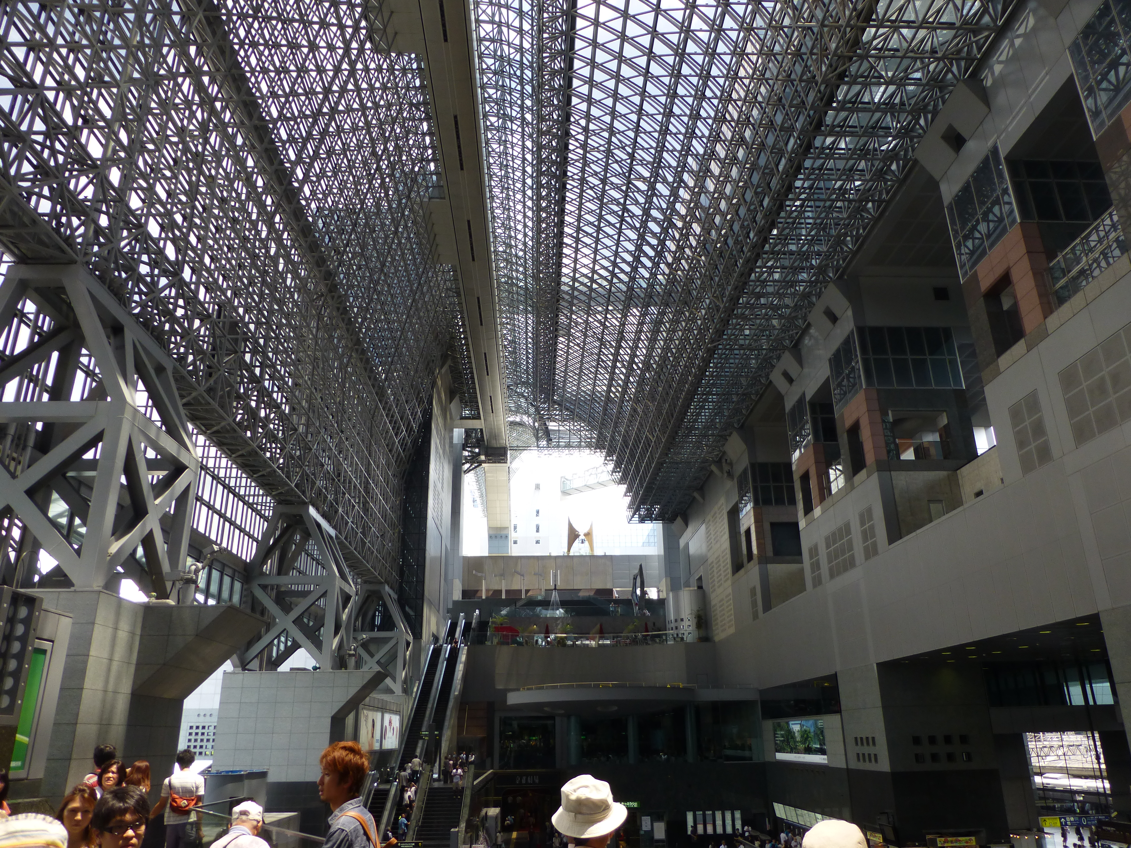
from functional to imperative
<Kyoto station roof>

Slide 42
From functional to imperative code
Functional code like TyTraCL (or Haskell, Idris, Scheme etc) is executed by reduction, so the order of the execution is based on the dependencies between expressions.
Imperative code (e.g. OpenCL C or Fortran) is executed in order of occurrence of the statements.
So how do we go from one to the other?

Slide 43
Administrative Normal Form
Create a unique name for every sub-expression.
List them in order of dependency.
Traversal of this list in order of occurrence (“imperative”) is the same as in dependency order.
So if we emit statements for these expressions, they will be in the right order for execution.

Slide 44
Administrative Normal Form
We create new names to bind all sub-expressions in an expression.
Expressions with higher-order functions are replaced by named functions.
Expressions that operate on vectors are replaced by new vectors.
All other sub-expressions are left unchanged.

Slide 45
Final code generation
The strategy for generating imperative code from the transformed TyTraCL code is quite straightforward:
  The program has been decomposed in a sequence of dependent loops over scalar functions.
  We generate code for the function to be called in each of these loops, the dependent functions and the loops themselves.
  In OpenCL, this means generating kernels for the device and enqeueNDRange statements for the host code.
  In Fortran, we follow a similar approach but generate a loop around the call to the kernel.

Slide 46
Final code generation
Because of the decomposition in ANF, the generated program consists of lots of functions.
So the final step is to inline these intermediate functions recursively
The resulting code is no larger than the original code.

Slide 47
Trading memory for computation
For intermediate arrays that are not the result of stencil operations, removal has no drawbacks at all.
For intermediate arrays that are the result of stencil operations, we trade memory for computation.
Because stencil code is usually memory bandwidth limited and not compute limited, the transformed code will in general still not be slower.

Slide 48
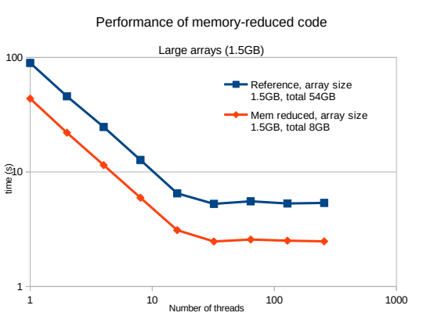

Slide 49
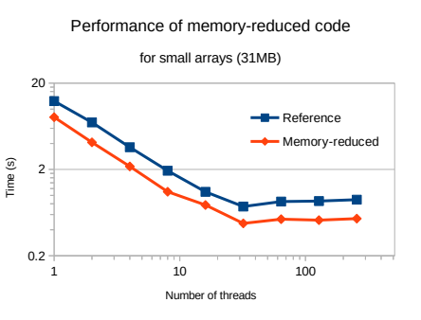

Slide 50
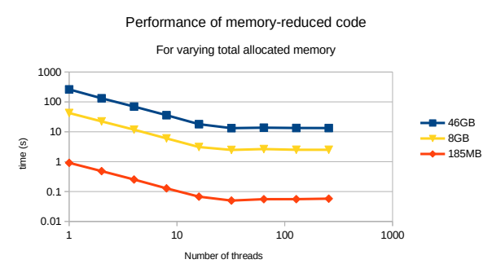

Slide 51
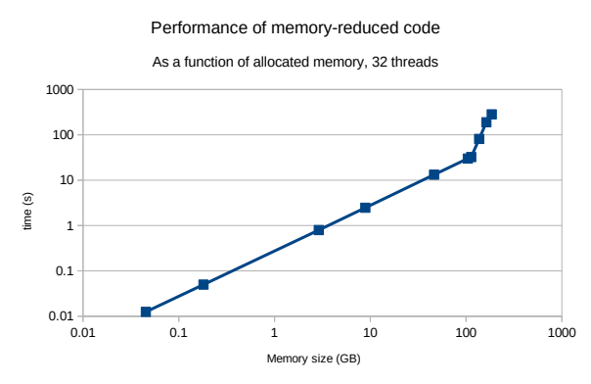

Slide 52
Conclusion
We presented an algorithm to reduce the memory utilisation of stencil-based scientific code, implemented in a source-to-source compiler.
Results in reduced memory usage and reduced memory access, e.g. from 37 to 6 arrays on Large Eddy Simulator for Urban Flows.
Allows increased problem size, higher resolution and/or improved performance.

Slide 53

Thank you!
=

