Slide 1
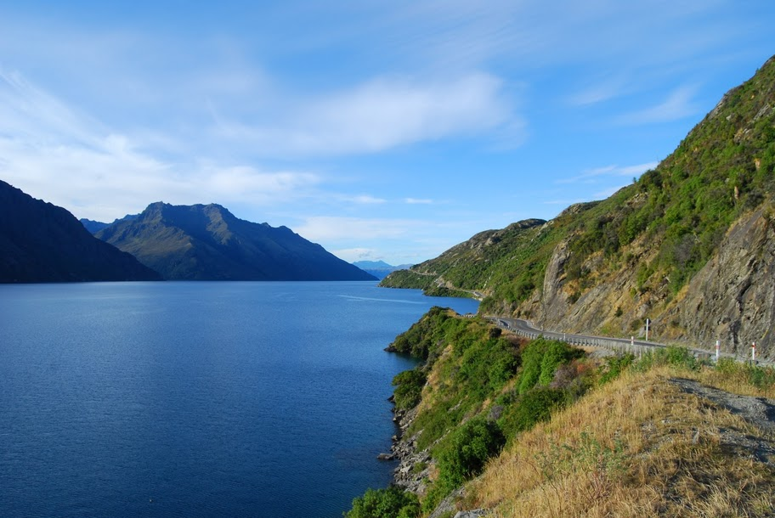
Kara Yu | Settings
GoGoGo
From
BOS
To
MBJ
Leave
7/4/11
Return
7/10/11
Hotel
$500/night
Flight
$700
GO!

Slide 2

Kara Yu | Settings
Jamaica
7/4/11 – 7/10/11 | Montego Bay, Negril, Ocho Rios
Total Price: $1200+
Ingredients
Details
Lodging
X
Flights
Flights
BOS 09:20 MBJ 11:30
2h10m (0 stops)
X
$650
MBJ 18:00 BOS 22:30
4h30m (1 stop)
Book
Activities
Details
Food
$435
JFK 09:20 MBJ 11:30
2h10m (0 stops)
MBJ 18:00 JFK 22:30
4h30m (1 stop)
Book
$350
BOS 09:20 MBJ 12:30
3h10m (0 stops)
MBJ 18:00 BOS 22:30
Book
4h30m (1 stop)
X
* Prices based on trip including transport and accommodation according to your preferences. To get better results, fill out your profile!
* Prices based on trip including transport and accommodation according to your preferences. To get better results, fill out your profile!

Slide 3








Kara Yu | Settings
Go Trips
San Francisco, CA 3/31/11 – 4/2/11
Christchurch, NZ 5/2/11 – 5/25/11
Summer w Fencers 7/4/11 – 7/10/11
San Francisco, Palo Alto, Mountain View
Nelson, Queensland, Hokitika, Milford Sound
…
Montego Bay, Negril, Ocho Rios
…
Planned Trips
Montreal, QC 4/16/11 – 4/19/11
Newport, RI 4/26/11 – 4/28/11
Summer Plans 7/4/11 – 7/10/11
Montreal, QC
…
Newport, RI
…
Barcelona, ES | Beijing, CN
…
Past Trips

Slide 4
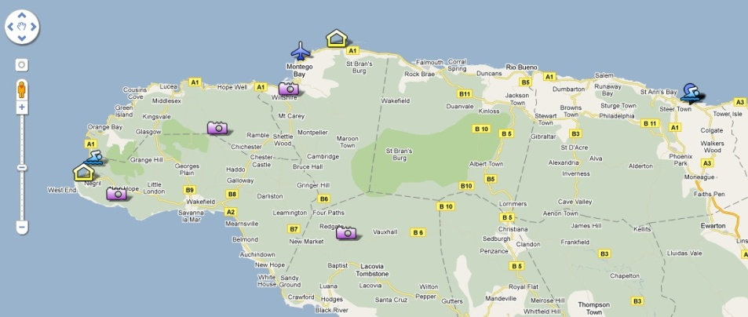

Summer with Fencers
7/4/11 – 7/10/11 | Montego Bay, Negril, Ocho Rios
Flight Time: 4hr 31 min | Total Driving Time: 10 hrs 21 min
Total Price: $1500+
Kara Yu | Settings
Ingredients
Details
Schedule
Lodging
X
Activities
X
Saturday 7/4
X
Flights
09:20
UA 892 from BOS
Activities
1
11:30
UA 892 in MBJ
Food
2
3
Afternoon
Friends
4
X
Evening
Rocklands Bird Sanctuary
X
1
Book
Sunday 7/5
Near Anchovy, St. James Montego Bay
Jamaica
876-952-2009; rocklandsbirdsanctuary@gmail.com
Morning
Reviews
Afternoon
TripAdvisor (2 of 25 Destinations in Montego Bay)
“I highly reccommend visiting this place. It is located just outside of Montego Bay…”
Evening
“This was, hands down, the worst one I've seen. pros: You get close to the birds…”
Comments
Monday 7/6
“Birds are lame…Let’s spend our time by the beach”
Morning
X
Afternoon
Dunns River Falls
Booked!
* Prices based on trip including transport and accommodation according to your preferences. To get better results, fill out your profile!

Slide 5
We’ll make money from affiliate fees and product/service suggestions
Core business model
Potential secondary revenue streams
We’ll incorporate search from trusted travel sites (e.g., Expedia) to facilitate travel research
When users book, we’ll earn affiliate fees
Fees will range from $2 (for flights) to 5% of overall booking (for hotels, activities and packages)
Additional revenue streams will come from trip-relevant recommendations such as:
  Passport/Visa services for international travel
  Rosetta Stone
  Trip supplies, such as sunscreen
  Tripwear, particularly when trips are “off season” (e.g., winter trip to Florida, when sandals not easily available in New England)
Monetization potential is high; it is a well-traveled path AND it complements our product

Slide 6
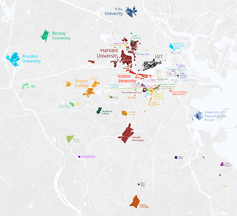
Our foothold customers will be students at Boston-area universities
Universities/Colleges in Boston Area
Over 50 institutions of higher education operate in Boston, with a total of over 200,000 students attending annually
Students have breaks for travel throughout the school year (Columbus Day weekend, Thanksgiving, Christmas, January break, President’s Day weekend, Spring Break, summer vacations); they often travel
Many schools have institutions that are already in the practice of planning group trips (e.g., Fraternities, Clubs, Sections, etc)
We can popularize GoGoGo at these institutions through personal contacts, events, and partnerships with organizations
Product will spread: travel activity we facilitate is inherently viral

Slide 7
Success will lead to a $100 M revenue business in 5 years with attractive margins
 | Year 1 | Year 2 | Year 3 | Year 4 | Year 5
Avg. users during year | 20,000 | 275,000 | 1,250,000 | 3,750,000 | 7,500,000
Avg. trips/user/yr | 3 | 3 | 3 | 3 | 3
Trips planned | 150,000 | 1,500,000 | 7,500,000 | 15,000,000 | 24,000,000
% trips that generate a lead | 50% | 50% | 50% | 50% | 50%
Leads | 30,000 | 375,000 | 2,250,000 | 5,250,000 | 9,600,000
Avg. revenue/lead | $ 7.00 | $ 7.50 | $ 8.00 | $ 8.50 | $ 9.00
Revenue | $ 210,000 | $ 3,093,750 | $ 15,000,000 | $ 47,812,500 | $ 101,250,000
Avg. rev/user | $10.50 | $ 11.25 | $ 12.00 | $ 12.75 | $ 13.50
Operating expenses (e.g., amazon web services) | $ 42,000 | $ 464,063 | $ 1,500,000 | $ 4,781,250 | $ 10,125,000
Marketing | $ 30,000 | $ 100,000 | $ 150,000 | $ 250,000 | $ 1,000,000
People | $ 1,000,000 | $ 3,000,000 | $ 5,000,000 | $ 8,000,000 | $ 12,000,000
FTE | 10 | 30 | 50 | 80 | 120
Other overhead (e.g., rent) | $ 10,000 | $ 150,000 | $ 300,000 | $ 1,000,000 | $ 2,000,000
Total costs | $ 1,082,000 | $ 3,714,063 | $ 6,950,000 | $ 14,031,250 | $ 25,125,000
EBIT | $ (872,000) | $ (620,313) | $ 8,050,000 | $ 33,781,250 | $ 76,125,000
After tax income (@35%) | $ (566,800) | $ (403,203) | $ 5,232,500 | $ 21,957,813 | $ 49,481,250
Cashflow turns positive in Q4 of Year 2, leaving total cash need at $1.03 million

Slide 8





We will win by making it easier to research, share, and organize travel plans
GoGoGo
Helpfulness in researching travel options
Ease of organizing and sharing travel plans
Notes:
Look up:
Tripbase.com
Joobili.com
Triporati.com
Kukunu.com

Slide 9
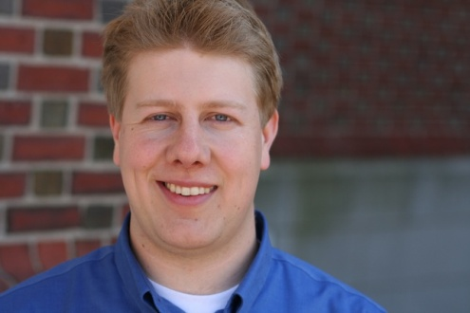
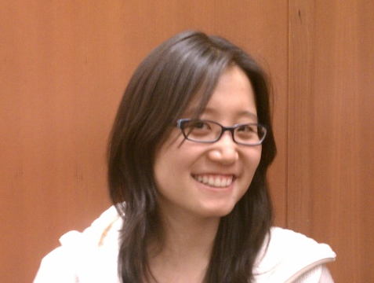
Our team
Founders
Luke Langford is an expert is disruptive strategy and business building. A former consultant for Innosight, Clayton Christensens’s firm, Luke spent nearly 3 years “building the first mile” of new consumer, technology and healthcare businesses for Fortune 500 clients. He also honed sales and online marketing skills as the Sr. Manager of Sales & Marketing for Guaranteach, an online math education company. He is currently an MBA candidate at Harvard Business School and received a B.A in Chemistry from Harvard College with advanced standing
Luke Langford
For the past two years, Kara Yu led a change in monetization strategy at Google Japan. In that time, she identified gaps in servicing the local market and changed both sales incentives and product priorities to make Google Search more suitable for the Japanese market. While living in Asia, she traveled to 15 countries for work and pleasure. Previously, she worked in California on sales strategy focusing on Asia and Latin America. Prior to working for Google, she was a Mergers and Acquisitions analyst with UBS in New York. She is currently an MBA candidate at Harvard Business School. She received degrees in Economics and Mathematics with Computer Science from MIT
Kara Yu

Slide 10
Having completed initial customer research, we’re ready to build an MVP
To date, GoGoGo team has conducted over two dozen interviews to understand the pains and needs of group travelers
  Many were recruited via ads on craigslist and facebook, all had recently planned and been on a group trip
We require $25,000 to hire a developer to create a minimum viable product (MVP) to test key assumptions. This capital will fund:
  Contracting with developer to refine design and build MVP
  Maintenance and operation costs of MVP for summer/fall months of testing
  Additional consumer surveys and interviews, as necessary for testing

Slide 11
Appendix

Slide 12
Appendix: Quarterly financial projections for first 2 years
 | Year 1 |  |  |  | Year 2
 | Q1 | Q2 | Q3 | Q4 | Q5 | Q6 | Q7 | Q8
Avg users/quarter | 0 | 5000 | 25000 | 50,000 | 100,000 | 200000 | 300000 | 500,000
Avg. trip/user/quarter | 0.75 | 0.75 | 0.75 | 0.75 | 0.75 | 0.75 | 0.75 | 0.75
Trips | - | 3,750 | 18,750 | 37,500 | 75,000 | 150,000 | 225,000 | 375,000
% trips that generate a lead | 50% | 50% | 50% | 50% | 50% | 50% | 50% | 50%
Leads | - | 1,875 | 9,375 | 18,750 | 37,500 | 75,000 | 112,500 | 187,500
Avg. revenue/lead | $ 7.00 | $ 7.00 | $ 7.00 | $ 7.00 | $ 7.50 | $ 7.50 | $ 7.50 | $ 7.50
Revenue | $ - | $ 13,125 | $ 65,625 | $ 131,250 | $ 281,250 | $ 562,500 | $ 843,750 | $ 1,406,250
Avg rev/user | $ 3 | $ 3 | $ 3 | $ 3 | $ 3 | $ 3 | $ 3 | $ 3
Marketing |  | $ 5,000 | $ 10,000 | $ 15,000 | $ 25,000 | $ 25,000 | $ 25,000 | $ 25,000
Infrastructure (e.g., amazon web services, etc) | $ 10,500 | $ 10,500 | $ 10,500 | $ 10,500 | $ 42,188 | $ 84,375 | $ 126,563 | $ 210,938
% of rev |  |  |  |  | 15% | 15% | 15% | 15%
People | $ 100,000 | $ 200,000 | $ 300,000 | $ 350,000 | $ 500,000 | $ 625,000 | $ 875,000 | $ 1,000,000
FTE | 4 | 8 | 12 | 14 | 20 | 25 | 35 | 40
Avg Salary / quarter / FTE | $ 25,000 | $ 25,000 | $ 25,000 | $ 25,000 | $ 25,000 | $ 25,000 | $ 25,000 | $ 25,000
Other corp overhead (e.g., rent, etc) | $ 2,500 | $ 2,500 | $ 2,500 | $ 2,500 | $ 37,500 | $ 37,500 | $ 37,500 | $ 37,500
Total costs | $ 113,000 | $ 218,000 | $ 323,000 | $ 378,000 | $ 604,688 | $ 771,875 | $ 1,064,063 | $ 1,273,438
Pretax income | $ (113,000) | $ (204,875) | $ (257,375) | $ (246,750) | $ (323,438) | $ (209,375) | $ (220,313) | $ 132,813
After tax income | $ (73,450) | $ (133,169) | $ (167,294) | $ (160,388) | $ (210,234) | $ (136,094) | $ (143,203) | $ 86,328
Tax rate | 35%
Cummulative cashflow | $ (73,450) | $ (206,619) | $ (373,913) | $ (534,300) | $ (744,534) | $ (880,628) | $(1,023,831) | $ (937,503)

