Slide 1
AUTOMATED THERMAL SCREENING AND ACCESS CONTROL SYSTEM
Smart Entry Control with IoT Monitoring
ECL211 – Project

Slide 2
Idea and Motivation
The Idea
To Build a smart entry system that automatically checks both identity and body temperature before allowing access.
Scan RFID card > Check ID > Measure temperature > Allow or deny entry automatically.
All records are logged and viewable on a phone via WiFi in real time.
Another important advantage is efficiency. Manual attendance takes time and can lead to errors. Similarly, manual temperature checks require extra manpower. This system reduces human effort, minimizes contact, and speeds up the entire process.
Why We Built This
During COVID-19, every office, hospital and school needed manual thermal screening at entry — slow, error-prone and needed extra staff.
Our system replaces manual screening with an automated, contactless solution using low-cost electronics.
The main motivation behind this project is to create a low-cost and easily deployable solution. It can be installed at multiple entry points, making it highly useful for schools, colleges, offices, and even public institutions. Instead of having separate systems for attendance and health checks, this integrated approach simplifies the process
ECL211 Project | Department of Electronics and Communication

Slide 3
System Block Diagram
LCD 16x2
RFID Sensor
Arduino Uno
Green LED
LM35 Sensor
Access Granted
Analog Temp
Red LED
Access Denied
5V USB Power
(from PC / Adapter)
ESP8266
WiFi Web Server
Mobile Phone
View via WiFi
Tip: Replace block labels with sensor images for your report!

Slide 4
Pin Connection Table
Component | Pin / Wire | Arduino Pin | Note
MFRC522 RFID | SDA | Pin 10 | SPI SS
MFRC522 RFID | SCK | Pin 13 | SPI Clock
MFRC522 RFID | MOSI | Pin 11 | SPI Data Out
MFRC522 RFID | MISO | Pin 12 | SPI Data In
MFRC522 RFID | RST | Pin 9 | Reset
MFRC522 RFID | 3.3V / GND | 3.3V / GND | Use 3.3V only!
LM35 | VCC / GND | 5V / GND | -
LM35 | OUT | A0 | Analog temp
LCD 16x2 | RS / EN | Pin 2 / Pin 3 | 4-bit mode
LCD 16x2 | D4-D7 | Pin 4, 5, 6, 7 | Data pins
LCD 16x2 | V0 (Pin 3) | GND | Max contrast
LCD 16x2 | A (Pin 15) | 5V via 220Ω | Backlight
Green LED | Anode | A1 via 220Ω | Allow
Red LED | Anode | A2 via 220Ω | Deny
ESP8266 | TX | Pin 8 (RX) | SoftSerial
ESP8266 | RX | A3 via divider | 1kΩ + 2kΩ
ESP8266 | VCC | 3.3V | NOT 5V!

Slide 5
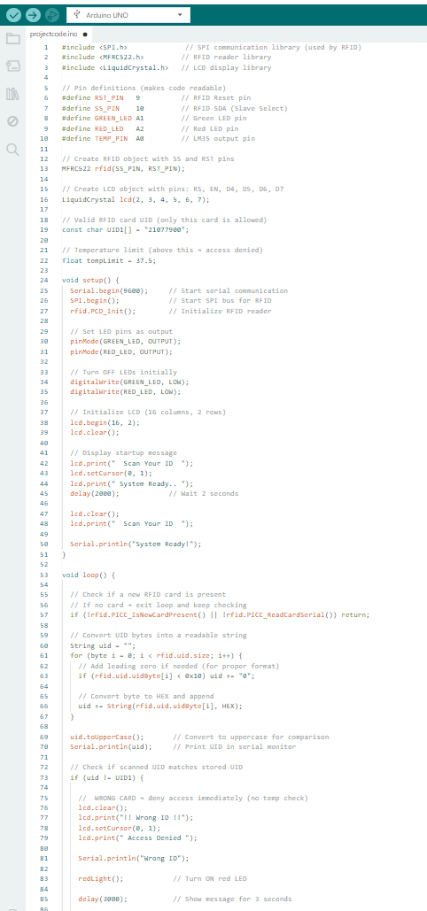
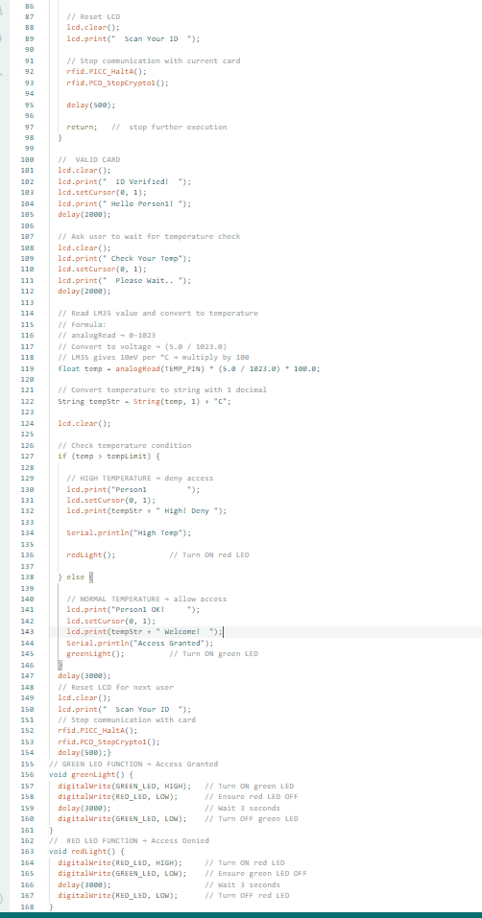
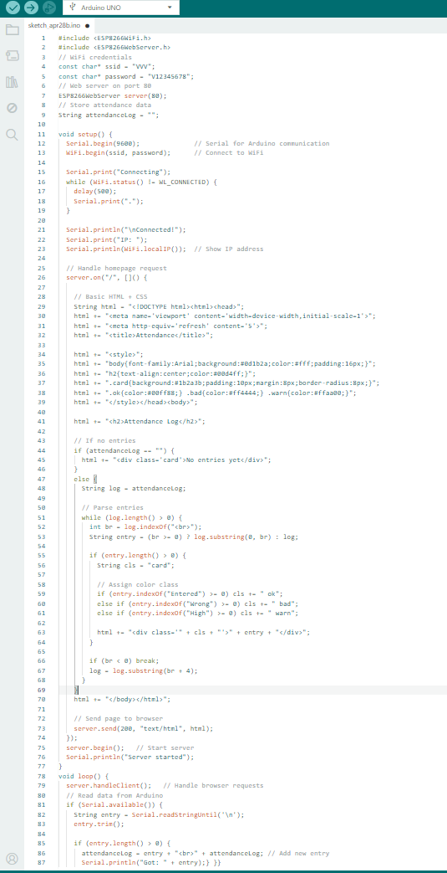
CODE AND EXPLANATION:

Slide 6
Working Procedure of the Code:
The Arduino code follows a step-by-step logic flow when a card is scanned:
Step 1 — System Initialization
During setup(), the Arduino initializes the SPI bus, RFID module, LCD display, and LED pins. The LCD displays 'Scan Your ID' to indicate the system is ready. A 500ms delay ensures the LCD has sufficient time to power up before any commands are sent, preventing display artifacts.
Step 2 — RFID Card Scanning
In loop(), the code continuously polls the RFID reader using PICC_IsNewCardPresent() and PICC_ReadCardSerial(). When a card is detected, the UID bytes are read and converted to a hexadecimal string. The UID is compared against the registered UID stored in the program (UID1 = "21077900").
Step 3 — Identity Verification
If the scanned UID does not match the registered UID, the system immediately shows '!! Wrong ID !!' on the LCD, activates the Red LED for 3 seconds, and returns without proceeding to temperature measurement. If the UID matches, the LCD shows 'ID Verified! Hello Person1!' confirming valid identity.
Step 4 — Temperature Measurement
After identity verification, the LCD displays 'Check Your Temp – Please Wait' for 2 seconds, allowing the LM35 sensor to stabilize. The analog value from pin A0 is read using analogRead() and converted to Celsius using the formula: Temp = ADC_Value × (5.0 / 1023.0) × 100.0, since LM35 produces 10mV per degree Celsius.
Step 5 — Access Decision
The measured temperature is compared against the threshold of 37.5°C. If temperature exceeds the limit, the Red LED glows and LCD shows 'High Temp – Deny'. If temperature is within the safe range, the Green LED glows and LCD shows 'Person1 OK! – Welcome!'. After 3 seconds, the display resets to 'Scan Your ID'.

Slide 7
Working Procedure of the ESP8266 Code:
The NodeMCU code manages WiFi communication and displays attendance data on a mobile webpage. It follows a simple step-by-step process:
Step 1 — System Initialization
During setup(), the ESP8266 starts serial communication using Serial.begin(9600) to receive data from the Arduino. It then connects to the WiFi network using the provided SSID and password. The system continuously checks the connection status using WiFi.status() until it becomes WL_CONNECTED. Once connected, the IP address is printed, which is used to access the webpage on a phone browser.
Step 2 — Web Server Setup
A web server is created using ESP8266WebServer server(80) on port 80. The function server.on("/") defines what happens when a user opens the IP address in a browser. It generates a dynamic HTML page containing the attendance log. Basic CSS styling is added to improve readability and appearance. The webpage is set to auto-refresh every 5 seconds to show the latest updates.
Step 3 — Attendance Display
When the webpage is opened:
If no data is received yet, it shows “No entries yet”
Otherwise, it reads the stored attendanceLog string
Each entry is separated using <br> and displayed one by one
Based on the message content:
“Entered” → shown in green (valid entry)
“Wrong” → shown in red (invalid card)
“High” → shown in orange (high temperature warning)
This makes the interface easy to understand.
Step 4 — Data Reception from Arduino
In the loop() function, the ESP8266 continuously checks for incoming data using Serial.available(). When Arduino sends a message (like “Person1 - 36.8C (Entered)”), it is read using readStringUntil('\n').
The received data is cleaned using trim() and added to the attendanceLog. Each new entry is placed at the top, so the latest record appears first on the webpage.
Step 5 — Continuous Web Handling
The function server.handleClient() runs continuously in the loop. It listens for incoming requests from a browser and sends the updated webpage whenever required. Due to auto-refresh, the user always sees the latest attendance records without manually refreshing.

Slide 8
How It Works — Logic Flow
Scan RFID Card
❌ DENY
Wrong ID
Red LED
ESP: Wrong ID
NO
UID Registered?
YES
Read Temperature
(LM35 → A0)
❌ DENY
High Temp!
Red LED
ESP: High Temp
Temp ≤ 37.5°C?
✅ ALLOW
Green LED
LCD: Welcome!
ESP: Entered
NO
YES
After each scan: LCD resets to 'Scan Your ID' · ESP8266 page auto-refreshes every 5 seconds

Slide 9
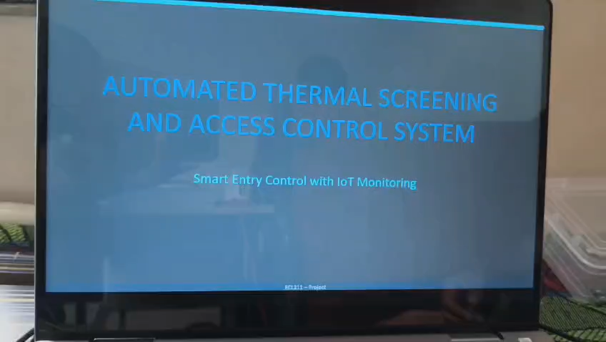

Slide 10
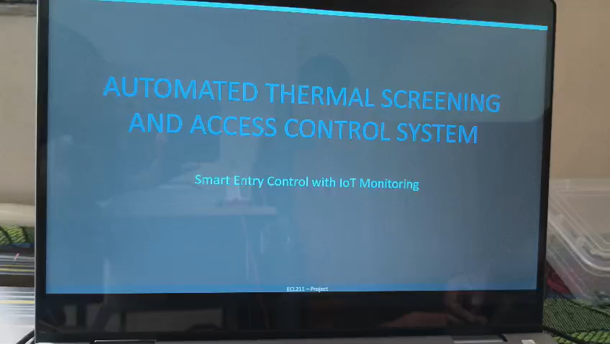
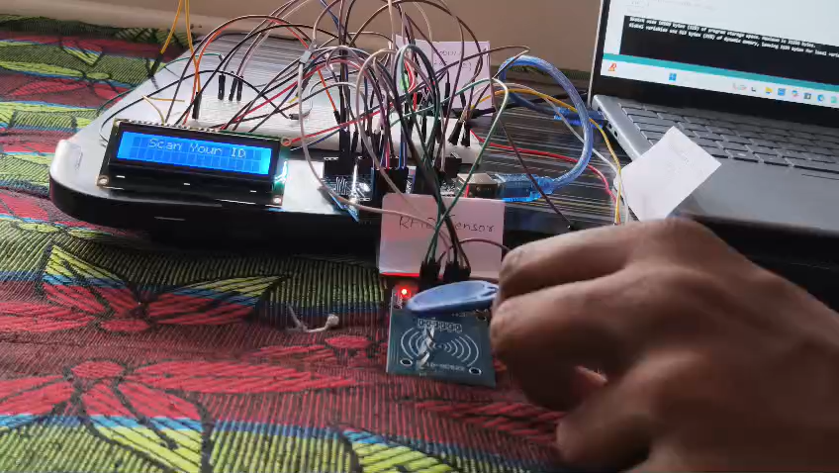
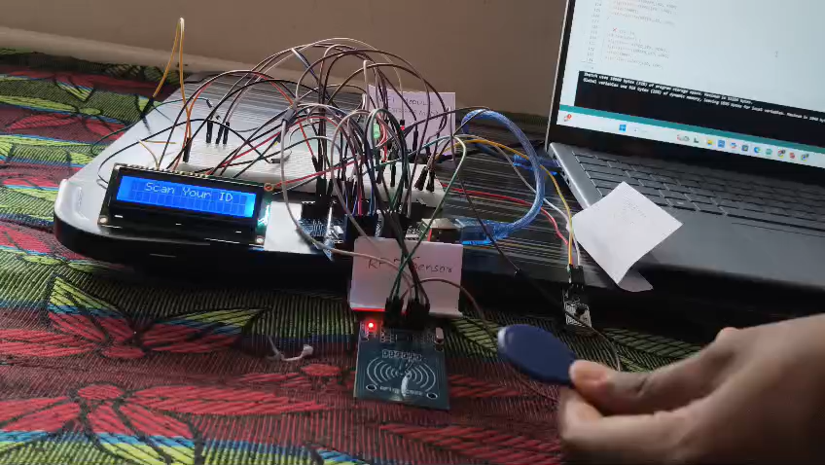

Slide 11
Output Display — LCD & Mobile
📋 Attendance Log
Person1 OK!
37.2C - Welcome!
Person1 - 37.2C (Entered)
✅ Correct ID + Normal Temp
A1B2C3D4 - 38.1C
(Wrong ID)
!! Wrong ID !!
Person1 - 38.5C
(High Temp!)
Denied
❌ Wrong ID
Person1
39.1C High!Denied
❌ Correct ID + High Temp

Slide 12
Project Summary
🪪 RFID Authentication
🌡️ Temperature Check
RFID-RC522 sensor scans cards. Only registered UIDs are allowed entry.
LM35 reads temp via A0. Entry blocked if temp > 37.5°C.
💡 LED Indicators
📺 LCD Display
Green LED = allowed. Red LED = denied. Instant visual feedback.
16x2 LCD shows name, temperature and status in 4-bit mode.
📱 IoT Monitoring
ESP8266 hosts a web page — view attendance log on our phone!
Built with Arduino Uno • RFID-RC522 • LM35 • ESP8266 • LCD 16x2

Slide 13
Thank You!
Team Members:
G. Vinay Varma (B24EC010) | G. Ganesh (B24EC011) | M.V. Sri Teja (B24EC016)
ECL211 Project | Department of Electronics & Communication

