Slide 1
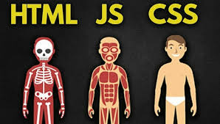
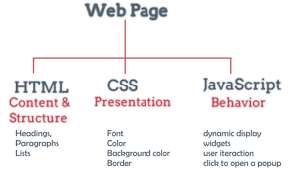
Intro
Subjects
What is HTML?
What is CSS ?
Hands-On

Slide 2
What is HTML?

Slide 3

What is HTML?
Syntax
Structure
Basic elements
Browser differences
Inline vs block
Forms
Head

Slide 4
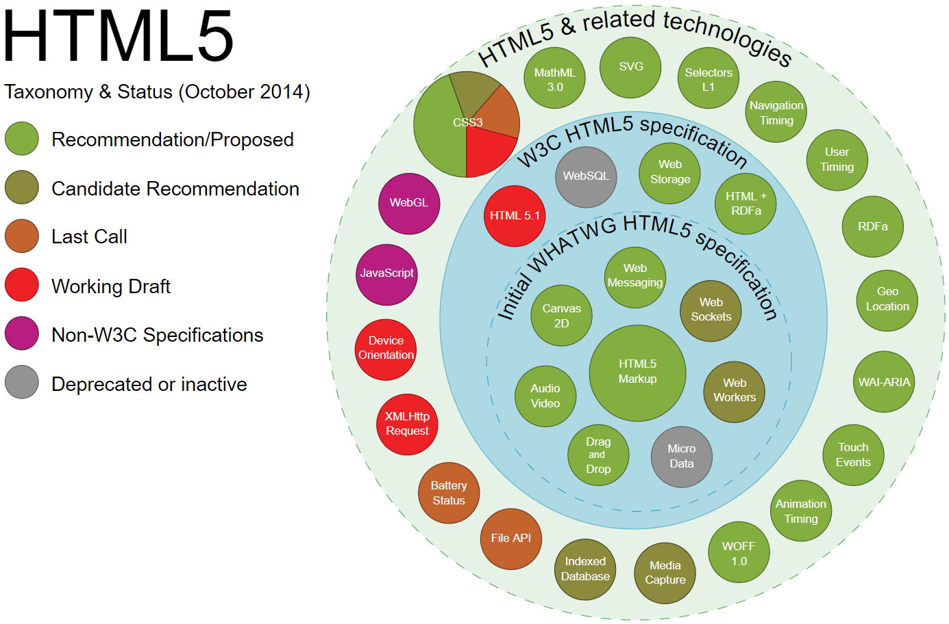

Slide 5
What is CSS?

Slide 7

What is CSS?
Syntax
Selectors
Declaration
Basic selectors
Specificity
Responsive design

Slide 8
What is Javascript?

Slide 9


Slide 10

What is Javascript?
Syntax
Variables & functions
External libs
Common errors

Slide 11
Hands on

Slide 12
Useful links
https://www.w3schools.com/html/default.asp
https://www.w3schools.com/css/default.asp
https://html.com/
https://html.com/css/
https://css-tricks.com/snippets/css/a-guide-to-flexbox/
https://flexboxfroggy.com/
https://www.w3schools.com/js/
https://docs.microsoft.com/en-us/aspnet/core/razor-pages/?view=aspnetcore-5.0&tabs=visual-studio

