Slide 1
Portfolio Summary – AI for Edge and IIoT
Slide 1: Title Slide
Title: Pf_Win_Aung_ITAI3377

Slide 2

Learning Journey Highlights
Explored Edge Computing & IIoT fundamentals using Raspberry Pi and sensors.
Deployed AI models using TensorFlow Lite and Edge Impulse.
Understood real-time AI applications through smart city and factory case studies.
Implemented forecasting using Nixtla and applied generative models for synthetic data.
Analyzed Age of Information (AoI) and reliability trade-offs using machine learning techniques.

Slide 3

Key Projects and Labs
L02: Conceptual AI model deployment using TensorFlow Lite.
L06 & A06: Time-series forecasting with Nixtla and synthetic data via Variational Autoencoder (VAE).
L07: AoI-reliability trade-off explored using Random Forest regression and visualizations.
A13: Designed a medical assistant robot and evaluated its ethical implications.
Capstone: Explored TinyAgents and predictive AI for smart manufacturing systems.

Slide 4

Reflections & Resources
Learned how AI boosts automation, predictive maintenance, and safety in IIoT.
Gained hands-on skills with GitHub, VS Code, Edge Impulse, and Google Colab.
Resources Used:
Nixtla GitHub
Edge Impulse Docs
TensorFlow Lite
Videos & Media:
“Minority Report” for predictive AI storytelling
Brain-computer interfaces and robotics case studies on YouTube
Reflected deeply on AI ethics: privacy, transparency, fairness, job impacts.

Slide 5
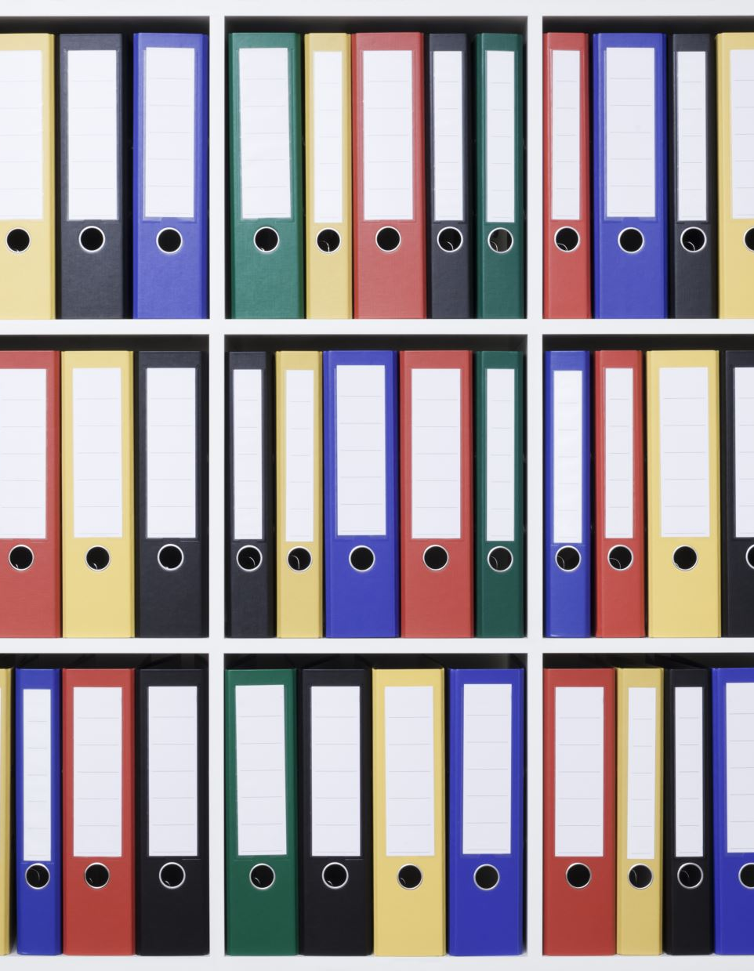
GitHub Portfolio
Repository includes all labs, assignments, reflections, and notebooks.
Organized with clear folders (e.g., /Module01, /Module02, etc.).
Each folder includes code, README, and any associated PDFs or images.
GitHub Link: https://github.com/your-username/ITAI3377-Portfolio (Replace your-username with your actual GitHub username)

