Slide 1

DualFaith at NLPCC-2026 Task 10:
Faithfulness Verification for Scientific Reports
against Experimental Results and Citation Evidence
Wenbiao Zhao* Longkun Shi*
Zicheng Zuo Turdi Tohti
Team：XJDX_001
* Equal contribution
School of Computer Science and Technology, Xinjiang University
Joint International Research Laboratory of Silk Road Multilingual Cognitive Computing
Xinjiang Key Laboratory of Signal Detection and Processing
School of Computer Science and Technology, Xinjiang University
Notes:
Timing: 20 seconds
ENGLISH SPEAKER NOTES
Hello everyone. We are team XJDX_001 from Xinjiang University. I will present DualFaith, our system for verifying scientific reports against experimental results and citation evidence. Our team achieved first place overall, with first place in Track 2 and second place in Track 1.
中文对照翻译（可整段删除）
大家好，我们是来自新疆大学的 XJDX_001 团队。今天介绍 DualFaith：根据实验结果和引用证据验证科研报告忠实性的系统。我们获得综合第一名，其中 Track 2 第一、Track 1 第二。
SOURCES
Source: Final submitted manuscript, 25_DualFaith_at_NLPCC_2026_Tas_Latex Source/main.tex.
Overall rank and score: nlpcc_track2_memories/nlpcc-track2-target-server.md.

Slide 2

1 Task Introduction
Faithfulness depends on the evidence source
 | Track 1: experimental results | Track 2: citation evidence
Input | Results paragraph + figures / tables | Atomic claim + full cited paper
Prediction | One label per sentence | One label + up to 3 paragraph IDs
Labels | Supported Unsupported Causal Mechanistic Unsupported Entity Scope Overgeneralization Contradiction | Supported Overstate Topical Match Irrelevant
Metric | ½ (Macro-F1 + PEM) | ½ (Macro-F1 + Joint@3)
PEM: every sentence in a paragraph must be correct.
Joint@3: the label must be correct and top-3 evidence must hit a gold paragraph.
School of Computer Science and Technology, Xinjiang University
1
Notes:
Timing: 55 seconds
ENGLISH SPEAKER NOTES
Scientific writing can be fluent and still unsupported. The task distinguishes two evidence settings. Track 1 labels every sentence of a results paragraph using figures or tables. Track 2 labels one atomic claim using the cited paper and returns up to three evidence paragraphs. Both scores average Macro-F1 with a stricter metric. Paragraph exact match requires every sentence to be correct. Joint at three requires both the correct label and a gold evidence hit. These metrics make local errors costly and directly motivate our two designs.
中文对照翻译（可整段删除）
科研文本即使流畅，也可能缺乏证据。任务分为两种证据场景：Track 1 根据图表逐句判断结果段落，Track 2 根据被引论文判断原子声明，并返回最多三个证据段落。两个赛道的分数均由 Macro-F1 与一个更严格的指标取平均。PEM 要求整段每句话都正确；Joint@3 要求标签正确且前三个证据命中金标准段落。这使局部错误的代价很高，也直接决定了我们的两套设计。
SOURCES
Source: Final submitted manuscript, 25_DualFaith_at_NLPCC_2026_Tas_Latex Source/main.tex.

Slide 3
1 Task Introduction
Data shifts expose different bottlenecks
Track 1: sparse training errors
Track 2: domain changes
93.7%
Domain (%) | Train / dev | Phase 1 | Phase 2
Physics / Materials | 0.3 | 64.8 | 0.6
CS / AI / ML | 49.3 | 2.2 | 52.8
of training–development sentences
have Supported as the primary label
Only 8 / 3,333 records contain ≥2 minority
sentences in paragraphs of ≥6 sentences.
Topic-holdout Macro-F1 drop
Claim-only: ~2 points
Evidence reader: ~7 points
About 84% of Phase-1 paragraphs
contain at least one minority sentence.
Track 2 domain shares are keyword-based estimates. Only the two main domain groups appear here.
School of Computer Science and Technology, Xinjiang University
2
Notes:
Timing: 60 seconds
ENGLISH SPEAKER NOTES
The two tracks face different distribution problems. In Track 1, Supported accounts for 93.7 percent of primary labels. Only eight long training-development paragraphs contain at least two minority sentences. Yet approximately 84 percent of Phase-1 paragraphs contain a minority sentence. A model can therefore under-detect errors in dense test paragraphs. In Track 2, physics and materials make up almost 65 percent of Phase 1 but less than one percent of training-development data. Phase 2 returns to a computer-science-heavy distribution. In a topic-holdout probe, the claim-only classifier loses about two Macro-F1 points, versus seven for the evidence reader. This suggests that their errors can be complementary.
中文对照翻译（可整段删除）
两个赛道遇到了不同的分布问题。Track 1 的主标签中，Supported 占 93.7%。训练与开发集合中，长段落含至少两句少数类错误的记录只有八条，而 Phase 1 约 84% 的段落包含少数类句子。因此模型容易漏检测试集中密集出现的错误。Track 2 的 Phase 1 中，物理与材料类接近 65%，但训练开发集中不到 1%；Phase 2 又回到计算机学科占主导的分布。在主题留出实验中，仅看声明的分类器 Macro-F1 下降约两分，证据阅读器下降约七分，说明二者可能具有互补性。
SOURCES
Source: Final submitted manuscript, 25_DualFaith_at_NLPCC_2026_Tas_Latex Source/main.tex.

Slide 4
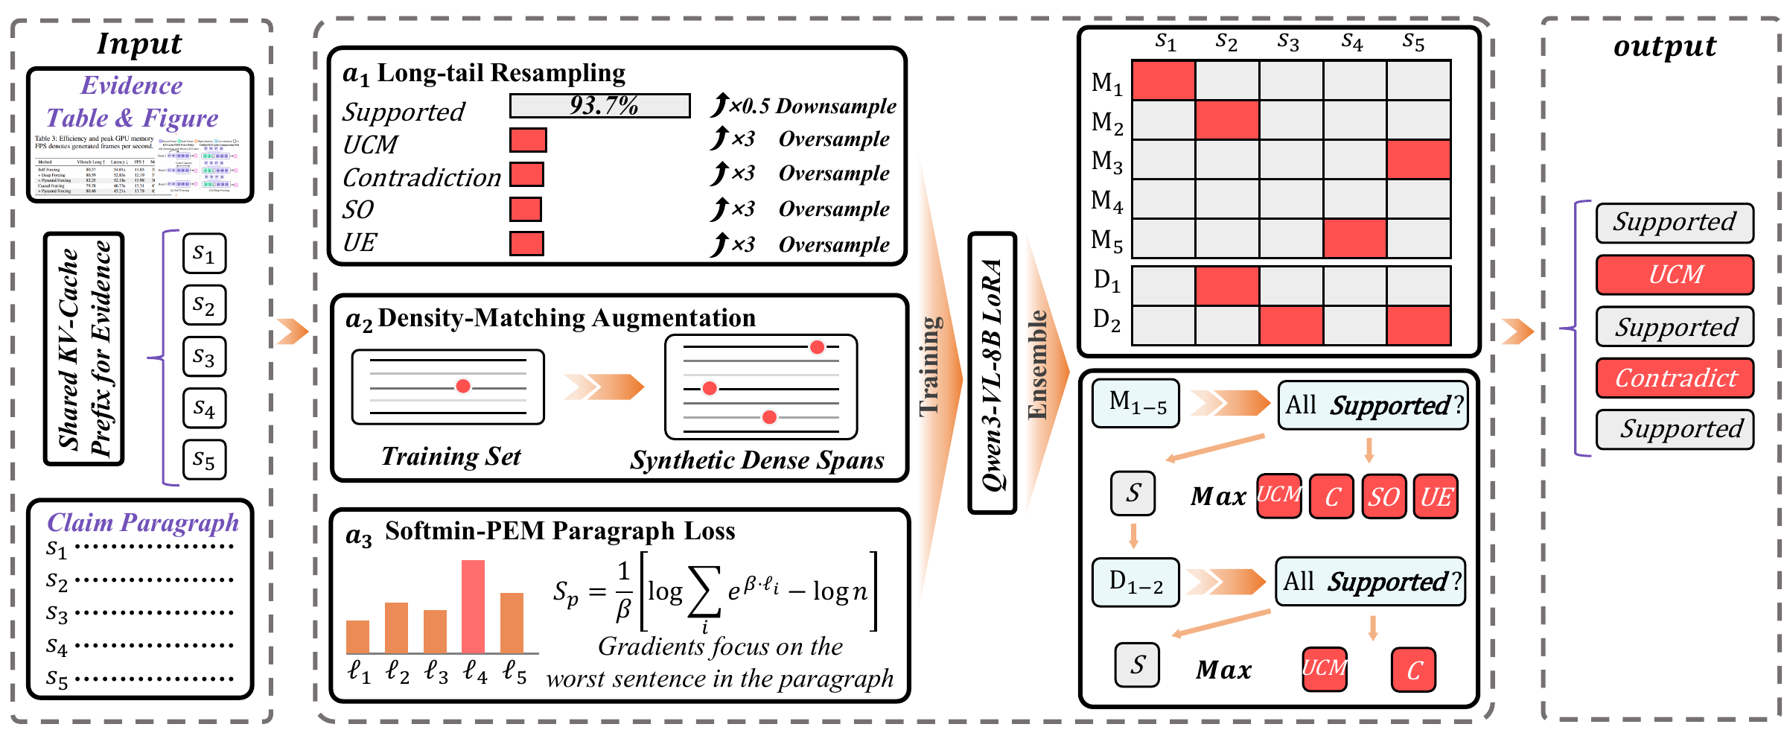
2 Track1 Method
Track 1: sentence-conditioned multimodal verification
School of Computer Science and Technology, Xinjiang University
3
Notes:
Timing: 55 seconds
ENGLISH SPEAKER NOTES
The shared input contains the visual evidence, caption and claim paragraph. Each target sentence defines a prediction unit. We adapt Qwen3-VL-8B with LoRA. Training increases minority-class exposure through resampling, and density-matched examples insert real minority sentences into long paragraphs. The softmin-PEM surrogate puts more emphasis on the sentence most likely to invalidate the paragraph. At inference, a first union combines five members. Two density-augmented members then add selected missing minority predictions. I will explain that decision rule next. The figure summarizes the recipe, while the later ablation distinguishes what we can and cannot attribute to the loss.
中文对照翻译（可整段删除）
共享输入包括图表证据、图注和声明段落，以每个目标句子为预测单位。我们通过 LoRA 适配 Qwen3-VL-8B。训练时通过重采样增加少数类曝光，并把真实少数类句子插入长段落，构造密度匹配数据。softmin-PEM 代理目标更加关注最可能导致整段判错的句子。推理时先融合五个成员，再利用两个密度增强成员补充特定少数类预测。下一页解释融合规则。该图概括最终配方，后续消融会区分哪些效果能归因于损失，哪些不能。
SOURCES
Source: Final submitted manuscript, 25_DualFaith_at_NLPCC_2026_Tas_Latex Source/main.tex.
Figure: track1_figure.pdf in the final manuscript source.

Slide 5
2 Track1 Method
The union preserves minority predictions
Stage 1: five-member union
Predict Supported only when every member agrees.
Otherwise, select the most-voted minority label and break ties toward the rarer class.
Stage 2: selective additions from two density-augmented members
Base prediction | Density-member prediction | Final action
Any minority label | Any label | Keep the base label
Supported | Causal / mechanistic or contradiction | Add the minority label
Supported | Entity or scope error only | Keep Supported
The final minority prediction set contains every minority prediction from Stage 1.
School of Computer Science and Technology, Xinjiang University
4
Notes:
Timing: 50 seconds
ENGLISH SPEAKER NOTES
The first-stage rule is deliberately recall-oriented. A sentence remains Supported only if all five members agree. Otherwise, we choose the minority label with the most votes, breaking ties toward the rarer label. The second stage never removes a minority label already found. It only changes remaining Supported positions when a density-augmented member predicts an unsupported causal explanation or a contradiction. We do not add entity or scope errors at this stage because class-wise ablations showed that those extra predictions mostly became false positives. This is selective recall expansion, rather than an unrestricted union of every model output.
中文对照翻译（可整段删除）
第一阶段的规则以召回为导向：仅当五个成员一致时才保留 Supported，否则选择票数最多的少数类，平票时偏向更稀有的类别。第二阶段不删除已经发现的少数类标签，只在仍为 Supported 的位置补入不受支持的因果机制或矛盾类。此时不补入实体或范围错误，因为分类消融显示这两类额外预测大多会成为假阳性。因此这是有选择地增加召回，而不是无条件并入所有模型的结果。
SOURCES
Source: Final submitted manuscript, 25_DualFaith_at_NLPCC_2026_Tas_Latex Source/main.tex.

Slide 6
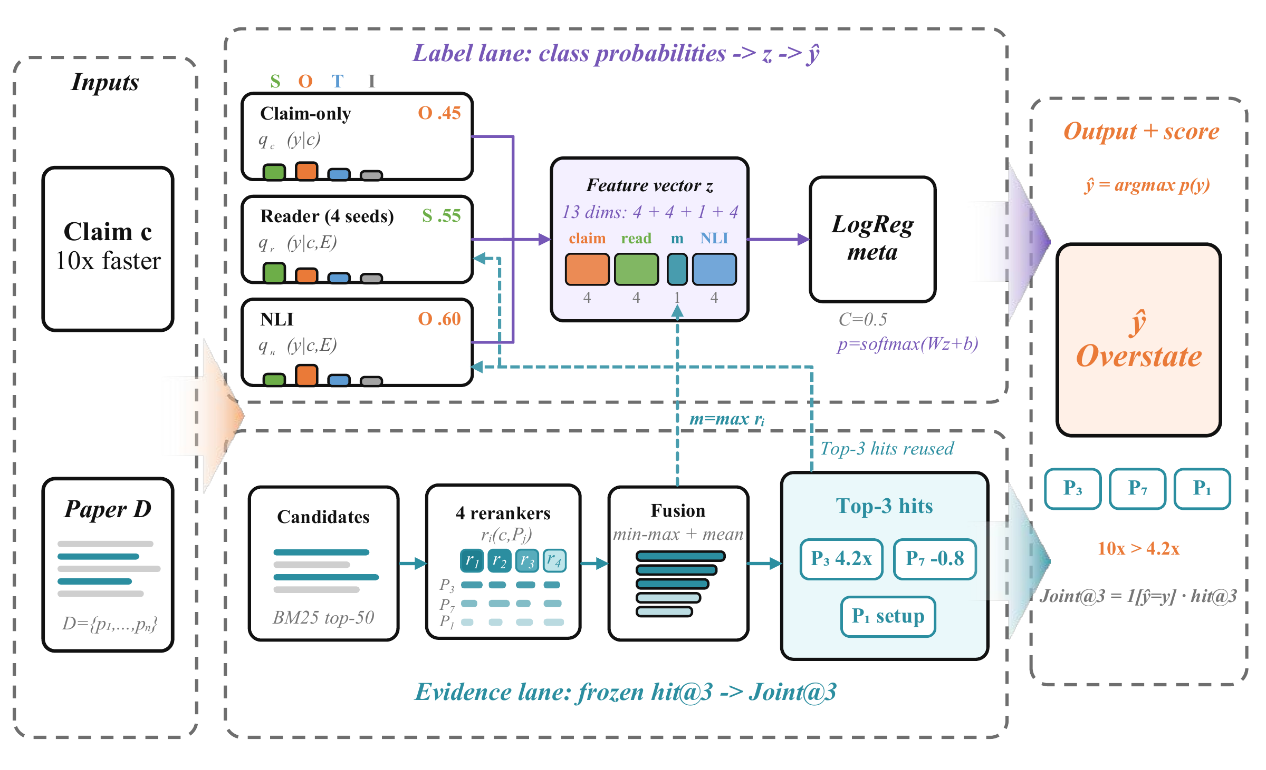
3 Track2 Method
Track 2: frozen evidence with label stacking
Evidence
BM25 top-50
Four rerankers
Normalize and average
Freeze top-3 paragraphs
Labels
Evidence reader
Claim-only classifier
Frozen NLI signal
Logistic regression
School of Computer Science and Technology, Xinjiang University
5
Notes:
Timing: 60 seconds
ENGLISH SPEAKER NOTES
Track 2 separates evidence retrieval from label prediction. BM25 first selects fifty candidate paragraphs. Four rerankers score them. We normalize scores within each record and average them to obtain a top-three evidence list. We then freeze that list. On the label side, we combine an evidence reader, a claim-only classifier and a frozen external NLI signal. A logistic-regression classifier receives their probability vectors together with the maximum fused evidence score. The schematic example shows why this helps: a claim of a tenfold speedup can overstate evidence showing only a 4.2-fold improvement. Those example values illustrate the architecture, rather than a measured case result.
中文对照翻译（可整段删除）
Track 2 将证据检索和标签预测分开。BM25 先选出五十个候选段落，四个重排序器分别评分，在每条记录内归一化后取平均，得到前三个证据段落，并冻结这份列表。标签侧结合证据阅读器、仅看声明的分类器和冻结的外部 NLI 信号。逻辑回归接收这些概率向量和最大的融合证据分数。图中的示例展示了作用：声明声称十倍加速，但证据只有 4.2 倍，应判断为夸大。这些数值用于解释架构，不是实际案例的测量结果。
SOURCES
Source: Final submitted manuscript, 25_DualFaith_at_NLPCC_2026_Tas_Latex Source/main.tex.
Figure: track2_figure.pdf in the final manuscript source.

Slide 7
3 Track2 Method
Complementary signals correct the citation label
Signal | What it reads | Role
Evidence reader DeBERTa-v3-large, 4 seeds | Claim + top-3 evidence | Task-specific support judgment
Claim-only classifier | Claim text | Claim-side regularities under shift
Frozen tasksource-NLI | Evidence as premise Claim as hypothesis | External entailment signal
Maximum fused score | Reranker scores | Evidence relevance strength
Logistic regression combines the signals while the evidence list stays fixed.
Claim-only predictions complement the evidence reader but may depend on writing style.
School of Computer Science and Technology, Xinjiang University
6
Notes:
Timing: 50 seconds
ENGLISH SPEAKER NOTES
Each signal has a different role. The four-seed DeBERTa reader models the relationship between the claim and the retrieved evidence. The claim-only classifier captures wording regularities without directly reading an out-of-domain document. Frozen tasksource-NLI contributes an external entailment signal, and the maximum fused score summarizes evidence relevance. Logistic regression learns how to combine them. The claim-only branch is an auxiliary signal, not a replacement for evidence. Its benefit may depend on the style of these claims, so transfer to human-written claims remains an open limitation.
中文对照翻译（可整段删除）
每个信号承担不同角色。四种随机种子的 DeBERTa 阅读器建模声明与检索证据的关系；仅看声明的分类器捕捉措辞规律，避免直接暴露于跨领域论文；冻结的 tasksource-NLI 提供外部蕴含信号；最大融合分数概括证据相关性。逻辑回归学习这些信号的组合方式。仅看声明的分支是辅助信号，不能替代证据，它的收益可能依赖当前声明的写作风格，因此迁移到人类撰写声明仍需验证。
SOURCES
Source: Final submitted manuscript, 25_DualFaith_at_NLPCC_2026_Tas_Latex Source/main.tex.

Slide 8
4 Experiments
Official results: first overall and first in Track 2
Overall score 77.5315
Team XJDX_001 / DualFaith
Track 1: 2nd / 11 teams
Track 2: 1st / 15 teams
System | Final | Phase 1 | Phase 2
SUAT-NLP | 68.90 | 51.85 | 85.95
DualFaith | 68.79 | 50.61 | 86.97
BIT-TrustAI | 57.99 | 44.09 | 71.88
System | Final | Macro-F1 | Joint@3
DualFaith | 86.27 | 91.18 | 81.37
Lenormand | 82.99 | 89.55 | 76.43
HER-DAC | 81.61 | 93.05 | 70.16
0.11 points behind first place
+3.28 score and +4.94 Joint@3 vs. 2nd
Final scores average both phases. Macro-F1 and Joint@3 in the right table are two-phase aggregates.
School of Computer Science and Technology, Xinjiang University
7
Notes:
Timing: 55 seconds
ENGLISH SPEAKER NOTES
These are the official results. Our combined score is 77.5315, ranking first overall. Track 1 ranks second among eleven teams, just 0.11 points behind the winner. Its blind Phase-2 score is 86.97. Track 2 ranks first among fifteen teams with 86.27, a 3.28-point lead over second place. Its Joint at three score is 4.94 points higher than second place. Notice that HER-DAC has a higher Macro-F1 than ours, but a much lower Joint at three score. This comparison shows why a strong label classifier alone is insufficient for this task.
中文对照翻译（可整段删除）
这是官方结果。我们的综合分数为 77.5315，排名第一。Track 1 在十一支队伍中排名第二，距离第一名只有 0.11 分，盲测 Phase 2 得分 86.97。Track 2 在十五支队伍中以 86.27 分排名第一，领先第二名 3.28 分，Joint@3 领先第二名 4.94 分。请注意 HER-DAC 的 Macro-F1 高于我们，但 Joint@3 明显更低，这说明单靠强标签分类器不足以解决这个任务。
SOURCES
Source: Final submitted manuscript, 25_DualFaith_at_NLPCC_2026_Tas_Latex Source/main.tex.
Combined ranking: nlpcc_track2_memories/nlpcc-track2-target-server.md. Tables: final manuscript, Official Track 1 results and Track 2 leaderboard.

Slide 9
4 Experiments
Track 1: recall union gives consistent gains
Phase-1 score by union size
Controlled loss comparison
Data setting | Softmin | Plain CE
No oversampling | 34.21 | 38.68
Same oversampled data | 39.14 | 42.87
The best single scores 47.80 with
softmin and stronger downsampling.
The data recipe differs.
253 to 399 minority predictions
The best single-model result does not isolate the effect of softmin-PEM. All scores on this slide are Phase 1.
School of Computer Science and Technology, Xinjiang University
8
Notes:
Timing: 60 seconds
ENGLISH SPEAKER NOTES
The left chart follows the recall-union progression. The best single model scores 47.80. Combining five members reaches 50.26, and the final selective density augmentation reaches 50.61. Minority predictions increase from 253 to 399. However, we should distinguish this ensemble evidence from claims about the loss. In controlled comparisons, plain cross-entropy beats softmin both without oversampling and on the same oversampled data. The best single model uses softmin with stronger Supported downsampling, so its 47.80 score does not isolate the loss effect. Our strongest transferable finding is the benefit of complementary minority recall under the selected data recipe.
中文对照翻译（可整段删除）
左图展示召回并集的逐步收益：最佳单模型得分 47.80，五成员并集达到 50.26，最终选择性密度增强达到 50.61，少数类预测数量由 253 增至 399。但应区分集成证据和损失函数的独立贡献。在受控比较中，无过采样和相同过采样数据两种设置下，普通交叉熵都优于 softmin。最佳单模型虽然使用 softmin，但还采用了更强的 Supported 下采样，所以 47.80 的结果无法单独证明损失函数收益。最可迁移的结论是在选定数据配方下，互补的少数类召回能带来收益。
SOURCES
Source: Final submitted manuscript, 25_DualFaith_at_NLPCC_2026_Tas_Latex Source/main.tex.

Slide 10
4 Experiments
Track 2: label stacking adds 3.11 points
Identical evidence lists across all three systems
Phase-1 label system | Score | Macro-F1 | Joint@3
Four-seed evidence reader | 83.10 | 87.02 | 79.19
+ Claim-only mixture | 85.10 | 89.41 | 80.79
+ NLI and meta-classifier | 86.21 | 90.46 | 81.96
+2.00
+1.11
86.21 / 86.33
Claim-only mixture
NLI + meta-classifier
Phase 1 / blind Phase 2
School of Computer Science and Technology, Xinjiang University
9
Notes:
Timing: 60 seconds
ENGLISH SPEAKER NOTES
This ablation freezes the evidence list, so score improvements come from the label side. The four-seed reader starts at 83.10. Adding the claim-only mixture gives two points. Adding the NLI feature and logistic-regression meta-classifier gives another 1.11 points, for a total gain of 3.11. Both Macro-F1 and Joint at three improve because the labels become correct on records whose evidence was already retrieved. The final system scores 86.21 in Phase 1 and 86.33 in blind Phase 2, despite the different domain composition. Changing the fusion function or adding a fifth reranker did not improve selection results.
中文对照翻译（可整段删除）
该消融固定了证据列表，因此分数提升来自标签侧。四种种子阅读器的起点是 83.10，加入仅看声明的混合信号增加两分，再加入 NLI 特征和逻辑回归元分类器增加 1.11 分，总计提升 3.11 分。Macro-F1 和 Joint@3 同时提升，是因为原先已检索到正确证据的记录现在也得到了正确标签。尽管领域构成不同，最终系统在 Phase 1 得到 86.21，在盲测 Phase 2 得到 86.33。更换证据融合函数或增加第五个重排序器都没有带来选型收益。
SOURCES
Source: Final submitted manuscript, 25_DualFaith_at_NLPCC_2026_Tas_Latex Source/main.tex.

Slide 11
4 Experiments
What carries across the two tracks
Track 1
Minority recall and paragraph exact match shape the ensemble.
Selective unions recover errors that individual models miss.
Track 2
Strong evidence retrieval makes label correction valuable.
Complementary signals improve stability under domain shift.
Limitations
Track 1: incomplete reconstruction of the best recipe and PEM nondeterminism.
Track 2: 433-record development set and claim-style dependence.
Next steps: stronger validation, evidence alignment and transfer to human-written claims.
School of Computer Science and Technology, Xinjiang University
10
Notes:
Timing: 55 seconds
ENGLISH SPEAKER NOTES
Our main lesson is to design around the error structure of the metric and the data. For Track 1, minority recall and paragraph exact match motivate selective recall unions. For Track 2, reliable retrieval makes label correction worthwhile, and complementary signals help across domains. Several larger or more complex alternatives failed to improve selection, including higher-resolution or chain-of-thought variants in Track 1 and domain adaptation or more seeds in Track 2. There are also limitations: incomplete reconstruction of the best Track-1 recipe and nondeterminism in PEM, plus a small development set and style dependence in Track 2. Better validation and transfer to human-written claims are important next steps.
中文对照翻译（可整段删除）
主要经验是围绕指标和数据中的错误结构进行设计。Track 1 的少数类召回和段落精确匹配促使我们采用选择性召回并集；Track 2 的可靠检索使标签修正有价值，多种互补信号帮助系统应对领域变化。一些更大或更复杂的方案未改善选型结果，例如 Track 1 的更高分辨率、思维链变体，以及 Track 2 的领域适应、更多种子。局限包括 Track 1 最佳配方不能完整重建及 PEM 的非确定性，还有 Track 2 较小的开发集和对声明风格的依赖。未来需要加强验证，并测试向人类撰写声明的迁移。
SOURCES
Source: Final submitted manuscript, 25_DualFaith_at_NLPCC_2026_Tas_Latex Source/main.tex.

Slide 12
Thank you
Questions & discussion
Team：XJDX_001
turdy@xju.edu.cn
School of Computer Science and Technology, Xinjiang University
Joint International Research Laboratory of Silk Road Multilingual Cognitive Computing
Xinjiang Key Laboratory of Signal Detection and Processing
School of Computer Science and Technology, Xinjiang University
Notes:
Timing: 20 seconds
ENGLISH SPEAKER NOTES
Thank you for your attention. We thank the shared-task organizers and our collaborators. We are happy to discuss the retrieval design, the recall-union strategy and the limitations of our validation.
中文对照翻译（可整段删除）
感谢大家聆听，感谢评测组织者和合作者。欢迎讨论证据检索设计、召回并集策略及验证方面的局限。
SOURCES
Source: Final submitted manuscript, 25_DualFaith_at_NLPCC_2026_Tas_Latex Source/main.tex.

