Slide 1

COMP1300
Group Presentation
Dr Sarah Hewitt

Slide 2
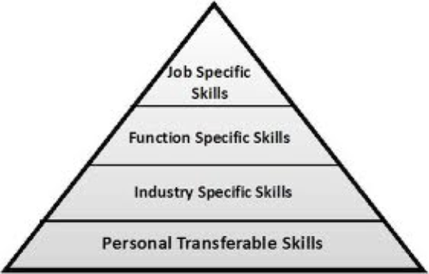
Sales Pitch to potential customer
Conference presentation
Technology upgrade pitch to your team
Project Progress report to management
Specification summary discussion with a customer

Slide 3

Objectives
To introduce you to some guidelines for making presentations and to prepare you to learn for yourself how to make an excellent presentation;
To prepare you (mentally) for the task of making a short presentation;
To understand some aspects of successful teamwork (under a bit of time pressure!);
To help you to refine your learning through applying your critical skills.

Slide 4
Coursework Guidance
All coursework guidance, hand-ins and feedback will be on Moodle
Lectures will be available as recordings on Moodle
Hand-ins must be submitted by everyone in the group except
Peer review hand-ins are individual

Slide 5
Timeline
Week 18
Week 21
Week 22
Groups released & confirmed
Team Write Summary and Plan
Groups allocated topic
Teams get feedback
Team
Hand-in
Team
Hand-in

Slide 6
Timeline
Week 23
Weeks 24-26
Team Make Presentation
Team Produce Final Presentation & hand-in
Team Peer Review other presentations
Team
Hand-in

Slide 7
Presentation FAQs
The presentation timetable will be published on Moodle.
Presentations last 10 minutes + 5 minutes for questions from the audience
Presentations will be in the lab space
There may be some immediate feedback if time allows

Slide 8
Presentation FAQs
You have hand-ins prior to the presentation - to pace you through the work
  By Friday 13th February 4pm: Summary & Plan;
  By Friday 7th March: Complete set of slides (videos must ne replaced with links).
  Each person in the group must hand-in.

Slide 9
Presentation FAQs
Presentations can be compiled using powerpoint or similar
Final hand-in will be at the end of the week prior to the presentations (end of week 23)
Each slide set must have a first slide including the title, group number and photo;
All participants in the group must be clearly identified;
Presentations will be made during weeks 24, 25 and 26
Every group participant will make a contribution.

Slide 10
Presentation FAQs
Marks are:
  10% from Interim Hand-in;
  80% from Presentation;
  10% Your contribution to Peer Reviews;
Interim hand-in:
  Feedback on your interim hand-in will be a mark and a summative comment.
  There will also be general whole class feedback;
  Everyone must hand in a plan

Slide 11
Presentation FAQs
Presentations will be marked by course lecturers (80%) using the published marking scheme in Moodle;
  This will produce a group mark.
Time permitting, you will be given immediate direct verbal feedback as a group:
  after the presentation and during the allocated presentation slot;
  and written feedback later.

Slide 12
Presentation FAQs
You will also gain a further contributory individual mark by participating in the review process, for which you will be allocated a slot;
You will use the standard mark sheet to create your review mark;
You will submit your marks online via Moodle;
The quality of your peer review will be marked;
You are welcome to attend any of the presentations;
All of them are relevant to your studies!

Slide 13
Why Peer Review?
Observing someone else’s efforts is often a good way to learn what works and what does not.
Learning to be CRITICAL: “exercising careful judgment or judicious evaluation”.
A chance to calibrate your judgement against others.
Providing a supportive and attentive audience.

Slide 14
Guidance
Check the Moodle pages;
Do your own background reading on how to present effectively;
Get motivated! https://youtu.be/UbCUTtzCic0 ;
Think about your audience;
Build a clear narrative structure https://www.youtube.com/watch?v=f7AfnJd55PI .

Slide 15
Teamwork
Get your team together asap
Group or team work means working as a group together, at the same time
  Don’t allocate slides to individuals and leave them to get on with it
  Discuss and plan together
Understand that if your team has a weaker member our assessment will not be marking you down for this. Rather it will be marking you up for how well you manage as a team.

Slide 16

Future Lectures
Group planning
How to work successfully as a team
General feedback
The peer review process

