Slide 1
Distributed Computing using MPI
Distributed and Parallel Technology
Yun Wu

Slide 2
Course Overview
Reunion
Version history, MPI in nutshell, objectives
Thinking in distribution
Quick review of hardware architecture organization
Message passing model and programming, compiling and execution
Immersed in the story
MPI implementation: data types, APIs
MPI operations: point-to-point, collective
MPI performance profiling
Advancing
Distributed programming: matrix multiplication
Introduction about hybrid parallel programming

Slide 3

Reunion

Slide 4
Version History
The story began in summer of 1991 when a small group of researchers started discussions of standards for message passing in a distributed memory environment at a mountain retreat in Austria.
Early:
The first release of version 1.0 is open to public in June 1994.
The next significant versions 1.3 and 2.1 are both approved in July and September 2008
Recent:
It reach version 3.0 in September 2012 and upgraded to 3.1 in June 2015
The version 4.0 was successfully approved by the MPI Forum on June 9, 2021
Current – still active:
After the version 4.1 announced on November 22 2021, the version 5.0 is on the agenda to address the need of current and next generation applications and architectures
Since MPI was invented, several variances of MPI implementations are developing in parallel:
OpenMPI, MPICH, MVAPICH, IMPI (Intel MPI), etc.
MPI
IMPI
MVAPICH
OpenMPI
MPICH
Others

Slide 5
MPI in Nutshell
MPI stands for Message Passing Interface
Extended message-passing model
Not a language or compiler specification
Not a specific implementation or product
Targeted for parallel computers, clusters, and network of workstations
Specified in C, C++, Fortran 77, F90
Message passing is a mature parallel programming model
MPI provides a powerful, efficient, and portable way to express parallel programs
MPI was explicitly designed to enable libraries, which only need to learn its robust implementation

Slide 6
Course Objectives
Introduction to the parallel architecture and MPI
Cover the basic message passing standard
Familiar with MPICH C implementation, mainly till Ver. 3.0.4
Focus on MPICHv3 programming for CPU cluster only
After completion of this course, you should be ready to begin parallelizing your application and distribute workload through MPICHv3

Slide 7
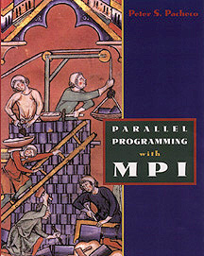
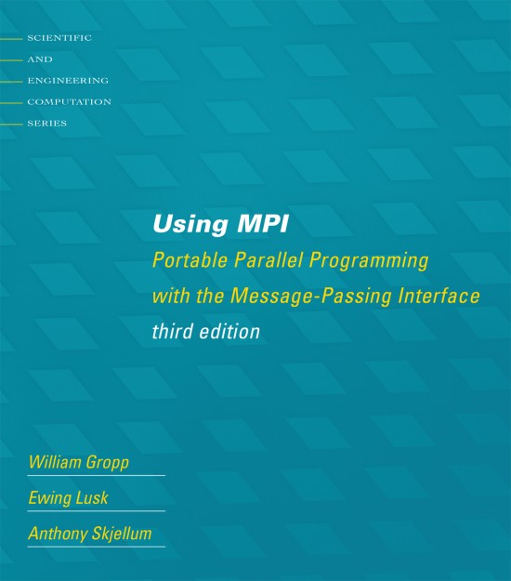
Supplementary Materials
Official MPI documents:
https://www.mpi-forum.org/docs/
Online MPI tutorial:
https://mpitutorial.com/tutorials/
Parallel Programming with MPI, by Peter Pacheco, 1996. (updated to MPI 1.1 in 2002)
Using MPI: Portable Parallel Programming with the Message-Passing Interface, 3rd ed., by William Gropp, Ewing Lusk and Anthony Skjellum, 2014. (updated to MPI 3.0 in third edition)

Slide 8

Hello World
#include <stdio.h>
#include <mpi.h>
int main(int argc, char** argv){
// Initialize the MPI environment
MPI_Init(NULL, NULL);
// Print off a hello world message
printf("Hello world \n");
// Finalize the MPI environment.
MPI_Finalize();
return 0;
}
mpicc –cflag binary ./myprogm
mpirun -n <# of processes> ./myprogm

Slide 9
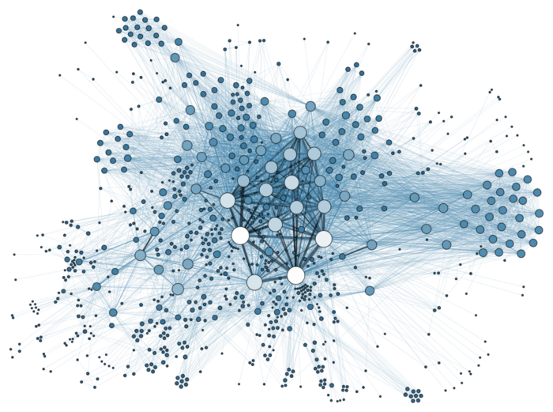
Thinking in Distribution

Slide 10
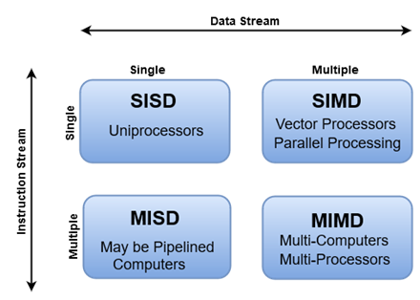
Recap Hardware Parallelism
Instruction-Level Parallelism (ILP)
Data parallelism
Increase amount of data to be operated on at same time
Processor parallelism
Increase number of processors
Memory system parallelism
Increase number of memory units
Increase bandwidth to memory
Communication parallelism
Increase amount of interconnection between elements
Increase communication bandwidth

Slide 11
Recap Parallel Architecture
Uniprocessor
Scalar processor
Vector processor
Single Instruction Multiple Data (SIMD)
Shared Memory Multiprocessor (SMP)
Shared memory address space
Bus-based memory system
Interconnection network
processor
e.g. single core processor
memory
processor
…
processor
bus
e.g. Intel Xeron Phi accelerator
processor
vector
e.g. intel 12th gen
Performance core
memory
memory
processor
…
processor
e.g. Remote Direct Memory Access (RDMA) systems
network
…
processor
e.g. ARM cortex-a with NEON accelerator
memory
…
memory

Slide 12
Recap Parallel Architecture
Distributed Memory Multiprocessor
Message passing between nodes
Massively Parallel Processor (MPP)
Many, many processors
Cluster of SMPs
Shared memory addressing within SMP node
Message passing between SMP nodes
Can also be regarded as MPP if processor number is large
memory
memory
…
processor
processor
e.g. IBM blue gene
M
M
…
…
interconnection network
P
…
P
P
P
network
interface
e.g. Intel Xeron phi server
processor
processor
interconnection network
…
memory
memory
P
…
P
P
…
P
…
M
M

Slide 13
Recap Parallel Architecture
Multicore
Multicore processor
GPU accelerator
Heterogenous SoC
Multicore SMP+GPU Cluster
Shared memory addressing within SMP node
Message passing between SMP nodes
GPU accelerators attached
C
C
C
C
m
m
m
m
Most modern CPU, cores can be hardware multithreaded (hyper-thread)
memory
M
…
M
…
processor
PCI
P
P
P
P
…
memory
Most modern CPU & discrete GPU Systems
e.g. ARM cortex-x server
interconnection network
P
…
P
P
…
P
processor
Most modern CPU & integrated GPU Systems
M
…
M
memory

Slide 14
Single Program Multiple Data (SPMD)
SPMD on shared memory
SPMD on distributed memory
~~~~~
~~~
~~~~
~~
~~~~~
~~~
~~~~
~~
~~~~~
~~~
~~~~
~~
~~~~~
~~~
~~~~
~~
~~~~~
~~~
~~~~
~~
~~~~~
~~~
~~~~
~~
~~~~~
~~~
~~~~
~~
MPI on both
~~~~~
~~~
~~~~
~~

Slide 15
Message Passing Model
A process is a program counter and address space
Processes can have multiple threads (program counters and associated stacks) sharing a single address space
MPI is for communication among processes
Not threads
Inter-process communication consists of
Synchronization
Data movement
process
P1
P2
P3
P4
thread
address space (memory)

Slide 16
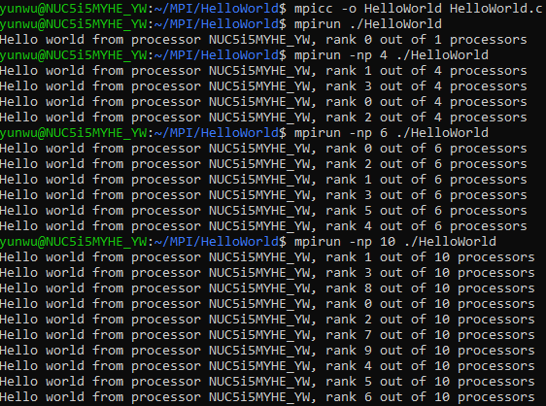
Hello World
#include <stdio.h>
#include <mpi.h>
int main(int argc, char** argv){
// Initialize the MPI environment
MPI_Init(NULL, NULL);
// Get the number of processes
int world_size;
MPI_Comm_size(MPI_COMM_WORLD, &world_size);
// Get the rank of the process
int world_rank;
MPI_Comm_rank(MPI_COMM_WORLD, &world_rank);
// Get the name of the processor
char processor_name[MPI_MAX_PROCESSOR_NAME];
int name_len;
MPI_Get_processor_name(processor_name, &name_len);
// Print off a hello world message
printf("Hello world from processor %s, rank %d out of %d processors\n", processor_name, world_rank, world_size);
// Finalize the MPI environment.
MPI_Finalize();
return 0;
}

Slide 17
Programming Model
Defined by explicit communication requirements
Data communication (necessary for algorithm)
Control communication (necessary for dependencies)
Program behavior is driven by communication patterns
User has full control of data partition and distribution
Message passing infrastructure attempts to support the forms of communication, which are most often used or desired for
Basic forms provide functional access
Can be used most often
Complex forms provide higher-level abstractions
Serve as basis for extension
Example: graph libraries, meshing libraries, …
Extensions for greater programming power

Slide 18

Hello World
#include <stdio.h>
#include <mpi.h>
int main( int argc, char *argv[] )
{
int numprocs, myrank, namelen, i;
char processor_name[MPI_MAX_PROCESSOR_NAME];
char greeting[MPI_MAX_PROCESSOR_NAME + 80];
MPI_Status status;
MPI_Init( &argc, &argv );
MPI_Comm_size( MPI_COMM_WORLD, &numprocs );
MPI_Comm_rank( MPI_COMM_WORLD, &myrank );
MPI_Get_processor_name( processor_name, &namelen );
sprintf( greeting, "Hello, world, from process %d of %d on %s",
myrank, numprocs, processor_name );
if ( myrank == 0 ) {
for ( i = 1; i < numprocs; i++ ) {
MPI_Recv( greeting, sizeof( greeting ), MPI_CHAR, i, 1, MPI_COMM_WORLD, &status );
printf( "%s\n", greeting );
}
}else{
MPI_Send( greeting, strlen( greeting ) + 1, MPI_CHAR, 0, 1, MPI_COMM_WORLD );
}
MPI_Finalize( );
return 0;
}
Each process there is a message
Message is received all the processes, except process 0
Message is sent to process 0 from all the other processes

Slide 19

Compiler
mpicc (MPICH implementation)
A wrapper around certain set of compilers in the systems
Used to compile and link MPI programs written in C
Support standard C compiler flags
The environment variable MPICH_CC may be used to select different C compiler and linker

Slide 20
Execution
Unix, Linux, MacOS
mpirun (non-standard), mpiexec (standard)
Windows OS
Microsoft MPI, Visual Studio
Mostly used:
mpiexec (https://www.mpich.org/static/docs/v3.1/www1/mpiexec.html)
-n (or np) Specify the number of processes to use
-host (or hostname) Name of host on which to run processes
Etc.

Slide 21

Immersed Into Story

Slide 22
MPI C Data Types
MPI_CHAR - char
MPI_SIGNED_CHAR - signed char
MPI_UNSIGNED_CHAR - unsigned char
MPI_BYTE - See standard; like unsigned char
MPI_WCHAR - wide character (wchar_t)
MPI_SHORT - short
MPI_UNSIGNED_SHORT - unsigned short
MPI_INT - int
MPI_UNSIGNED - unsigned int
MPI_LONG - long
MPI_UNSIGNED_LONG - unsigned long
MPI_LONG_LONG_INT - long long
MPI_LONG_LONG - synonyn for MPI_LONG_LONG_INT
MPI_UNSIGNED_LONG_LONG - unsigned long long
MPI_FLOAT - float
MPI_DOUBLE - double
MPI_LONG_DOUBLE - long double (some systems may not implement this)
MPI_INT8_T - int8_t
MPI_INT16_T - int16_t
MPI_INT32_T - int32_t
MPI_INT64_T - int64_t
MPI_UINT8_T - uint8_t
MPI_UINT16_T - uint16_t
MPI_UINT32_T - uint32_t
MPI_UINT64_T - uint64_t
MPI_C_BOOL - _Bool
MPI_C_FLOAT_COMPLEX - float _Complex
MPI_C_COMPLEX - float _Complex
MPI_C_DOUBLE_COMPLEX - double _Complex
MPI_C_LONG_DOUBLE_COMPLEX - long double _Complex

Slide 23
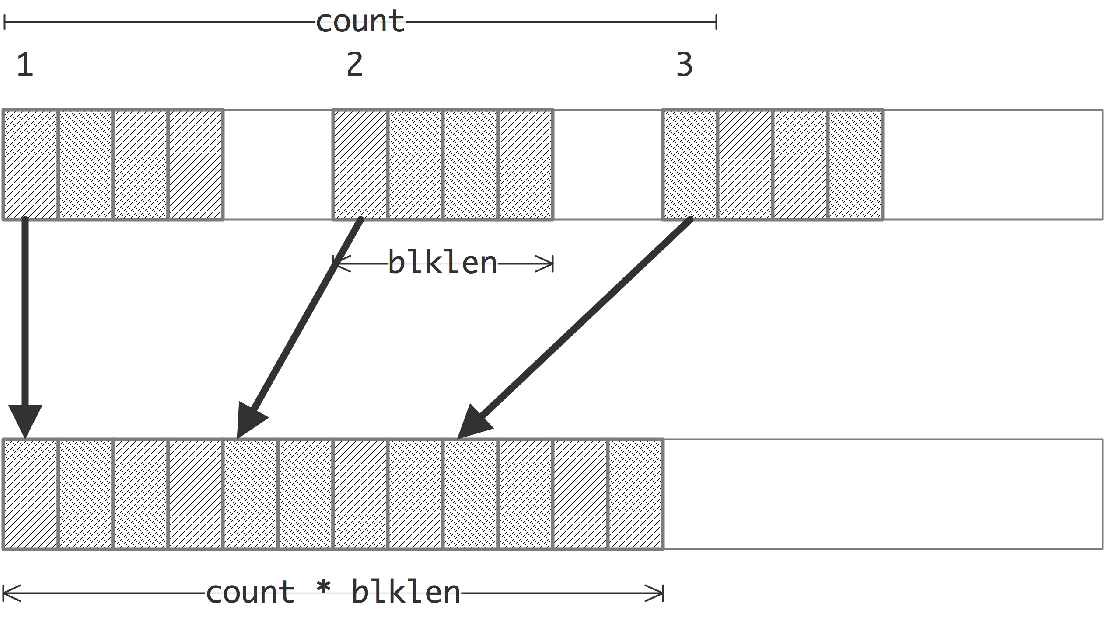
MPI_PACKED Data Types
Packs data of a given datatype into contiguous memory:
int MPI_Pack(
void* inbuf, // input buffer start (choice)
int incount, // number of input data items (integer)
MPI_Datatype datatype, // datatype of each input data item (handle)
void *outbuf, // output buffer start (choice)
int outsize, // output buffer size, in bytes (integer)
int *position, // current position in buffer, in bytes (integer)
MPI_Comm comm) // communicator for packed message (handle)
dealing with non-contiguous data
Unpacks a datatype into contiguous memory:
int MPI_Unpack(
void* inbuf, // input buffer start (choice)
int insize, // size of input buffer, in bytes (integer)
int *position, // current position in bytes (integer)
void *outbuf, // output buffer start (choice)
int outcount, // number of items to be unpacked (integer)
MPI_Datatype datatype, // datatype of each output data item (handle)
MPI_Comm comm) // communicator for packed message (handle)
Unpack a receive process

Slide 24

MPI_PACKED Data Types
… …
float value = 10; char name[STRLEN];
sprintf(name, "My Name");
int param = 1;
/* now let's pack all those values into a single message */
MPI_Pack(&value, 1, MPI_FLOAT, message, BUFFSIZE, &position, MPI_COMM_WORLD);
/* position has been incremented to first free byte in the message.. */
MPI_Pack(name, STRLEN, MPI_CHAR, message, BUFFSIZE, &position, MPI_COMM_WORLD);
/* position has been incremented again.. */
MPI_Pack(&param, 1, MPI_INT, message, BUFFSIZE, &position, MPI_COMM_WORLD);
MPI_Send(message, BUFFSIZE, MPI_PACKED, 1, 1, MPI_COMM_WORLD);
… …
… …
MPI_Recv(message, BUFFSIZE, MPI_PACKED, 0, 1, MPI_COMM_WORLD, MPI_STATUS_IGNORE);
position = 0;
MPI_Unpack(message, BUFFSIZE, &position, &value, 1, MPI_FLOAT, MPI_COMM_WORLD);
/* Note that we must know the length of string to expect here! */
MPI_Unpack(message, BUFFSIZE, &position, name, STRLEN, MPI_CHAR, MPI_COMM_WORLD);
MPI_Unpack(message, BUFFSIZE, &position, &param, 1, MPI_INT, MPI_COMM_WORLD);
… …

Slide 25
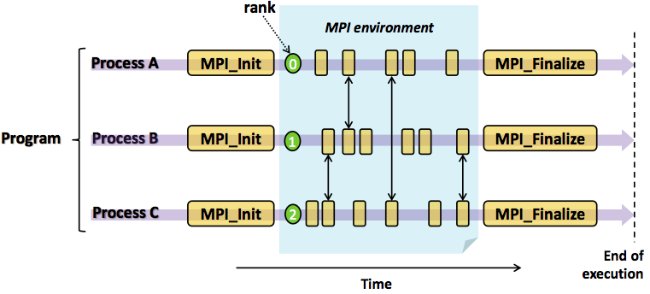
MPI Enviroment
MPI_Init initializes the MPI library in the calling process.
MPI_Finalize cleans up all MPI states.
{
/* declare variables */
MPI_Init(&argc, &argv); // Initializes the MPI execution environment
/* parse arguments */
/* do something here*/
/* main program */
MPI_Finalize(); // Terminates MPI execution environment.
}

Slide 26

Point-to-Point Operations
In a point-to-point communication, a piece of data (a message) is copied from the memory of one process to the memory of another process.
Do MPI mainly in six functions:
MPI_Init ()
MPI_Comm_size()
MPI_Comm_rank()
MPI_Send()
MPI_Recv()
MPI_Finalize()
Things that need specifying:
Where to receive data or send from
How will the receiver recognize/screen messages?
What is the actual message sent/received

Slide 27
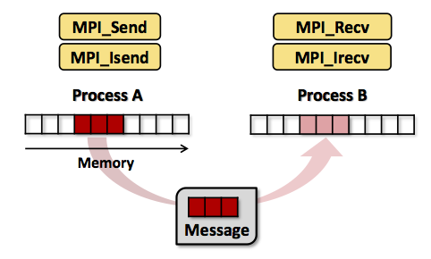
Point-to-Point Operations
int MPI_Send(
const void *buf, // outcoming message buffer
int count, // amount of outcoming message
MPI_Datatype datatype, // message data type
int dest, // rank of destination process
int tag, // tag of message
MPI_Comm comm) // type of communicator
int MPI_Recv(
void *buf, // incoming message buffer
int count, // amount of incoming message
MPI_Datatype datatype, // message data type
int source, // rank of source process
int tag, // tag of message (must match the source’s)
MPI_Comm comm, // type of communicator
MPI_Status *status) // MPI status structure
There are three predefined communicators:
MPI_COMM_WORLD comprises all processes
MPI_COMM_SELF contains only the current process.
MPI_COMM_NULL invalid communicator.
MPI_Status:
int count; // Number of received entries.
int cancelled; // Indication if the corresponding request was cancelled.
int MPI_SOURCE;// rank of source process
int MPI_TAG; // Tag of message.
int MPI_ERROR; // Error codex

Slide 28

Point-to-Point Operations
#include "mpi.h"
#include <stdio.h>
int main(argc,argv) int argc; char *argv[];
{
int numtasks, rank, dest, source, rc, count, tag=1;
char inmsg, outmsg='x';
MPI_Status Stat;
MPI_Init(&argc,&argv);
MPI_Comm_size(MPI_COMM_WORLD, &numtasks);
MPI_Comm_rank(MPI_COMM_WORLD, &rank);
if (rank == 0) {
dest = 1;
source = 1;
rc = MPI_Send(&outmsg, 1, MPI_CHAR, dest, tag, MPI_COMM_WORLD);
rc = MPI_Recv(&inmsg, 1, MPI_CHAR, source, tag, MPI_COMM_WORLD, &Stat);
} else if (rank == 1) {
dest = 0;
source = 0;
rc = MPI_Send(&outmsg, 1, MPI_CHAR, dest, tag, MPI_COMM_WORLD);
rc = MPI_Recv(&inmsg, 1, MPI_CHAR, source, tag, MPI_COMM_WORLD, &Stat);
}
rc = MPI_Get_count(&Stat, MPI_CHAR, &count);
printf(“Process %d: Received %d char(s) from task %d with tag %d \n",
rank, count, Stat.MPI_SOURCE, Stat.MPI_TAG);
MPI_Finalize();
}
MPI_Comm_size()
reports the total number of processes
MPI_Comm_rank()
reports the rank of current process
MPI_Get_processor_name()
reports the name of the current processor (host)
Instead of thread ID in OpenMP, the MPI use ‘rank’ to indicate the index of process.

Slide 29
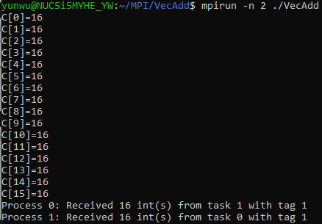
Vector Addition
send
send
recv
add
recv
if (rank == 0) {
… …
for(i=0;i<LEN/2;i++){
MPI_Send(&A[LEN/2], 1, MPI_INT, dest, tag, MPI_COMM_WORLD);
MPI_Send(&B[LEN/2], 1, MPI_INT, dest, tag, MPI_COMM_WORLD);
C[i] = A[i] + B[i];
MPI_Recv(&C[i+LEN/2], 1, MPI_INT, source, tag, MPI_COMM_WORLD, &Stat);
}
… …
}else if (rank == 1) {
… …
for(i=0;i<LEN/2;i++){
MPI_Recv(&tmpA, 1, MPI_INT, source, tag, MPI_COMM_WORLD, &Stat);
MPI_Recv(&tmpB, 1, MPI_INT, source, tag, MPI_COMM_WORLD, &Stat);
tmpC = tmpA + tmpB;
MPI_Send(&tmpC, 1, MPI_INT, dest, tag, MPI_COMM_WORLD);
}}
add
send
recv

Slide 30
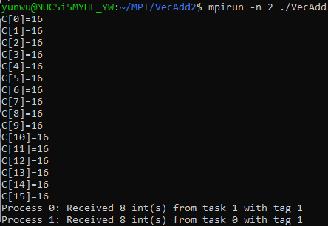
Vector Addition
send
…
send
…
recv
…
add
recv
if (rank == 0) {
… …
MPI_Send(&A[LEN/2], LEN/2, MPI_INT, dest, tag, MPI_COMM_WORLD);
MPI_Send(&B[LEN/2], LEN/2, MPI_INT, dest, tag, MPI_COMM_WORLD);
for(i=0;i<LEN/2;i++){C[i] = A[i] + B[i];}
MPI_Recv(&C[LEN/2], LEN/2, MPI_INT, source, tag, MPI_COMM_WORLD, &Stat);
… …
}else if (rank == 1) {
… …
int *tmpA, *tmpB, *tmpC;
tmpA = (int*) malloc(sizeof(int)*LEN/2);
tmpB = (int*) malloc(sizeof(int)*LEN/2);
tmpC = (int*) malloc(sizeof(int)*LEN/2);
MPI_Recv(tmpA, LEN/2, MPI_INT, source, tag, MPI_COMM_WORLD, &Stat);
MPI_Recv(tmpB, LEN/2, MPI_INT, source, tag, MPI_COMM_WORLD, &Stat);
for(i=0;i<LEN/2;i++){tmpC[i] = tmpA[i] + tmpB[i];}
MPI_Send(tmpC, LEN/2, MPI_INT, dest, tag, MPI_COMM_WORLD);
}}
… …
…
add
add
…
add
send
…
recv
…
send
…
recv

Slide 31
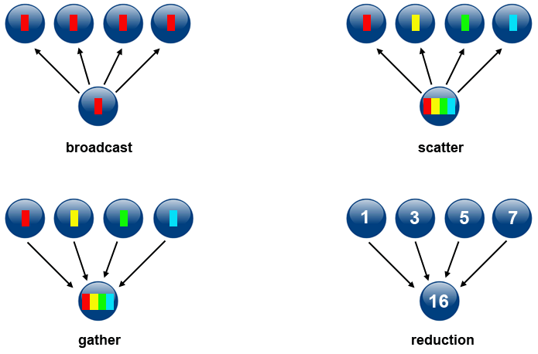
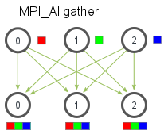
Collective Operations
Types of Collective Operations:
Synchronization: processes wait until all members of the group have reached the synchronization point.
MPI_Barrier()
Data Movement: broadcast, scatter/gather, all to all.
MPI_Bcast()
MPI_Scatter()
MPI_Gather()
MPI_Allgather()
Collective Computation: one member of the group collects data from the other members and performs an operation (min, max, add, multiply, etc.) on that data.
MPI_Reduce()
allgather

Slide 32
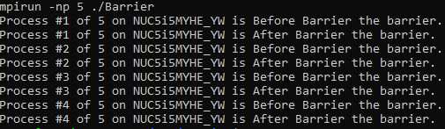
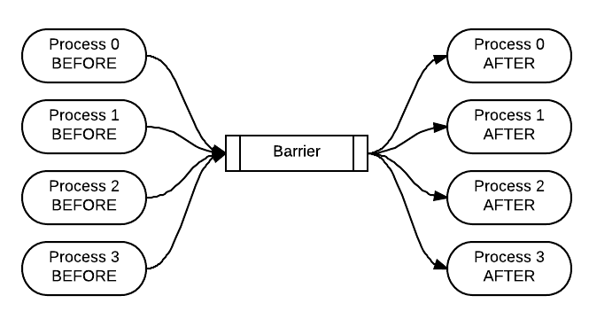
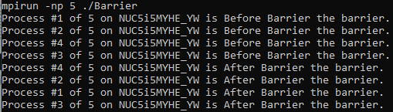
Collective Operations - Barrier
… …
if (id != MASTER) {
// Worker: Build a message and send it to the Master
int length = sprintf(buffer, "Process #%d of %d on %s is %s the barrier.\n",
id, numProcesses, hostName, "Before Barrier");
MPI_Send(buffer, length+1, MPI_CHAR, 0, 0, MPI_COMM_WORLD);
} else {
// Master: Receive and print the messages from all Workers
for(int i = 0; i < numProcesses-1; i++) {
MPI_Recv(buffer, BUFFER_SIZE, MPI_CHAR, MPI_ANY_SOURCE,
MPI_ANY_TAG, MPI_COMM_WORLD, &status);
printf("%s", buffer);
}
}
MPI_Barrier(MPI_COMM_WORLD);
if (id != MASTER) {
// Worker: Build a message and send it to the Master
int length = sprintf(buffer, "Process #%d of %d on %s is %s the barrier.\n",
id, numProcesses, hostName, "After Barrier");
MPI_Send(buffer, length+1, MPI_CHAR, 0, 0, MPI_COMM_WORLD);
} else {
// Master: Receive and print the messages from all Workers
for(int i = 0; i < numProcesses-1; i++) {
MPI_Recv(buffer, BUFFER_SIZE, MPI_CHAR, MPI_ANY_SOURCE,
MPI_ANY_TAG, MPI_COMM_WORLD, &status);
printf("%s", buffer);
}
}
… …

Slide 33

Collective Operations - Broadcast
int MPI_Bcast(
void *buffer, // Starting address of buffer
int count, // Number of elements in buffer
MPI_Datatype datatype, // Data type of buffer
int root, // Rank of broadcast root
MPI_Comm comm) // Communicator
… …
MPI_Comm_rank(MPI_COMM_WORLD, &my_rank);
if(my_rank == broadcast_root){
buffer = 12345;
printf("[MPI process %d] I am the broadcast root, and send value %d.\n", my_rank, buffer);
}
MPI_Bcast(&buffer, 1, MPI_INT, broadcast_root, MPI_COMM_WORLD);
if(my_rank != broadcast_root){
printf("[MPI process %d] I am a broadcast receiver, and obtained value %d.\n", my_rank, buffer);
}
… …

Slide 34

Collective Operations - Scatter
int MPI_Scatter(
const void *sendbuf, // Address of send buffer
int sendcount, // Number of elements
MPI_Datatype sendtype, // Datatype of buffer elements
void *recvbuf, // Address of receive buffer
int recvcount, // Datatype of receive buffer elements
MPI_Datatype recvtype, // Rank of sending process
int root, // Rank of sending process
MPI_Comm comm) // Communicator
… …
MPI_Comm_rank(MPI_COMM_WORLD, &my_rank);
if(my_rank == root_rank){
int buffer[4] = {0, 100, 200, 300};
printf("Values to scatter from process %d: %d, %d, %d, %d.\n",
my_rank, buffer[0], buffer[1], buffer[2], buffer[3]);
MPI_Scatter(buffer, 1, MPI_INT, &my_value, 1, MPI_INT, root_rank, MPI_COMM_WORLD);
}
else{
MPI_Scatter(NULL, 1, MPI_INT, &my_value, 1, MPI_INT, root_rank, MPI_COMM_WORLD);
}
… …

Slide 35

Collective Operations - Gather
int MPI_Gather(
const void *sendbuf, // Starting address of send buffer
int sendcount, // Number of elements
MPI_Datatype sendtype, // Datatype of send buffer elements
void *recvbuf, // Address of receive buffer
int recvcount, // Number of elements for any single receive
MPI_Datatype recvtype, // Datatype of recvbuffer elements
int root, // Rank of receiving process
MPI_Comm comm) // Communicator
… …
MPI_Comm_rank(MPI_COMM_WORLD, &my_rank);
int my_value = my_rank * 100;
printf("Process %d, my value = %d.\n", my_rank, my_value);
if(my_rank == root_rank){
int buffer[4];
MPI_Gather(&my_value, 1, MPI_INT, buffer, 1, MPI_INT, root_rank,MPI_COMM_WORLD);
printf("Values collected on process %d: %d, %d, %d, %d.\n",
my_rank, buffer[0], buffer[1], buffer[2], buffer[3]);
}
else{
MPI_Gather(&my_value, 1, MPI_INT, NULL, 0, MPI_INT, root_rank, MPI_COMM_WORLD);
}
… …

Slide 36

Collective Operations - Reduce
int MPI_Reduce(
const void *sendbuf, // Address of send buffer
void *recvbuf, // Address of receive buffer
int count, // Number of elements in send buffer
MPI_Datatype datatype, // Data type of elements of send buffer
MPI_Comm comm) // Communicator
… …
MPI_Comm_rank(MPI_COMM_WORLD, &my_rank);
int reduction_result = 0;
MPI_Reduce(&my_rank, &reduction_result, 1, MPI_INT, MPI_SUM, root_rank, MPI_COMM_WORLD);
if(my_rank == root_rank){
printf("The sum of all ranks is %d.\n", reduction_result);
}
… …

Slide 37
Predefined Reduction Operators
Operation | Meaning
MPI_MAX | Maximum Value
MPI_MIN | Minimum Value
MPI_SUM | Sum
MPI_PROD | Product
MPI_LAND, MPI_LOR, MPI_LXOR | Logical AND, Logical OR, Logical XOR
MPI_BAND, MPI_BOR, MPI_BXOR | Bitwise AND, Bitwise OR, Bitwise XOR
MPI_MAXLOC | Maximum Value and Location
MPI_MINLOC | Minimum Value and Location

Slide 38
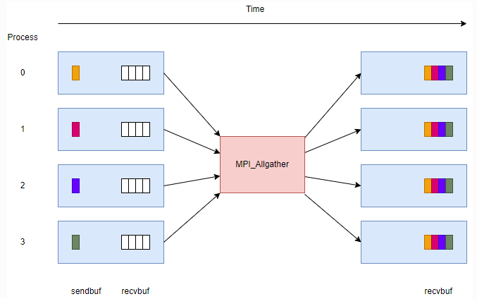
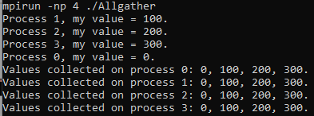
Collective Operations - Allgather
int MPI_Allgather(
const void *sendbuf, // Starting address of send buffer
int sendcount, // Number of elements in send buffer
MPI_Datatype sendtype, // Datatype of send buffer elements
void *recvbuf, // Starting address of recv buffer
int recvcount, // Number of elements received from any process
MPI_Datatype recvtype, // Datatype of receive buffer elements
MPI_Comm comm) // Communicator
… …
MPI_Comm_rank(MPI_COMM_WORLD, &my_rank);
int my_value = my_rank * 100;
printf("Process %d, my value = %d.\n", my_rank, my_value);
… …
MPI_Allgather(&my_value, 1, MPI_INT, buffer, 1, MPI_INT, MPI_COMM_WORLD);
printf("Values collected on process %d: %d, %d, %d.\n", my_rank, buffer[0], buffer[1], buffer[2]);
… …

Slide 39
Point-to-Point V.S. Collective
Point-to-Point
What: set the sending/receiving message as well as its amount and type
Where: set sending destination and receiving source
Who: set identity tag
How: sending or receiving
When: set the pairwise order of send and receive between host and guests
Collective
What: set the message for either distributing or gathering as well as its amount and type
Where: both host and all the guests are involved
Who: set the host identity
How: distributing or gathering
When: only set the host identity since bipartite operations support

Slide 40


Performance Profiling
Since data is distributed between processes or nodes, both communication and computation timing are considered for the performance profiling.
MPI_Wtime() is the built-in function to measuring the timing in seconds:
… …
starttime = MPI_Wtime();
MPI_Send(&A[LEN/2], LEN/2, MPI_INT, dest, tag, MPI_COMM_WORLD);
MPI_Send(&B[LEN/2], LEN/2, MPI_INT, dest, tag, MPI_COMM_WORLD);
sendtime = MPI_Wtime();
for(i=0;i<LEN/2;i++){C[i] = A[i] + B[i];}
comptime = MPI_Wtime();
MPI_Recv(&C[LEN/2], LEN/2, MPI_INT, source, tag, MPI_COMM_WORLD, &Stat);
recvtime = MPI_Wtime();
… …
… …
starttime = MPI_Wtime();
MPI_Recv(tmpA, LEN/2, MPI_INT, source, tag, MPI_COMM_WORLD, &Stat);
MPI_Recv(tmpB, LEN/2, MPI_INT, source, tag, MPI_COMM_WORLD, &Stat);
recvtime = MPI_Wtime();
for(i=0;i<LEN/2;i++){tmpC[i] = tmpA[i] + tmpB[i];}
comptime = MPI_Wtime();
rc = MPI_Send(tmpC, LEN/2, MPI_INT, dest, tag, MPI_COMM_WORLD);
sendtime = MPI_Wtime();
… …

Slide 41
Communication Costs
Sending bytes takes time
Setup time for message
Transmission length-based time
Messages are implicit synchronization
Most likely one party must wait (most likely the receiver)
Rules of thumb
Create as few messages as possible
Keep messages small
Fewer messages is usually better than smaller messages

Slide 42

Advancing

Slide 43
Matrix Multiplication (P2P)
Row-wise Partition
Vectorization
send
recv
send
send
×
×
=
send
=
A – DIM1 x DIM2
C – DIM1 x DIM3
recv
B – DIM2 x DIM3

Slide 44
Initialization
int *allocatevector(int len){
int *vec = (int *) malloc(sizeof(int)*len); // single pointer to an array
memset(vec, 0, len*sizeof(int));
return vec;
}
int **allocatematrix(int row, int col){
int **m = (int **) malloc(sizeof(int*)*row); // double pointer to an array of arrays
for(int i=0;i<row;i++){
m[i] = allocatevector(col);
}
return m;
}

Slide 45
Vectorzation
void matrix2vector(int row, int col, int **m, int *v){
for(int i=0;i<row;i++){
for(int j=0;j<col;j++){
v[i*col+j] = m[i][j];
}
}
}
void vector2matrix(int row, int col, int *v, int **m){
for(int i=0;i<row;i++){
for(int j=0;j<col;j++){
m[i][j] = v[i*col+j];
}
}
}

Slide 46
Send Partial A and Entire B on Host
… …
if (myrank==0) {
… …
for(i=1;i<np;i++){
int dest = i;
MPI_Send(&vA[i*DIM1*DIM2/np], DIM1*DIM2/np, MPI_INT, dest, tag, MPI_COMM_WORLD);
MPI_Send(vB, DIM2*DIM3, MPI_INT,
dest, tag, MPI_COMM_WORLD);
… …
}}
… …
mpiexec –np 4 MatMul
stagy on host
send 1
send 2
send 3
send 1~3

Slide 47
Receive Partial A and Entire B on Guest
… …
else{
… …
int sour = 0;
MPI_Recv(vA, DIM1*DIM2/np, MPI_INT, sour, tag, MPI_COMM_WORLD, &status);
MPI_Recv(vB, DIM2*DIM3, MPI_INT, sour, tag, MPI_COMM_WORLD, &status);
… …
}
… …
recv i
recv i

Slide 48
Do Sub Matrix Multiplicaiton
On both host and guest:
for(i=0;i<DIM1/np;i++){ // only partition matrix A row-wise
for(j=0;j<DIM3;j++){
vC[i*DIM3+j] = 0;
for(k=0;k<DIM2;k++){
vC[i*DIM3+j] += vA[i*DIM2+k] * vB[j*DIM2+k];
}
}
}

Slide 49
Send Partial Matrix C on Guest
… …
else{
… …
MPI_Send(vC, DIM1*DIM3/np, MPI_INT, dest, tag, MPI_COMM_WORLD);
… …
}
… …
send i

Slide 50
Receive Partial Matrix C on Host
… …
if(myrank==0)
… …
for(i=1;i<np;i++){
int sour = i;
MPI_Recv(&vC[i*DIM1*DIM3/np], DIM1*DIM3/np, MPI_INT, sour, tag, MPI_COMM_WORLD, &status);
}}
… …
recv i

Slide 51
Collective Equivalent Operations
MPI_Send(&vA[i*DIM1*DIM2/np], DIM1*DIM2/np, MPI_INT, dest, tag, MPI_COMM_WORLD);
MPI_Send(vB, DIM2*DIM3, MPI_INT, dest, tag, MPI_COMM_WORLD);
host
MPI_Recv(vA, DIM1*DIM2/np, MPI_INT, sour, tag, MPI_COMM_WORLD, &status);
MPI_Recv(vB, DIM2*DIM3, MPI_INT, sour, tag, MPI_COMM_WORLD, &status);
guest
MPI_Send(vC, DIM1*DIM3/np, MPI_INT, dest, tag, MPI_COMM_WORLD);
guest
MPI_Recv(&vC[i*DIM1*DIM3/np], DIM1*DIM3/np, MPI_INT, sour, tag, MPI_COMM_WORLD, &status);
host

Slide 52
Matrix Multiplication (Collective)
Row-wise Partition
Vectorization
scatter
gather
broadcast
scatter
×
×
=
broadcast
=
gather

Slide 53
Broadcast and Scatter
broadcast
int *Apart = (int *) malloc(sizeof(int)*DIM1*DIM2/2);
int *Cpart = (int *) malloc(sizeof(int)*DIM1*DIM3/2);
MPI_Bcast (TB, DIM2*DIM3, MPI_INT, 0, MPI_COMM_WORLD);
MPI_Scatter (A, DIM1*DIM2/np, MPI_INT, Apart, DIM1*DIM2/np, MPI_INT, 0, MPI_COMM_WORLD);
scatter

Slide 54
Gather
for (i=0; i<DIM1/np; i++) {
for (j=0; j<DIM3; j++) {
Cpart[i*DIM3+j]=0;
for (k=0; k<DIM2; k++)
Cpart[i*DIM3+j] += Apart[i*DIM2+k]*TB[j*DIM2+k];
}}
MPI_Gather(Cpart, DIM1*DIM3/np, MPI_INT, C, DIM1*DIM3/np, MPI_INT, 0, MPI_COMM_WORLD);
MPI_Barrier(MPI_COMM_WORLD);
gather

Slide 55
MPI with OpenMP or/and OpenCL
Many latest run-time are built on hybrid parallel programming models for heterogeneous high performance computing systems
MPI Communication APIs
OpenMP Threads
OpenMP Threads
OpenMP Threads
CPU
CPU
CPU
CPU
CPU
CPU
CPU
CPU
CPU
CPU
CPU
CPU
CUDA/OpenCL
CUDA/OpenCL
CUDA/OpenCL
GPU
GPU
GPU
Node 0
Node 1
Node N
The AllScale Runtime Application Model, Herbert Jordan, etc., IEEE International Conference on Cluster Computing (CLUSTER), 2018.
EXA2PRO: A Framework for High Development Productivity on Heterogeneous Computing Systems, Lazaros Papadopoulos, etc., IEEE Transactions on Parallel and Distributed Systems, 2021

Slide 56

Keep In The Loop

