Slide 1
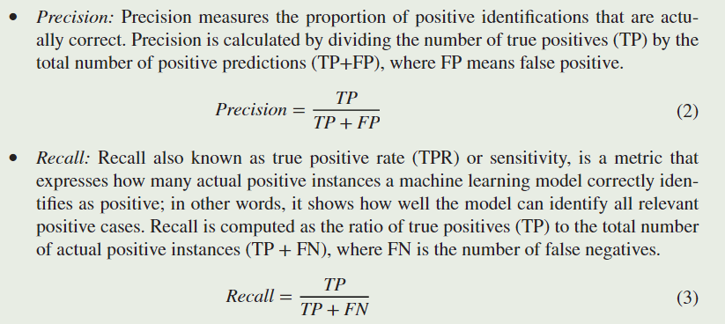

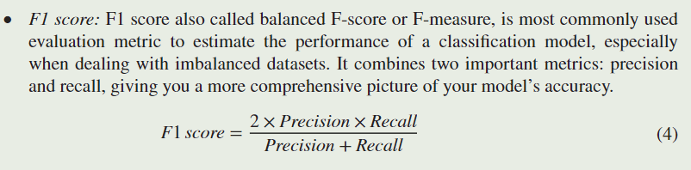
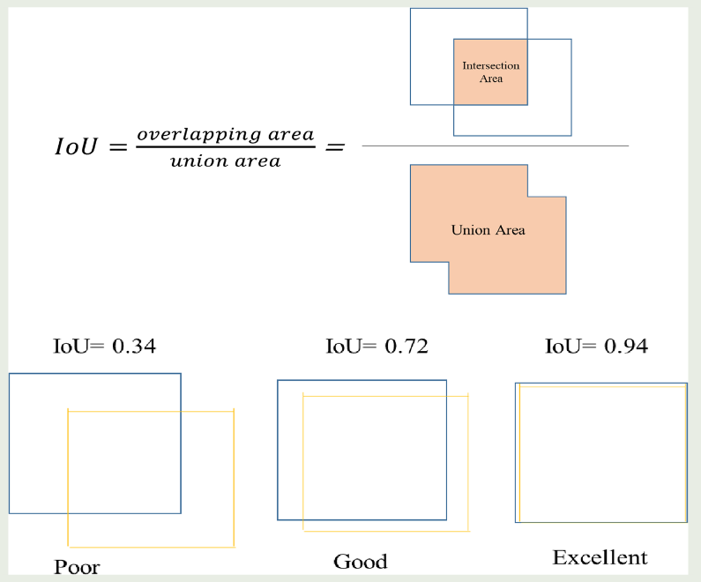
Average Precision (AP)
Intersection over Union (IoU)
IoU 计算为预测边界框与地面实况边界框之间的重叠面积与两个框的组合面积之间的比率。

Slide 2
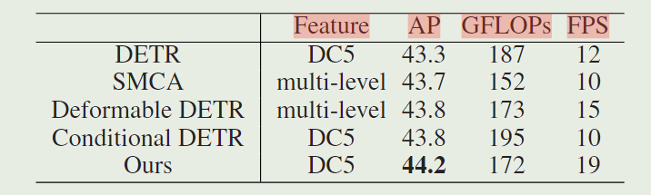

Slide 3
DETR | COCO 2017 detection and panoptic segmentation datasets
Deformable DETR | COCO 2017 dataset
Dynamic DETR | MS COCO

Slide 4
YOLOV5魔改 | Small-Object Detection in Remote Sensing Images With Super-Resolution Perception

Slide 5
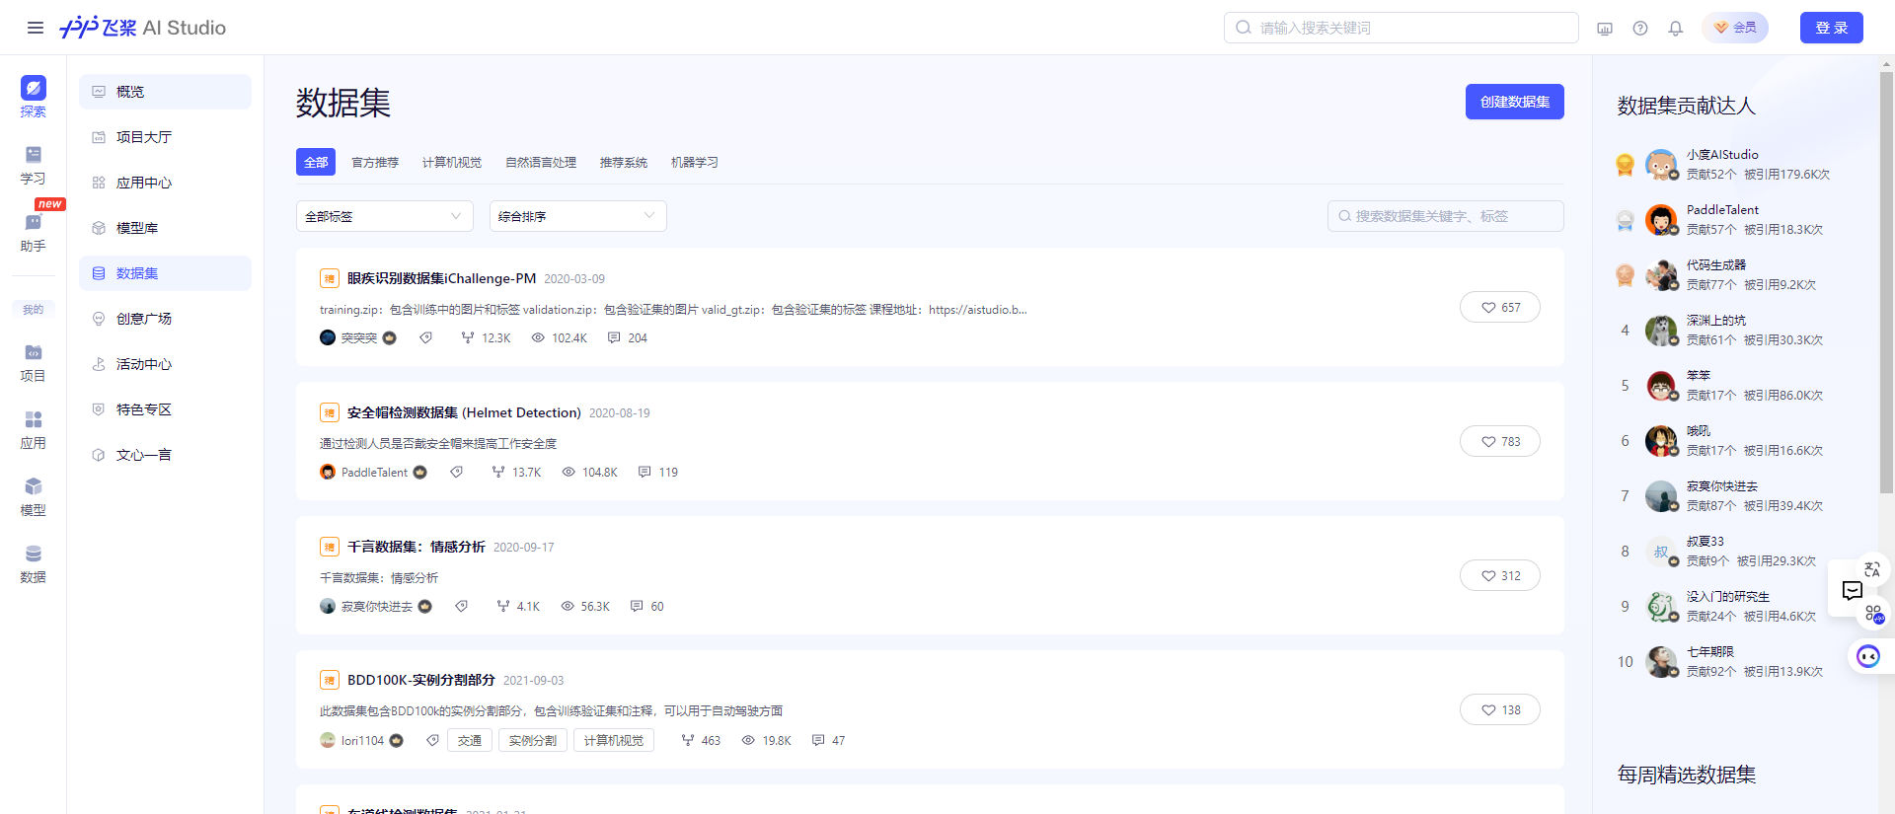
飞桨上都可以找到这些数据集：
https://aistudio.baidu.com/datasetoverview
数据集-OpenDataLab

Slide 6
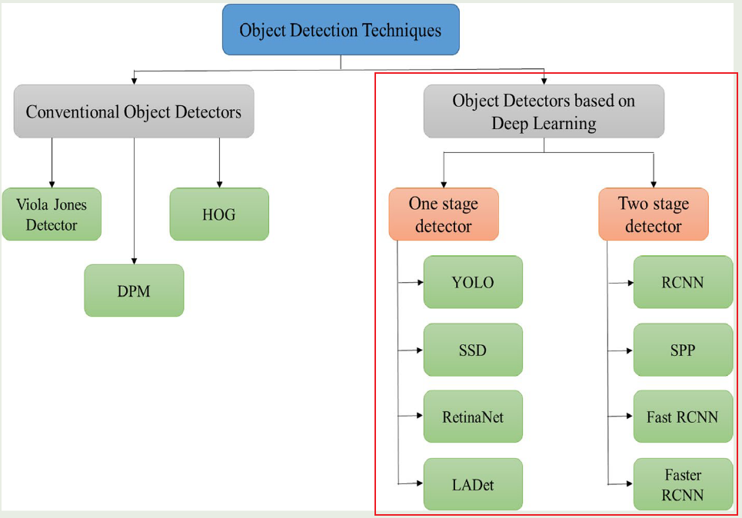
CVHighlightPapers-Page

Slide 7
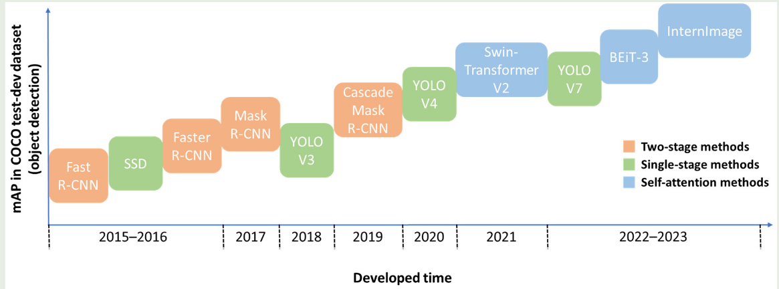

Slide 8
目标检测三大开源神器：
https://github.com/misads/easy_detection
open-mmlab/mmdetection: OpenMMLab Detection Toolbox and Benchmark
facebookresearch/detectron2: Detectron2 is a platform for object detection, segmentation and other visual recognition tasks.
alibaba/EasyCV: An all-in-one toolkit for computer vision

Slide 9
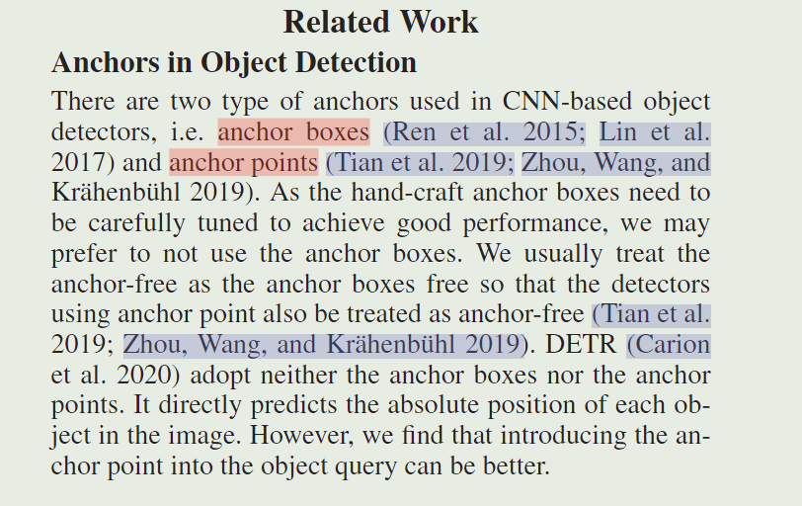

Slide 10
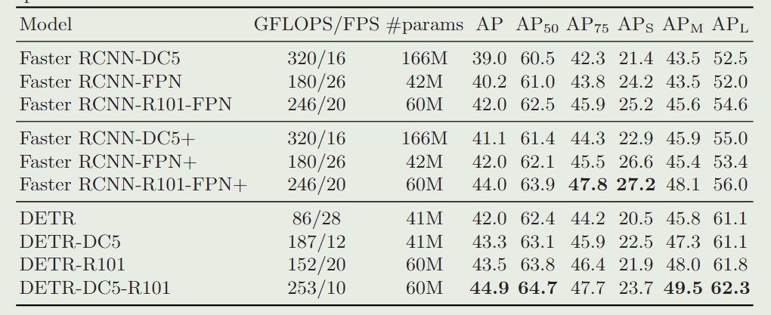
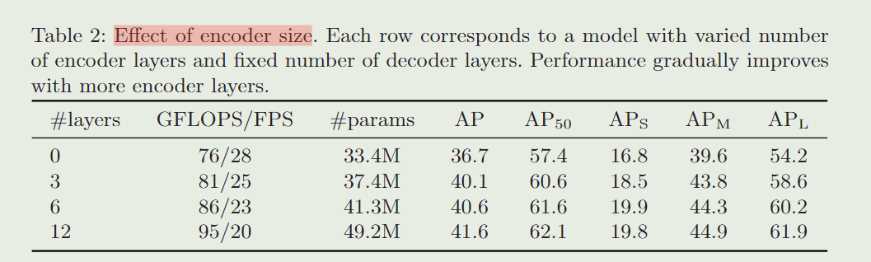

Slide 11
