Slide 1
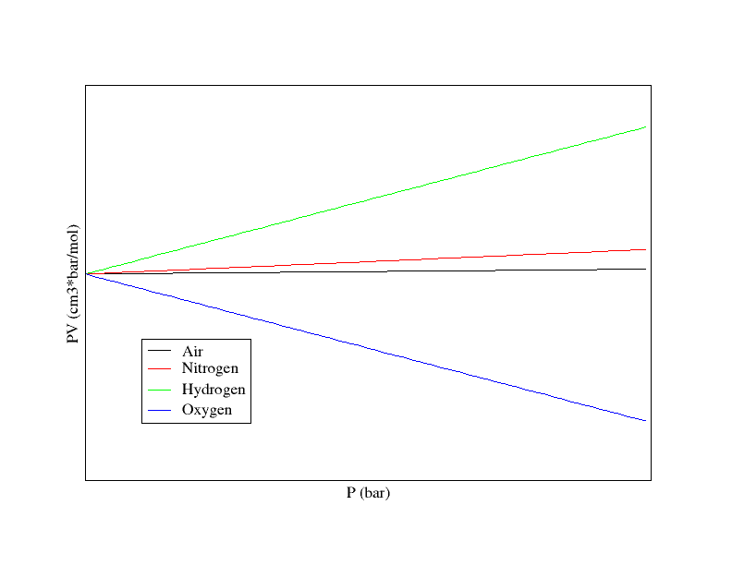
(PV)*T=22711.8 cm³.bar.mol⁻¹
T= 273.16K

