Slide 1
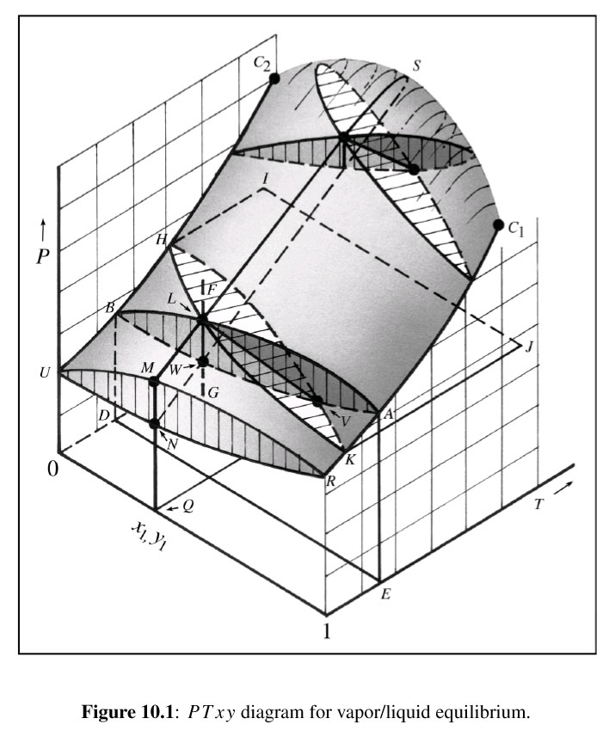
P_{K}
K₂
K_{M}
K_{I}
K₁
β
α

