Slide 1
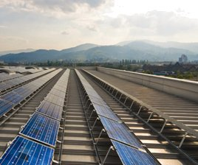
Energy and the New Reality, Volume 2:
C-Free Energy Supply
Chapter 5: Geothermal Energy
L. D. Danny Harvey
harvey@geog.utoronto.ca
Publisher: Earthscan, UK
Homepage: www.earthscan.co.uk/?tabid=101808
This material is intended for use in lectures, presentations and as handouts to students, and is provided in Powerpoint format so as to allow customization for the individual needs of course instructors. Permission of the author and publisher is required for any other usage. Please see www.earthscan.co.uk for contact details.

Slide 2
The temperature increases
with increasing depth in the Earth’s crust at a typical rate of 20 K/km

Slide 3
Types of geothermal resources:
Hydrothermal – hot water or steam in confined aquifers, under pressure
Geopressurized – hot, high-pressure brines (saline water) with dissolved methane
Hot dry rock
Magma

Slide 4
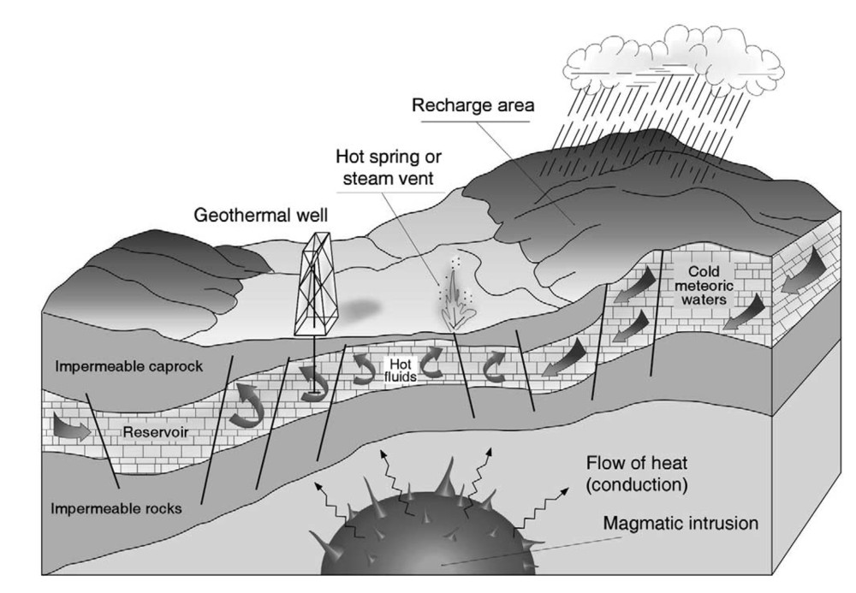
Figure 5.1 A hydrothermal geothermal resource
Source: Barbier (2002, Renewable and Sustainable Energy Reviews 6, 63–65, http://www.sciencedirect.com/science/journal/13640321)

Slide 5
Geothermal energy can be used:
Directly for heating
To generate electricity

Slide 6
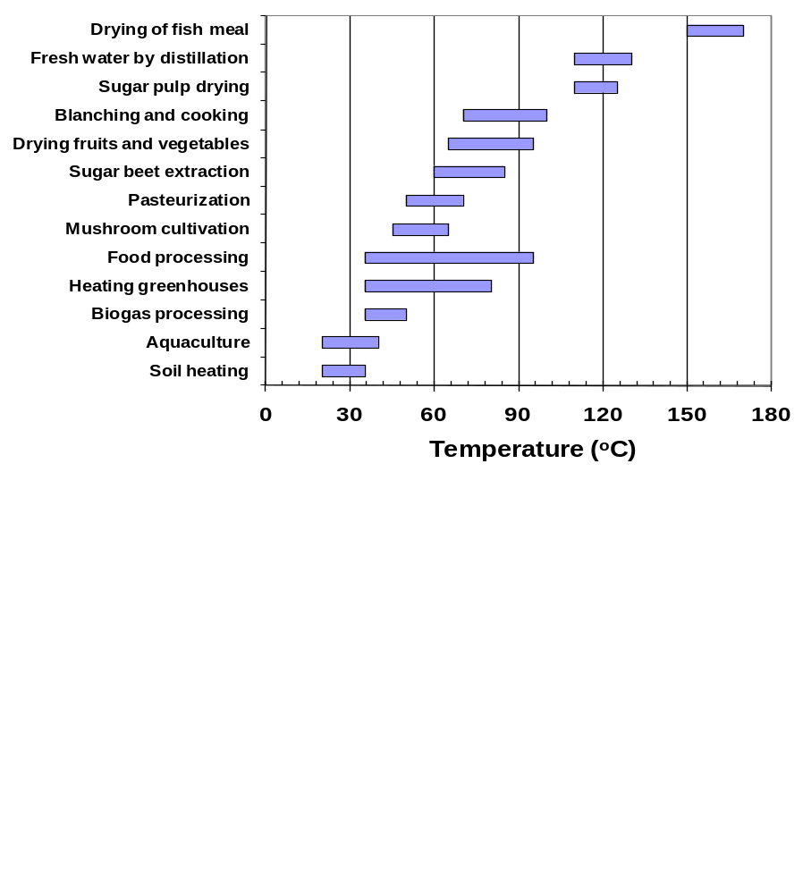
Figure 5.2 Agricultural uses of heat

Slide 7
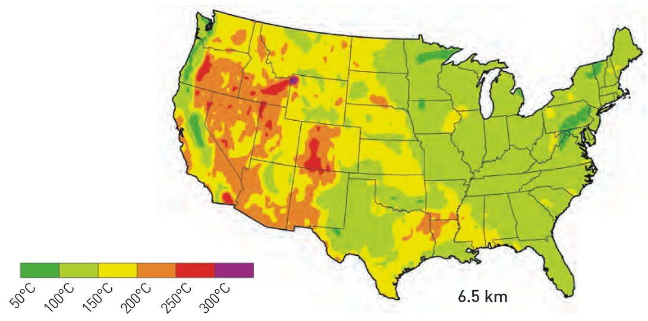
Figure 5.3a US subsurface temperature
at a depth of 6.5 km
Source: MIT (2006, The Future of Geothermal Energy: Impact of Enhanced Geothermal systems (EGS) on the United States in the 21st Century)

Slide 8
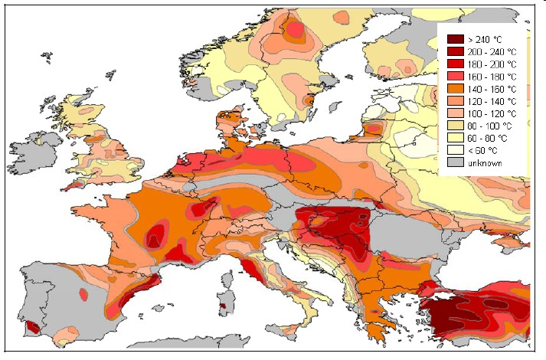
Figure 5.3b Temperatures encountered as a depth
of 5 km in Europe
Source: GAC (2006, Trans-Mediterranean Interconnection for Concentrating Solar Power, Final Report, GAC)

Slide 9
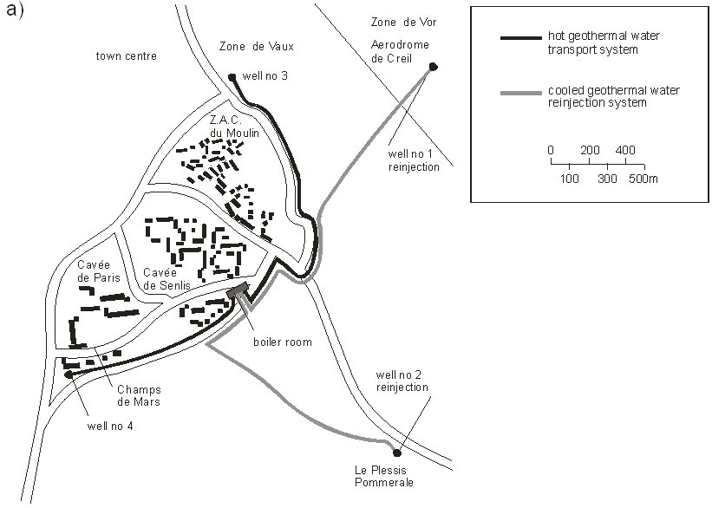
Figure 5.4a Creil geothermal district heating (near Paris)
Source: Brown (1996, Renewable Energy, Power for a Sustainable Future, Oxford University Press, Oxford)

Slide 10
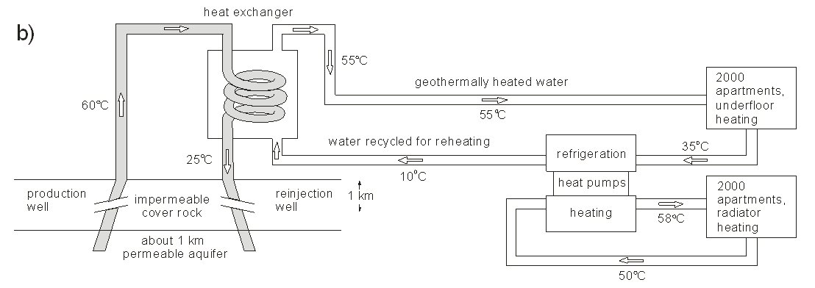
Figure 5.4b Creil geothermal district heating
Source: Brown (1996, Renewable Energy, Power for a Sustainable Future, Oxford University Press, Oxford)

Slide 11
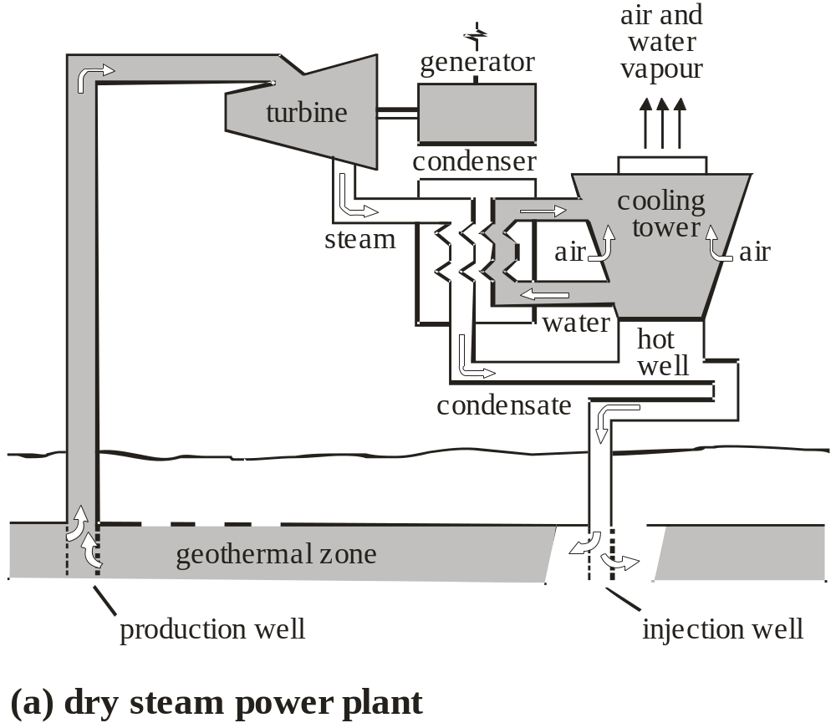
Figure 5.5a Dry steam geothermal power
Source: Brown (1996, Renewable Energy, Power for a Sustainable Future, Oxford University Press, Oxford)

Slide 12
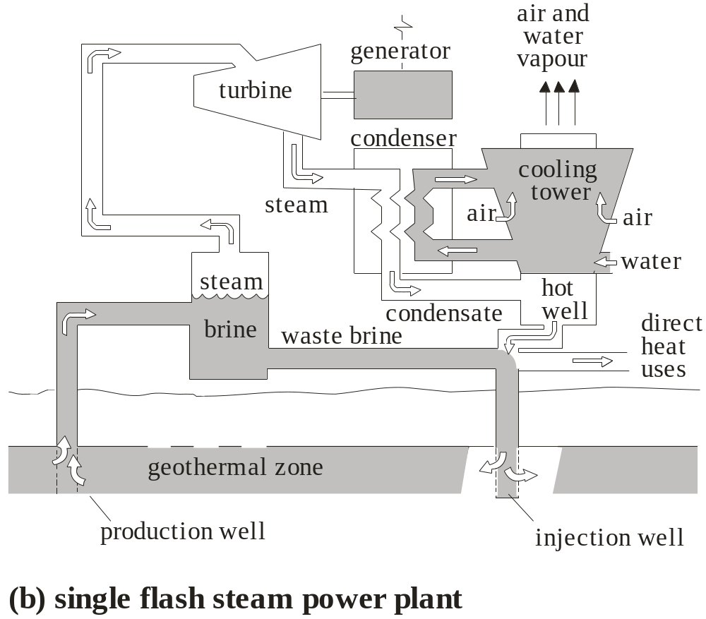
Figure 5.5b Single-flash geothermal power
Source: Brown (1996, Renewable Energy, Power for a Sustainable Future, Oxford University Press, Oxford)

Slide 13
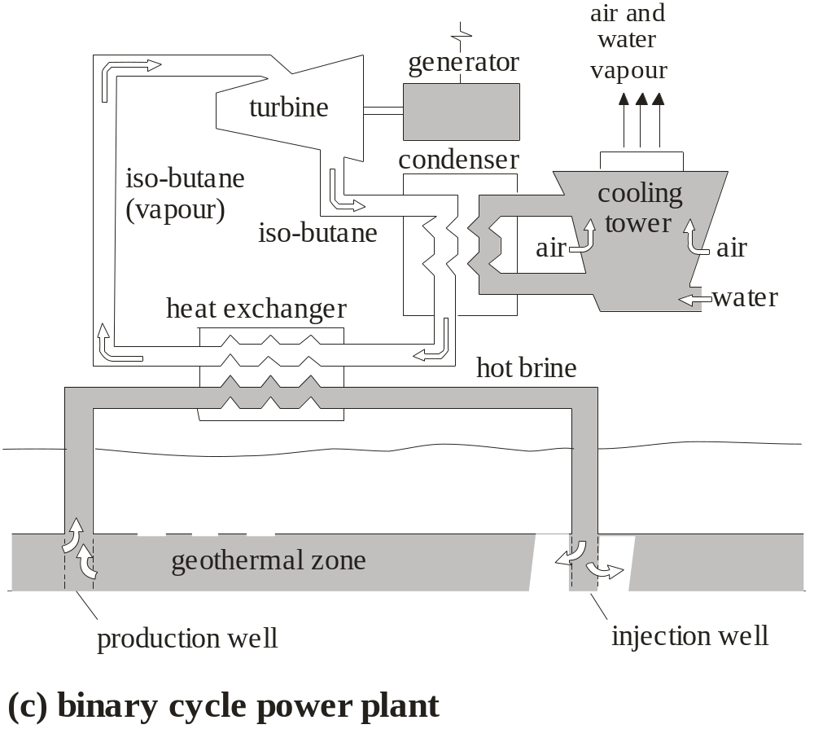
Figure 5.5c Binary-cycle geothermal power
Source: Brown (1996, Renewable Energy, Power for a Sustainable Future, Oxford University Press, Oxford)

Slide 14
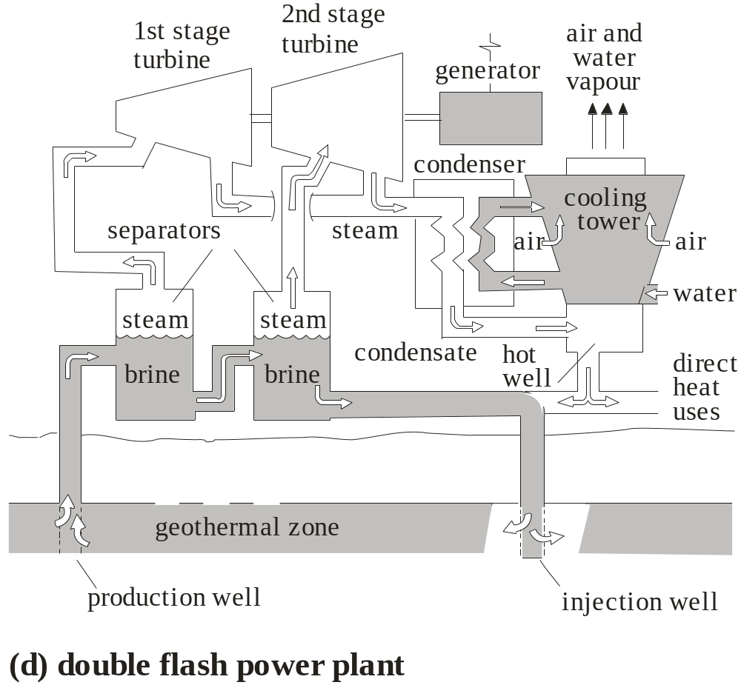
Figure 5.5d Double-flash geothermal power
Source: Brown (1996, Renewable Energy, Power for a Sustainable Future, Oxford University Press, Oxford)

Slide 15
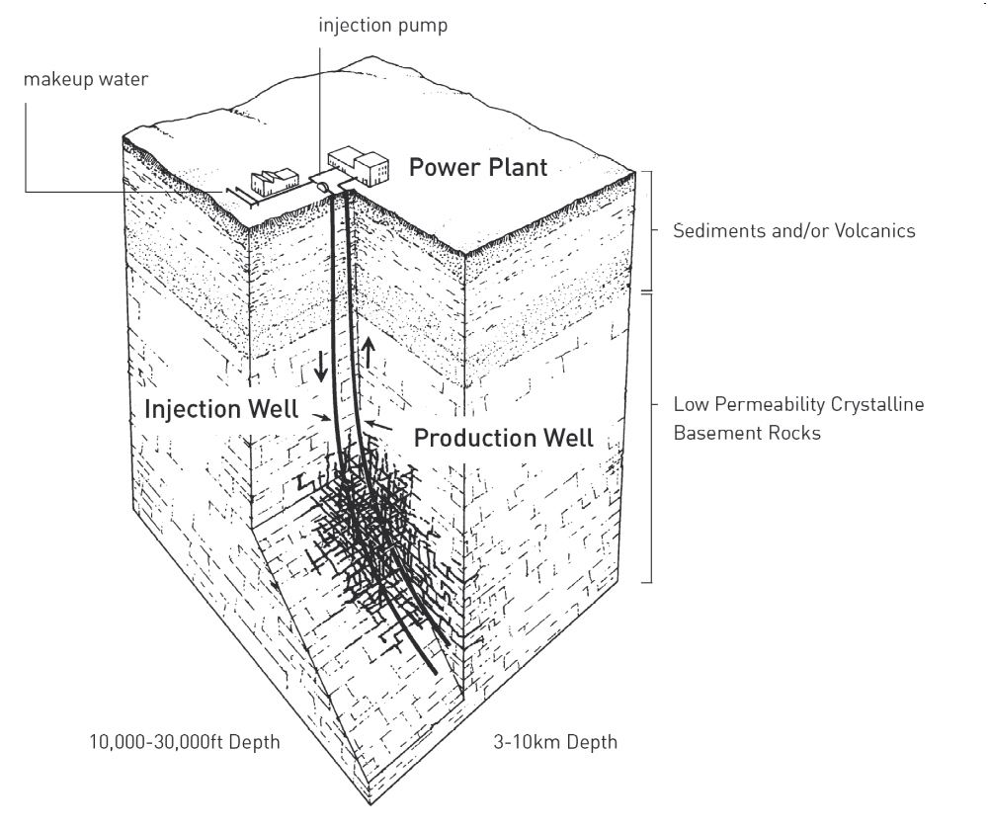
Figure 5.6 Enhanced geothermal system (EGS)
Source: Mock et al (1997, Annual Review of Energy and Environment 22, 305–356)

Slide 16
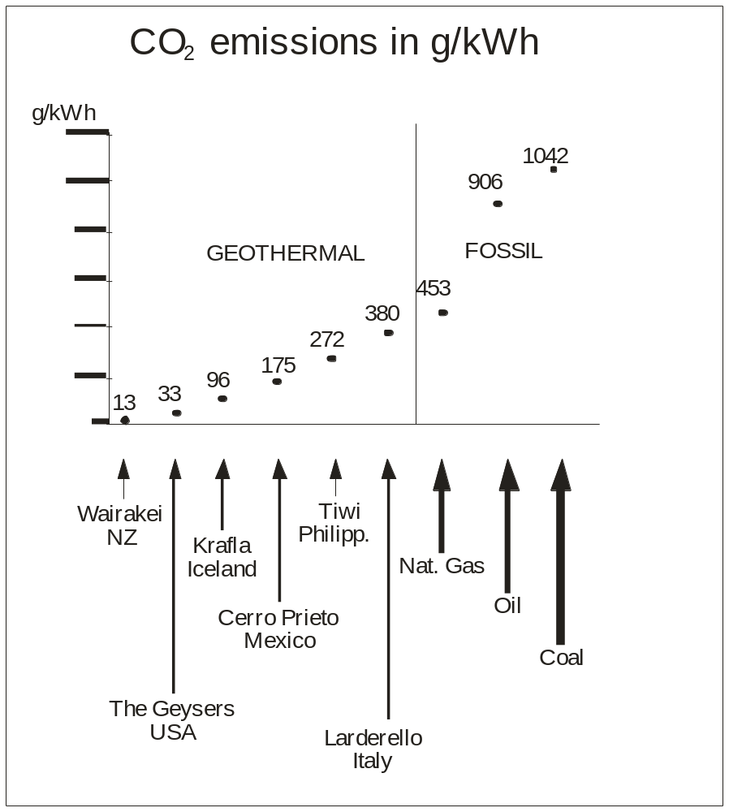
Figure 5.7a CO₂ emissions
Source: Barbier (2002, Renewable and Sustainable Energy Reviews 6, 63–65, http://www.sciencedirect.com/science/journal/13640321)

Slide 17
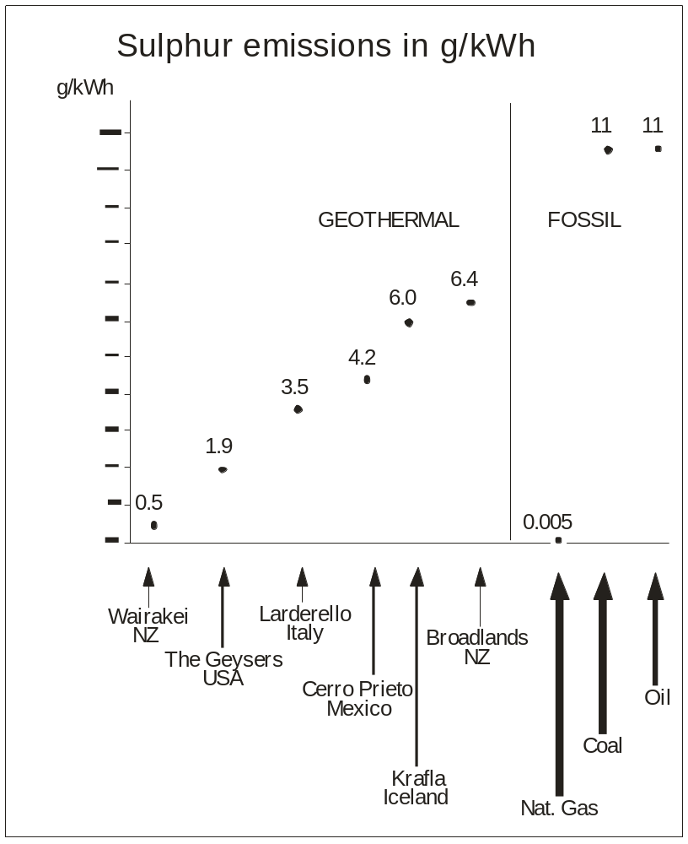
Figure 5.7b S emissions
Source: Barbier (2002, Renewable and Sustainable Energy Reviews 6, 63–65, http://www.sciencedirect.com/science/journal/13640321)

Slide 18
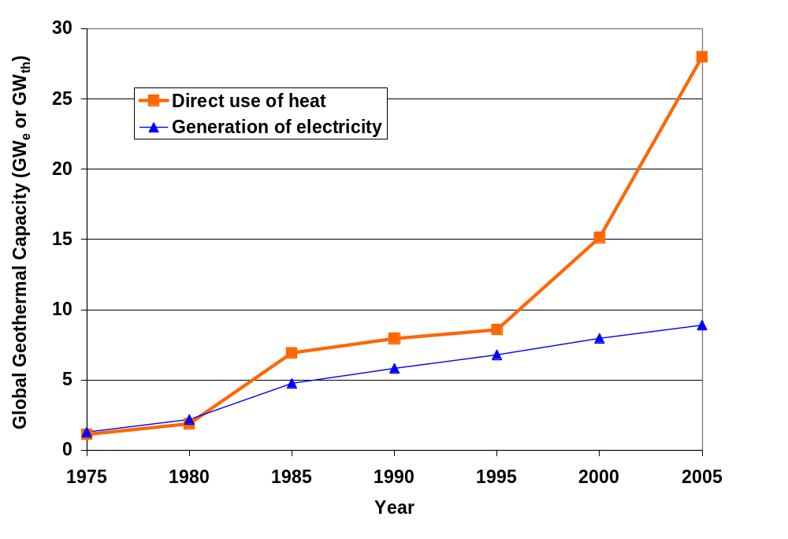
Figure 5.8 Worldwide direct use of geothermal heat and
generation of electricity from geothermal energy

Slide 19
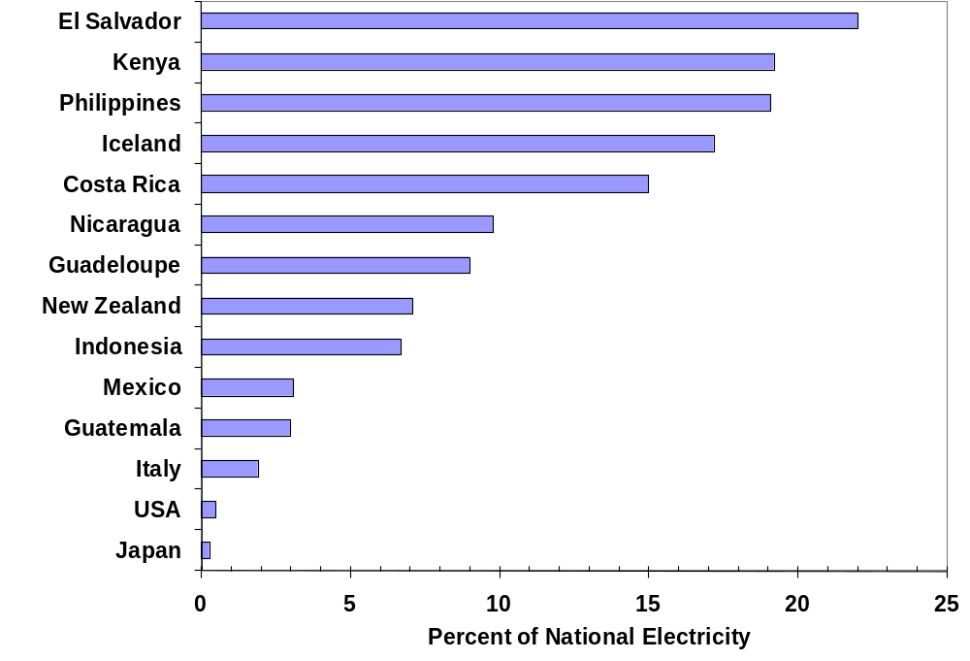
Figure 5.9 Geothermal share of national electricity production

Slide 20
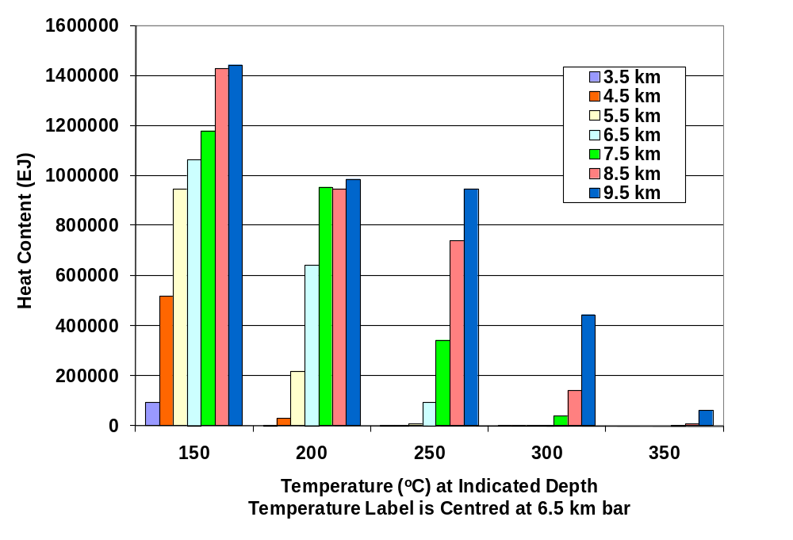
Figure 5.10 Amount of heat available at different
temperatures and at different depths below the US land surface
Source: MIT (2006, The Future of Geothermal Energy: Impact of Enhanced Geothermal systems (EGS) on the United States in the 21st Century)

Slide 21
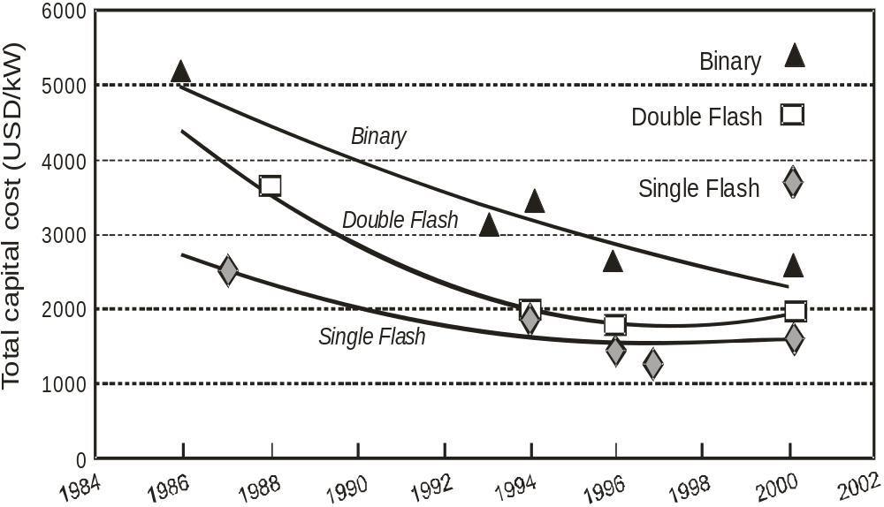
Figure 5.11 Cost of geothermal electric powerplants
Source: IEA (2006c) , Renewable Energy: RD&D Priorities, Insights from IEA Technology Programmes, International Energy Agency, Paris)

Slide 22
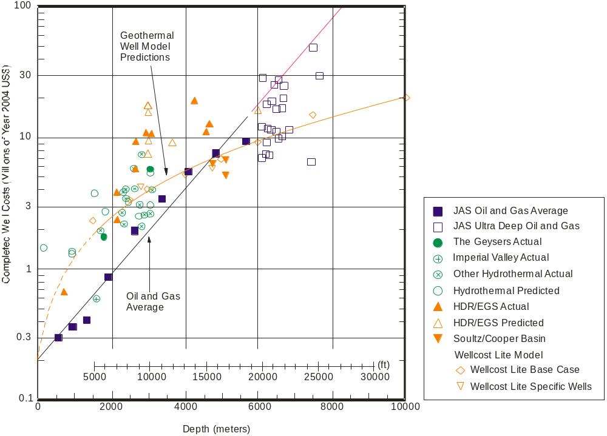
Figure 5.14 Cost of oil, gas and hot dry rock geothermal wells
Source: MIT (2006, The Future of Geothermal Energy: Impact of Enhanced Geothermal systems (EGS) on the United States in the 21st Century)

Slide 23
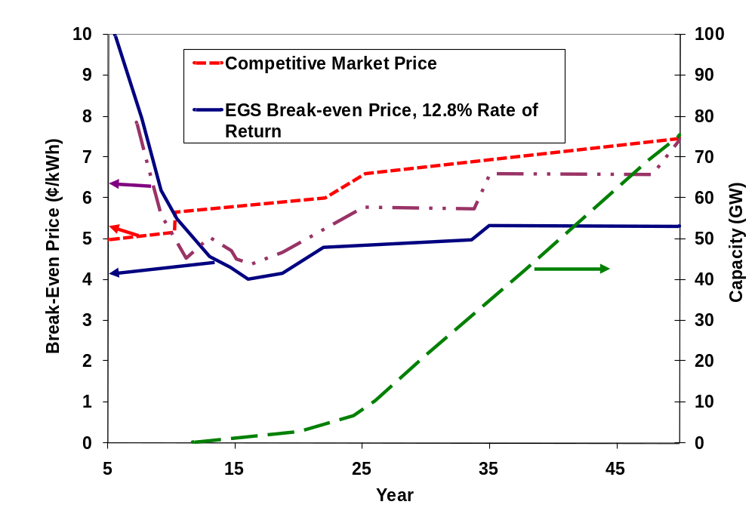
Figure 5.13 Scenario for the variation in the cost of electricity
from EGS as the EGS power capacity in the US
increases to 100 GW by 2050
Source: MIT (2006, The Future of Geothermal Energy: Impact of Enhanced Geothermal systems (EGS) on the United States in the 21st Century)

