Slide 1
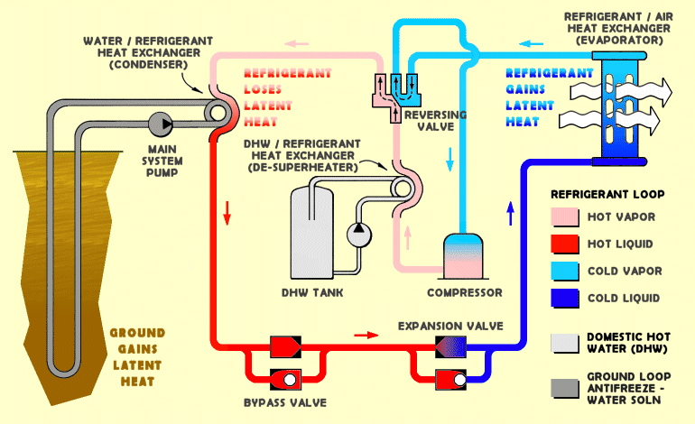
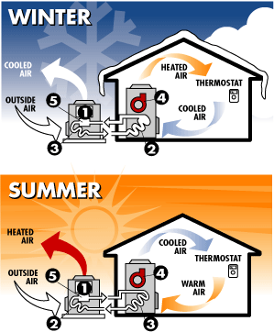
Hot
Reservoir
(house)
QH
(desired
output)
Heat
Pump
Wnet
(required
input)
QL
Cold
Reservoir
(environment)

