Slide 1
School of Engineering
Renewable Energy 1: Solar and Geothermal (EG501J)
Geothermal Energy:
2. Sources, Technologies and Preliminary Environmental Analysis
Jeff Gomes
September 2015
jefferson.gomes@abdn.ac.uk

Slide 2
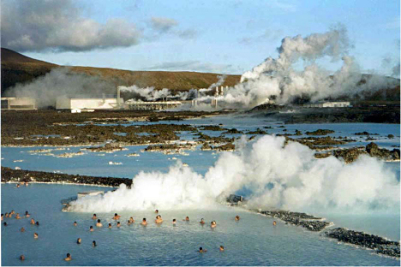
Outline
Economics of Geothermal Energy
Geothermal Sources
Basics of a Geothermal Power Plants
Environmental Impact
( Blue Lagoon, Iceland. Hot springs with geothermal plant in the background.)
jefferson.gomes@abdn.ac.uk

Slide 3
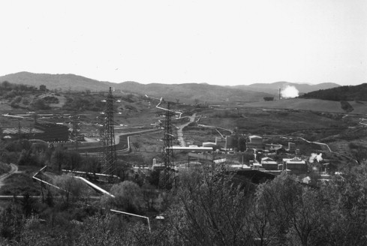
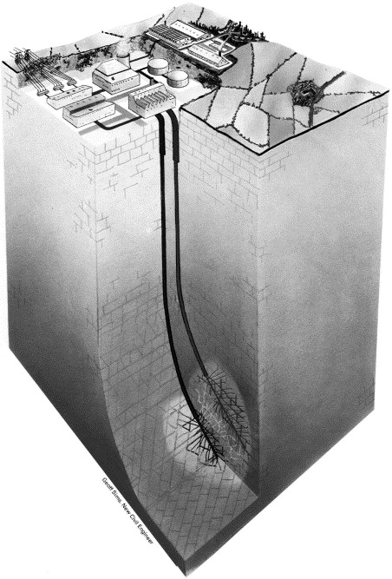
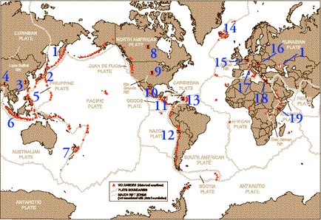
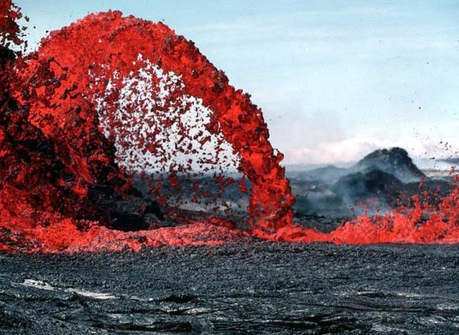
Geothermal Energy:
Initial Analysis
jefferson.gomes@abdn.ac.uk

Slide 4
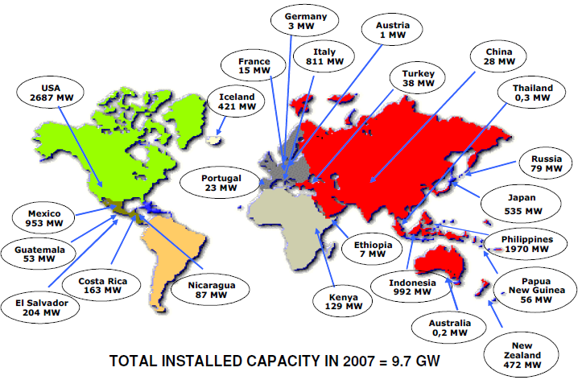
Geothermal Potential in the World Energy Mix
Source: IPCC, 2008
jefferson.gomes@abdn.ac.uk

Slide 5
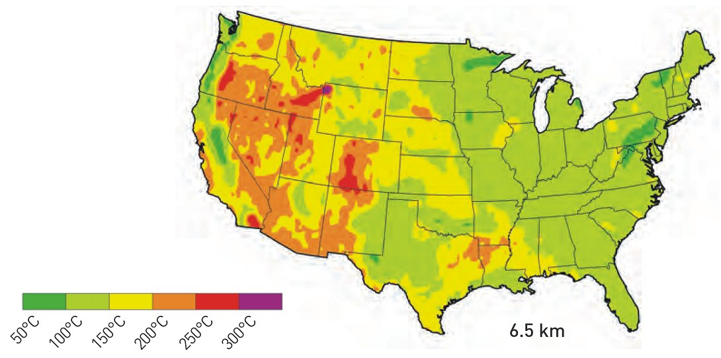
Geothermal Potential in the World Energy Mix
Geothermal sources of T > 150ºC @ depths of 1500-3000 m: Electricity production;
Thermal sources 90 ≤ T ≤ 150ºC @ depths below 1000m: Thermal generation.
US subsurface temperature at depth of 6.5 km
Source: MIT (006), The Future of Geothermal Energy
jefferson.gomes@abdn.ac.uk

Slide 6
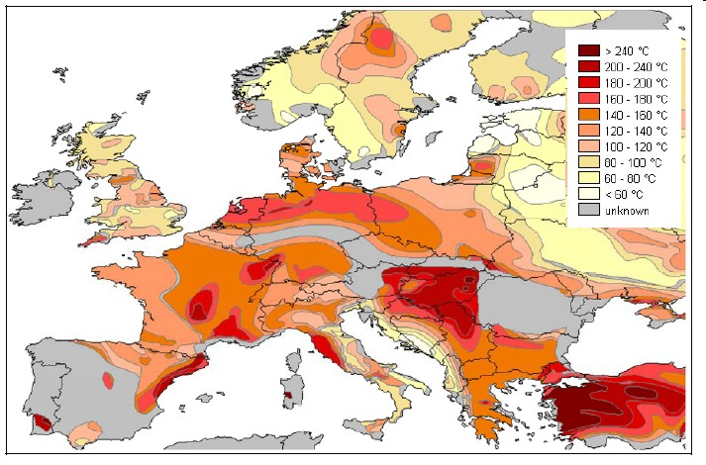
Geothermal Potential in the World Energy Mix
Europe subsurface temperature at depth of 5 km
Source: Trans-Mediterranean Interconnection for Concentrating Solar Power , Final Report (2006)
jefferson.gomes@abdn.ac.uk

Slide 7
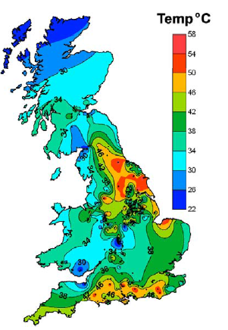
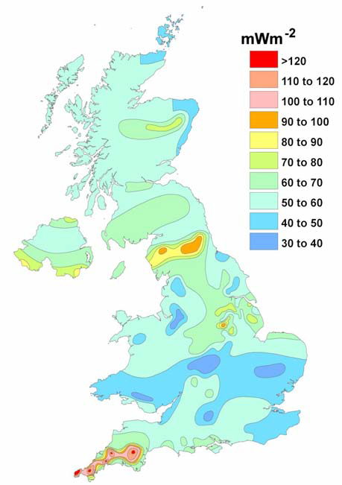
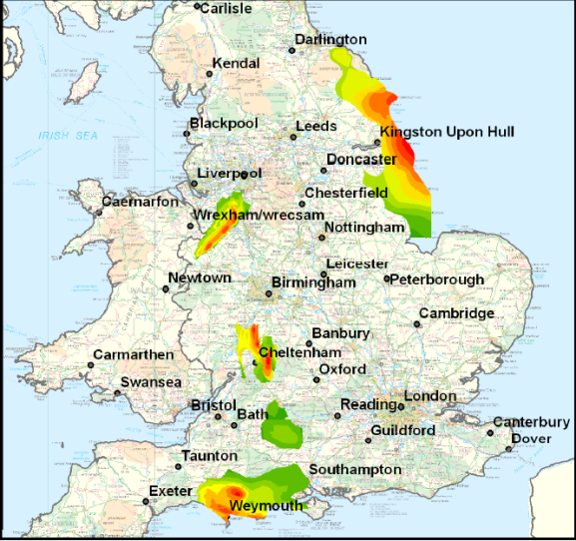
Geothermal Potential in the World Energy Mix
UK subsurface temperature at depth of 1 km
Heat flux based on UK geothermal map
Source: British Geological Survey
jefferson.gomes@abdn.ac.uk

Slide 8
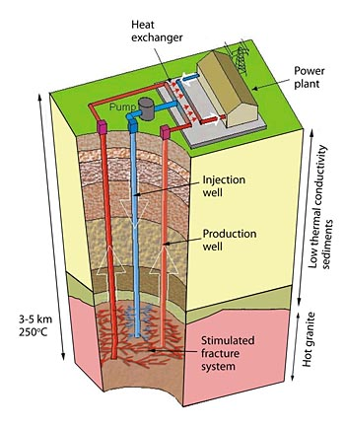
Geothermal Sources
Classification:
T > 150ºC (high temperature): electricity production and direct heating;
90 ≤ T ≤ 150ºC (medium temperature): electricity production and direct heating;
30 ≤ T < 90ºC (low temperature): heat pump for heating and air conditioner;
T < 30ºC (very low temperature): heat pump for heating and air conditioner.
jefferson.gomes@abdn.ac.uk

Slide 9
Geothermal Sources
0 km
10ºC
Heating with heat pumps
Heat exchange pile system (2-4MW)
1 km
Borehole heat exchange (0.006-0.2MW)
40-60ºC
2 km
60-90ºC
Heating without heat pumps
Aquifer system (0.2-6MW)
3 km
100-130ºC
Fractured rock
>130ºC
Enhanced geothermal system (10-200MW)
Power and heat
jefferson.gomes@abdn.ac.uk

Slide 10
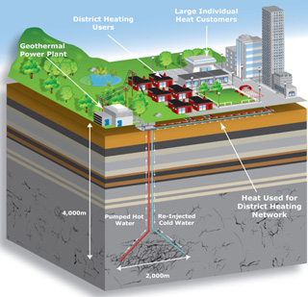
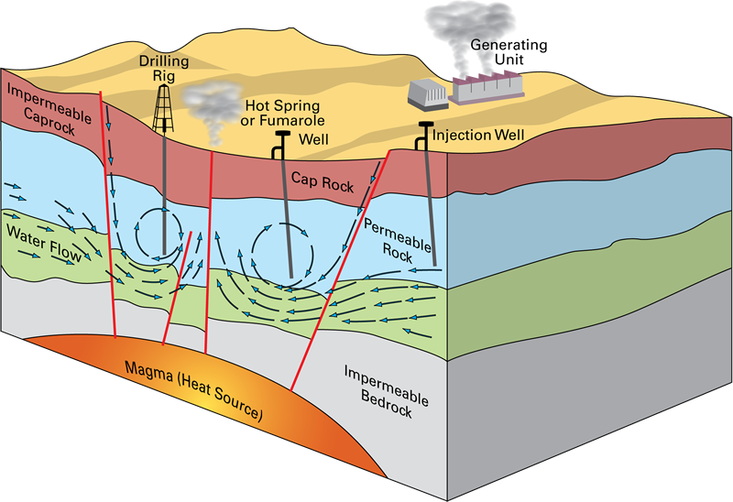
Geothermal Sources: Direct Use
The GS can be exploited at high temperature with efficiency of 50-70%:
Cold water is injected into the permeable rock;
Leading to the fracturing of the hot rocks and heat transferring to water;
Heated water is diffused and recovered in production well;
Hot water can be used for: space heating (52%); bathing & balneology (hot spring, medical etc – 30%); agriculture (greenhouse, fish farming, etc – 12%); industry (4%).
Source: Lund et al. (2011) Geothermics 40:159-180.
jefferson.gomes@abdn.ac.uk

Slide 11
Geothermal Sources: Indirect Use (Power Generation)
Convert energy stored in hydrothermal fluids to electricity;
Three main conversion technologies:
Dry-steam power plant;
Geothermal flash power plant;
Binary-cycle power plant
Choice of technology depends on:
Source temperature and reservoir pressure (i.e., depth of the hot fluid reservoir);
State of the driving thermal: dry or wet steam, water-steam solution, brine (hot water);
Thermo-physical properties of the driving fluid.
jefferson.gomes@abdn.ac.uk

Slide 12
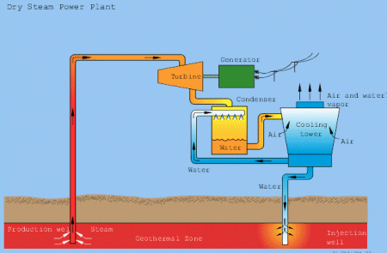
Geothermal Sources: Indirect Use (Power Generation)
Dry Steam Geothermal Power Plant
jefferson.gomes@abdn.ac.uk

Slide 13
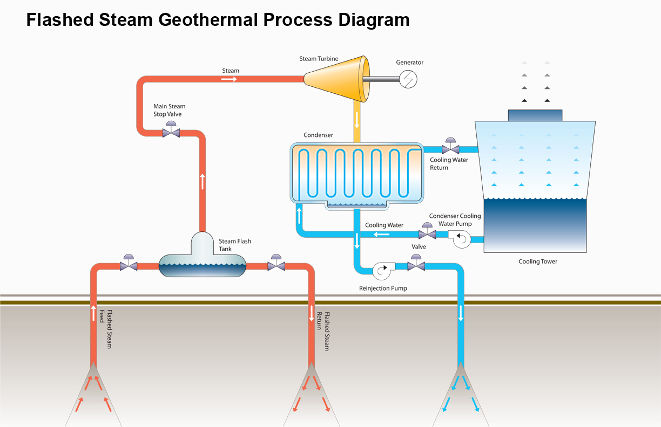
Geothermal Sources: Indirect Use (Power Generation)
Most common geothermal power plant;
T > 182°C;
Water is driven upwards through the well under its own pressure;
As it rises, pressure decreases leading to partial boiling ;
Liquid (hot) water and steam are separated (flash) and the steam drives the turbine
jefferson.gomes@abdn.ac.uk

Slide 14
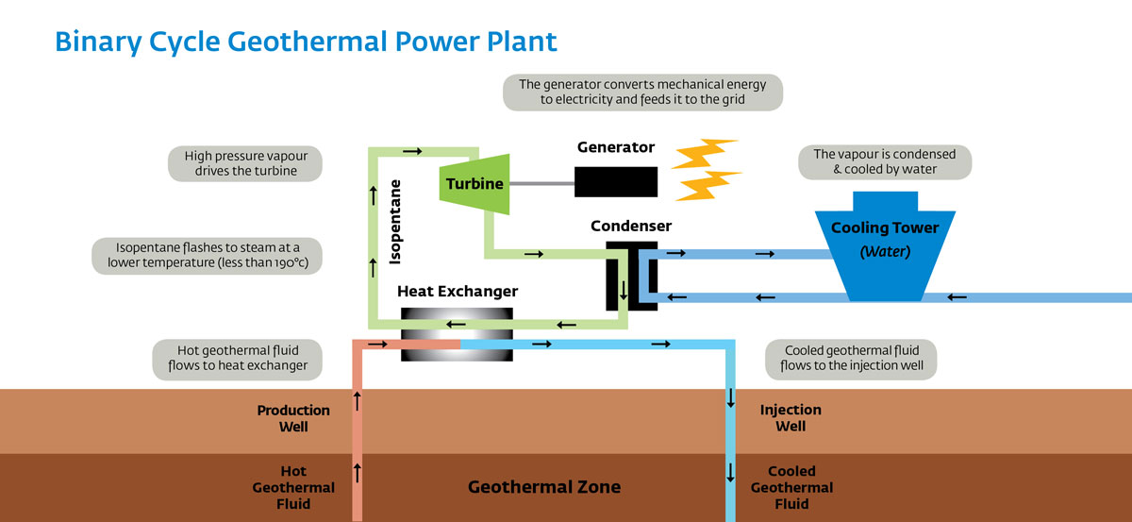
Geothermal Sources: Indirect Use (Power Generation)
107≤T ≤ 182°C;
Hot water is then used to boil the working fluid (often organic compound with low boiling point);
The vaporized working fluid is used to drive the turbine;
Thermal water and working fluid are operated in separated cycles with little emissions;
jefferson.gomes@abdn.ac.uk

Slide 15
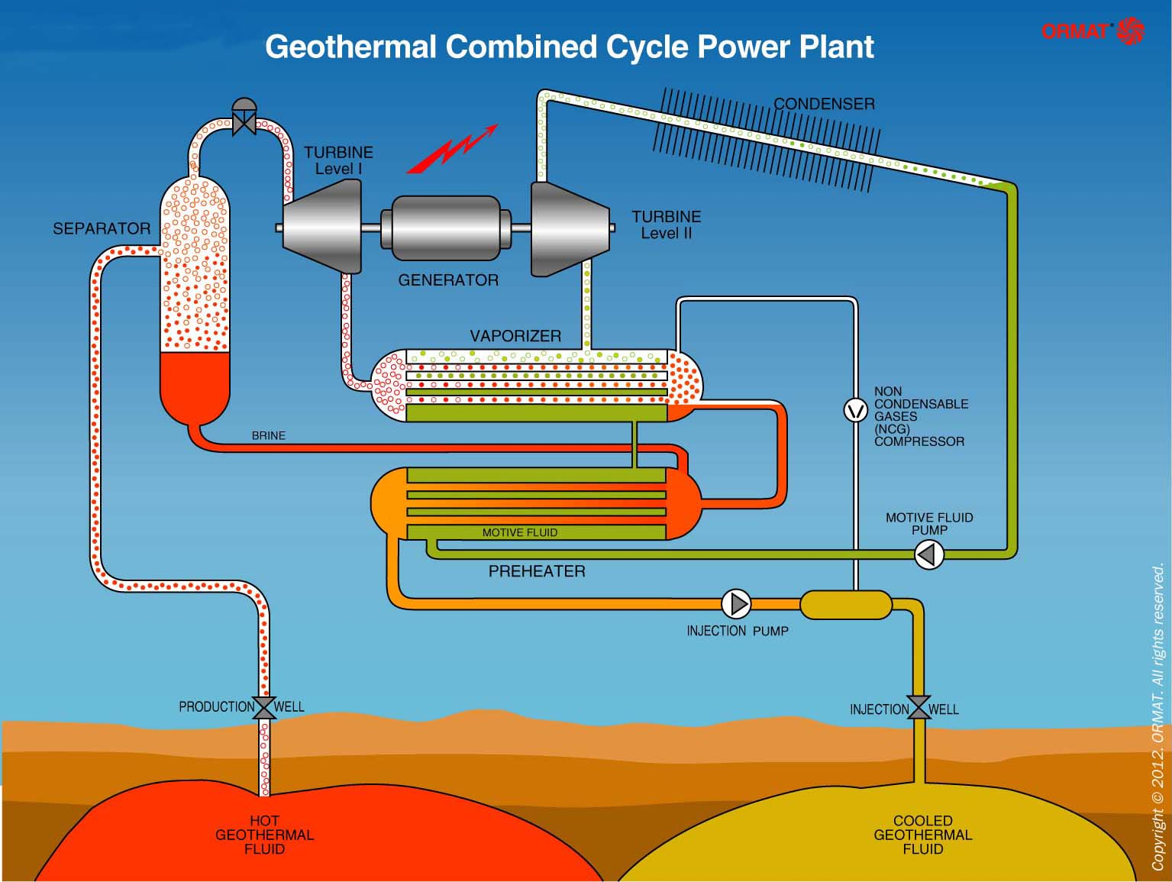
Geothermal Sources: Indirect Use (Power Generation)
Designed to be used with high and medium temperature sources;
Combining flash and binary power plant design.
jefferson.gomes@abdn.ac.uk

Slide 16
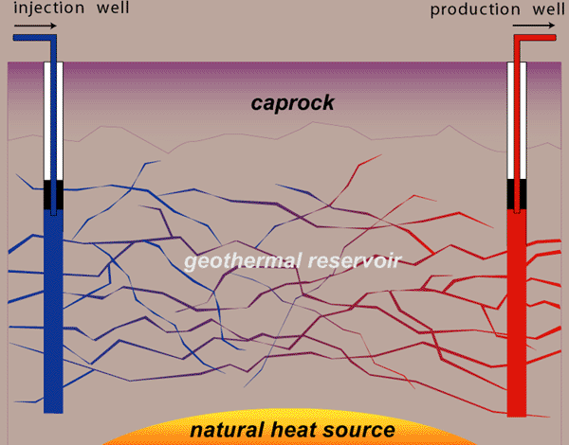
Geothermal Sources: Indirect Use (Power Generation)
Enhanced Geothermal Systems (EGS)
Used in deep subsurface with high temperature (150≤T ≤ 200°C);
Fractures are induced by injection of cold water into deep wells (often with low permeability);
Heat is transferred from the rocks to the water that is diffused through the fractures and;
Collected in production wells;
The hot fluid is then used as part of the previous power technologies.
Source: IPCC (2010) and
http://energy.gov/eere/geothermal/how-enhanced-geothermal-system-works
jefferson.gomes@abdn.ac.uk

Slide 17
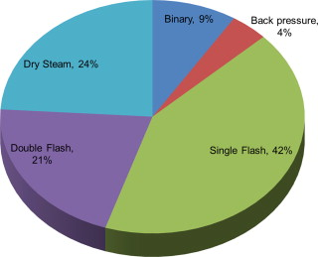
Geothermal Sources: Indirect Use (Power Generation)
Share of different geothermal plant technologies in global electricity production.
Source: Renewable and Sustainable Energy Reviews 26(2013):446-463.
Capital Cost of Geothermal Power Plants in the US
Source: IEA(2006).
jefferson.gomes@abdn.ac.uk

Slide 18
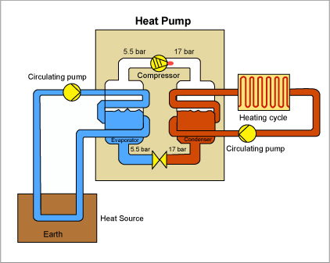
Geothermal Sources: Heat Pump
The nearly constant temperature in the soil at low depths (< 4 m) is used by geothermal heat pumps for heating and cooling of houses and industrial facilities;
Heat pumps are designed to use this low-grade heat source to keep temperatures of 10°–16°C;
This temperature range is enough to keep the environment warmer in the winter and cooler during the summer;
It operates two independent cycles.
jefferson.gomes@abdn.ac.uk

Slide 19
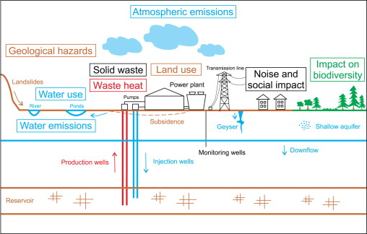
Environmental Impact
Source: Renewable and Sustainable Energy Reviews 26(2013):446-463.
jefferson.gomes@abdn.ac.uk

Slide 20
Energy Consumption
Environmental Impacts of Energy Matrix
FUEL PHASE | Coal | Petroleum | Natural Gas | Nuclear | Hydro | Solar Photovoltaic | Solar Power Tower | Wind | Fusion | Geothermal
Extraction | Mining accident; Lung damage | Drilling-spills (off-shore) | Drilling | Mining accidents; Lung damage | Construction | Mining accidents | -- | -- | He, Li, H₂ production | --
Refining | Refuse piles | Water pollution | -- | Milling tails | -- | -- | -- | -- | -- | --
Transportation | Collisions | Spills | Pipeline explosions | -- | -- | -- | -- | -- | -- | --
On-Site
Thermal | High efficiency | High efficiency | High efficiency | Low efficiency | -- | High efficiency; Ecosystem change | Ecosystem change | -- | -- | Low efficiency
Air | Particulates, SO₂, NOx | SO₂, NOx | NOx | Radiation releases | -- | -- | -- | -- | -- | H₂S
Water | Water treatment chemicals | Water treatment chemicals | Water treatment chemicals | Water treatment chemicals | Destroy prior ecosystems | Water treatment chemicals | Water treatment chemicals | -- | Tritium in cooling water | Brine in streams
Aesthetic | Large plant transmission lines | Large plant transmission lines | Large plant transmission lines | Large plant transmission lines | Large plant transmission lines | Poor large areas | Poor large areas | Large areas; Large towers; Noise | Small area | Poor large area
Wastes | Ash; Slag | Ash | -- | Spent fuel; Reprocessing waste storage | -- | Spent cells | -- | Irradiated structural material | -- | --
Special Problems | -- | -- | -- | -- | -- | Construction accidents | -- | Bird; Human injuries | Occupational radiation doses | --
Major Accidents | Mining | Oil spills | Pipeline explosions | Reactor cooling and meltdown | Dam failure | Fire | -- | -- | Tritium release | --
jefferson.gomes@abdn.ac.uk
Source: MITOpenCourseWare

Slide 21
Environmental Impact
Atmospheric Emissions:
NOx: small amounts mainly due to the combustion of H₂S;
H₂S (hydrogen sulfide): from volcano gases, petroleum deposits, natural gas and geothermal fluids and need to be captured;
SO₂: this compound is not directly released by geothermal power plants, but H₂S can react in the atmosphere and form SO₂;
Particulate matter (PM): this involves liquid droplets and particles from smoke, dust and ashes. Water-cooled geothermal power plants do emit small quantities of PM from cooling towers as steam condensates;
CO₂ : Geothermal power plants emit small quantities. Some geothermal reservoir fluids contain varying amounts of non-condensable gases, including CO₂.
jefferson.gomes@abdn.ac.uk

Slide 22
Environmental Impact
Plant Type | NO_{x} (kg/MWh) | SO₂ (kg/MWh) | CO₂ (kg/MWh) | PM
Coal-fired | 1.95 | 4.71 | 993.82 | 1.01
Oil-fired | 1.81 | 5.44 | 758.41 | NA
Natural Gas-fired | 1.34 | 0.10 | 549.75 | 0.06
Geothermal (flash) | 0 | 0.16 | 27.21 | 0
Geothermal (binary & flash/binary) | 0 | 0 | 0 | Traces
Geothermal (geysers dry steam) | Traces | Traces | 40.28 | Traces
Source: Kagel et al. (2007) A Guide to Geothermal Energy and the Environment, http://www.geo-energy.org
jefferson.gomes@abdn.ac.uk

Slide 23
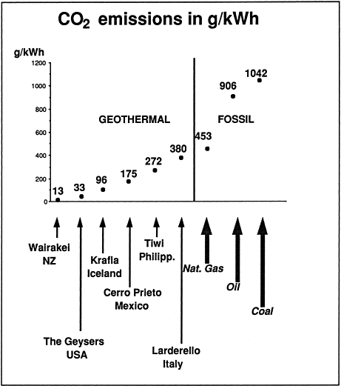
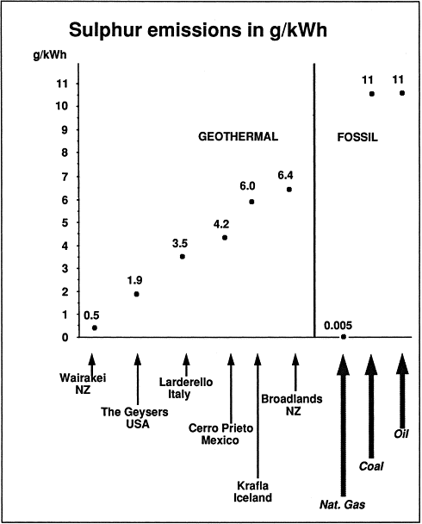
Environmental Impact
Source: Renewable and Sustainable Energy Reviews 6(2002):3-65.
jefferson.gomes@abdn.ac.uk

Slide 24
Environmental Impact
Solid and Liquid Waste: (Tutorial)
Arsenic is produced from the subsurface geothermal fluids as part of sludge and scales from the H₂S processing;
Waste is produced from drilling activities, as drilling cuttings (mainly bentonites). Mud and cuttings are stored as ‘sumps’ for disposal.
Land Use: (Tutorial)
Properties of small sizes;
Subsidence;
Induced seismicity;
Land slides.
Water Quality (Tutorial)
Chemical for water & wastewater treatment;
Cool brine.
jefferson.gomes@abdn.ac.uk

Slide 25
Energy Consumption
Summary
Current geothermal technologies;
Environmental impacts;
Drive for the future.
jefferson.gomes@abdn.ac.uk

Slide 26
Energy Consumption
Additional Reading
Annual Energy review 2011 (DoE/EIA-0384): http://www.eia.gov/totalenergy/data/annual/pdf/aer.pdf
Energy for a Sustainable Future: Reports and Recommendations (2010), The Secretary-General’s Advisory Group on Energy and Climate Change (AGECC): http://www.un.org/wcm/webdav/site/climatechange/shared/Documents/AGECC%20summary%20report%5B1%5D.pdf
The Future of Geothermal Energy: https://www1.eere.energy.gov/geothermal/pdfs/future_geo_energy.pdf
R. DiPippo (2012) ‘Geothermal Power Plants’; Butterworth Heinemann.
H.K. Gupta (1980) ‘Developments in Economic Geology – 12. Geothermal Resources: An Energy Alternative’; Elsevier.
H.C.H. Armstead (1983) ‘Geothermal Energy: Its Past, Present and Future Contribution to the Energy Needs of Man’; E&FN Spon.
E. Barbier (2002) ‘Geothermal Energy Technology and Current Status: An Overview’, Renewable & Sustainable Energy Reviews 6:3-65.
S.J. Zarrouk & H. Moon (2014) ‘Efficiency of Geothermal Power Plants: A Worldwide Review’, Geothermics 51:142-153.
L. Rybach (2003) ‘Geothermal Energy: Sustainability and the Environment’, Geothermics 32:463-470.
H.N. Pollack, S.J. Hurter, J.R. Johnson (1993) ‘Heat Flow from the Earth’s Interior: Analysis of the Global Data Set’, Reviews of Geophysics 31:267-280.
jefferson.gomes@abdn.ac.uk

