Slide 1
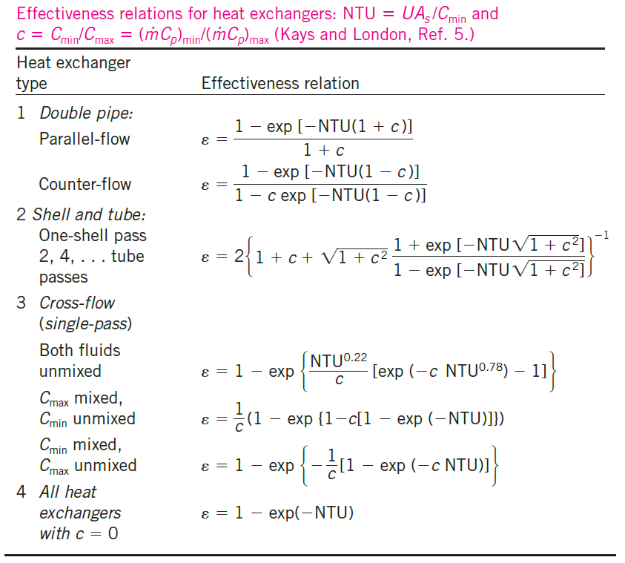
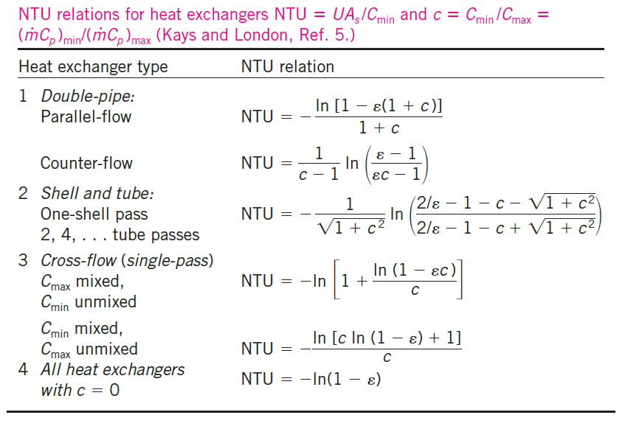
Table 10.3
Extracted from Y.A. Cengel, “Heat Transfer: A Practical Approach”, 2nd Edition.

