Slide 1
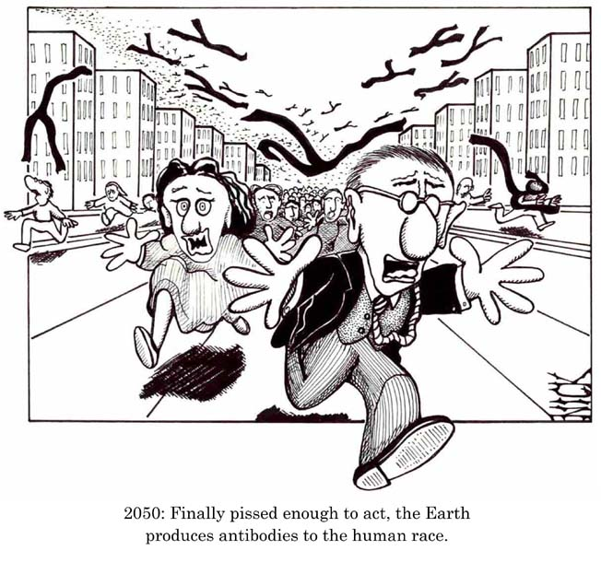
And now, THERMODYNAMICS!

Slide 2
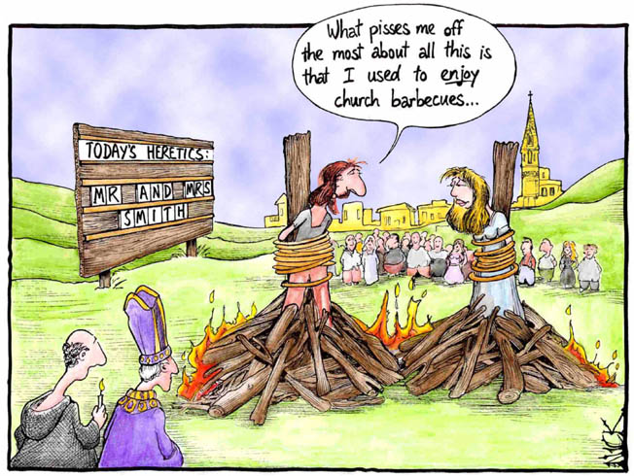
Thermodynamics need not be so hard if you think of it as heat and chemical “flow” between “phases”.

Slide 3
Derivation of Phase Rule
Let’s do a “book-keeping” exercise and evaluate the number of minerals (phases) that can co-exist in a chemical system under certain P,T conditions.
(Derivation adapted from Prince, 1967, Alloy Phase Equilibria)

Slide 4
The Gibbs Phase Rule
F = C - P + 2
  F = # degrees of freedom, or..
    The number of intensive parameters that must be specified in order to completely determine the system
    What does this MEAN?

Slide 5
The Phase Rule-P & C
F = C - P + 2
  P = # of phases
    phases are mechanically separable constituents
  C = minimum # of components (the # of chemical constituents that must be specified in order to define all phases)

Slide 6
The Phase Rule-”2”
F = C - P + 2
  2 = the number of intensive parameters
    Usually = 2 for Temperature and Pressure and this is especially useful for geologists

Slide 7
Derivation of Phase Rule
a balancing of
FIXED PARAMETERS
and
SYSTEM VARIABLES
??which means?????

Slide 8
HOW MANY VARIABLES ARE THERE IN A CHEMICAL SYSTEM?
Simplistically, “3”,
Pressure, Temperature, Composition,
BUT, for more than one phase, what is the TOTAL number of variables?

Slide 9
Assign
C components between P phases
For each Phase, composition is defined by (C-1) concentration terms.
For ALL Phases in the system, P(C-1) = the number of concentration terms.
Can also vary Pressure & Temperature, or P + T, which = 2 more variables.

Slide 10
Therefore,
the TOTAL NUMBER OF VARIABLES =
P(C-1) +2

Slide 11
NOW, LET’S EXAMINE HOW MANY FACTORS EXIST THAT FULLY DESCRIBE THE SYSTEM and ARE “FIXED” BY THE SET FACTORS.

Slide 12
Since the system is in equilibrium, BY DEFINITION, we have already implicitly defined some of the variables.
µ = chemical potential or chemical flux or energy between two minerals.

Slide 13
So, if system is “in equilibrium”,
and if there is NO NET CHANGE in the net “amounts” of chemicals moving between phases that are in dynamic equilibrium,
(e.g., NO NET MOVEMENT or CHEMICAL CHANGE, PLUS OR MINUS BETWEEN PHASES), then

Slide 14
^{A}µ_{α} = ^{A}µ_{β} = ^{A}µ_{γ}….. = ^{A}µ∞
^{B}µ_{α} = ^{B}µ_{β} = ^{B}µ_{γ}….. = ^{B}µ∞
^{C}µ_{α} = ^{C}µ_{β} = ^{C}µ_{γ}….. = ^{C}µ∞
The chemical potential or the chemical flux of a given chemical must be the same in all phases coexisting at equilibrium-No NET Change!

Slide 15
So,
^{A}µ_{α} = ^{A}µ_{β} & ^{A}µ_{β} = ^{A}µ∞
and, they yield
^{A}µ_{α} = ^{A}µ∞
and then,
TWO independent equations determine the equilibrium between 3 phases for EACH Component.

Slide 16
For EACH Component,
there are:
(P-1) independent equations relating the chemical potential, µ, of that component in ALL of the Phases.

Slide 17
For the GENERAL case of P phases and C components,
There are
C(P-1) independent equations.
Thus, we “FIX” C(P-1) variables when we stipulate that the system is in equilibrium.

Slide 18
Now, the number of independent variables or the total number of variations which can be made independently =
the total number of variables, less those that are automatically fixed.

Slide 19
F= number of “Freedom” factors
F = [P(C-1) +2] – [C(P-1)]
TOTAL AUTOMATICALLY
FIXED

Slide 20
The variance of a system or the Degrees of Freedom =
F= C-P +2
Which is called
the Gibb’s Phase Rule.
For a ”dry” system w/ no vapor,
F =C-P +1

Slide 21
The Goldschmidt Mineralogical Phase Rule
What is the likelihood of being on a specific reaction curve in P-T space or being in “general” P-T space, where P & T are variables?

Slide 22
The Phase Rule in Metamorphic Systems
If F ≥ 2 (at least P & T are variables) which is the most common situation, then the phase rule may be adjusted accordingly:
F = C - P + 2, and P = C
P ≤ C which is Goldschmidt’s “Mineralogical Phase Rule” when solid solutions and system is ”open” and components are “mobile”.
Notes:
The above simplified phase rule states that in the most common situation for a rock at equilibrium the number of phases is equal to or greater than the number of components
It has been called Goldschmidt’s mineralogical phase rule, or simply the mineralogical phase rule
It is useful in evaluating whether or not a rock is at equilibrium

Slide 23
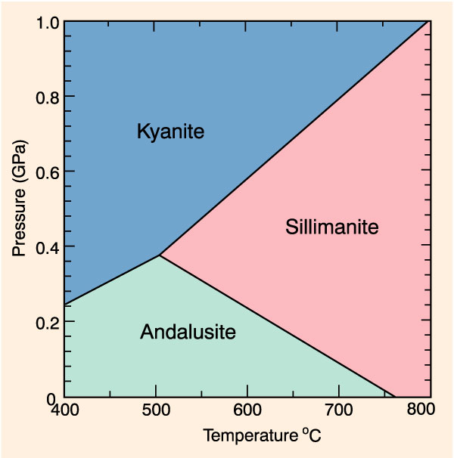
Consider each of the following three scenarios for P-T space for the alumino-silicate polymorphs:
C = 1
P= 1 common
P= 2 rare
P= 3 only at the specific P-T conditions of the invariant point
  (~ 0.37 GPa and 500ºC)
Calculated P-T phase diagram for the system Al₂SiO_{5.} Winter, 2001

Slide 24
“Problems” in real Rock Systems
Equilibrium has not been attained
    The phase rule applies only to systems at equilibrium, and there could be any number of minerals coexisting if equilibrium is not attained
We didn’t choose the number of components correctly
Notes:
Graywackes typically contain fragments of a number of different rocks in a matrix of grains derived from a rapidly eroding source
Dozens of minerals may be present, but they are not in equilibrium with one another
A number of igneous and metamorphic rocks also have retrograde reactions that begin, but do not run to completion

Slide 25
Choosing the number of components correctly
    Components that substitute for each other
    Adding a component such as NaAlSi₃O₈ (albite) to the 1-C anorthite system would dissolve in the anorthite structure, resulting in a single solid-solution mineral (plagioclase) below the solidus
    Fe and Mn commonly substitute for Mg
    Al may substitute for Si
    Na may substitute for K

Slide 26
Correct number of components: “Perfectly mobile” components
    Mobile components are either a freely mobile fluid component or a component that dissolves readily in a fluid phase and can be transported easily.
    The chemical activity of such components is commonly controlled by factors external to the local rock system
    They are commonly ignored in deriving C for most rock systems

