Slide 1
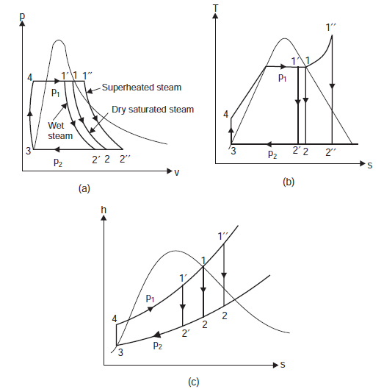
Rankine Cycle

