Slide 1
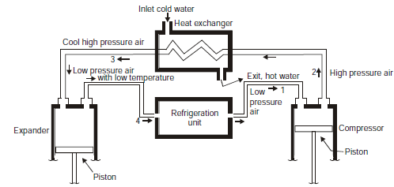
T
T
P
T
P2
2
P2
3
3
QH
2
S3
S1
1
P1
4
P1
4
1
QL
V
S3=S4
S1=S2
S

