Slide 1
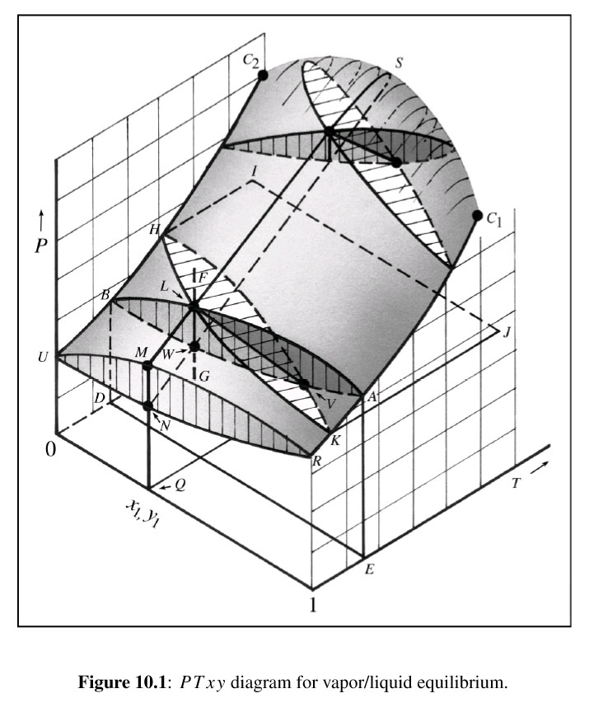
K₂
K₁
β
α

