Slide 1

Introduction to
Effective Permeability and
Relative Permeability

Slide 2
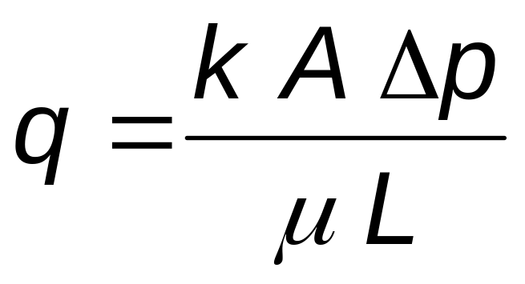
Review: Absolute Permeability
Absolute permeability: is the permeability of a porous medium saturated with a single fluid (e.g. S_{w}=1)
Absolute permeability can be calculated from the steady-state flow equation (1D, Linear Flow; Darcy Units):

Slide 3
Multiphase Flow in Reservoirs
Commonly, reservoirs contain 2 or 3 fluids
Water-oil systems
Oil-gas systems
Water-gas systems
Three phase systems (water, oil, and gas)
To evaluate multiphase systems, must consider the effective and relative permeability
Notes:
Multi-phase flow is common in most petroleum reservoirs. In such multi-phase systems, we need to quantify the flow of each phase in the presence of other phases. This is done through effective and relative permeability data.
We use sets of relative permeability data that correspond to the fluids moving in the reservoir.
Example :
We need to use a water-gas relative permeability set to perform reservoir engineering calculations when we study dry gas reservoirs under water influx from an aquifer

Slide 4
Effective Permeability
Effective permeability: is a measure of the conductance of a porous medium for one fluid phase when the medium is saturated with more than one fluid.
The porous medium can have a distinct and measurable conductance to each phase present in the medium
Effective permeabilities: (ko, kg, kw)
Amyx, Bass, and Whiting, 1960; PETE 311 Notes

Slide 5
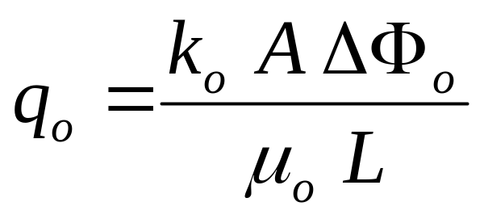
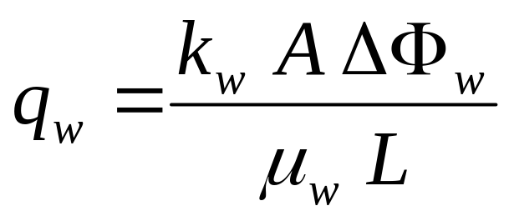
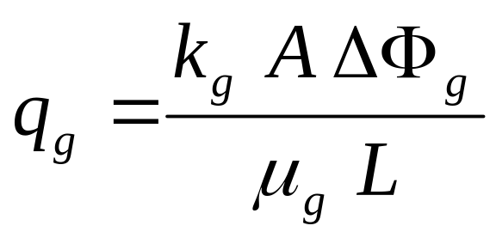
Effective Permeability
Steady state, 1D, linear flow equation (Darcy units):
q_{n} = volumetric flow rate for a specific phase, n
A = flow area
ΔΦ_{n} = flow potential drop for phase, n (including pressure, gravity and capillary pressure terms)
μ_{n} = fluid viscosity for phase n
L = flow length
Oil
Water
Gas
Modified from NExT, 1999; Amyx, Bass, and Whiting, 1960; PETE 311 NOTES

Slide 6
Relative Permeability
Relative Permeability is the ratio of the effective permeability of a fluid at a given saturation to some base permeability
Base permeability is typically defined as:
  absolute permeability, k
  air permeability, k_{air}
  effective permeability to non-wetting phase at irreducible wetting phase saturation [e.g. k_{o}(S_{w}=S_{wi})]
  because definition of base permeability varies, the definition used must always be:
    confirmed before applying relative permeability data
    noted along with tables and figures presenting relative permeability data
Amyx, Bass, and Whiting, 1960

Slide 7
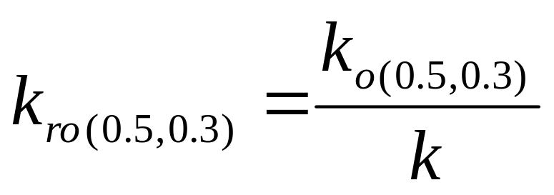


Relative Permeability
Oil
Water
Gas
So =0.5
Sw =0.3
∴Sg = 0.2
Modified from Amyx, Bass, and Whiting, 1960

Slide 8
Relative Permeability Functions
Imbibition Relative Permeability
(Water Wet Case)
1.00
k_{ro} @ S_{wi}
Wettability and direction of saturation change must be considered
  drainage
  imbibition
Base used to normalize this
relative permeability curve is
k_{ro} @ S_{wi}
As S_{w} increases, k_{ro} decreases
and k_{rw} increases until
reaching residual oil
saturation
0.80
Two-Phase Flow
Region
Residual Oil
Saturation
0.60
Relative Permeability (fraction)
Irreducible
Water
Saturation
Oil
0.40
0.20
k_{rw} @ S_{or}
Water
0
0
0.20
0.40
0.60
0.80
1.00
Water Saturation (fraction)
Modified from NExT, 1999
Notes:
The figure represents typical oil-water relative permeability data. Usually the experiment is done in the direction of increasing water saturation to simulate water injection in the reservoir. The base used to normalize the relative permeability data is the effective oil permeability at the irreducible water saturation.
As water saturation increases, the relative permeability to oil decreases and the water relative permeability increases until it reaches a maximum at the residual oil saturation.

Slide 9
Effect of Wettability for Increasing S_{w}
1.0
1.0
0.8
0.8
0.6
0.6
Relative Permeability, Fraction
Oil
Relative Permeability, Fraction
Oil
Water
0.4
0.4
0.2
0.2
Water
0
0
0
20
40
60
80
100
0
20
40
60
80
100
Water Saturation (% PV)
Water Saturation (% PV)
Strongly Water-Wet Rock
Strongly Oil-Wet Rock
Modified from NExT, 1999
Water flows more freely
Higher residual oil saturation
Notes:
In a strongly oil-wet system, water is expected to flow easier than in a strongly water-wet system. In addition, we generally would expect that the residual oil saturation will be higher.

Slide 10
Factors Affecting Relative Permeabilities
Fluid saturations
Geometry of the pore spaces and pore size distribution
Wettability
Fluid saturation history (i.e., imbibition or drainage)
After Standing, 1975
Notes:
The effect of fluid saturations was shown on previous slides. In general, relative permeability to a particular fluid increases as the saturation of that fluid increases.
The geometry of the rock pore spaces and grain size distribution also affect both the shape of the relative permeability curves and their end points. Different rock characteristics are expected to produce different relative permeability curves.
The effect of wettability and saturation history is shown in the following few slides.

Slide 11
Characteristics of Relative Permeability Functions
Relative permeability is unique for different rocks and fluids
Relative permeability affects the flow characteristics of reservoir fluids.
Relative permeability affects the recovery efficiency of oil and/or gas.
Modified from NExT, 1999
Notes:
Relative permeability data influence the flow of fluids in the reservoir. Relative permeability curves determine how much oil, gas, and water are flowing relative to each other.

Slide 12
Applications of
Relative Permeability Functions
Reservoir simulation
Flow calculations that involve multi-phase flow in reservoirs
Estimation of residual oil (and/or gas) saturation
Notes:
Effective and relative permeability data are used in almost all reservoir engineering calculations that involve movements of several fluids together.
Relative permeability data is an important input to reservoir simulation models. Reservoir simulation is used to study the reservoir behavior under a variety of conditions. Among the many uses of reservoir simulation models are:
- Prediction of reservoir performance
- Development planning
- Alternative production plans evaluation (water injection, gas injection, EOR… etc)
- Alternative well configurations (fractured wells, horizontal wells … etc)
Relative permeability is also an input to simple models that calculate flow of more than one fluid (e.g. water flooding models).
Relative permeability can also be used to estimate residual hydrocarbon saturation.

