Slide 1
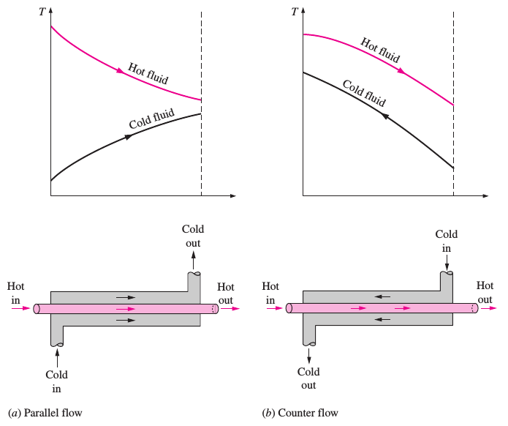
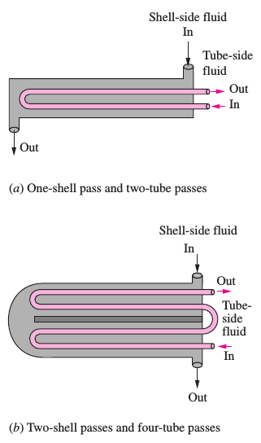
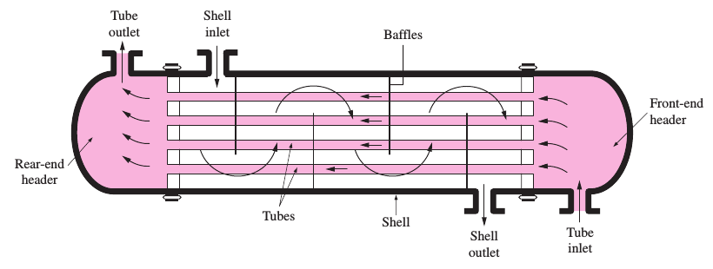
Concentric tube HE
Multipass flow arrangements in shell-and-tube HE.
Shell-and-tube HE (one-shell pass and one-tube pass)

