Slide 1
Introduction
Samuel Louvan
(Credit to Denny, Bayu, Alfan)
Notes:
Enterprise application: the phrase used to describe applications (or software) that a business would use to assist the organization in solving enterprise problems

Slide 2
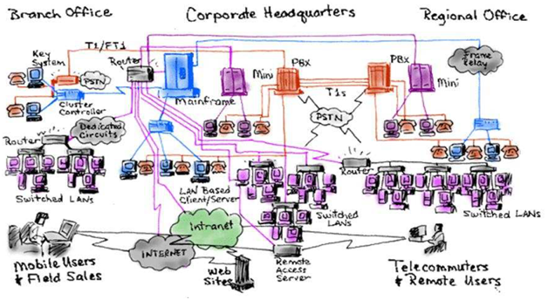
As the complexity of the system gets greater, the task of building the software gets exponentially harder.
http://labs.sogeti.com/testing/service-virtualization-new-or-old-news-for-software-testers/
Notes:
Membangun computer system sebenarnya tidak mudah...
Kok bisa nyampe ke sini?
Ceritain kalau dulu seperti apa, mainframe, mini computer, apple computer, windows PC, internet, mobile
Complexity in enterprise applications: complex business process, growing customer needs, demanding software requirements
Terkadang dalam membangun enterprise application, kita harus memenuhi ratusan bahkan ribuan requirement
In today’s corporate environment, enterprise applications are complex, scalable, distributed, component-based, and mission-critical. They may be deployed on a variety of platforms across corporate networks, intranets, or the Internet.
They are data-centric, user-friendly, and must meet stringent requirements for uptime, security, administration, and maintenance. In short, they are highly complex systems.
Di kuliah ini kita akan bahas:
pattern2 yang sering digunakan
Platform/framework untuk mengembangkan aplikasi enterprise yang scalable

Slide 3
Building Enterprise Applications
Building enterprise applications is hard

Slide 4
Architecture
"Architecture" is a term that lots of people try to define, with little agreement.
There are two common elements:
the highest-level breakdown of a system into its parts
decisions that are hard to change
Architecture influences the design of components, technology, and middleware
Notes:
Yang decision: keputusan yang diambil oleh developers dan harapannya tepat/benar karena keputusan2 tersebut dirasa sangat sulit untuk ubah.

Slide 5
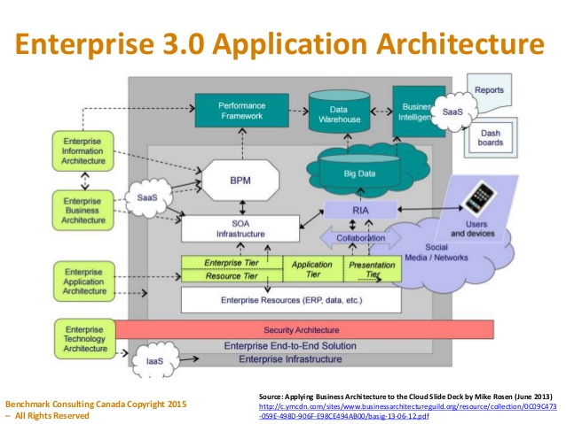
Architecture: contoh
Notes:
Alignment between business and IT
SOA?
BPM?
SaaS?
IaaS?
Need to understand about this

Slide 6
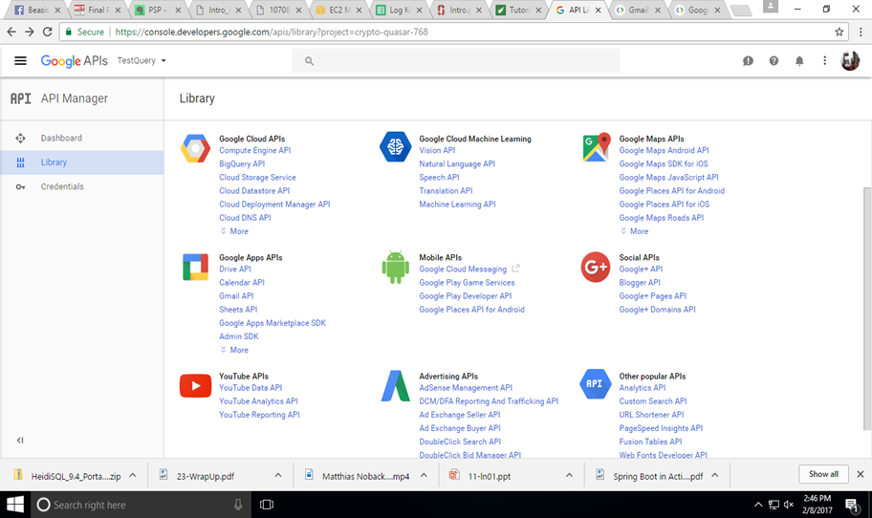
SOA

Slide 7




SaaS (Software as a Service)

Slide 8
SOA vs SaaS
Apa perbedaannya?

Slide 9
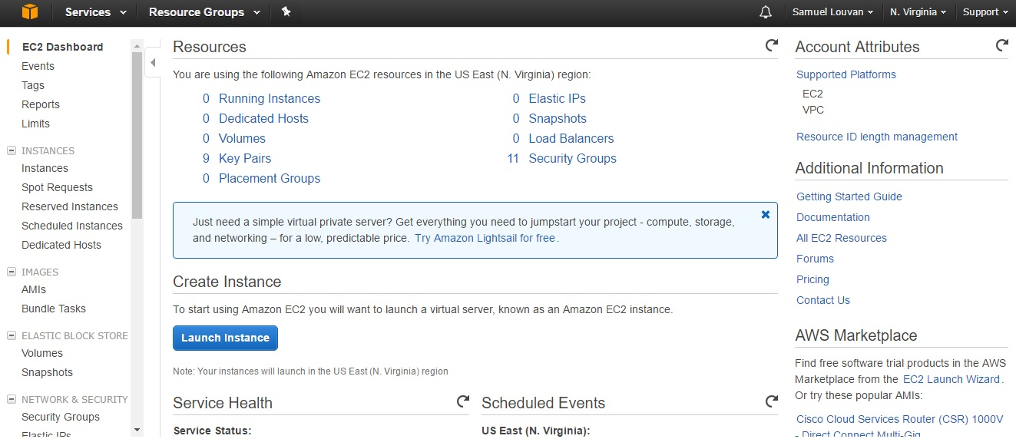
IaaS (Infrastructure as a Service)

Slide 10
Architecture
Architecture is a subjective thing
A shared understanding of a system's design by the expert developers on a project
This shared understanding is in the form of the major components of the system and how they interact
Notes:
Commonly this shared understanding is in the form of the major components of the system and how
they interact.
It's also about decisions, in that it's the decisions that developers wish they could get right
early on because they're perceived as hard to change. The subjectivity comes in here as well because, if you
find that something is easier to change than you once thought, then it's no longer architectural. In the end
architecture boils down to the important stuff—whatever that is

Slide 11
Architecture
The architectural pattern we show you is that of layers.
This lecture is about how you decompose an enterprise application into layers and how these layers work together.
Layer vs tier?
Notes:
Bukan cuma ini lho…

Slide 12
Enterprise Applications
Enterprise applications include:
patient records
shipping tracking
cost analysis
automated billing systems
supply chain
enterprise resource planning (ERP)
Notes:
automated billing systems
payment processing
email marketing systems
content management
call center and customer support
Customer Relationship Management (CRM)
Enterprise Resource Planning (ERP)
Business Intelligence
Business Continuity Planning (BCP)
HR Management
Enterprise Application Integration (EAI)
enterprise search
messaging and collaboration systems.
In some ways enterprise applications are much
easier than telecoms software—we don't have very hard multithreading problems, and we don't have
hardware and software integration.
But in other ways it's much tougher. Enterprise applications often have
complex data—and lots of it—to work on, together with business rules that fail all tests of logical reasoning.

Slide 13
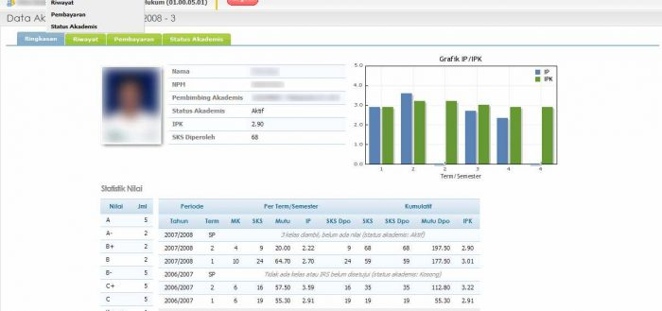
Enterprise Applications
Contoh: SIAK

Slide 14
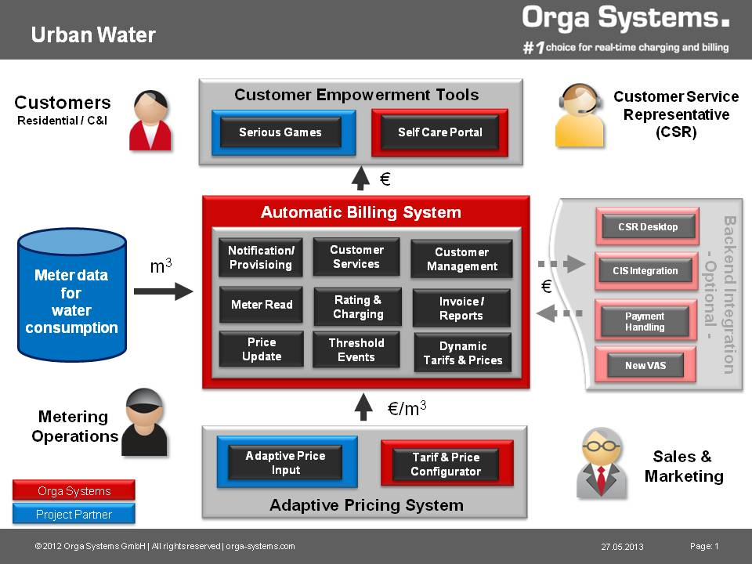
Enterprise Applications
Contoh: automated billing system
http://urbanwater-ict.eu/automatic-billing-system/

Slide 15
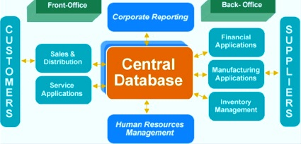
Enterprise Applications
Contoh: enterprise resource planning
http://www.maturski.org/EN-Management/Enterprise-Resource-Planning.html
Notes:
An Enterprise Resource Planning (ERP) system is an integrated computer-based application used to manage internal and external resources, including tangible assets, financial resources, materials, and human resources. Its purpose is to facilitate the flow of information between all business functions inside the boundaries of the organization and manage the connections to outside stakeholders.

Slide 16
Enterprise Applications
Enterprise applications DON’T include
automobile fuel injection
word processors
elevator controllers
chemical plant controllers
telephone switches
operating systems
compilers
and games

Slide 17
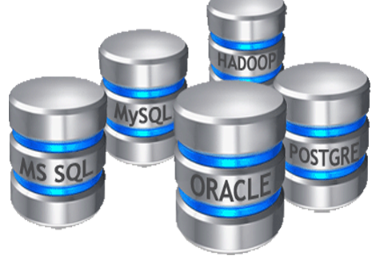
Enterprise Applications
Enterprise applications usually involve persistent data.
The data is persistent because it needs to be around between multiple runs of the program.
Notes:
Persistent data: data yang dapat disimpan. Biasanya dalam bentuk table database, atau files yang disimpan di fs
Selama bertahun-tahun, mungkin saja aplikasi/program yang menggunakan data tersebut berubah-ubah.
Bahkan data tersebut dapat disimpan lebih lama dibandingkan hardware dimana data itu dibuat, OS dimana data itu dibuat, compilers, dl
Business applications, B2C

Slide 18
Enterprise Applications
There's usually a lot of data - so much that managing it is a major part of the system.
Modern systems usually use databases, mostly relational databases.
Notes:
NoSQL?

Slide 19
Enterprise Applications
Usually many people access data concurrently.
For many systems this may be less than a hundred people, but for Web-based systems that talk over the Internet this goes up by orders of magnitude.
http://www.slideshare.net/Gomez_Inc/best-practices-to-fix-5-common-web-application-problems-gomez
Notes:
Ada isu dimana 2 users tidak boleh akses data yang sama secara bersamaan -> Transaction Manager
Why this is a problem?
Bagaimana handle hal ini?

Slide 20


Slide 21
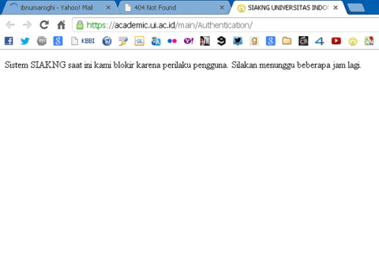

Slide 22
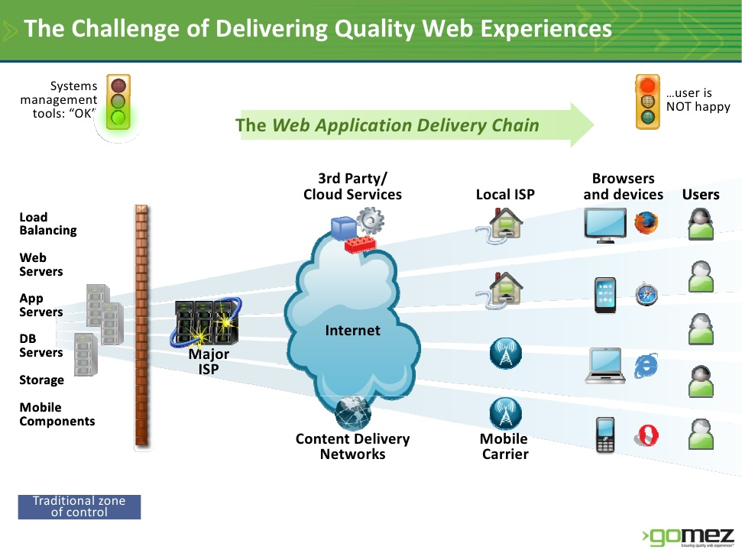
Notes:
Pipeline yang ada itu panjang …

Slide 23
Enterprise Applications
With so much data, there's usually a lot of user interface screens to handle it.
It's not unusual to have hundreds of distinct screens.

Slide 24
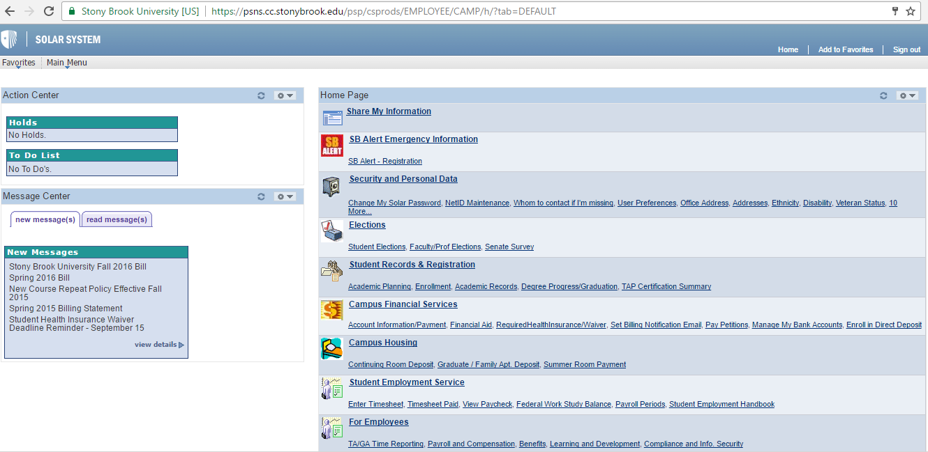
Stony Brook’s SOLAR UI

Slide 25
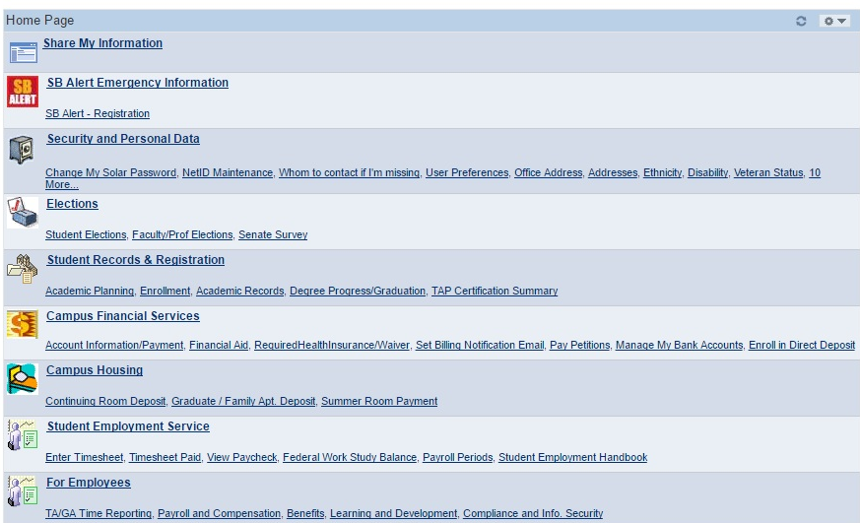
Enterprise Applications
Enterprise applications rarely live on an “island”.
Usually they need to integrate with other enterprise applications scattered around the enterprise.
Notes:
SIAK – SISIDANG – Plagiarism detection – Learning Analytics Module – SceLE
Komunikasi lewat CORBA, Web Service, RPC

Slide 26
Enterprise Applications
Complex business logic makes business software so difficult.
In this situation you have to organize the business logic as effectively as you can, because the only certain thing is that the logic will change over time.
Notes:
Kalau kita disuruh membuat OS, maka jelas kita pasti berusaha agar semuanya logical. => kapanpun logic itu sama.
Buatlah program yang mencari terpendek -> input sama -> sampai kapanpun hasilnya sama.
Business software kadang sulit, makanya kadang disebut “Business Illogic” : contoh -> business logic itu terus menerus berubah sepanjang waktu.
Retailer online shop system -> mempunyai sistem penawaran product di tanggal 1 setiap bulan, karena orang baru gajian dan pasti beli product.
Ternyata nggak juga. Bisa jadi orang malah nggak suka belanja tanggal 1, di akhir bulan malah banyak belanja.

Slide 27
Enterprise Applications
For some people the term "enterprise application" implies a large system.
However, it's important to remember that not all enterprise applications are large, even though they can provide a lot of value to the enterprise.
Notes:
Banyak orang beranggapan bahwa system yang kecil itu tidak bermasalah, jika gagal, maka akan memberikan efek noise sedikit.
Tapi jika ada banyak system kecil, akumulasi kegagalan bisa berbahaya !
Jika kita melakukan perbaikan di system kecil, dan banyak, maka efeknya juga bisa memperbaiki keseluruhan performance system

Slide 28
Kinds of Enterprise Applications
It's important to realize that enterprise applications are all different and that different problems lead to different ways of doing things.
“Always do this !” X
Notes:
?

Slide 29
Kinds of Enterprise Applications
B2C (business to customer) online retailer
People browse and—with luck and a shopping cart—buy
a very high volume of users: must be efficient in terms of resources, and scalable.
But, the domain logic for such an application can be pretty straightforward
Notes:
Scalable: load bisa ditambah jika kita tambah more hardware atau server misalnya, load balancer
Domain logic: order capturing, pricing and shipping calculations, shipment notification.
Mungkin perlu terhubung dengan sistem inventory untuk cek apakah barangnya ada atau tidak, dan informasi pengiriman

Slide 30
Kinds of Enterprise Applications
A system that automates the processing of leasing agreements.
much simpler system than the B2C retailer's; fewer users.
But, business logic is complicated.
System also has more complexity in the user interface (UI).
Notes:
Leasing agreement: perjanjian sewa
User sedikit: hanya ratusan paling.
Business logic: menghitung biaya bulanan sewa, handle early return & late payment, validasi data, UI complex
Database bisa mencakup lebih dari 200 tables
Lease
A contract by which the owner of property (lessor) grants to
another (lessee) the right to possess and use the property for a specified
period of time in exchange for a stipulated periodic payment (rent).

Slide 31
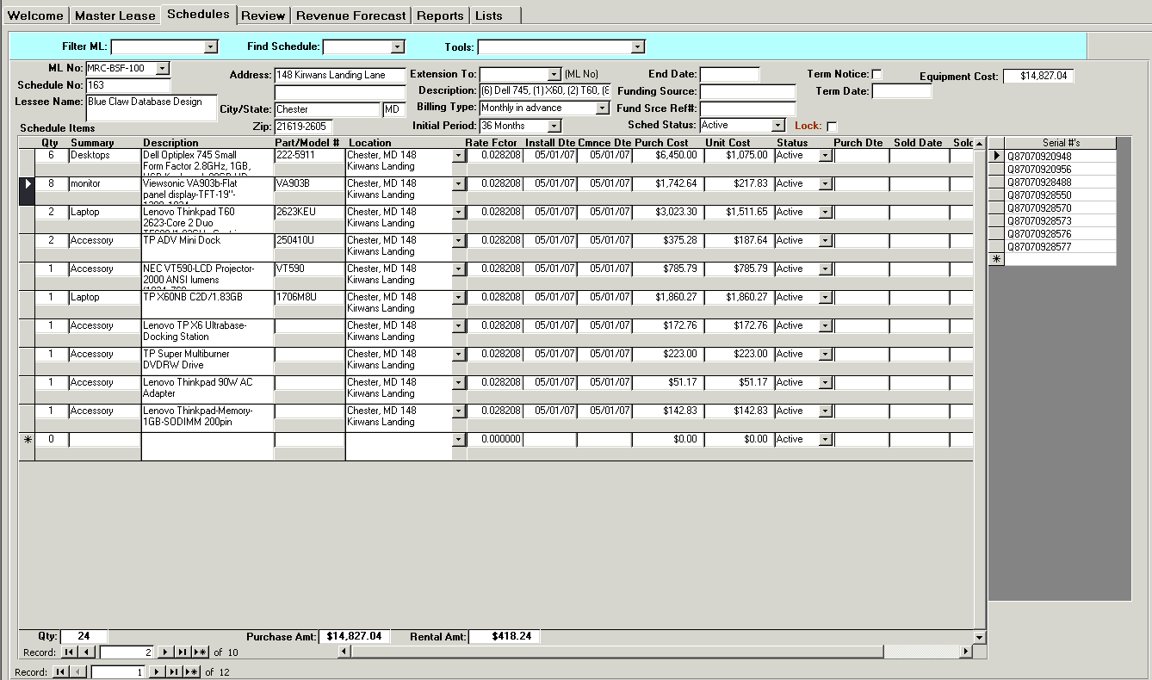
Kinds of Enterprise Applications

Slide 32
Kinds of Enterprise Applications
A simple expense-tracking system for a small company
has few users and simple logic
Trying to use the architecture for either of the previous two example systems will slow down the development of this one.
Notes:
Expense-tracking system: sistem yang menyimpan informasi beserta pengolahan data pengeluaran kita untuk apa saja.
Tanggal – product/expense – amount -
Each of these three enterprise application examples has difficulties, and they are different difficulties. As a
result you can't come up with a single architecture that will be right for all three. Choosing an architecture
means that you have to understand the particular problems of your system and choose an appropriate
design based on that understanding.
That's why in this book I don't give a single solution for your enterprise
needs. Instead, many of the patterns are about choices and alternatives. Even when you choose a particular
pattern, you'll have to modify it to meet your demands. You can't build enterprise software without thinking,
and all any book can do is give you more information to base your decisions on.

Slide 33
Thinking About Performance
Many architectural decisions are about performance.
It's always difficult to talk about performance because any advice about performance should not be treated as fact until it's measured on your configuration.
Notes:
Banyak sekali rancangan/design yang diterima atau ditolak karena isu performance, yang pada akhirnya itu semua tidak terbukti/bohon
Ketika seseorang pada akhirnya menguji dengan sebenarnya pada sebuah sistem.
Kuliah ini juga akan menyampaikan beberapa isu untuk isu performa, termasuk minimizing remote calls. Tetapi tetap apapun tips yang
Diberikan, kita tetap perlu melihat/mengujinya di sistem yang kita bangun di lingkungan yang sesungguhnya.
Jika ada perubahan di hardware atau lingkungan kita => aturan yang baik adalah kita perlu test ulang performanya

Slide 34
Thinking About Performance
Response time is the amount of time it takes for the system to process a request from the outside.
This may be a UI action, such as pressing a button, or a server API call.

Slide 35
Thinking About Performance
Responsiveness is about how quickly the system acknowledges a request as opposed to processing it.
This is important in many systems because users may become frustrated if a system has low responsiveness, even if its response time is good. → example: providing progress bar
Notes:
Seberapa cepat sistem menyampaikan kepada kita sejauh mana request sedang diproses.

Slide 36
Thinking About Performance
Latency is the minimum time required to get any form of response, even if the work to be done is nonexistent.
Throughput is how much stuff you can do in a given amount of time. For enterprise applications a typical measure is transactions per second (tps).
Notes:
Throughput: berapa banyak pekerjaan yang dapat dilakukan dalam selang waktu tertentu.
Latency: waktu minimal yang diperlukan agar reponse dijawab.
Di laptop: perintah donothing() akan cepat diproses dan langsung menjawab pertanyaan
Di sistem terdistribusi (remote call): perintah donothing() bisa agak lama karena isu jaringan request/response mengalir di kabel.

Slide 37
Thinking About Performance
Load is a statement of how much stress a system is under, which might be measured in how many users are currently connected to it.
Efficiency is performance divided by resources. A system that gets 30 tps on two CPUs is more efficient than a system that gets 40 tps on four identical CPUs.

Slide 38
Thinking About Performance
Scalability is a measure of how adding resources (usually hardware) affects performance.
A scalable system is one that allows you to add hardware and get a commensurate performance improvement, such as doubling how many servers you have to double your throughput.
Notes:
Important issues
Commensurate : sepadan
Vertical scalability, or scaling up,
means adding more power to a single server, such as more memory. Horizontal scalability, or scaling
out, means adding more servers.
Mana yang lebih scalable: awalnya :2 server, 20 tps.
Tambah 2 server, jadi 40tps
Tambah 2 server, jadi 30tps

Slide 39
Thinking About Performance
When building enterprise systems, it often makes sense to build for hardware scalability rather than capacity or even efficiency.
Often designers do complicated things that improve the capacity on a particular hardware platform when it might actually be cheaper to buy more hardware.
Similarly, adding more servers is often cheaper than adding more programmers—providing that a system is scalable.

Slide 40
Patterns
"Each pattern describes a problem which occurs over and over again in our environment, and then describes the core of the solution to that problem, in such a way that you can use this solution a million times over, without ever doing it the same way twice“ (Alexander et al.)

Slide 41
Patterns
The focus of the pattern is a particular solution, one that's both common and effective in dealing with one or more recurring problems.
A key thing about patterns is that you can never just apply the solution blindly! You have to tweak it a little bit for your own project.
Notes:
Contoh?

Slide 42
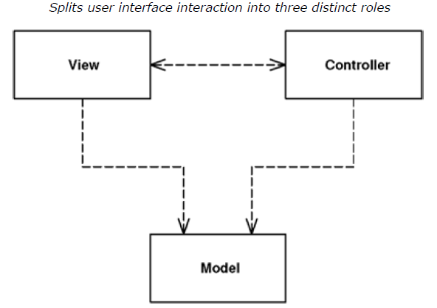
Patterns
Example on Web Presentation Patterns:
Model View Controller (MVC) is one of the most quoted (and most misquoted) patterns around !
Notes:
Kasih contoh

