Slide 1
Layering
Denny, Bayu, Alfan, Samuel

Slide 2
What is Layering?
Layering is one of the most common techniques that software designers use to break apart a complicated software system.

Slide 3
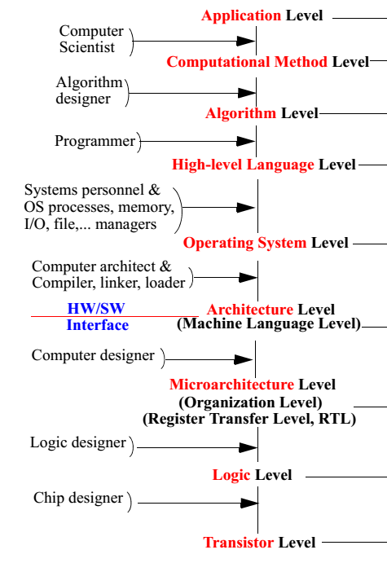
Example: Layering in Machine Architectures
cse.poly.edu/cs2214/layeredcompdesign.pdf

Slide 4
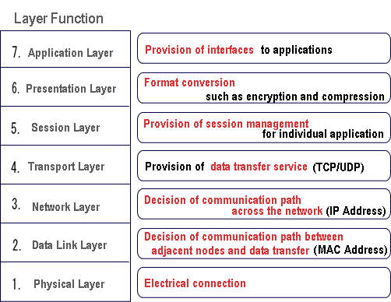
Example: Networking Layer (OSI 7 Layers)
http://markun.cs.shinshu-u.ac.jp/learn/osi/e_learn-a-2.htm
Notes:
Physical-- The interface between the medium and the device. The layer transmits bits (ones and zeros) and defines how the data is transmitted over the network, what control signals are used and the mechanical properties of the network (Cable size, connector for example.
Data Link-- Provides low-level error detection and correction. For example if a packet is corrupted this layer is responsible for retransmitting the packet.
Network-- Responsible for routing packets of data across the network. For example, a large email file will be divided up into packets, each packet addressed and sent out at this layer.
Transport-- An intermediate layer that higher layers use to communicate to the network layer. This layer hides the complexities of low-level networking communication from the higher levels.
Session-- The User's (transparent) interface into the network. The layer manages the ``current'' connection (or session) to the network. Note: In packet-switched network a full-time network connection does exist, even though it may seem so. The Session layer keeps the communication flowing.
Presentation-- Ensures computers speak the same language. They convert text to ASCII or EBCDIC form and also encode or decode binary data for transport.
Application-- The programs you use directly may need to communicate. E.g a file transfer or email program.

Slide 5
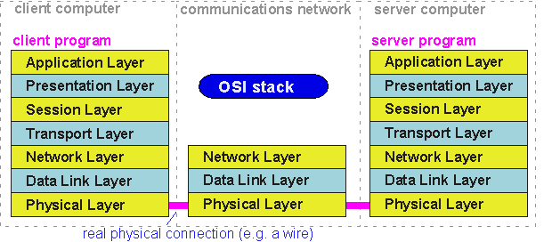
Example: Networking Layer (OSI 7 Layers)
http://www.ee.surrey.ac.uk/Projects/CAL/networks/Intro.htm
Notes:
Physical-- The interface between the medium and the device. The layer transmits bits (ones and zeros) and defines how the data is transmitted over the network, what control signals are used and the mechanical properties of the network (Cable size, connector for example.
Data Link-- Provides low-level error detection and correction. For example if a packet is corrupted this layer is responsible for retransmitting the packet.
Network-- Responsible for routing packets of data across the network. For example, a large email file will be divided up into packets, each packet addressed and sent out at this layer.
Transport-- An intermediate layer that higher layers use to communicate to the network layer. This layer hides the complexities of low-level networking communication from the higher levels.
Session-- The User's (transparent) interface into the network. The layer manages the ``current'' connection (or session) to the network. Note: In packet-switched network a full-time network connection does exist, even though it may seem so. The Session layer keeps the communication flowing.
Presentation-- Ensures computers speak the same language. They convert text to ASCII or EBCDIC form and also encode or decode binary data for transport.
Application-- The programs you use directly may need to communicate. E.g a file transfer or email program.

Slide 6
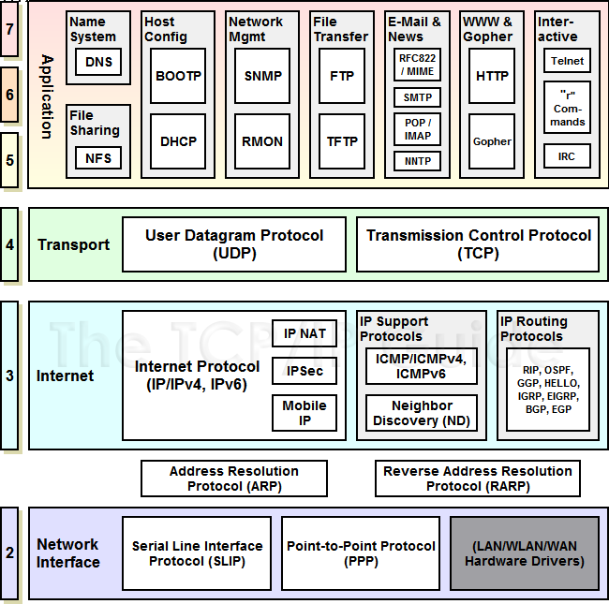
Example: Networking Layer (TCP/IP Layers)
http://www.tcpipguide.com/free/t_TCPIPProtocols.htm
Notes:
Host-to-Network Layer: It translates data and addresses information into format appropriate for an Ethernet Network or Token Ring Network. It uses a protocol (not specified due to lack of information concerned with this layer) in order for the host to connect to the network. Through this layer communication is achieved with physical links such as twisted pair or fiber optics carrying 1's and 0's.
Internet Layer: This layer is a connectionless internetwork layer and defines a connectionless protocol called IP. Its concerned with delivering packets from source to destination. These packets travel independently each taking a different route so may arrive in a different order than they were send. Internet layer does not care about the order the packets arrive at the destination as this job belongs to higher layers.
Transport Layer: It contains two end-to-end protocols. TCP is a connection oriented protocol and is responsible for keeping track of the order in which packets are sent and reassemble arriving packets in the correct order. It also ensures that a byte stream originating on one machine to be delivered without error on any other machine on the internet. The incoming byte stream is fragmented into discrete messages and is passed to the internet layer. With an inverse process, at the destination, an output stream is produced by reassembling the received massage.
UDP is the second protocol in this layer and it stands for User Datagram Protocol. In contrast to TCP, UDP is a connectionless protocol used for applications operating on its own flow control independently from TCP. It is also an unreliable protocol and is widely used for applications where prompt delivery is more important than accurate delivery. such as transmitting speech or video.
Application Layer: Is the upper layer of the model and contains different kinds of protocols used for many applications. It includes virtual terminal TELNET for remote accessing on a distance machine, File Transfer Protocol FTP and e-mail (SMTP). It also contains protocols like HTTP for fetching pages on the www and others.

Slide 7
Layered Systems
In this scheme the higher layer uses various services defined by the lower layer, but the lower layer is unaware of the higher layer.
Each layer usually hides its lower layers from the layers above, so layer 4 uses the services of layer 3, which uses the services of layer 2, but layer 4 is unaware of layer 2

Slide 8
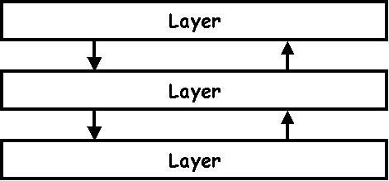
Layered Systems
A Layer is a design construct. It is implemented by any number of classes or modules that behave like they are all in the same layer.
http://www.dossier-andreas.net/software_architecture/layers.html

Slide 9
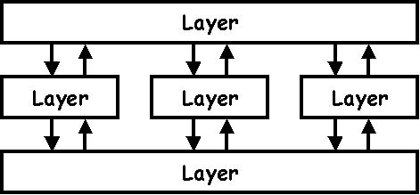
Layered Systems: How Does It Work?
The user calls a function on an object in the upper layer.
This object calls functions in the layer below.
These functions in turn approach the layer below and the layer above. Etc.
Eventually the function is performed and control is returned to the user. All this is usually done sequentially, in the same thread.
http://www.dossier-andreas.net/software_architecture/layers.html

Slide 10
The Benefits
You can understand a single layer as a coherent whole without knowing much about the other layers.
You can substitute layers with alternative implementations of the same basic services.
You minimize dependencies between layers.
Layers make good places for standardization.
Once you have a layer built, you can use it for many higher-level services.
Thus, TCP/IP is used by FTP, telnet, SSH, and HTTP.

Slide 11
The Downsides
Layers encapsulate some, but not all, things well.
The classic example of this in a layered enterprise application is adding a field that needs to display on the UI, must be in the database, and thus must be added to every layer in between (cascading changes).
Extra layers can harm performance.
But the hardest part of a layered architecture is deciding what layers to have and what the responsibility of each layer should be.

Slide 12
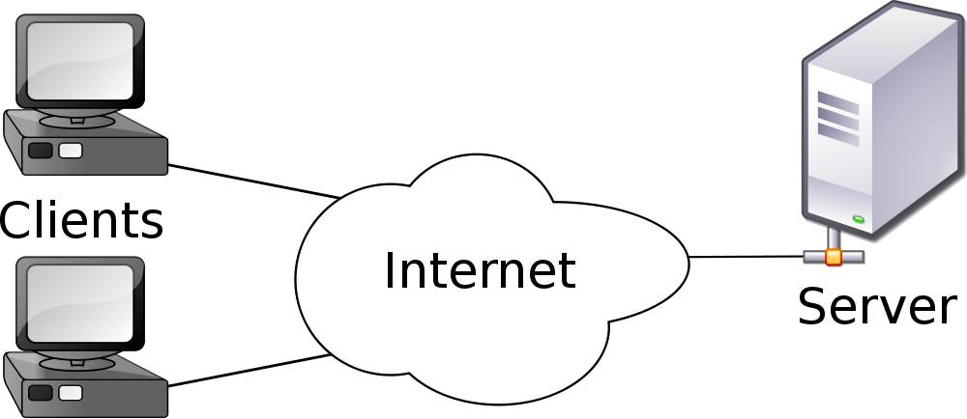
The Evolution of Layers in Enterprise Applications
The notion of layers became more apparent in the '90s with the rise of client–server systems (a two-layer system).
The client held the user interface and other application code.
The server was usually a relational database.
If the application was all about the display and simple update of relational data, then these client–server systems worked very well.
http://imasters.expert/rest-architecture-model-definition-constraints-benefits/

Slide 13
The Evolution of Layers in Enterprise Applications
Problem With Client-Server Model?
The problem came with domain logic: business rules, validations, calculations, and the like.
Usually people would write these on the client, but this was awkward and usually done by embedding the logic directly into the UI screens.
As the domain logic got more complex, this code became very difficult to work with.

Slide 14
The Evolution of Layers in Enterprise Applications
At the same time that client–server was gaining popularity, the object-oriented world was rising.
The object community had an answer to the problem of domain logic: Move to a three-layer system.
In this approach you have a presentation layer for your UI, a domain layer for your domain logic, and a data source.

Slide 15
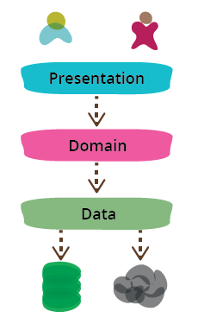
The Three Layers
You often see web applications divided into a web layer that:
knows about handling http requests and rendering HTML, [presentation layer]
a business logic layer that contains validations and calculations, [domain layer]
and a data access layer that sorts out how to manage persistent data in a database or remote services. [data layer]
http://martinfowler.com/bliki/PresentationDomainDataLayering.html
Notes:
Another reason to modularize is to allow me to substitute different implementations of modules. This separation allows me to build multiple presentations on top of the same domain logic without duplicating it.
Modularity also supports testability, which naturally appeals to me as a big fan of SelfTestingCode.
Benefit of modularity: substitutability and testability

Slide 16
The Three Layers: Presentation
Responsibility: to display information to the user and to interpret commands from the user into actions upon the domain and data source.
How to handle the interaction between the user and the software
This can be as simple as a command-line or text-based menu system
These days, it's more likely to be a rich-client graphics UI or an HTML-based browser UI

Slide 17
The Three Layers: Data Source
Responsibility: to communicate with other systems that carry out tasks on behalf of the applications.
Communication with Databases
Mostly in many enterprise applications, the biggest piece of data source logic is a database that is responsible for storing persistent data
Communication with other applications
Communication with Messaging systems
Communication with Transaction managers
Notes:
What is messaging systems
What is transaction managers

Slide 18
The Three Layers: Domain Logic
Responsibility: This is the work that this application needs to do for the domain you're working with
Also referred as Business Logic
It involves calculations based on inputs and stored data
validation of any data that comes in from the presentation
and figuring out exactly what data source logic to dispatch
Notes:
Permasalahan: kadang kita sulit mendeteksi apa yang menjadi domain logic ?
Simple test:
TEST #1 An informal test I like is to imagine adding a
radically different layer to an application, such as a command-line interface to a Web application. If there's
any functionality you have to duplicate in order to do this, that's a sign of where domain logic has leaked into
the presentation
TEST #2 Similarly, do you have to duplicate logic to replace a relational database with an XML file?
EXAMPLES LALALA

Slide 19
The Three Layers
Sometimes the layers are arranged so that the domain layer completely hides the data source from the presentation.
More often, however, the presentation accesses the data store directly.
While this is less pure, it tends to work better in practice ☺
Notes:
Sometimes the layers are arranged so that the domain layer completely hides the data source from the
presentation. More often, however, the presentation accesses the data store directly. While this is less pure,
it tends to work better in practice.
The presentation may interpret a command from the user, use the data
source to pull the relevant data out of the database, and then let the domain logic manipulate that data
before presenting it on the glass.

Slide 20
The Three Layers: How to separate them?
It depends on how complex the application is !
As the system gets more complex, we would break the three layers into separate classes.
As complexity increased, we would divide the classes into separate packages.
Make sure you do some kind of separation—at least at the subroutine level!
Notes:
A small program may just put separate functions for the layers into different files. A larger system may have layers corresponding to namespaces with many classes in each.

Slide 21
The Three Layers: Some Rules...
The domain and data source should never be dependent on the presentation!
What does it mean? There should be no subroutine call from the domain or data source code into the presentation code.
Benefit: It will be easier for us to substitute with other/different presentations ☺

Slide 22
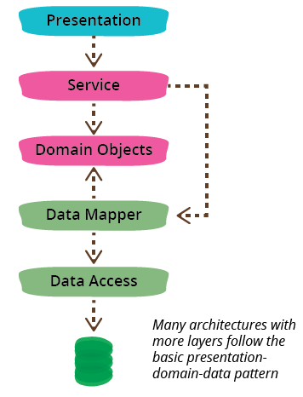
Variations on The Three Layers
A common variation is to put a service layer between the domain and presentation.
A common variation is to arrange things so that the domain does not depend on its data sources by introducing a mapper between the domain and data source layers.
This is often referred to as Hexagonal Architecture
http://martinfowler.com/bliki/PresentationDomainDataLayering.html

Slide 23
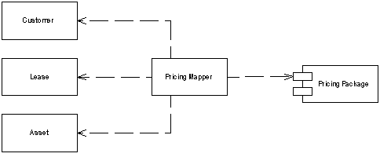
Variations on The Three Layers
What is mapper? An object that sets up a communication between two independent objects.
http://martinfowler.com/eaaCatalog/mapper.html
Notes:
Sometimes you need to set up communications between two subsystems that still need to stay ignorant of each other. This may be because you can't modify them or you can but you don't want to create dependencies between the two or even between them and the isolating element.

Slide 24
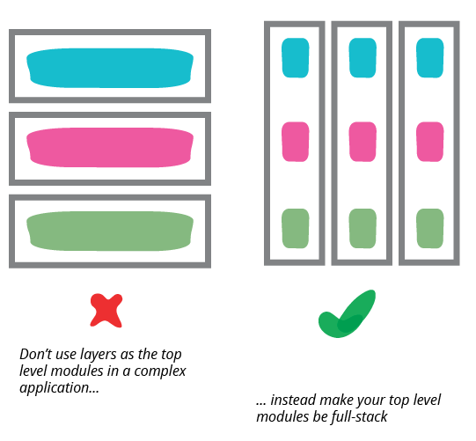
When your system gets sufficiently complex
Once any of these three layers gets too big you should split your top level into domain oriented modules which are internally layered.
http://martinfowler.com/bliki/PresentationDomainDataLayering.html

Slide 25
Choosing Where to Run Your Layers
Until now, we were talking about logical layers/separation, dividing a system into separate pieces to reduce the coupling between different parts of a system.
It is very useful even if all the layers are running on one pysical machine.
Now, we are talking about physical separation. there are places where the physical structure of a system makes a difference.

Slide 26
Choosing Where to Run Your Layers
Simple case: Run everything on servers !
Advantages:
Every thing is easy to upgrade and fix
You don't have to worry about deployment to many desktops
You don't have to worry about compatibilities with other desktop software
Problems:
Problems on responsiveness and disconnected operations
Notes:
For most IS applications the decision is whether to run processing on a client, on a desktop machine, or on a
server.
The great advantage of running on the server is that everything is easy to upgrade and
fix because it's in a limited amount of places.

Slide 27
Choosing Where to Run Your Layers
Alternatives: we can look at the options layer by layer
Data Source
The data source pretty much always runs only on servers.
The exception is where you might duplicate server functionality onto a suitably powerful client, usually when you want disconnected operation.

Slide 28
Choosing Where to Run Your Layers
Alternatives: we can look at the options layer by layer
Presentation
It depends mostly on what kind of user interface you want
Running a rich client pretty much means running the presentation on the client.
Running a Web interface pretty much means running on the server
Notes:
If you're building a B2C system, you have no choice. Any Tom, Dick, or Harriet can be connecting to your
servers and you don't want to turn anyone away because they insist on doing their online shopping with a
TRS-80. In this case you do all processing on the server and offer up HTML for the browser to deal with. Your
limitation with the HTML option is that every bit of decision making needs a roundtrip from the client to the
server, and that can hurt responsiveness. You can reduce some of the lag with browser scripting and
downloadable applets, but they reduce your browser compatibility and tend to add other headaches.

Slide 29
Choosing Where to Run Your Layers
Alternatives: we can look at the options layer by layer
Domain Logic
You can run business logic all on the server or all on the client, or you can split it.
Again, all on the server is the best choice for ease of maintenance
The demand to move it to the client is for either responsiveness or disconnected use.
Notes:
Jika berjalan pada client, In this case you can still keep your domain logic in separate modules from the presentation
Splitting across both the desktop and the server sounds like the worst of both worlds because you don't
know where any piece of logic may be. The main reason to do it is that you have only a small amount of
domain logic that needs to run on the client. The trick then is to isolate this piece of logic in a self-contained
module that isn't dependent on any other part of the system. That way you can run that module on the client
or the server.

Slide 30
Simple Example - Java

