Slide 1
Development Using Framework & MVC Pattern
Denny, Bayu, Alfan,Samuel

Slide 2
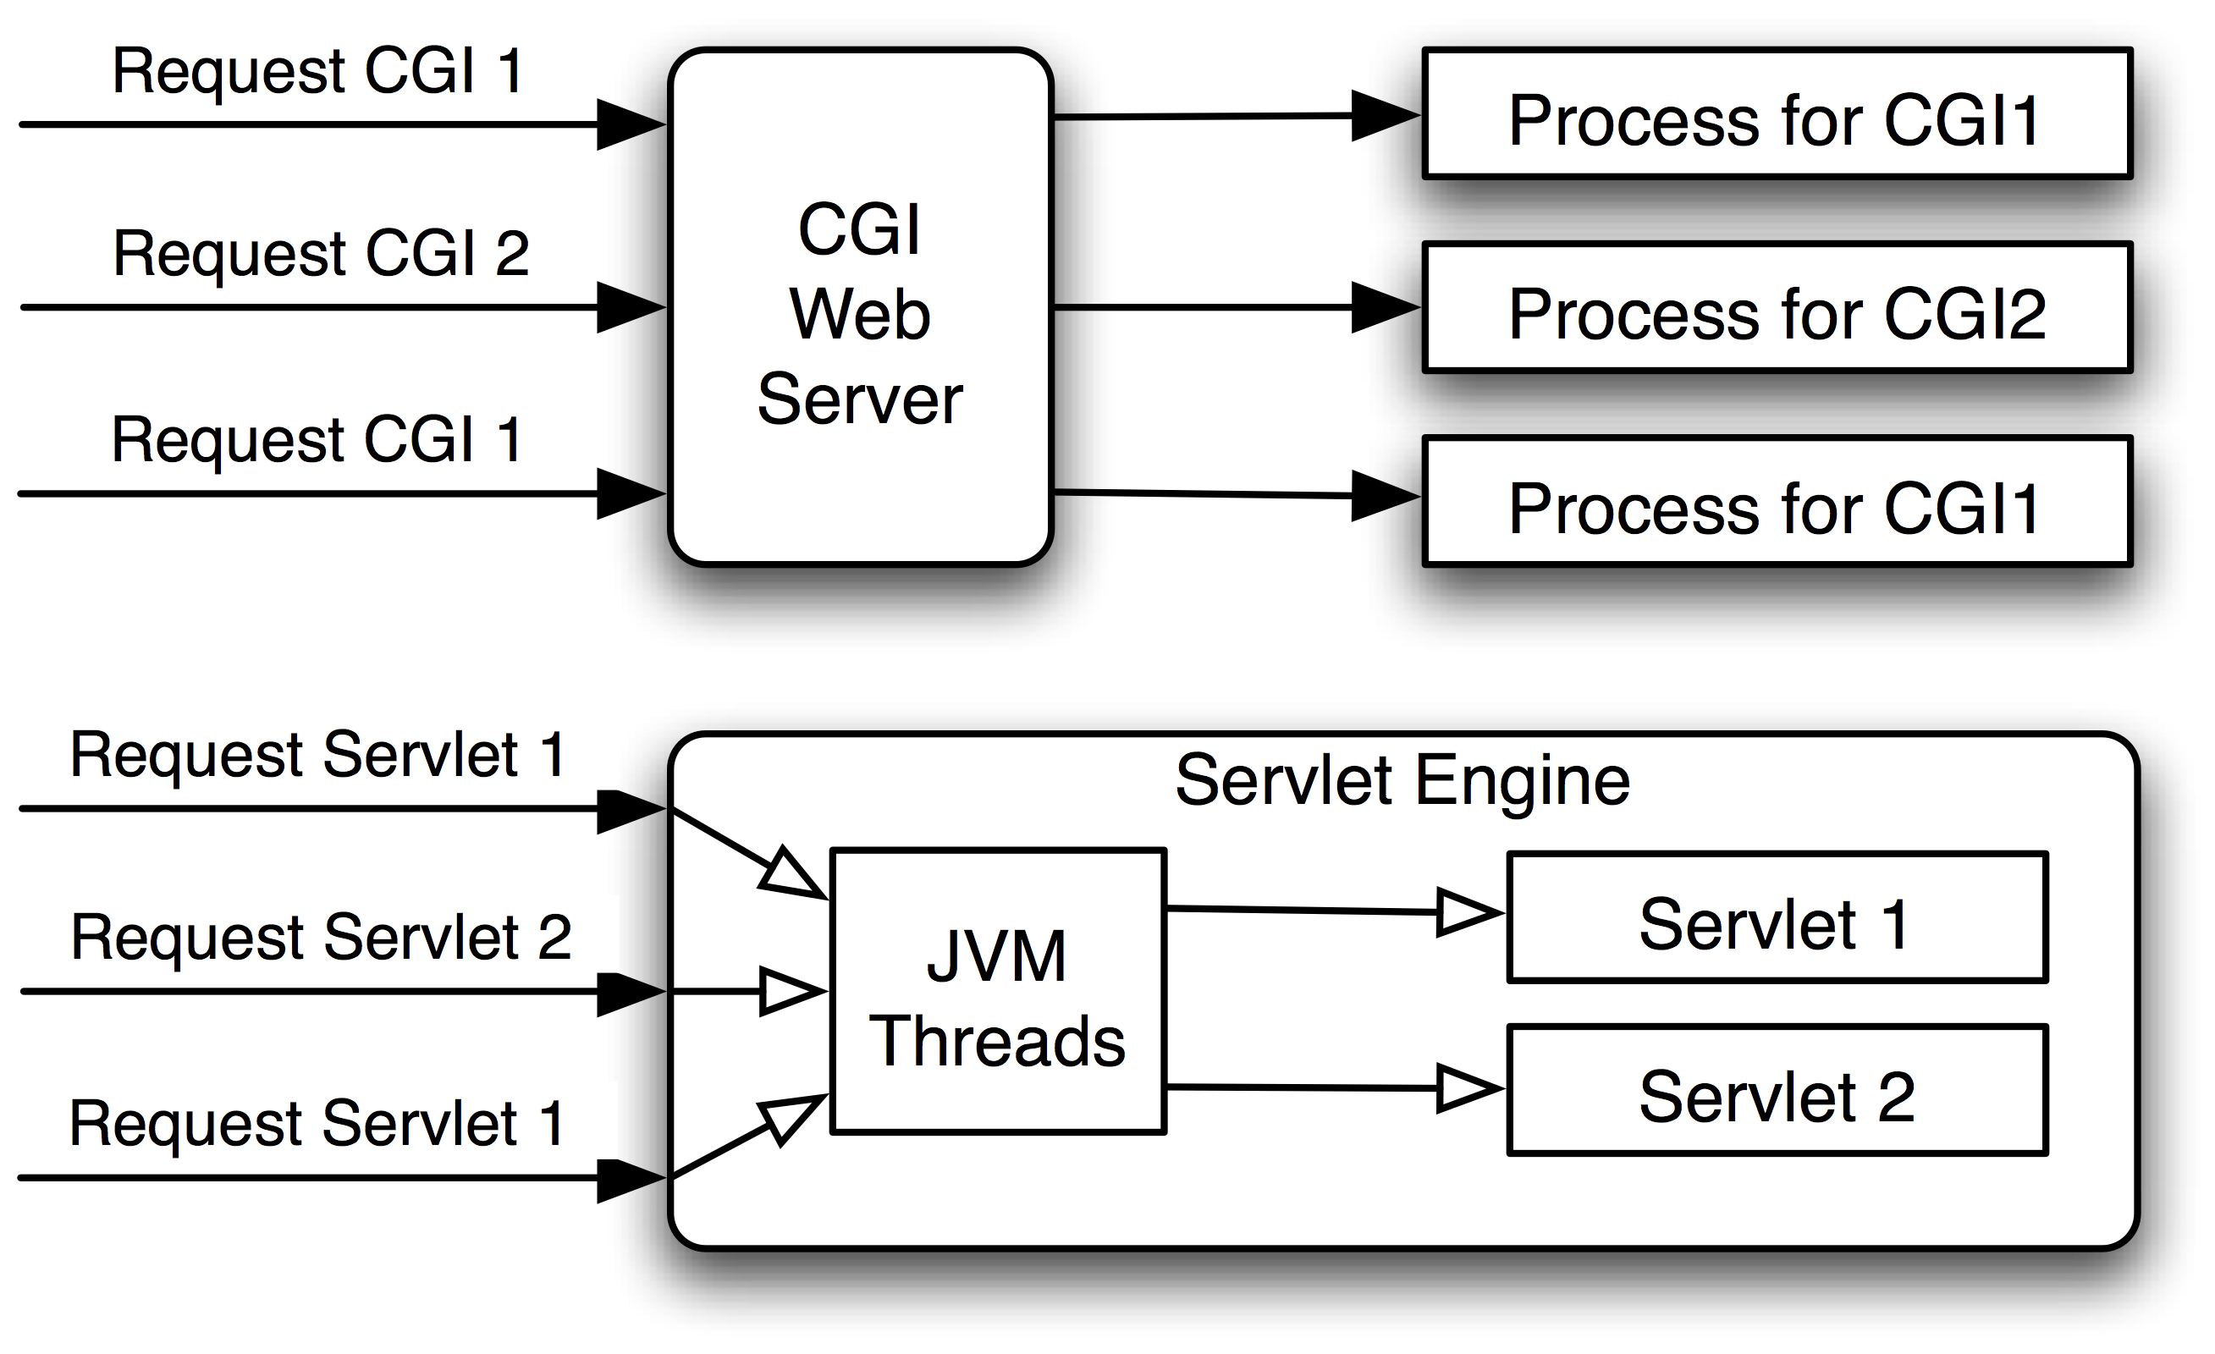
CGI , Servlet

Slide 3
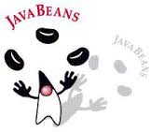
JavaBeans
Basically, just classes

Slide 4
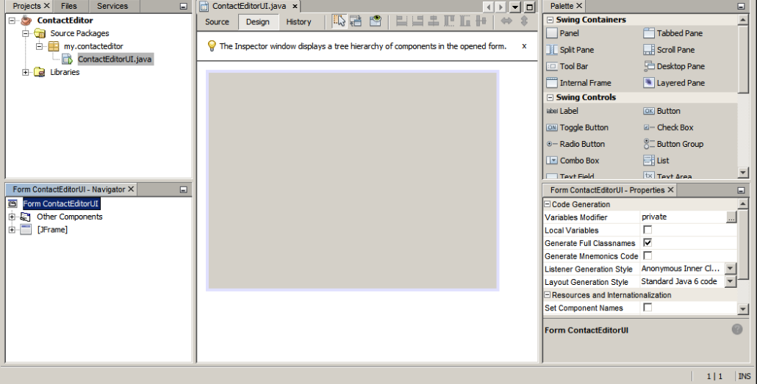
JavaBeans

Slide 5
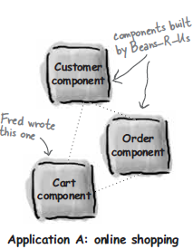
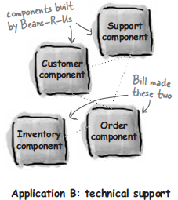
Enterprise Java Beans (EJB)
Component based development:
Reuse and customize

Slide 6
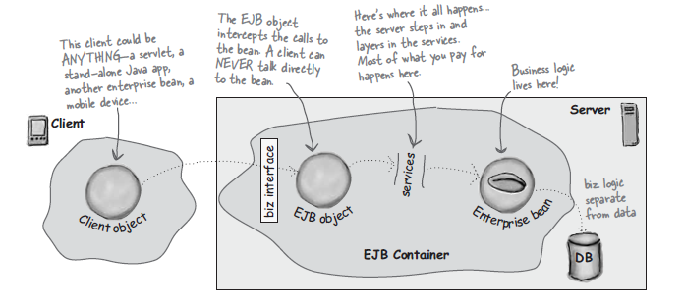
Enterprise Java beans

Slide 7
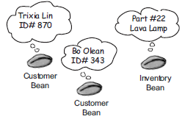
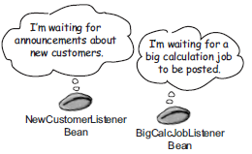
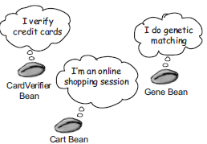
Enterprise Java Beans
Entity
Message-Driven
Session

Slide 8
Enterprise Java Beans
Create bean class
Create two interfaces
XML deployment descriptor
JAR file
Deplot

Slide 9
Java EE
EJB + Servlet ≈ Java EE

Slide 10
Java EE
Notes:
http://www.c4learn.com/java/servlet/servlet-vs-cgi/
http://www.kai-waehner.de/blog/2011/11/21/why-i-will-use-java-ee-jee-and-not-j2ee-instead-of-spring-in-new-enterprise-java-projects-in-2012/

Slide 11

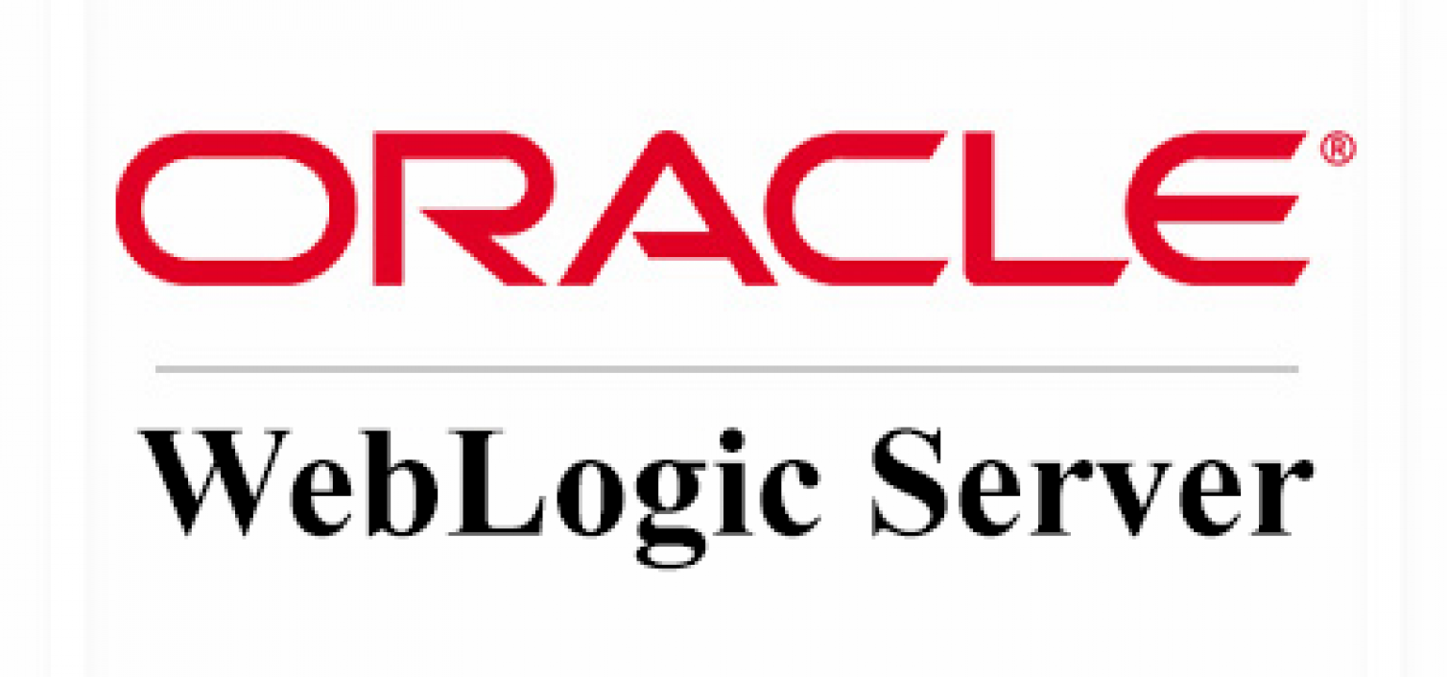
Application Server

Slide 12
Application Server
HTTP Server
EJB Server
JDBC
JNDI
Servlets
JSP
RMI
Notes:
http://www.c4learn.com/java/servlet/servlet-vs-cgi/

Slide 13
Why Framework ?
There is a huge amount of activity in building alternatives to the mainstream J2EE technologies.
A lot of this is a reaction to the heavyweight complexity in the mainstream J2EE world, but much of it is also exploring alternatives and coming up with creative ideas.
A common issue to deal with is how to wire together different elements and to provide a general capability to assemble components from different layers.
Solution? Lightweight Containers/Lightweight Frameworks
Notes:
History
EJB + Servlet
J2EE vs Spring
J2EE is a abstract specification
http://www.kai-waehner.de/blog/2011/11/21/why-i-will-use-java-ee-jee-and-not-j2ee-instead-of-spring-in-new-enterprise-java-projects-in-2012/
POJO vs complex EJB objects
Jetty / Tomcat vs full application server
More flexible : Spring
A common issue to deal with is how to wire together different elements: how do you fit together this web controller architecture with that database interface backing when they were built by different teams with little knowledge of each other.

Slide 14
Lightweight Framework
Several Lightweight Frameworks:
Spring Framework (spring.io)
Pico Container (picocontainer.com)
HiveMind
Avalon (closed)
Notes:
What does lightweight framework means?
Relative to…

Slide 15
Spring Framework & Spring-Boot
“One of the most popular Java web development frameworks”

Slide 16
Spring Framework
Spring is an open source layered Java/J2EE application framework
Created by Rod Johnson
Based on book “Expert one-on-one J2EE Design and Development” (October, 2002)
A software framework is a re-usable design for a software system.
Notes:
Namun tidak semua di-implemntasi mengikuti JEE Standard

Slide 17
Spring Framework Goals
Make J2EE easier to use
Enhance productivity compared to “traditional” J2EE approaches
Provide the Inversion of Control solution
“Non-invasive” framework
Application code has minimal or no dependency on Spring APIs
More power to the POJO
Fully portable across application servers
Core container can run in any environment, not only a server
Works well in WebSphere
Notes:
Configuration
Forcing to import specific class

Slide 18
...Spring Framework Goals
Facilitate unit testing
Allow effective TDD (Test Driven Development)
Allow business objects to be unit tested outside the container
Notes:
Mock object?
What is EJB? How to use this
But one area where Java EE still lacks behind Spring is comfortable testability. It is not easy to write unit tests for EJB - for this you have to use a special third-party framework (Arquillian) and write some boilerplate code inside your tests (e.g. for building the test deployment package and deploying it onto the container, etc.). In fact, Java EE lacks any support for testing EJBs out of the box. In contrast, Spring is buuild with testability and TDD in mind. Testing Spring beans is easy since Spring includes bundled support for both testing (unit testing, integration testing) of all parts of the application as well as mocking.

Slide 19
Spring Framework Goals
Checked exceptions are overused in Java. A framework shouldn't force you to catch exceptions you're unlikely to be able to recover from.
Your application code should not depend on Spring APIs
Spring should not compete with good existing solutions, but should foster integration.
For example, JDO – Java Data Objects and Hibernate are great O/R mapping solutions. Don't need to develop another one.
Notes:
What is JDO and Hibernate?
http://jandiandme.blogspot.co.id/2013/05/why-javas-checked-exceptions-are-issue.html

Slide 20
Spring: A Layered Framework !
You have learnt about Layering Concept previously !
Web MVC (Model – View – Controller)
Inversion of Control Container
Dependency Injection
Aspect Oriented Programming
Cross cutting concern
Transaction Management
Data Access

Slide 21
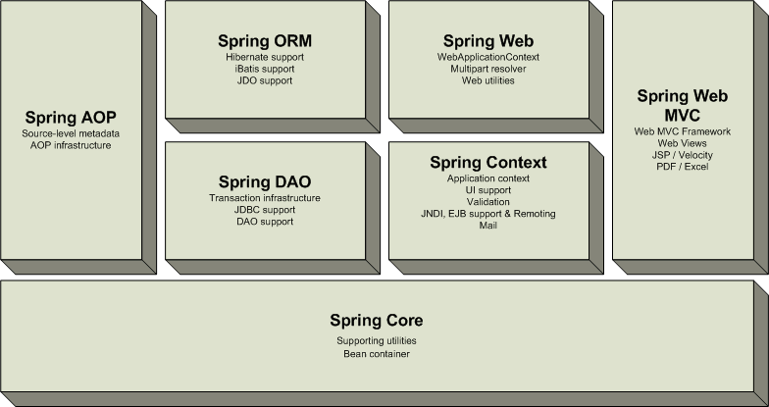
Overview of the Spring Framework
Very loosely coupled, components widely reusable and separately packaged.
Notes:
http://www.java2s.com/Tutorials/Java/Spring/0040__Spring_Loosely_Coupled.htm

Slide 22
Modules of the Spring Framework
The Spring Framework can be considered as a collection of frameworks-in-the-framework:
Core - Inversion of Control (IoC) and Dependency Injection
AOP - Aspect-oriented programming
DAO - Data Access Object support, transaction management, JDBC-abstraction
ORM - Object Relational Mapping data access, integration layers for JPA, JDO, Hibernate, and iBatis
MVC - Model-View-Controller implementation for web-applications
Remote Access, Authentication and Authorization, Remote Management, Messaging Framework, Web Services, Email, Testing, …

Slide 23
Spring Solutions
Solutions address :
Web application development (MVC)
Enterprise Java Beans (EJB, JNDI)
Database access (JDBC, MyBatis, ORM)
Transaction management (JTA, Hibernate, JDBC)
Remote access (Web Services, RMI)
Each solution builds on the core architecture
Solutions foster integration, they do not re-invent the wheel

Slide 24
How to Start Using Spring?
See https://projects.spring.io/spring-framework/
In this course, we use Maven as our build manager for java project
So, you just need to add the following dependency on your pom.xml file:
<dependencies>
<dependency>
<groupId>org.springframework</groupId>
<artifactId>spring-context</artifactId>
<version>4.3.2.RELEASE</version>
</dependency>
</dependencies>
Notes:
Tunjukkan demo Spring Application....

Slide 25
Dependency Injection

Slide 26
Interface Segregation Principle
Clients should not be forced to
depend on methods that they do not use

Slide 27
Interface Segregation Principle
1 2 3 4 5 6 | public interface Toy { void setPrice(double price); void setColor(String color); void move(); void fly(); }

Slide 28
Interface Segregation Principle
1 2 3 4 5 6 7 8 9 10 11 12 13 14 15 16 | public class ToyHouse implements Toy { double price; String color; @Override public void setPrice(double price) { this.price = price; } @Override public void setColor(String color) { this.color=color; } @Override public void move(){} @Override public void fly(){} }
Why is this bad?

Slide 29
Interface Segregation Principle
Fat interface vs role interface

Slide 30
Inversion of Control (IoC)
Lightweight container that is used in Spring Framewok
This is the core of Spring Framework that help to assemble components from different projects into a cohesive application.
Provides centralized, automated configuration, managing and wiring of application Java objects
Java objects that are managed by the Spring IoC container are referred to as Beans

Slide 31
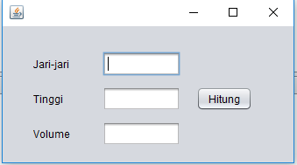
Inversion of Control
public class Test {
/**
* @param args the command line arguments
*/
public static void main(String[] args) {
Scanner scanner = new Scanner(System.in);
System.out.println("Masukkan panjang jari-jari tabung :");
double jariJari = scanner.nextDouble();
System.out.println("Masukkan tinggi tabung :");
double tinggi = scanner.nextDouble();
System.out.println("Volume tabung adalah :"+Math.PI * Math.pow(jariJari, 2) * tinggi);
}
}
VS

Slide 32
Inversion of Control (IoC)
Container responsibilities:
creating objects,
configuring objects,
calling initialization methods
passing objects to registered callback objects
etc
All together form the object lifecycle which is one of the most important features
Notes:
http://www.javaworld.com/article/2071914/excellent-explanation-of-dependency-injection--inversion-of-control-.html

Slide 33
Inversion of Control (IoC)
Actually, Inversion of Control (IoC) is is a common pattern to how containers perform the wiring.
Spring Framework is not the only framework which implements this pattern
PicoContainer, Avalon
There is a more specific name for this IoC pattern, i.e. Dependency Injection.

Slide 34
Components & Services
The topic of wiring elements together drags us almost immediately into the knotty terminology problems that surround the terms service and component.
A component means a glob of software that's intended to be used, without change, by an application that is out of the control of the writers of the component.
'without change' means that the using application doesn't change the source code of the components
a component to be used locally (think jar file, assembly, dll, or a source import)
A service is similar to a component in that it's used by foreign applications.
A service will be used remotely through some remote interface, either synchronous or asynchronous (e.g. web service, RPC)

Slide 35
IoC/Dependency Injection: motivation
In this example, let’s write a component that provides a list of movies directed by a particular director.
class MovieLister...
public Movie[] moviesDirectedBy(String arg) {
List allMovies = finder.findAll();
for (Iterator it = allMovies.iterator(); it.hasNext();) {
Movie movie = (Movie) it.next();
if (!movie.getDirector().equals(arg)) it.remove();
}
return (Movie[]) allMovies.toArray(new Movie[allMovies.size()]);
}
The real point of this example is that
how we connect lister object and finder object ?
Notes:
The implementation of this function is naive in the extreme, it asks a finder object (which we'll get to in a moment) to return every film it knows about.

Slide 36
IoC/Dependency Injection: motivation
We want our wonderful moviesDirectedBy method to be completely independent of how all the movies are being stored !
Solution: using java interface !
public interface MovieFinder {
List findAll();
}

Slide 37
IoC/Dependency Injection: motivation
Now all of this is very well decoupled, but at some point we have to come up with a concrete class to actually come up with the movies!
class MovieLister...
private MovieFinder finder;
public MovieLister() {
finder = new ColonDelimitedMovieFinder("movies1.txt");
}

Slide 38
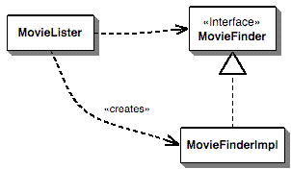
IoC/Dependency Injection: motivation
But what happens when my friends would like a copy of my program?
But what if they have a completely different form of storing their movie listing: a SQL database, an XML file, a web service, or just another format of text file?
The MovieLister class is dependent on both the MovieFinder interface and upon the implementation.
Notes:
In this case we need a different class to grab that data. Now because I've defined a MovieFinder interface, this won't alter my moviesDirectedBy method. But I still need to have some way to get an instance of the right finder implementation into place.

Slide 39
IoC/Dependency Injection: motivation
We would prefer it if it were only dependent on the interface, but then how do we make an instance to work with?
In this course’s textbook, we described this situation as a Plugin.
The implementation class for the finder isn't linked into the program at compile time, since I don't know what my friends are going to use
So the core problem is how do we assemble these plugins into an application? Solusion: Inversion of Control/Dependency Injection

Slide 40
Non-IoC
lister
creates
finder
public class MovieLister {
private MovieFinder finder;
public MovieLister() {
finder = new ColonDelimitedMovieFinder("movies1.txt");
}
public Movie[] moviesDirectedBy(String arg) {
List allMovies = finder.findAll();
for (Iterator it = allMovies.iterator(); it.hasNext();) {
Movie movie = (Movie) it.next();
if (!movie.getDirector().equals(arg)) it.remove();
}
return (Movie[]) allMovies.toArray(new Movie[allMovies.size()]);
}
}

Slide 41
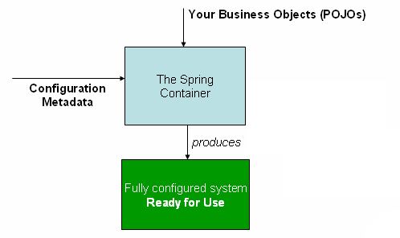
IoC/dependecy injection
Beans define their dependencies through constructor arguments or properties
Container resolves (injects) dependencies of components by setting implementation object during runtime
Notes:
BeanFactory interface - the core that
loads bean definitions and manages beans

Slide 42
IoC vs Non-IoC
creates
setFinder(finder)
lister
finder
finder
lister
Non Inversion of Control approach
Inversion of Control approach

Slide 43
IoC (setter dependecy injection)
public class MovieLister {
private MovieFinder finder;
public void setFinder (MovieFinder finder) {
this.finder = finder;
}
public Movie[] moviesDirectedBy(String arg) {
List allMovies = finder.findAll();
//...same as before...
}
}
setFinder(finder)
finder
lister
Rather than locating needed resources, application components provide setters through which resources are passed (injected) in during initialization.

Slide 44
Spring in the Middle Tier
The most complete IoC container
Setter Dependency Injection
Configuration via JavaBean properties
Constructor Dependency Injection
Configuration via constructor arguments
Pioneered by PicoContainer
Rod Johnson favours Setter Injection, but the Spring philosophy is that you make the choice
We are not ideological.
A good IoC container must provide sophisticated support for both injection models to allow use of legacy code

Slide 45
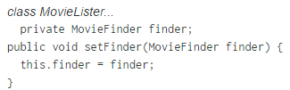

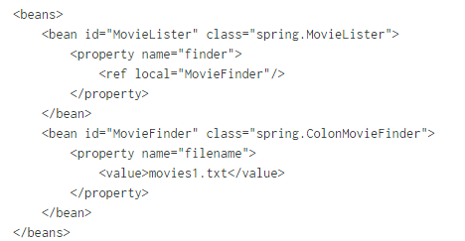
Dependency Injection : Setter Dependency Injection

Slide 46
Dependency Injection
"Any nontrivial application is made up of two or more classes that collaborate with each other to perform some business logic. Traditionally, each object is responsible for obtaining its own references to the objects it collaborates with (its dependencies). When applying DI, the objects are given their dependencies at creation time by some external entity that coordinates each object in the system. In other words, dependencies are injected into objects."

Slide 47
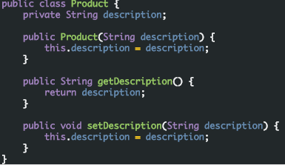
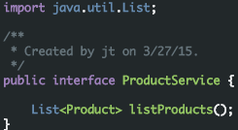
Dependency Injection – Other example
Domain
Service Layer

Slide 48
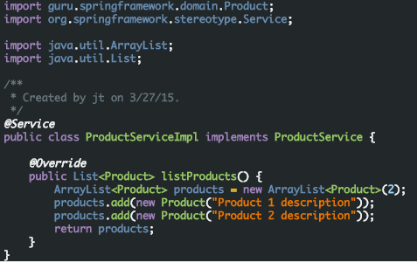
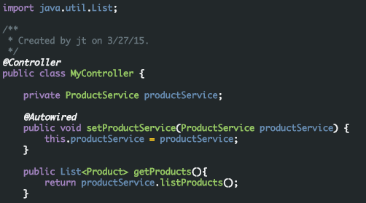
Dependency Injection
Service Implementation
Controller

Slide 49
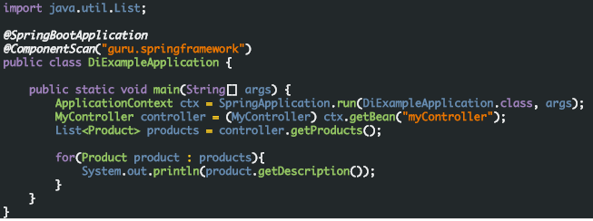
Dependency Injection

Slide 50
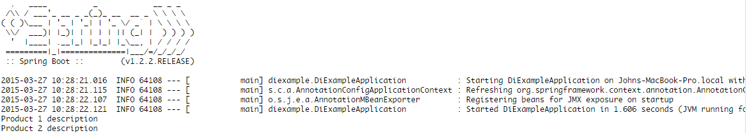
Dependency Injection

Slide 51
Spring-Boot

Slide 52
Introduction
while Spring is lightweight in terms of component code, it is heavyweight in terms of configuration.
Initially, Spring was configured with XML (and lots of it).
Spring 2.5 introduced annotation-based component-scanning, which eliminated a great deal of explicit XML configuration.
Spring 3.0 introduced a Java-based configuration as a type-safe and refactorable option to XML.
Even so, there was no escape from configuration.
Notes:
Cari website
Enabling certain Spring features
such as transaction management and Spring MVC required explicit configuration,
either in XML or Java. Enabling third-party library features such as Thymeleaf-based
web views required explicit configuration. Configuring servlets and filters (such as
Spring’s DispatcherServlet) required explicit configuration in web.xml or in a servlet
initializer.

Slide 53
Developing “hello word” with Spring
A project structure, complete with a Maven or Gradle build file including required dependencies.
A web.xml file (or a WebApplicationInitializer implementation) that declares Spring’s DispatcherServlet.
A Spring configuration that enables Spring MVC.
A controller class that will respond to HTTP requests with “Hello World”.
A web server, such as Tomcat, to deploy the application to.
Only one item is specific to developing the
Hello World functionality: the controller !
The rest of it is generic boilerplate !

Slide 54
Spring-Boot
Spring Boot brings a great deal of magic to Spring application development.
Automatic configuration—Spring Boot can automatically provide configuration for application functionality common to many Spring applications.
Starter dependencies—You tell Spring Boot what kind of functionality you need.
E.g. Tomcat is automatically embedded !
The command-line interface—This optional feature of Spring Boot lets you write complete applications with just application code.
Notes:
Demo this?

Slide 55
Spring-Boot
Goal: Spring Boot helps you accelerate and facilitate application development

Slide 56
Spring vs Spring-Boot ???
In short, at its heart, Spring Boot is just Spring !
Inside, Spring Boot is doing the same kind of bean configuration in Spring that you might do on your own if Spring Boot didn’t exist.
Thankfully, because Spring Boot does exist, you’re freed from dealing with explicit boilerplate configuration and are able to focus on the logic that makes your application unique.
Notes:
https://dzone.com/articles/why-springboot

Slide 57
Some Misconceptions regarding Spring-Boot
Spring Boot is not an application server.
This misconception stems from the fact that it’s possible to create web applications as self-executable JAR files.
Spring-Boot only embeds a servlet container, like tomcat
Spring Boot doesn’t implement any enterprise Java specifications such as JPA or JMS.
Spring Boot doesn’t employ any form of code generation to accomplish its magic.
Instead, it leverages conditional configuration features from Spring 4
Notes:
conditional configuration features from Spring 4

Slide 58
Spring-Boot: Hello Word
package hello;
import org.springframework.web.bind.annotation.RestController;
import org.springframework.web.bind.annotation.RequestMapping;
@RestController
public class HelloController {
@RequestMapping("/")
public String index() {
return "Greetings from Spring Boot!";
}
}
Notes:
@RestController vs @Controller

Slide 59
Spring-Boot: Hello Word
package hello;
import java.util.Arrays;
import org.springframework.boot.SpringApplication;
import org.springframework.boot.autoconfigure.SpringBootApplication;
import org.springframework.context.ApplicationContext;
@SpringBootApplication
public class Application {
public static void main(String[] args) {
ApplicationContext ctx = SpringApplication.run(Application.class, args);
System.out.println("Let's inspect the beans provided by Spring Boot:");
String[] beanNames = ctx.getBeanDefinitionNames();
Arrays.sort(beanNames);
for (String beanName : beanNames) {
System.out.println(beanName);
}
}
}

Slide 60
Spring-Boot: Hello Word
Did you notice that there wasn’t a single line of XML? No web.xml file either.
This web application is 100% pure Java and you didn’t have to deal with configuring any plumbing or infrastructure.
Notes:
// Using spring initiazr

Slide 61
Web MVC

Slide 62
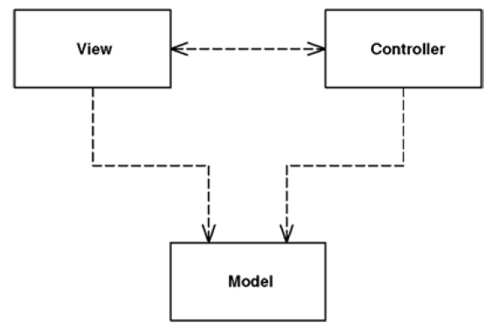
Overview
MVC considers three roles

Slide 63
Model
The model is an object that represents some information about the domain.
It's a nonvisual object containing all the data and behavior other than that used for the UI.
In its most pure OO form the model is an object within a Domain Model.

Slide 64
View
The view represents the display of the model in the UI.
Thus, if our model is a customer object our view might be a frame full of UI widgets or an HTML page rendered with information from the model.
In this course, we use Thymeleaf for the view technology.

Slide 65
Controller
The view is only about display of information.
any changes to the information are handled by the third member of the MVC trinity: the controller.
The controller takes user input, manipulates the model, and causes the view to update appropriately.

Slide 66
Two Principal Separations
separating the presentation from the model
separating the controller from the view
Of these, separation of presentation from model is one of the most fundamental heuristics of good software design.
Notes:
Separating presentation dan model:
Mengizinkan kita membuat presentasi yang banyak, sementara modelnya tetap. Contoh: Tampilan SCELE bisa diganti-ganti tapi informasi yang ditampilkan sama saja
Presentation dan view adalah 2 hal yang berbeda.view => isu UI dan layouting. Model => business policies dan database interactions. Library yang digunakan beda-beda. Programmer/tim pengembangnya pun bisa dibedakan.
Model lebih mudah ditest daripada view, pemisahan ini memudahkan test model

Slide 67
Example: Controller
package hello;
import org.springframework.stereotype.Controller;
import org.springframework.web.servlet.ModelAndView;
import org.springframework.web.bind.annotation.RequestMapping;
import org.springframework.web.bind.annotation.RequestParam;
@Controller
public class GreetingController {
@RequestMapping("/greeting")
public ModelAndView greeting(@RequestParam(value="name",
required=false,
defaultValue="World")
String name) {
Person person = new Person(name);
return new ModelAndView("greeting", "person", person);
}
}

Slide 68
Example: View
greeting.html
<!DOCTYPE HTML>
<html xmlns:th="http://www.thymeleaf.org">
<head>
<title>Getting Started: Serving Web Content</title>
<meta http-equiv="Content-Type"
content="text/html; charset=UTF-8" />
</head>
<body>
<p th:text="'Hello, ' + ${person.name} + '!'" />
</body>
</html>

Slide 69
Example: Model
public class Person {
private String name;
public void setName(String name) {
this.name = name;
}
public String getName() {
return this.name;
}
}
Notes:
Bedanya @RestController and @Controller

Slide 70
Summary
Servlet + EJB ≈ Java EE
Lightweight framework (Spring)
Spring Boot is Spring
Dependency Injection
MVC

Slide 71
References
Our text book (Martin Fowler)
Spring Framework Slides, by Rod Johnson
http://www.martinfowler.com/articles/injection.html
https://springframework.guru/dependency-injection-example-using-spring/
http://docs.spring.io/spring/docs/current/spring-framework-reference/html/beans.html
http://spring.io/guides/gs/serving-web-content/

