Slide 1
Organizing Domain Logic
Denny, Bayu, Alfan, Samuel
Notes:
Bagaimana mengorganisasikan kode/logic yang berhubungan dengan transaksi yang dilakukan oleh pengguna aplikasi.
Mungkin bisa dilihat dari sisi use case. Domain logic atau business logic ini merepresentasikan workflow/business rules yang
akan menentukan bagaimana data harus disimpan atau dimanipulasi.

Slide 2
Three Primary Patterns
In organizing domain logic, there are three primary patterns:
Transaction Script
Domain Model
Table Module
Notes:
Pattern adalah semacam pola solusi yang dipakai untuk memecahkan suatu masalah. Terdapat banyak sekali pattern untuk melakukan implementasi dari domain logic ini.
Dalam kuliah ini kita akan bahas tiga pattern untuk mengorganisasikan domain logic.
Yang pertama adalah transaction script (procedural), domain model (object oriented), table module (mirip dengan domain module) tetapi…..

Slide 3
Transaction Script

Slide 4
Transaction Script
This pattern is essentially a procedure that:
takes the input from the presentation
process it with validations and calculations
stores data in the database
invokes any operations from other systems

Slide 5
Transaction Script
We can think of this pattern as being a script for an action, or business transaction.
It doesn't have to be a single inline procedure of code.
Pieces get separated into subroutines, and these subroutines can be shared between different Transaction Scripts
Notes:
How to Organize Transaction Scripts? The most common is to have several Transaction Scripts in a single class, where each class defines a subject area of related Transaction Scripts. This is
straightforward and the best bet for most cases. The other way is to have each Transaction Script in its own class (Figure 9.1 ), using the Command pattern [Gang of Four ]

Slide 6
Transaction Script
For example, in a Retailing System, we might have several transaction scripts:
for checkout/logout
for adding something to the shopping cart
for displaying delivery status
And so on.
Notes:
I use the term Transaction Script because most of the time you'll have one Transaction Script for each database
transaction.

Slide 7
Transaction Script
With Transaction Script the domain logic is primarily organized by the transactions that you carry out with the system
Exercise: If your need is to book a hotel room, what are kind of transaction scripts needed?
Notes:
the logic to check room availability, calculate rates, and update the
database is found inside the Book Hotel Room procedure

Slide 8
Transaction Script
Advantages:
It's a simple procedural model that most developers understand.
It works well with a simple data source layer
It's obvious how to set the transaction boundaries: Start with opening a transaction and end with closing it

Slide 9
Transaction Script
Disadvantages:
Problems appear as the complexity of the domain logic increases.
Often there will be duplicated code as several transactions need to do similar things.
Notes:
The resulting application can end up being quite a tangled web of routines
without a clear structure.
Example?
Bahkan kadang2 pake OO language tapi mrogramnya procedural hahahaha

Slide 10
Domain Model

Slide 11
Domain Model
This is the solution for the previous problem
An object-oriented way to handle a problem
Notes:
With a Domain Model (116) we build a model of our domain which, at least on a
first approximation, is organized primarily around the nouns in the domain. Thus, a leasing system would
have classes for lease, asset, and so forth.
OOAD

Slide 12
Domain Model
Rather than one routine having all the logic for a user action (Transaction Script), in domain model, each object takes a part of the logic that's relevant to it.
Notes:
With a Domain Model (116) we build a model of our domain which, at least on a first approximation, is organized primarily around the nouns in the domain. Thus, a leasing system would
have classes for lease, asset, and so forth.

Slide 13
Domain Model
Advantage:
More options in structuring the code when the business model getting complex
Disadvantage:
It’s “hard” to trace the behaviour
Needs to learn OO principles first

Slide 14
Transaction Script vs Domain Model
To see the difference, let’s look at sequence diagrams for the two approaches.
Suppose, we are building a system for recognizing revenue given a contract.
Notes:
The calculation method has to
determine what kind of product a given contract is for, apply the correct algorithm, and then create revenue
recognition objects to capture the results of the calculation.

Slide 15
The Revenue Recognition Problem
Example:
We'll imagine a company that sells three kinds of products: word processors, databases, and spreadsheets.
According to the rules, when you sign a contract for a word processor you can book all the revenue right away
If it's a spreadsheet, you can book one-third today, one-third in 60 days, and one-third in 90 days
If it's a database, you can book one-third today, one-third in 30 days, and one-third in 60 days

Slide 16
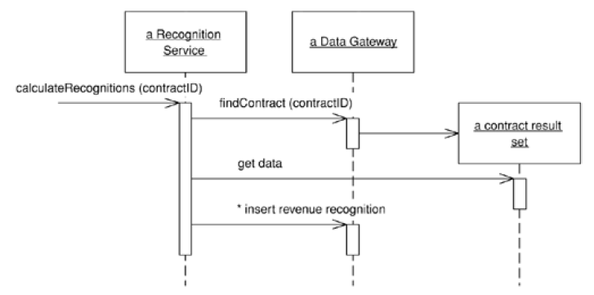
Transaction Script vs Domain Model
A Transaction Script’s way of calculating revenue recognitions
Notes:
In Figure 2.1, Transaction Script's (110) method does all the work. The underlying objects are just Table Data Gateways (144), and all they do is pass data to the transaction script.
Table Data Gateway contains the SQL statements

Slide 17
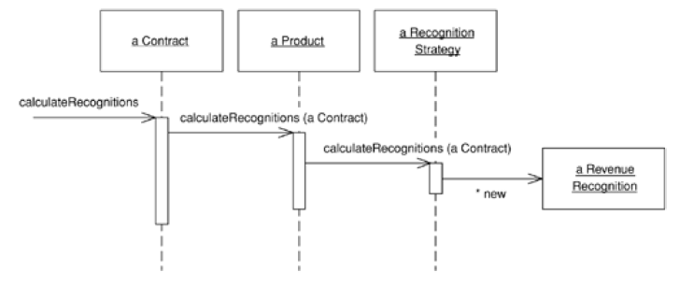
Transaction Script vs Domain Model
A Domain Model’s way of calculating revenue recognitions
Notes:
In contrast, Figure 2.2 shows multiple objects, each forwarding part of the behavior to another until a
strategy object creates the results.

Slide 18
Transaction Script vs Domain Model
Domain Model: As we get more and more algorithms for calculating revenue recognition, we can add these by adding new recognition strategy objects.
With Transaction Script we're adding more conditions to the conditional logic of the script

Slide 19
Back to the revenue recognition problems...
Now, we are going to see how to solve a problem using two different Domain Logic paradigms:
Transaction script
Domain model
We want our system has two functionalities:
tell how much revenue on a contract has been recognized by a certain date
calculate the revenue recognitions for a contract

Slide 20
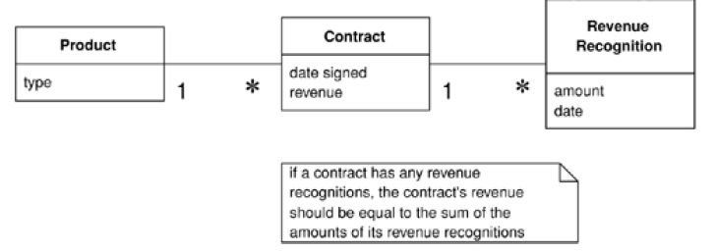
A conceptual model for simplified revenue recognition problem

Slide 21
The database structure has three tables: one for the products, one for the contracts, and one for the revenue recognitions
CREATE TABLE products
(ID int primary key, name varchar, type varchar)
CREATE TABLE contracts
(ID int primary key, product int, revenue decimal, dateSigned date)
CREATE TABLE revenueRecognitions
(contract int, amount decimal, recognizedOn date,
PRIMARY KEY (contract, recognizedOn))

Slide 22
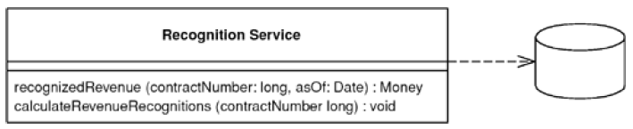
Using Transaction Script
There will be two transaction scripts corresponding to each functionality.
First transaction script !
Second transaction script !
Notes:
The first script calculates the amount of recognition due by a particular day.

Slide 23
Using Transaction Script
First transaction script
class RecognitionService...
public Money recognizedRevenue(long contractNumber, MfDate asOf) {
Money result = Money.dollars(0);
try {
ResultSet rs = db.findRecognitionsFor(contractNumber, asOf);
while (rs.next()) {
result =
result.add(Money.dollars(rs.getBigDecimal("amount")));
}
return result;
}catch (SQLException e) {throw new ApplicationException (e);
}
}

Slide 24
Using Transaction Script
First transaction script
class Gateway...
public ResultSet findRecognitionsFor
(long contractID, MfDate asof) throws SQLException {
PreparedStatement stmt =
db.prepareStatement(findRecognitionsStatement);
stmt = db.prepareStatement(findRecognitionsStatement);
stmt.setLong(1, contractID);
stmt.setDate(2, asof.toSqlDate());
ResultSet result = stmt.executeQuery();
return result;
}
private static final String findRecognitionsStatement =
"SELECT amount " +
"FROM revenueRecognitions " +
"WHERE contract = ? AND recognizedOn <= ?";
private Connection db;

Slide 25
Using Transaction Script
Second transaction script
class RecognitionService...
public void calculateRevenueRecognitions(long contractNumber) {
try {
ResultSet contracts = db.findContract(contractNumber);
contracts.next();
Money totalRevenue =
Money.dollars(contracts.getBigDecimal("revenue"));
MfDate recognitionDate =
new MfDate(contracts.getDate("dateSigned"));
String type = contracts.getString("type");
...

Slide 26
Using Transaction Script
Second transaction script
Do you see problems here ?
class RecognitionService (cont’d)...
if (type.equals("S")){
Money[] allocation = totalRevenue.allocate(3);
db.insertRecognition
(contractNumber, allocation[0], recognitionDate);
db.insertReconition
(contractNumber, allocation[1], recognitionDate.addDays(60));
db.insertRecognition
(contractNumber, allocation[2], recognitionDate.addDays(90));
}else if (type.equals("W")){
db.insertRecognition(contractNumber, totalRevenue, recognitionDate);
}else if (type.equals("D")) {
Money[] allocation = totalRevenue.allocate(3);
db.insertRecognition
(contractNumber, allocation[0], recognitionDate);
db.insertRecognition
(contractNumber, allocation[1], recognitionDate.addDays(30));
db.insertRecognition
(contractNumber, allocation[2], recognitionDate.addDays(60));
}
...

Slide 27
Using Transaction Script
Second transaction script
class Gateway...
public ResultSet findContract (long contractID) throws SQLException{
PreparedStatement stmt = db.prepareStatement(findContractStatement);
stmt.setLong(1, contractID);
ResultSet result = stmt.executeQuery();
return result;
}
private static final String findContractStatement =
"SELECT * " +
"FROM contracts c, products p " +
"WHERE ID = ? AND c.product = p.ID";
public void insertRecognition (long contractID, Money amount, MfDate asof) throws
SQLException {
PreparedStatement stmt = db.prepareStatement(insertRecognitionStatement);
stmt.setLong(1, contractID);
stmt.setBigDecimal(2, amount.amount());
stmt.setDate(3, asof.toSqlDate());
stmt.executeUpdate();
}
private static final String insertRecognitionStatement =
"INSERT INTO revenueRecognitions VALUES (?, ?, ?)";

Slide 28
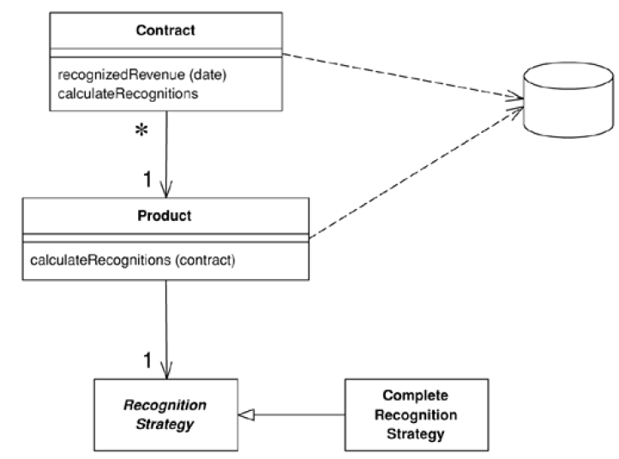
Using Domain Model
An object model of the domain that incorporates both behavior and data.
Notes:
If you're using Domain Model, my first choice for database interaction is Data Mapper (165). This will help keep
your Domain Model independent from the database and is the best approach to handle cases where the Domain
Model and database schema diverge.

Slide 29
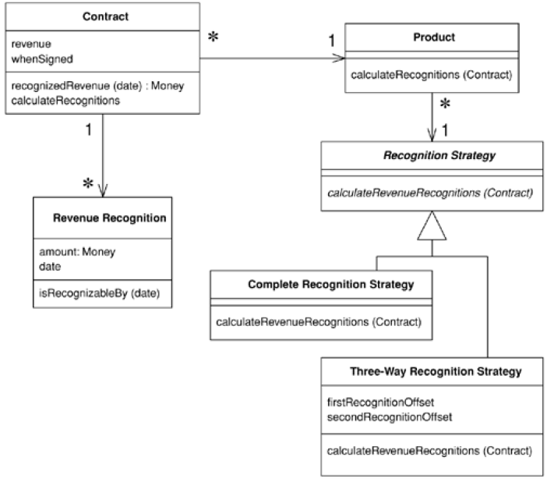
Using Domain Model
Class diagram for the domain model
Avoid duplication, low coupling
Notes:
A common thing you find in domain model s is how multiple classes interact to do even the simplest tasks. This is
what often leads to the complaint that with OO programs you spend a lot of time hunting around from class to
class trying to find them. There's a lot of merit to this complaint.
Di recognition strategynya paka inheritance, inilah mengapa avoid duplication, and reduce coupling

Slide 30
Using Domain Model
Calculating how much revenue is recognized by a certain data
class Contract...
private List revenueRecognitions = new ArrayList();
public Money recognizedRevenue(MfDate asOf) {
Money result = Money.dollars(0);
Iterator it = revenueRecognitions.iterator();
while (it.hasNext()) {
RevenueRecognition r = (RevenueRecognition) it.next();
if (r.isRecognizableBy(asOf))
result = result.add(r.getAmount());
}
return result;
}
Notes:
A common thing you find in domain model s is how multiple classes interact to do even the simplest tasks.
Like this one: involves both the contract and revenue recognition classes.

Slide 31
Using Domain Model
class Contract (cont’d)...
private Product product;
private Money revenue;
private MfDate whenSigned;
private Long id;
public Contract(Product product, Money revenue, MfDate whenSigned)
{
this.product = product;
this.revenue = revenue;
this.whenSigned = whenSigned;
}

Slide 32
Using Domain Model
class Product...
private String name;
private RecognitionStrategy recognitionStrategy;
public Product(String name,
RecognitionStrategy recognitionStrategy) {
this.name = name;
this.recognitionStrategy = recognitionStrategy;
}
public static Product newWordProcessor(String name) {
return new Product(name, new CompleteRecognitionStrategy());
}
public static Product newSpreadsheet(String name) {
return new Product(name, new ThreeWayRecognitionStrategy(60, 90));
}
public static Product newDatabase(String name) {
return new Product(name, new ThreeWayRecognitionStrategy(30, 60));
}

Slide 33
Using Domain Model
class RecognitionStrategy...
abstract void calculateRevenueRecognitions(Contract contract);
class CompleteRecognitionStrategy...
void calculateRevenueRecognitions(Contract contract) {
contract.addRevenueRecognition(
new RevenueRecognition(contract.getRevenue(),
contract.getWhenSigned()));
}
Notes:
The great value of the strategies is that they provide well-contained plug points to extend the application. Adding
a new revenue recognition algorithm involves creating a new subclass and overriding the
calculateRevenueRecognitions method

Slide 34
Using Domain Model
class ThreeWayRecognitionStrategy...
private int firstRecognitionOffset;
private int secondRecognitionOffset;
public ThreeWayRecognitionStrategy(int firstRecognitionOffset,
int secondRecognitionOffset)
{
this.firstRecognitionOffset = firstRecognitionOffset;
this.secondRecognitionOffset = secondRecognitionOffset;
}
void calculateRevenueRecognitions(Contract contract) {
Money[] allocation = contract.getRevenue().allocate(3);
contract.addRevenueRecognition(new RevenueRecognition
(allocation[0], contract.getWhenSigned()));
contract.addRevenueRecognition(new RevenueRecognition
(allocation[1],
contract.getWhenSigned().addDays(firstRecognitionOffset)));
contract.addRevenueRecognition(new RevenueRecognition
(allocation[2],
contract.getWhenSigned().addDays(secondRecognitionOffset)));
}

Slide 35
Using Domain Model
When you create products, you hook them up with the appropriate strategy objects.
private Product word = Product.newWordProcessor("Thinking Word");
private Product calc = Product.newSpreadsheet("Thinking Calc");
private Product db = Product.newDatabase("Thinking DB");

Slide 36
Using Domain Model
Calculating the revenue recognitions
class Contract...
public void calculateRecognitions() {
product.calculateRevenueRecognitions(this);
}
class Contract...
void calculateRevenueRecognitions(Contract contract) {
recognitionStrategy.calculateRevenueRecognitions(contract);
}
You'll notice that there are no conditionals in this calculation.
Notes:
The OO habit of successive forwarding from object to object moves the behavior to the object most qualified to
handle it, but it also resolves much of the conditional behavior. You'll notice that there are no conditionals in this
calculation.

Slide 37
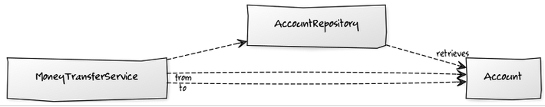
Example 2

Slide 38

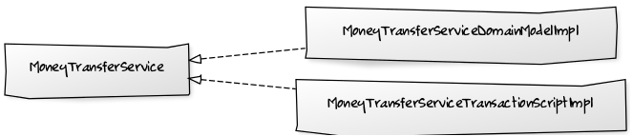
Example 2

Slide 39
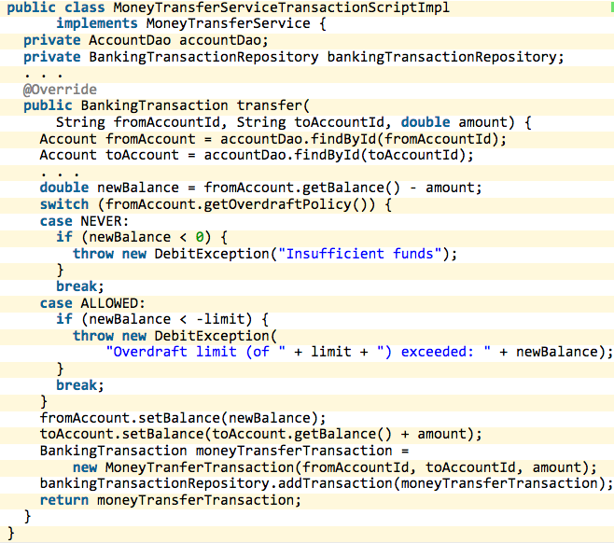
Example 2

Slide 40
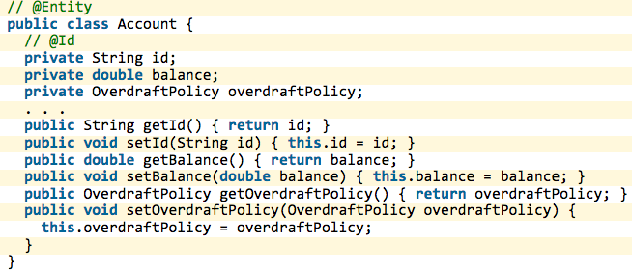

Example 2

Slide 41
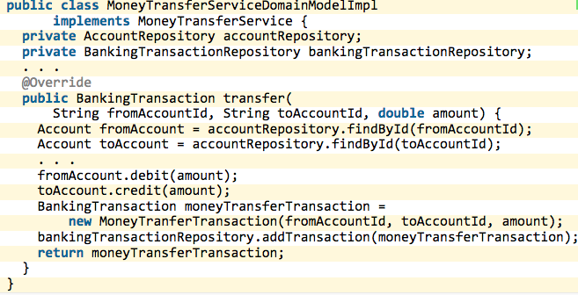
Example 2

Slide 42
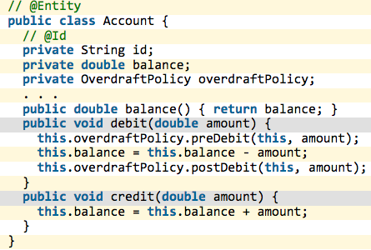
Example 2

Slide 43
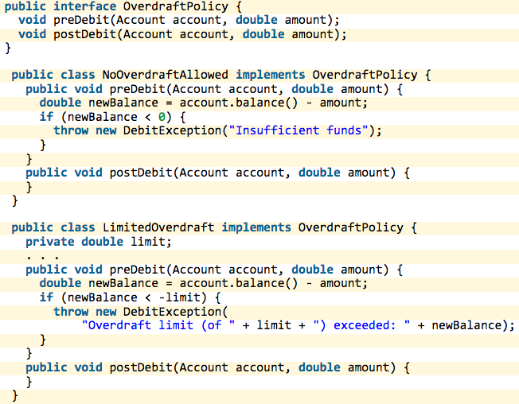
Example 2

Slide 44
Table Module
At very first blush the Table Module looks like a Domain Model since both have classes for contracts, products, and revenue recognitions.
The vital difference is that a Domain Model has one instance of contract for each contract in the database whereas a Table Module has only one instance.

Slide 45
Table Module

Slide 46
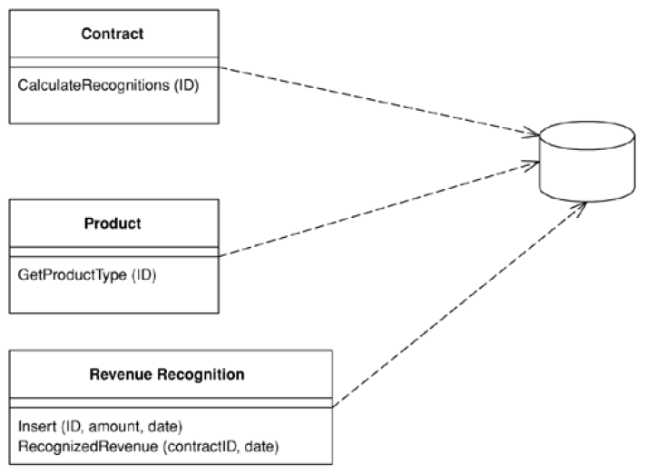
Table Module
A single instance that handles the business logic for all rows in a database table or view.
Notes:
One of the key messages of object orientation is bundling the data with the behavior that uses it. The traditional
object-oriented approach is based on objects with identity, along the lines of Domain Model (116). Thus, if we
have an Employee class, any instance of it corresponds to a particular employee.
A Table Module organizes domain logic with one class per table in the database, and a single instance of a class
contains the various procedures that will act on the data.
Thus, if you want to obtain the address of an employee, you use a method like anEmployeeModule.getAddress(long employeeID) .
Every time you want to do something to a particular employee you have to pass in some kind of identity reference.
Often this will be the primary key used in the database.

Slide 47
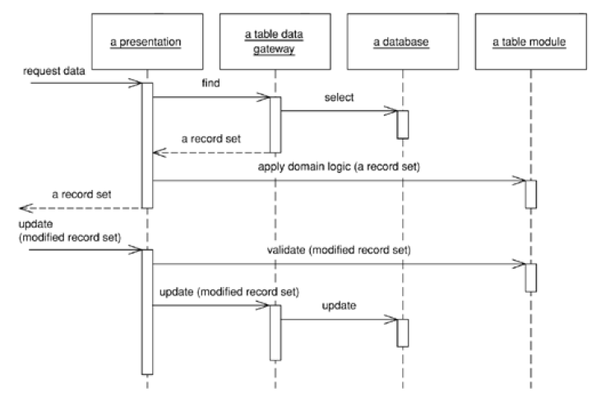
Table Module
Typical interactions for the layers around a Table Module

Slide 48
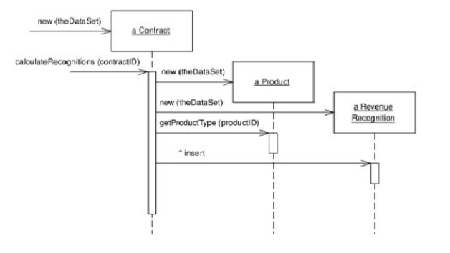
Table Module

Slide 49
Table Module
However, Table Module doesn't give you the full power of objects in organizing complex logic.
You can't have direct instance-to-instance relationships, and polymorphism doesn't work well.
So, for handling complicated domain logic, a Domain Model is a better choice

Slide 50
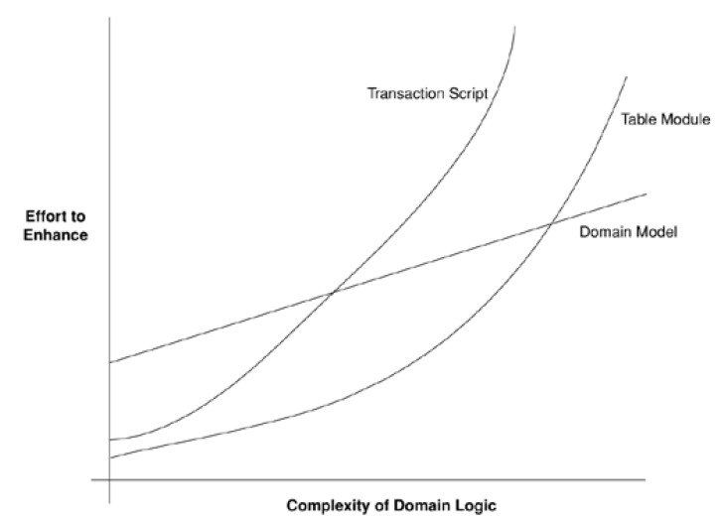

Slide 51
Service Layer

Slide 52
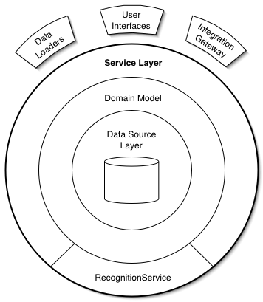
Defines an application's boundary with a layer of services that establishes a set of available operations and coordinates the application's response in each operation.
Notes:
Enterprise applications typically require different kinds of interfaces to the data they store and the logic they implement: data loaders, user interfaces, integration gateways, and others. Despite their different purposes, these interfaces often need common interactions with the application to access and manipulate its data and invoke its business logic.

Slide 53
Why Service Layer?
Like Transaction Script and Domain Model, Service Layer is a pattern for organizing business logic.
There two kinds of business logic
Domain logic
Application logic
Notes:
Many designers, including me, like to divide "business logic" into two kinds: "domain logic," having to
do purely with the problem domain (such as strategies for calculating revenue recognition on a contract),
and "application logic," having to do with application responsibilities [Cockburn UC] (such as notifying
contract administrators, and integrated applications, of revenue recognition calculations).
Application logic → workflow logic

Slide 54
Why Service Layer?
If you use Domain Model, domain object classes are less reusable across applications if they implement application-specific logic.
Service Layer factors each kind of business logic into a separate layer, yielding the usual benefits of layering and rendering the pure domain object classes more reusable from application to application.

Slide 55
Demonstration
We’ll see how Service Layer is used to script application logic and delegate for domain logic in a Service Layer operation.
To make the demonstration we expand the scenario to include some application logic:
when the revenue recognitions for a contract are calculated, the application must respond by sending an e-mail notification to a contract administrator
And then, publishing a message using message-oriented middleware to notify other integrated applications

Slide 56
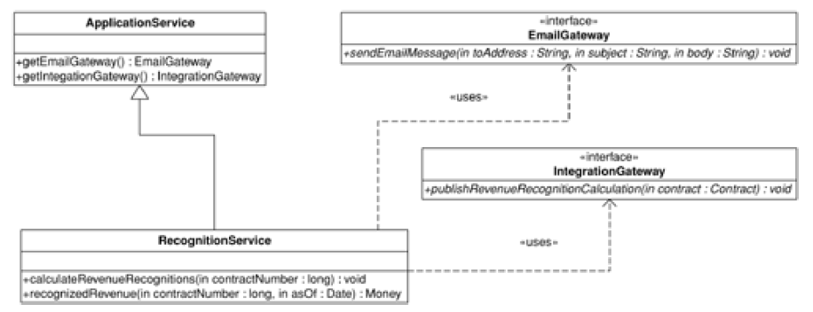
We start by changing the RecognitionService class from the Transaction Script example to extend a Layer Supertype and to use a couple of Gateways in carrying out application logic.

Slide 57
public class ApplicationService {
protected EmailGateway getEmailGateway() {
//return an instance of EmailGateway
}
protected IntegrationGateway getIntegrationGateway() {
//return an instance of IntegrationGateway
}
}
public interface EmailGateway {
void sendEmailMessage(String toAddress,
String subject, String body);
}
public interface IntegrationGateway {
void publishRevenueRecognitionCalculation(Contract contract);
}

Slide 58
RecognitionService becomes a POJO implementation
of a Service Layer
public class RecognitionService extends ApplicationService {
public void calculateRevenueRecognitions(long contractNumber) {
Contract contract = Contract.readForUpdate(contractNumber);
contract.calculateRecognitions();
getEmailGateway().sendEmailMessage(
contract.getAdministratorEmailAddress(),
"RE: Contract #" + contractNumber,
contract + " has had revenue recognitions calculated.");
getIntegrationGateway().
publishRevenueRecognitionCalculation(contract);
}
public Money recognizedRevenue(long contractNumber, Date asOf) {
return Contract.read(contractNumber).recognizedRevenue(asOf);
}
}
Domain logic
Application logic

Slide 59
Service Layer
When to use it:
When you have many kinds of “clients”

Slide 60
Summary
Transaction Script
Domain Model
Table Module
Service Layer

Slide 61
Class Activity
You are assigned to design e-commerce application with the following components:
Product
Cart
Customer
Business Process
Selecting product (add to cart)
Payment
Design the application using the pattern in domain logic

