Slide 1
Mapping to Relational Database
Denny, Bayu, Alfan, Samuel

Slide 2
References
Martin Fowler’s Patterns of Enterprise Application Architecture.
Alur et al’s Core J2EE Patterns.

Slide 3
So far
Separating Presentation and Business Logic (Model – View - Controller)
Domain Logic
Transaction Script
Table Module
Domain Model
Data Source/Access Pattern

Slide 4
What is this chapter about?
We are going to learn several Data Access Patterns
Why?
Many real-world Enterprise Applications need to use persistent data at some point.
For many applications, persistent storage is implemented with different mechanisms.
There are marked differences in the APIs used to access these different persistent storage mechanisms
Notes:
Other applications may need to access data that resides on separate systems. For example, the data may reside in mainframe
systems, Lightweight Directory Access Protocol (LDAP) repositories, and so forth. Another example is where data is provided by services through external systems
such as business-to-business (B2B) integration systems, credit card bureau service, and so forth.

Slide 5
Problems in Data Access
Some of the problems with data access from OO programs:
Data source and OO program use different data modelling concepts
Decoupling domain logic from database technology

Slide 6
Problems in Data Access
Access to data varies depending on the source of the data.
type of storage (relational databases, object-oriented databases, flat files, etc)
particular vendor implementation for a type
coupling between the components and the data source implementation: appears when including the connectivity and data access code provided by different API’s within the business components (domain objects)
Notes:
Such code dependencies in components make it difficult to migrate the application from one type of data source to another Components need to be transparent to the actual persistent store or data source implementation to provide easy migration to different vendor products, different storage types, and different data source types.

Slide 7
Relational Database?
Actually, With an OO database you don't have to worry about mapping (when you use OO paradigm on your program).
Martin Fowler said ...
Most enterprise application projects don’t use OO database
Relational databases are well-understood
Relational databases are proven technology backed by big vendors who have been around for long time
SQL provides a relatively standard interface for all sorts of tools
Notes:
During the early days of objects many people realized that there was a fundamental "impedance mismatch" between
objects and relations. Thus, there followed a spate of effort on object-oriented databases, which essentially
brought the OO paradigm to disk storage

Slide 8
Mapping to Relational Database
Despite SQL's widespread use in enterprise software, there are still pitfalls in using it.
Many application developers don't understand SQL well and, as a result, have problems defining effective queries
Database administrations (DBAs) also like to get at the SQL that accesses a table so that they can understand how best to tune it
it's wise to separate SQL access from the domain logic and place it in separate classes.
Notes:
One the biggest reasons for the success of relational databases is the presence of SQL, a mostly standard
language for database communication. Although SQL is full of annoying and complicated vendor-specific
enhancements, its core syntax is common and well understood.

Slide 9
Patterns
From Martin Fowler’s book:
Row Data Gateway
Active Record
Table Data Gateway
Data Mapper
Other pattern related to Martin Fowler’s patterns:
Data Access Object (DAO)

Slide 10
Row Data Gateway

Slide 11
Row Data Gateway
An object that acts as a Gateway to a single record in a data source.
There is one instance per row.
Motivations:
Embedding database access code in in-memory objects can leave you with a few disadvantages (Table Data Gateway).
if you use in-memory objects have business logic of their own, adding the database manipulation code increases complexity.
Testing is awkward too since, if your in-memory objects are tied to a database, tests are slower to run because of all the database access.

Slide 12
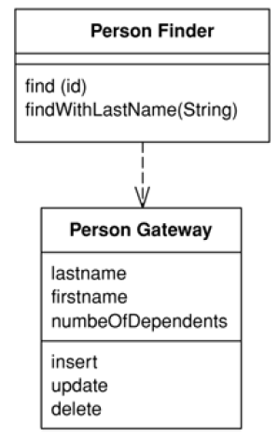
Row Data Gateway
A Row Data Gateway gives you objects that look exactly like the record in your record structure but can be accessed with the regular mechanisms of your programming language.
Notes:
All details of data source access are hidden behind this interface.

Slide 13
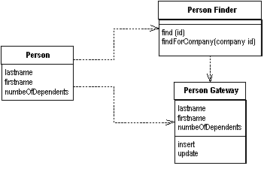
Row Data Gateway
A Row Data Gateway has one instance per row returned by a query.

Slide 14
How It Works
A Row Data Gateway acts as an object that exactly mimics a single record, such as one database row.
In it each column in the database becomes one field.
But, you're faced with the questions of where to put the find operations that generate this pattern.
It often makes sense to have separate finder objects so that each table in a relational database will have one finder class and one gateway class for the results

Slide 15
When To Use It
Martin Folwer: “I use Row Data Gateway most often when I'm using a Transaction Script. I don't use a Row Data Gateway when I'm using a Domain Model.”
In this case, it nicely factors out the database access code and allows it to be reused easily by different Transaction Scripts.
If the mapping is complex, Data Mapper works better, as it's better at decoupling the data structure from the domain objects because the domain objects don't need to know the layout of the database

Slide 16
Example: A Person Record
Let’s see the Table structure first...
create table people (ID int primary key,
lastname varchar,
firstname varchar,
number_of_dependents int)

Slide 17
Example: A Person Record
It starts with data fields and accessors...
public class PersonGateway {
private String lastName;
private String firstName;
private int numberOfDependents;
public String getLastName() {
return lastName;
}
public void setLastName(String lastName) {
this.lastName = lastName;
}
//and other setters getters
...//continued on the next slide...

Slide 18
Example: A Person Record
The gateway class itself can handle updates and inserts.
...
private static final String updateStatementString =
" UPDATE people " +
" set lastname = ?, firstname = ?, number_of_dependents = ? " +
" where id = ?";
public void update() {
PreparedStatement updateStatement = null;
try {
updateStatement = DB.prepare(updateStatementString);
updateStatement.setString(1, lastName);
updateStatement.setString(2, firstName);
...
updateStatement.execute();
...
}
...

Slide 19
Example: A Person Record
The gateway class itself can handle updates and inserts.
...
private static final String insertStatementString =
"INSERT INTO people VALUES (?, ?, ?, ?)";
public void insert() {
PreparedStatement insertStatement = null;
try {
insertStatement = DB.prepare(insertStatementString);
insertStatement.setInt(1, getID().intValue());
insertStatement.setString(1, lastName);
insertStatement.setString(2, firstName);
...
insertStatement.execute();
...
}
...

Slide 20
Example: A Person Record
To pull people out of the database, we have a separate PersonFinder.
public class PersonFinder {
private final static String findStatementString =
"SELECT id, lastname, firstname, number_of_dependents " +
" from people " +
" WHERE id = ?";
public PersonGateway find(Long id) {
PreparedStatement insertStatement = null;
ResultSet rs = null;
try {
findStatement = DB.prepare(findStatementString);
findStatement.setLong(1, id.longValue());
rs = findStatement.executeQuery();
rs.next();
PersonGateway result = PersonGateway.load(rs);
return result;
} catch (...) {...}
}
...

Slide 21
Example: A Person Record
Contoh penggunaan pada sebuah Transaction Script.
PersonFinder finder = new PersonFinder();
Iterator people = finder.findResponsibles().iterator();
StringBuffer result = new StringBuffer();
while (people.hasNext()) {
PersonGateway each = (PersonGateway) people.next();
result.append(each.getLastName());
result.append(" ");
result.append(each.getFirstName());
result.append(" ");
result.append(String.valueOf(each.getNumberOfDependents()));
result.append("
}
return result.toString();

Slide 22
Example: A Person Record
I use Row Data Gateway mostly with Transaction Script
If we want to use the Row Data Gateway from a Domain Model, the domain objects need to get at the data from the gateway.
public class Person {
private PersonGateway data;
public Person(PersonGateway data) {
this.data = data;
}
...//continued on the next slide

Slide 23
Example: A Person Record
Accessors on the domain logic can then delegate to the gateway for the data.
And, The domain logic uses the getters to pull the data from the gateway.
...
public int getNumberOfDependents() {
return data.getNumberOfDependents();
}
public Money getExemption() {
Money baseExemption = Money.dollars(1500);
Money dependentExemption = Money.dollars(750);
return baseExemption.add(dependentExemption.
multiply(this.getNumberOfDependents()));
}
}

Slide 24
Active Record

Slide 25
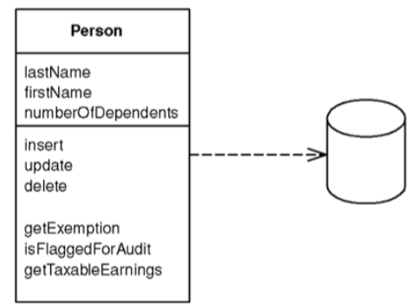
Active Record
An object that wraps a row in a database table or view, encapsulates the database access and adds domain logic on that data

Slide 26
Active Record – How it works
The data structure should exactly match that of the database : one field per class for each column in the table
Typically has the methods that do the following:
Construct an instance of the Active Record from a SQL result set row
Construct a new instance for later insertion into the table
Static finder methods to wrap commonly used SQL queries and return Active Record objects
Get & Set fields
Implement some pieces of business logic

Slide 27
Active Record – When to use it
For domain logic that is not too complex such as CRUD
If you are using Transaction Script

Slide 28

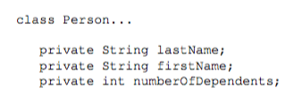
Active Record - Example

Slide 29
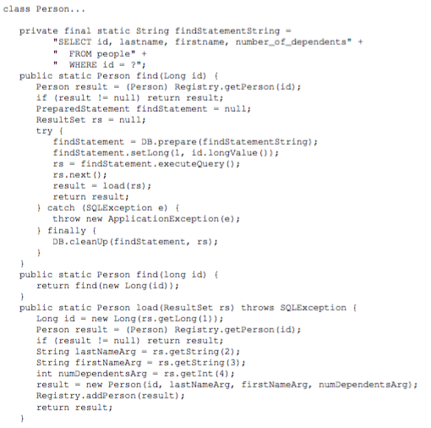
Active Record - Example

Slide 30
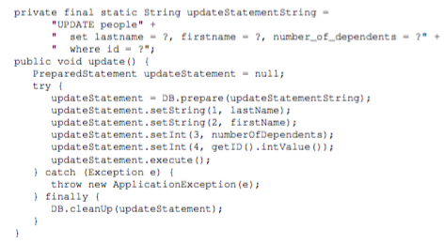
Active Record - Example

Slide 31
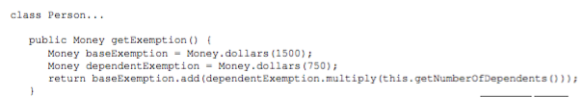
Active Record - Example

Slide 32
Data Mapper

Slide 33
Data Mapper
A layer of Mappers that moves data between objects and a database while keeping them independent of each other and the mapper itself.
Motivations:
Objects and relational databases have different mechanisms for structuring data.
When you build an object model with a lot of business logic it's valuable to use these mechanisms to better organize the data and the behavior.
Doing so leads to variant schemas; that is, the object schema and the relational schema don't match up.
Notes:
Objects and relational databases have different mechanisms for structuring data. Many parts of an object, such as
collections and inheritance, aren't present in relational databases. When you build an object model with a lot of
business logic it's valuable to use these mechanisms to better organize the data and the behavior that goes with it.
Doing so leads to variant schemas; that is, the object schema and the relational schema don't match up.

Slide 34
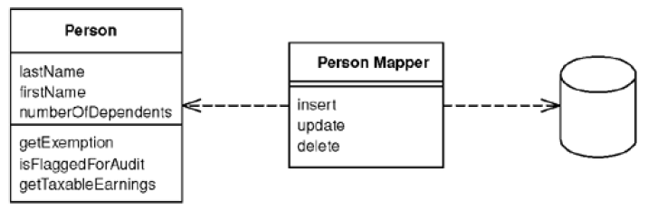
Data Mapper
The Data Mapper is a layer of software that separates the in-memory objects from the database.
Its responsibility is to transfer data between the two and also to isolate them from each other.
Notes:
Its responsibility is to transfer data between the two and also to isolate them from each other. With Data Mapper the in-memory
objects needn't know even that there's a database present; they need no SQL interface code, and certainly no
knowledge of the database schema.
(The database schema is always ignorant of the objects that use it.) Since it's a
form of Mapper (473), Data Mapper itself is even unknown to the domain layer.

Slide 35
How It Works
The separation between domain and data source is the main function of a Data Mapper
A simple case would have a Person and PersonMapper class.
To load a person from the database, a client would call a find method on the mapper
Updates: A client asks the mapper to save a domain object. The mapper pulls the data out of the domain object and shuttles it to the database.
Inserts and Updates: the database mapping layer needs to understand:
what objects have changed,
which new ones have been created,
and which ones have been destroyed

Slide 36
How It Works
An application can have one Data Mapper or several.
If you're hardcoding your mappers, it's best to use one for each domain class or root of a domain hierarchy

Slide 37
When To Use It
The primary occasion for using Data Mapper is when you want the database schema and the object model to evolve independently.
The most common case for this is with a Domain Model.
Data Mapper's primary benefit is that when working on the domain model you can ignore the database, both in design and in the build and testing process.
The domain objects have no idea what the database structure is

Slide 38
Example
Domain Model Objects and Data Mapper Objects
<<domain model>> Person
lastName firstName numberOfDependents
setLastName(...) getLastName() ... getExemption() ...
<<data mapper>> PersonMapper
findPersonById(int id) getAllPersons() insert(Person person) update(Person person) ...
http://richard.jp.leguen.ca/tutoring/soen343-f2010/tutorials/implementing-data-mapper/

Slide 39
Example
Domain Model Objects
public class Person {
private int id;
private String lastName
private String firstName;
private int numberOfDependents;
public int getLastName() {
return lastName;
}
public void setLastName(String lastName) {
this.lastName = lastName;
}
//and other setters & getters..
...
}

Slide 40
Example
Person Data Mapper Object
public class PersonMapper {
public Person findPersonByID(int id) {
try {
Connection db = ....;
String statement = "SELECT * from person where...";
...
Person person = new Person(id);
person.setLastName(rs.getString("lastName"));
person.setFirstName(rs.getString("firstName"));
...
return person;
} catch (...) {...}
}
//continued on the next slide...

Slide 41
Example
Person Data Mapper Object
...
public void update(Person person) {
try {
Connection db = ....;
String statement = "UPDATE person SET id,...";
...
} ...
}
public List<Person> getAllPersons() {...}
public void insert(Person person) {...}
public void delete(Person person) {...}
}

Slide 42
Table Data Gateway

Slide 43
Table Data Gateway
An object that acts as a Gateway to a database table. One instance handles all the rows in the table.
Motivations:
Mixing SQL in application logic can cause several problems.
Many developers aren't comfortable with SQL, and many who are comfortable may not write it well.
Database administrators need to be able to find SQL easily so they can figure out how to tune and evolve the database.

Slide 44
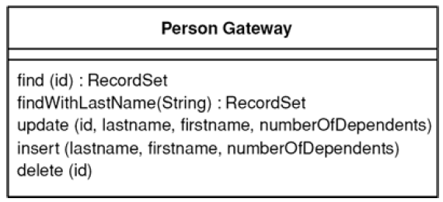
Table Data Gateway
A Table Data Gateway holds all the SQL for accessing a single table or view: selects, inserts, updates, and deletes.
Other code calls its methods for all interaction with the database.

Slide 45
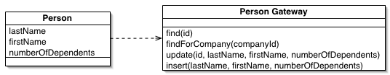
Table Data Gateway

Slide 46
How It Works
A Table Data Gateway has a simple interface, usually consisting of several find methods to get data from the database and update, insert, and delete methods.
Just a wrapper for SQL statements
Each method maps the input parameters into a SQL call and executes the SQL against a database connection.
Most times when you use Table Data Gateway, you'll have one for each table in the database.

Slide 47
When To Use It
Table Data Gateway is very suitable for Transaction Scripts.
This pattern is NOT suitable if you use Domain Model.
One of the benefits of using a Table Data Gateway to encapsulate database access is that the same interface can work both for using SQL to manipulate the database and for using stored procedures.

Slide 48
Data Access Object (DAO)
From “Core J2EE Patterns”, Alur et al.
Notes:
Encapsulating data access calls in a
data access object makes it easier to adapt the enterprise bean’s data access to different
schemas or different database types. The sample application uses separate
data access objects for implementing persistence.
Contoh:
The UserDAO encapsulates all Java Database Connectivity (JDBC)
code and decouples the servlet from the implementation details. The servlet code is
much simpler as a result.

Slide 49
Data Access Object (DAO)
Closely related to Martin Fowlers’ Data Mapper
Use a Data Access Object (DAO) to abstract and encapsulate all access to the data source.
The DAO manages the connection with the data source to obtain and store data.
Reading the following link would be useful:
https://pkp.sfu.ca/wiki/index.php?title=Data_Access_Objects_(DAO)

Slide 50
Participants in DAO Pattern
Data Access Objects
Business Objects
It is the object that requires access to the data source to obtain and store data
Model Objects / Value Objects : a simple POJO
The DataAccessObject may use a value object to return data to the client
The DataAccessObject may also receive the data from the client in a value object to update the data
Datasource
This represents a data source implementation
A data source could be a database such as an RDBMS, OODBMS, XML repository, flat file system, and so forth
Notes:
The DAO usually implements a basic "Create-Read-Update-Delete" (CRUD) pattern to handle single instances of entity objects. Most of the time additional use-case specific methods are required that batch-retrieve objects to improve data access performance, populate objects differently, e.g. with or without dependent objects loaded and deal with polymorphism. The DAO returns domain objects (DO) that represent instances of data entities (e.g. articles, users, etc.).
DOs contain either only values or in more recent design paradigms (

Slide 51
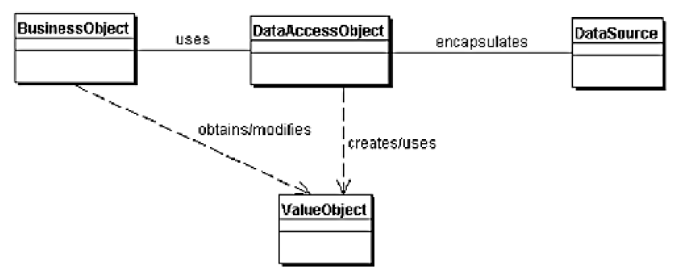
Participants in DAO Pattern

Slide 52
Example
DAO interface
import java.util.List;
public interface StudentDao {
public List<Student> getAllStudents();
public Student getStudent(int rollNo);
public void updateStudent(Student student);
public void deleteStudent(Student student);
}

Slide 53
Example
DAO implementation class
import java.util.List;
public class StudentDaoImpl implements StudentDao {
public List<Student> getAllStudents() {
Connection db = ...;
String statement = "SELECT * FROM student";
...
List<Student> students = ...;
return students;
}
public Student getStudent(int studentId) {...}
public void updateStudent(Student student) {...}
public void deleteStudent(Student student) {...}
}

Slide 54
Example
Model Object / Value Object
import java.io.Serializable;
public class Student implements Serializable {
private int studentId;
private String name;
private int age;
public int getStudentId() {
return studentId;
}
public void setStudentId(int studentId) {
this.studentId = studentId;
}
// and other setters - getters
}
Notes:
demo

Slide 55
Just another view of DAO ...
Persistent
Data
Store
DAO
controller
model
user
view
Application code

Slide 56
Instantiate a UserDao Object in Application Code
1.
StudentDaoImpl studentDao =
new StudentDaoImpl();
2.
StudentDao studentDao =
new StudentDaoImpl();
Which one is better??

Slide 57
Another Way to Instantiate studentDao
StudentDao studentDao;
...
@Autowired
public void setStudentDao( StudentDao studentDao)
{
this.studentDao = studentDao;
}
No more dependency on a specific implementation of the DAO
But who will call the setter?
Do you still remember IoC/Dependency Injection? ☺

Slide 58
Summary
Row Data Gateway
Active Record
Data Mapper
Table Data Gateway (TDG)
DAO

