Slide 1
Web Presentation
Denny, Bayu, Alfan

Slide 2
Intro
Presentation
Domain/Business
Data Source

Slide 3
Introduction
One of the biggest changes to enterprise applications in the last few years has been the rise of Web browser-based user interfaces.
Advantages:
no client software to install
A common UI approach
easy universal access

Slide 4
Introduction
Preparing a Web app begins with the server software itself.
The Web server's job is to interpret the URL of a request and hand over control to a Web server program.

Slide 5
Challenges
How to separate user interface from the business logic?
UI is an HTML string
How to provide OO design?
Code reuse
How to abstract from underlying system?

Slide 6
Web Layer Design
How to design web applications?
Two approaches
Script based
Server page based
Web browser
Web
server
Web
Application
DB
Server

Slide 7
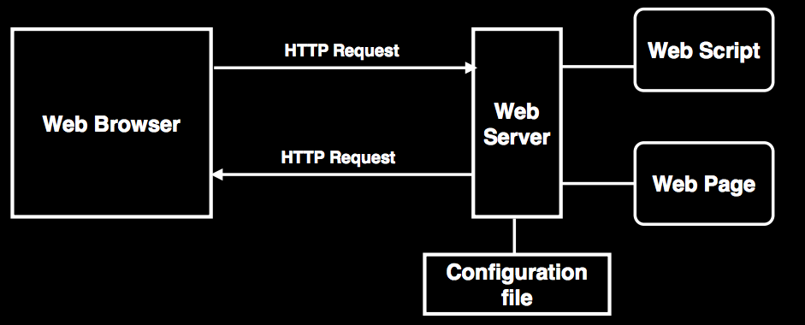
Web Applications

Slide 8
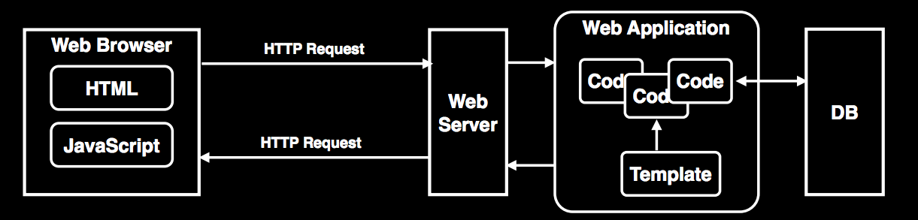
Script Based

Slide 9
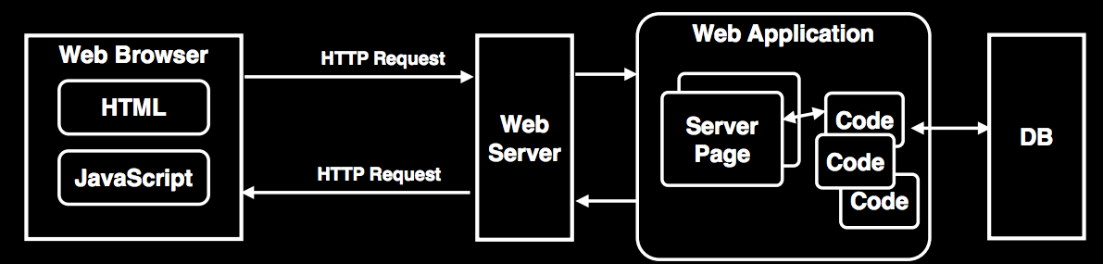
Server Page Based

Slide 10
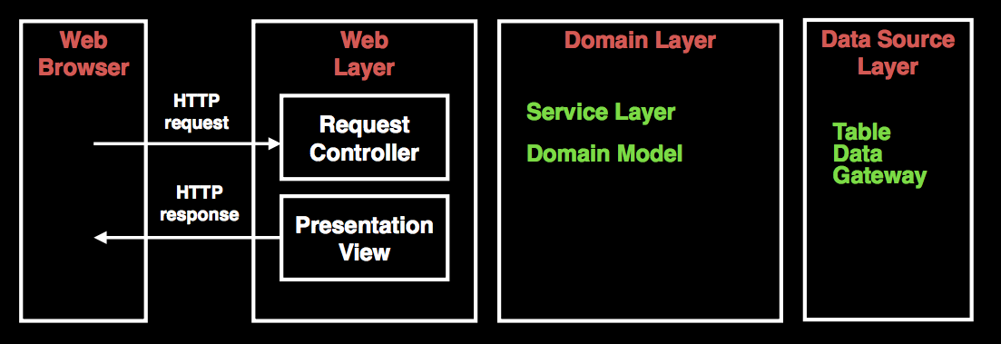
Web Design

Slide 11
Model View Controller

Slide 12
Idea
We separate two works:
interpreting the request
formatting a response
And then, Combine it with the essential notion that non-presentation logic should be factored out.

Slide 13
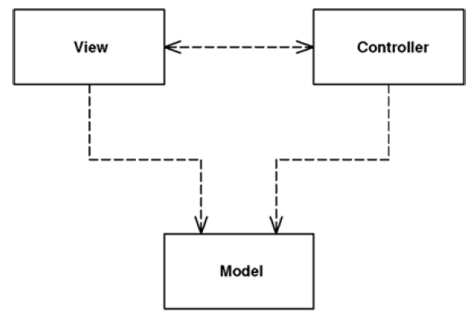
Overview
MVC considers three roles

Slide 14
Model
The model is an object that represents some information about the domain.
It's a nonvisual object containing all the data and behavior other than that used for the UI.
In its most pure OO form the model is an object within a Domain Model.

Slide 15
View
The view represents the display of the model in the UI.
Thus, if our model is a customer object our view might be a frame full of UI widgets or an HTML page rendered with information from the model.
In this course, we use Thymeleaf for the view technology.

Slide 16
Controller
The view is only about display of information.
any changes to the information are handled by the third member of the MVC trinity: the controller.
The controller takes user input, manipulates the model, and causes the view to update appropriately.

Slide 17
Two Principal Separations
separating the presentation from the model
separating the controller from the view
Of these, separation of presentation from model is one of the most fundamental heuristics of good software design.
Notes:
Separating presentation dan model:
Mengizinkan kita membuat presentasi yang banyak, sementara modelnya tetap. Contoh: Tampilan SCELE bisa diganti-ganti tapi informasi yang ditampilkan sama saja
Presentation dan view adalah 2 hal yang berbeda.view => isu UI dan layouting. Model => business policies dan database interactions. Library yang digunakan beda-beda. Programmer/tim pengembangnya pun bisa dibedakan.
Model lebih mudah ditest daripada view, pemisahan ini memudahkan test model

Slide 18
When to use it
Separating the model and the view
Any nontrivial system should use MVC

Slide 19
MVC in Web Design
Web apps are request/response based
Input Controller:
Takes the request
Examines the input parameters
Calls the Model
Decides how to handle response
Sends the control to the View for rendering

Slide 20
Example: Controller
package hello;
import org.springframework.stereotype.Controller;
import org.springframework.web.servlet.ModelAndView;
import org.springframework.web.bind.annotation.RequestMapping;
import org.springframework.web.bind.annotation.RequestParam;
@Controller
public class GreetingController {
@RequestMapping("/greeting")
public ModelAndView greeting(@RequestParam(value="name",
required=false,
defaultValue="World")
String name) {
Person person = new Person(name);
return new ModelAndView("greeting", "person", person);
}
}

Slide 21
Example: View
greeting.html
<!DOCTYPE HTML>
<html xmlns:th="http://www.thymeleaf.org">
<head>
<title>Getting Started: Serving Web Content</title>
<meta http-equiv="Content-Type"
content="text/html; charset=UTF-8" />
</head>
<body>
<p th:text="'Hello, ' + ${person.name} + '!'" />
</body>
</html>

Slide 22
Example: Model
public class Person {
private String name;
public void setName(String name) {
this.name = name;
}
public String getName() {
return this.name;
}
}

Slide 23
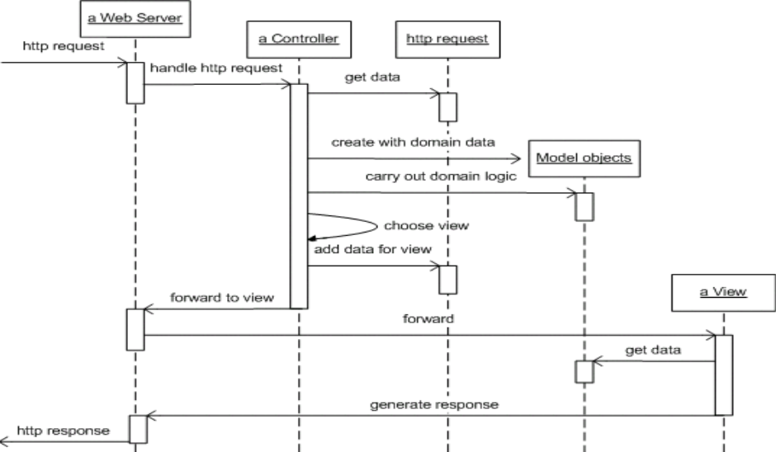
MVC in Web Design

Slide 24
MVC Patterns
Input controller patterns:
Page Controller
Front Controller
View patterns:
Template View
Transform View

Slide 25
Question
What design principle is the most important in MVC?
Separation of different concerns
All request go to the same place
Easy to test different components
Easy to change the view

Slide 26
Page Controller

Slide 27
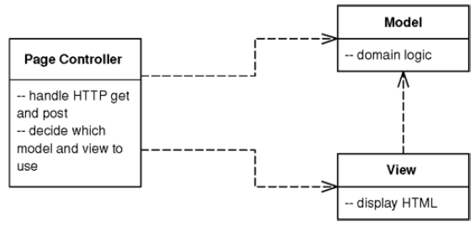
Introduction
An object that handles a request for a specific page or action on a Web site.

Slide 28
How It Works
the approach of one path leading to one file that handles the request is a simple model to understand.
The basic idea behind a Page Controller is to have one module on the Web server act as the controller for each page on the Web site.
The Page Controller can be structured either as a script (CGI script, servlet, etc.) or as a server page (ASP, PHP, JSP, etc.).

Slide 29
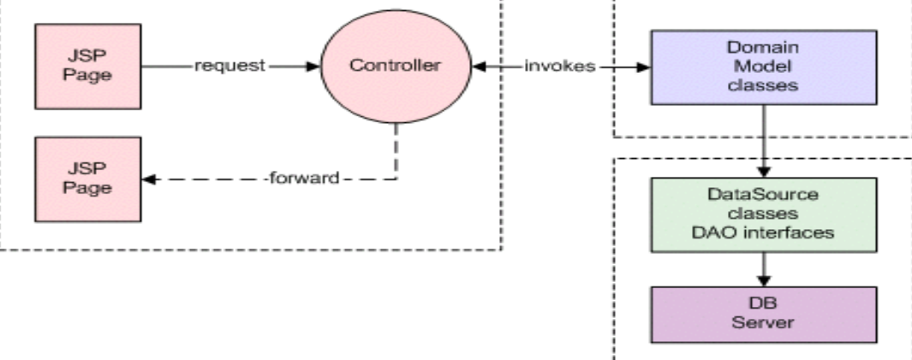
Page Controller Pattern

Slide 30
Spring’s Page Controller
@RequestMapping("/greeting")
public ModelAndView greeting(@RequestParam(value="name",
required=false,
defaultValue="World")
String name) {
Person person = new Person(name);
return new ModelAndView("greeting", "person", person);
}

Slide 31
Responsibilities
Decode the URL and extract any form data to figure out all the data for the action.
Create and invoke any model objects to process the data.
All relevant data from the HTML request should be passed to the model so that the model objects don't need any connection to the HTML request.
Determine which view should display the result page and forward the model information to it.
Notes:
It is important that the HTTP stuff does not go to the model layer

Slide 32
When To Use It
Page Controller works particularly well in a site where most of the controller logic is pretty simple.

Slide 33
Front Controller

Slide 34
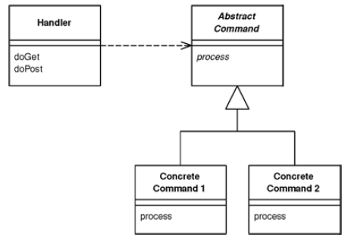
Introduction
A controller that handles all requests for a Web site.

Slide 35
Motivation
In a complex Web site there are many similar things you need to do when handling a request.
If the input controller behavior is scattered across multiple objects, much of this behavior can end up duplicated.
Also, it's difficult to change behavior at runtime.
The Front Controller consolidates all request handling by channeling requests through a single handler object.
Taken care by Spring!

Slide 36
How It Works
Takes care of common tasks e.g. security, authentication etc
A Front Controller handles all calls for a Web site, and is usually structured in two parts:
A Web Handler
object that actually receives post or get requests from the Web server.
The Web handler is almost always implemented as a class rather than as a server page, as it doesn't produce any response.
A Command Hierarchy

Slide 37
Web Handler
It pulls just enough information from the URL and the request to decide what kind of action to initiate and then delegates to a command to carry out the action.
The Web handler itself is usually a fairly simple program that does nothing other than decide which command to run.
The Web handler can decide which command to run either statically or dynamically.
The static version involves parsing the URL and using conditional logic
the dynamic version usually involves taking a standard piece of the URL and using dynamic instantiation to create a command class

Slide 38
Command
Remember that both the handler and the commands are part of the controller.
As a result the commands can (and should) choose which view to use for the response.
The only responsibility of the handler is in choosing which command to execute. Once that's done, it plays no further part in that request.

Slide 39
When To Use It
The Front Controller is a more complicated design than its obvious counterpart, Page Controller.
Only One Front Controller has to be configured into the Web server; the Web handler does the rest of the dispatching.
Because you create new command objects with each request, you don't have to worry about making the command classes thread-safe.

Slide 40
Template View
Pattern yang mendasari Thymeleaf

Slide 41
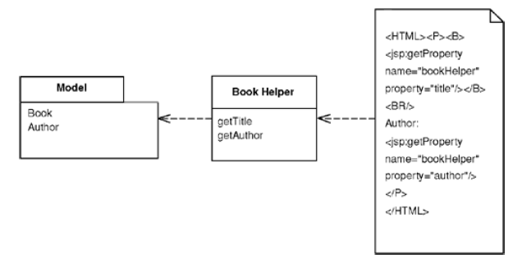
Introduction
Renders information into HTML by embedding markers in an HTML page.

Slide 42
Motivation
Writing a program that spits out HTML is often more difficult than you might imagine.
Although programming languages are better at creating text than they used to be, creating and concatenating string constructs is still painful.
The best way to work is to compose the dynamic Web page as you do a static page but put in markers that can be resolved into calls to gather dynamic information.
Since the static part of the page acts as a template for the particular response, I call this a Template View.

Slide 43
How It Works
The basic idea of Template View is to embed markers into a static HTML page when it's written.
When the page is used to service a request, the markers are replaced by the results of some computation, such as a database query.
Embedding the markers or using Helper Objects

Slide 44
When To Use It
The name Template View brings out the fact that the primary function of this pattern is to play the view in Model View Controller.
For many systems the Template View should only play the view.

Slide 45
When To Use It
For implementing the view in Model View Controller, the main choice is between Template View and Transform View.
The strength of Template View is that it allows you to compose the content of the page by looking at the page structure.

Slide 46
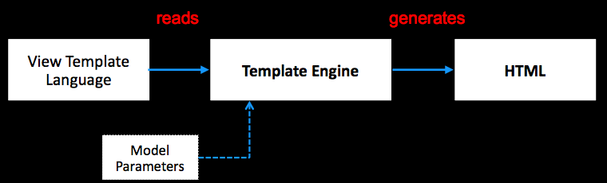
Template
Template engine will execute the view and create the HTML

Slide 47
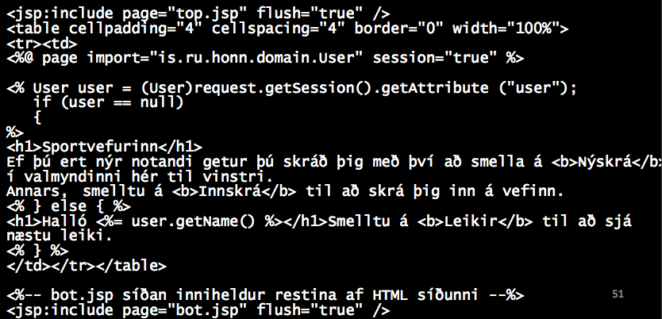
Example

Slide 48


Slide 49
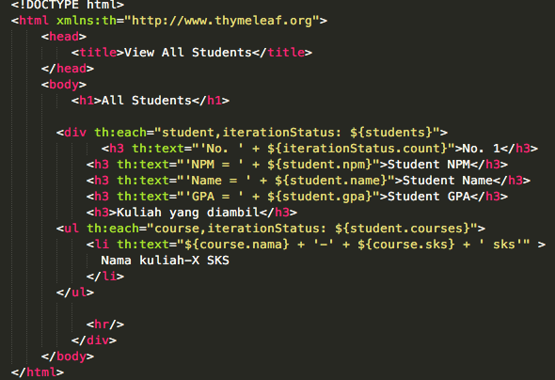
Example

Slide 50
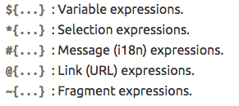
Thymeleaf – Standard Expression Syntax

Slide 51

Variable Expression
Executed on model attribute

Slide 52
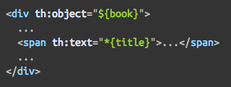

Selection Expression

Slide 53


Link Expression
Suppose deployed at myapp

Slide 54
Link Expression

Slide 55
th:text
Message Expression

Slide 56
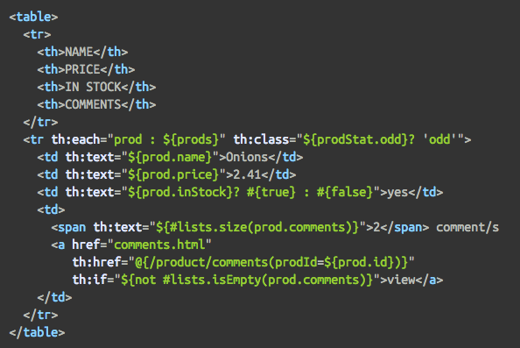
Conditional Evaluation

Slide 57

Conditional Evaluation

Slide 58

Conditional Evaluation

Slide 59
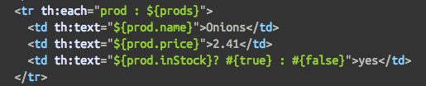
Iteration

Slide 60
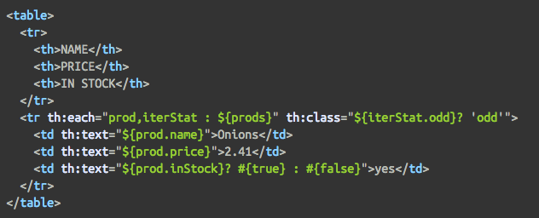
Iteration

Slide 61
Iteration Status
index
count
size
even/odd
first
last

Slide 62
Transform View

Slide 63
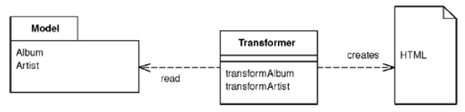
Introduction
A view that processes domain data element by element and transforms it into HTML.

Slide 64
Introduction
When you issue requests for data to the domain and data source layers, you get back all the data you need to satisfy them, but without the formatting you need to make a proper Web page.
The role of the view in Model View Controller is to render this data into a Web page.
Using Transform View means thinking of this as a transformation where you have the model's data as input and its HTML as output.

Slide 65
How It Works
The basic notion of Transform View is writing a program that looks at domain-oriented data and converts it to HTML.
The program walks the structure of the domain data and, as it recognizes each form of domain data, it writes out the particular piece of HTML for it.
If you think about this in an imperative way, you might have a method called renderCustomer that takes a customer object and renders it into HTML.
If the customer contains a lot of orders, renderCustomer method loops over the orders calling renderOrder.

Slide 66
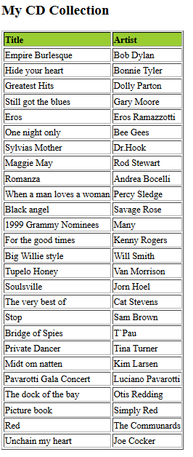
XLST
<?xml version="1.0" encoding="UTF-8"?> <catalog> <cd> <title>Empire Burlesque</title> <artist>Bob Dylan</artist> <country>USA</country> <company>Columbia</company> <price>10.90</price> <year>1985</year> </cd> . . </catalog>
XML
Transformer
<?xml version="1.0" encoding="UTF-8"?> <xsl:stylesheet version="1.0" xmlns:xsl="http://www.w3.org/1999/XSL/Transform"> <xsl:template match="/"> <html> <body> <h2>My CD Collection</h2> <table border="1"> <tr bgcolor="#9acd32"> <th>Title</th> <th>Artist</th> </tr> <xsl:for-each select="catalog/cd"> <tr> <td><xsl:value-of select="title"/></td> <td><xsl:value-of select="artist"/></td> </tr> </xsl:for-each> </table> </body> </html> </xsl:template> </xsl:stylesheet>
XSL Style Sheet
Notes:
http://www.w3schools.com/xsl/xsl_transformation.asp

Slide 67
What’s the difference?
The key difference between Transform View and Template View is the way in which the view is organized.
A Template View is organized around the output.
By adding marker in the HTML
A Transform View is organized around separate transforms for each kind of input element. The transform is controlled by something like a simple loop that looks at each input element, finds the appropriate transform for that element, and then calls the transform on it.

Slide 68
Advantages
Transform View avoids two of the biggest problems with Template View:
It's easier to keep the transform focused only on rendering HTML, thus avoiding having too much other logic in the view.
It's also easy to run the Transform View and capture the output for testing.
This makes it easier to test the view and you don't need a Web server to run the tests.
Because, the output is pure HTML, without marker.

Slide 69
Summary
MVC
Controller Pattern
Page Controller
Front Controller
View pattern
Template View
Transform View

