Slide 1
Web Services & REST
Samuel,Denny, Bayu, Alfan

Slide 2
Today
Web Service

Slide 3
Distributed Computing Technologies
Enterprise Applications can be very complex
They need to integrate with other enterprise applications scattered around the enterprise.
How to establish a communication that allow interoperability between different applications on different platforms?

Slide 4
Distributed Computing Technologies
History...
CORBA (OMG)
Vendor-neutral
Very powerful but limited however by its complicated way of utilizing the power and flexibility of the Internet
DCOM (Microsoft)
Distributed Computing platform closely tied to Microsoft component efforts such as OLE, COM and ActiveX
RMI (Sun Microsystems)
Java based effort which doesn’t play well with other languages.
Web Services (W3C)

Slide 5
Web Services
Based on W3C, web services provide a standard means of interoperating between software applications running on a variety of platforms and frameworks.
Actually, a Web service is a Web page that’s meant to be consumed by an autonomous program as opposed to a Web browser or similar UI tool.
Notes:
On the conceptual level, a service is a software component provided through a network-accessible endpoint.
The service consumer and provider use messages to exchange invocation request and response information in the form of self-containing documents that make very few assumptions about the technological capabilities of the receiver.

Slide 6
Web Service
Movie Client
Class A
getMovieById
updateMovie
searchMovieByTitle
getActorsByName
Class B
Notes:
Example here…

Slide 7
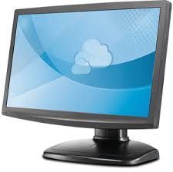
Web Service
MOVIE SERVICE
Internet
getMovieById
updateMovie
searchMovieByTitle
getActorsByName

Slide 8
Web Service vs Web Application
Web Service | Web Application
XML/JSON | HTML
Program to Program interaction | User to program
CRUD based | User interaction
Service integration | Monolithic

Slide 9
Web Services
Formally...
A Web Service is a standards-based, language-agnostic software entity, that accepts specially formatted requests from other software entities on remote machines via vendor and transport neutral communication protocols, producing application specific responses.
Keywords:
Standards based
Language agnostic
Formatted requests
Remote machines
Vendor and Transport Neutral
Notes:
Web services are characterized by their great interoperability and extensibility, as well as their machine-processable descriptions, thanks to the use of XML. Web services can be combined in a loosely coupled way to achieve complex operations. Programs providing simple services can interact with each other to deliver sophisticated added-value services.

Slide 10
Benefits of Web Services
Loosely Coupled
Ease of Integration
Service Reuse
Notes:
Each service exists independently of the other services that make up the application. Individual pieces of the application to be modified without impacting unrelated areas.
Data is isolated between applications. Web Services act as glue between these and enable easier communications within and across organizations.
Service reuse:
Takes code reuse a step further. A specific function within the domain is only ever coded once and used over and over again by consuming applications.

Slide 11
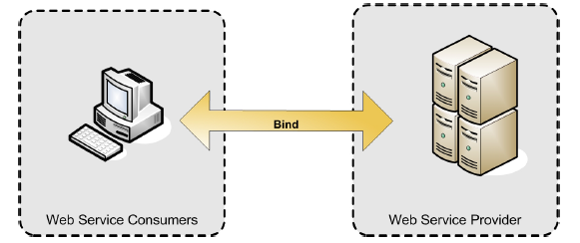
Web Service Architectures
The SIMPLEST web service system has two participants:
A service producer (provider)
A service consumer (requester)
Ian G. Baltopoulos, Introduction to web services, ICL
Notes:
The provider presents the interface and implementation of the
service, and the requester uses the Web service.

Slide 12
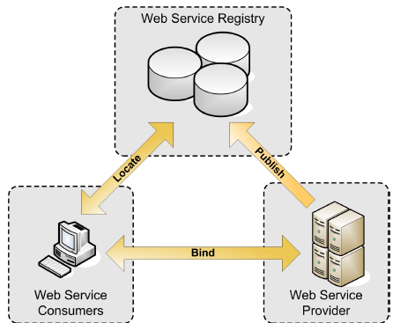
Web Service Architectures
The MORE SOPHISTICATED web service system (A Service Oriented Architecture / SOA)
A registry, acts as a broker for Web services.
A provider, can publish services to the registry
A consumer, can then discover services in the Registry
Ian G. Baltopoulos, Introduction to web services, ICL

Slide 13
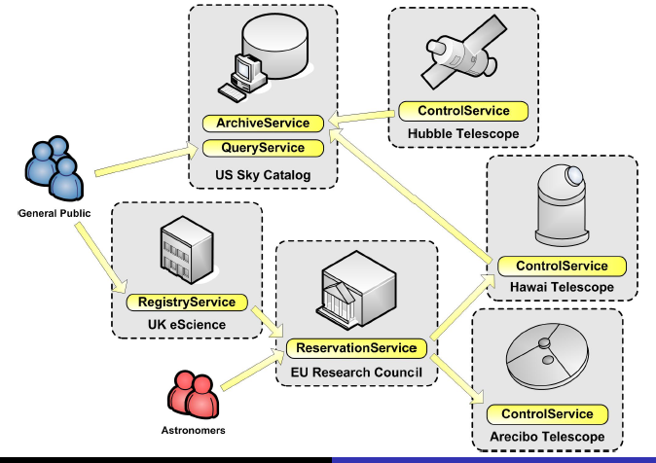
Example
Web Enabled Telescope Access
Ian G. Baltopoulos, Introduction to web services, ICL

Slide 14
Type of Web Services
“Big” Web Services (SOAP Web Services)
Big web services use XML messages that follow the Simple Object Access Protocol (SOAP) standard, an XML language defining a message architecture and message formats.
“Light” RESTful Web Services
RESTful web services, often better integrated with HTTP than SOAP-based services are, do not require XML messages or WSDL service–API definitions.
Notes:
http://docs.oracle.com/javaee/6/tutorial/doc/giqsx.html
On a technical level, web services can be implemented in various ways. The two types of web services discussed in this section can be distinguished as “big” web services and “RESTful” web services.

Slide 15
“Big” SOAP Web Services
An XML language defining a message architecture and message formats.
SOAP web services often contain a machine-readable description of the operations offered by the service, written in the Web Services Description Language (WSDL), an XML language for defining interfaces syntactically.
Notes:
The architecture needs to handle asynchronous processing and invocation.
The architecture must address complex nonfunctional requirements.
SOAP itu apa? Cara kerjanya bagaimana

Slide 16
Why XML?
The Web already supports machine-to-machine integration
What's not machine-processable about the current Web isn't the protocol, it's the content.
Using XML formats as your machine-processable representations for resources allows applying new tools to old data
It also simplifies interconnection with remote systems
Notes:
Informasi tidak terstruktur

Slide 17
But, Why Not Just Use Plain HTML?
Web pages are designed to be understood by people, who care about layout and styling, not just raw data
Every URI could have a human-readable and a machine-processable representation:
Browsers ask for the human-readable one
Web Services clients ask for the machine-readable one

Slide 18
RESTful Web Services
Notes:
http://www.drdobbs.com/web-development/restful-web-services-a-tutorial/240169069
More than a decade after its introduction, REST has become one of the most important technologies for Web applications. Its importance is likely to continue growing quickly as all technologies move towards an API orientation. Every major development language now includes frameworks for building RESTful Web services. As such, it is important for Web developers and architects to have a clear understanding of REST and RESTful services. This tutorial explains REST architecturally, then dives into the details of using it for common API-based tasks.

Slide 19
REST
REST stands for Representational State Transfer, which is an architectural style for networked hypermedia applications, it is primarily used to build Web services that are lightweight, maintainable, and scalable.
REST is not dependent on any protocol

Slide 20
Motivation
Every system uses resources.
The purpose of a service is to provide a window to its clients so that they can access these resources.
Service architects and developers want this service to be easy to implement, maintainable, extensible, and scalable.
The goal of REST
Notes:
A web page is a representation of a resource
Resources are just concepts
URIs tell a client that there's a concept somewhere
Who uses REST
REST vs SOAP

Slide 21
Properties and Features of RESTful Web Services
Representations
Messages
Resource Identification through URIs
Uniform Interface
Stateless
Links between resources
Caching

Slide 22
#1 Representations
The focus of a RESTful service is on resources and how to provide access to these resources.
Once we have identified our resources, the next thing we need is to find a way to represent these resources in our system.
For example, depending on your requirement, you can decide to use JSON or XML.
{
"ID": "1",
"Name": “Budi",
"Email": "budi@gmail.com",
"Country": "indonesia"
}
<Person>
<ID>1</ID>
<Name>budi</Name>
<Email>budi@gmail.com</Email>
<Country>indonesia</Country>
</Person>
Notes:
A resource can easily be thought of as an object as in OOP.

Slide 23
#2 Messages
Resources are decoupled from their representation so that their content can be accessed in a variety of formats, such as HTML, XML, plain text, PDF, JPEG, JSON, and others.
Metadata about the resource is available and used, for example, to control caching, detect transmission errors, negotiate the appropriate representation format, and perform authentication or access control.

Slide 24
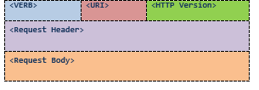
#2 Messages
The client and service talk to each other via messages.
Apart from the actual data, these messages also contain some metadata about the message.
Example of HTTP Request:
<VERB> is one of the HTTP methods like GET, PUT, POST, DELETE, OPTIONS, etc
<URI> is the URI of the resource on which the operation is going to be performed
...
Notes:
<VERB> is one of the HTTP methods like GET, PUT, POST, DELETE, OPTIONS, etc
<URI> is the URI of the resource on which the operation is going to be performed
<HTTP Version> is the version of HTTP, generally "HTTP v1.1" .
<Request Header> contains the metadata as a collection of key-value pairs of headers and their values. These settings contain information about the message and its sender like client type, the formats client supports, format type of the message body, cache settings for the response, and a lot more information.
<Request Body> is the actual message content. In a RESTful service, that's where the representations of resources sit in a message.

Slide 25
#3 Resource Identification through URIs
REST requires each resource to have at least one URI.
A RESTful service uses a directory hierarchy like human readable URIs to address its resources.
Example: Suppose we have a database of persons and we wish to expose it to the outer world through a service. A resource person can be addressed like this:
This URL has following format:
http://MyService/Persons/1
Protocol://ServiceName/ResourceType/ResourceID
Notes:
Here are some important recommendations for well-structured URIs:
Use plural nouns for naming your resources.
Avoid using spaces as they create confusion. Use an _ (underscore) or – (hyphen) instead.
A URI is case insensitive. I use camel case in my URIs for better clarity. You can use all lower-case URIs.
You can have your own conventions, but stay consistent throughout the service. Make sure your clients are aware of this convention. It becomes easier for your clients to construct the URIs programmatically if they are aware of the resource hierarchy and the URI convention you follow.
Avoid verbs for your resource namesA cool URI never changes; so give some thought before deciding on the URIs for your service. If you need to change the location of a resource, do not discard the old URI. If a request comes for the old URI, use status code 300 and redirect the client to the new location.
until your resource is actually an operation or a process. Verbs are more suitable for the names of operations. For example, a RESTful service should not have the URIs http://MyService/FetcthPerson/1 or http://MyService/DeletePerson?id=1.

Slide 26
#3 Resource Identification through URIs
URIs may have Query Parameters.
The basic purpose of query parameters is to provide parameters to an operation that needs the data items.
For example, if you want the format of the presentation to be decided by the client.
http://MyService/Persons/1?format=json&encoding=UTF8
http://MyService/Persons/1?format=xml&encoding=UTF8

Slide 27
URI, URL
Uniform Resource Identifier
www.cs.ui.ac.id
www.coursera.org
Uniform Resource Locator
http://www.cs.ui.ac.id
ftp://kambing.cs.ui.ac.id

Slide 28
#4 Uniform Interface
RESTful systems should have a uniform interface. HTTP 1.1 provides a set of methods, called verbs, for this purpose.
Method | Operation performed on server | Quality
GET | Read a resource | Safe
PUT | Insert a new resource or update if the resource already exists. | Idempotent
POST | Insert a new resource. Also can be used to update an existing resource | N/A
DELETE | Delete a resource | Idempotent
OPTIONS | List the allowed operations on a resource | Safe
HEAD | Return only the response headers and no response body | Safe
Notes:
A Safe operation is an operation that does not have any effect on the original value of the resource. For example, the mathematical operation "divide by 1" is a safe operation because no matter how many times you divide a number by 1, the original value will not change. An Idempotent operation is an operation that gives the same result no matter how many times you perform it. For example, the mathematical operation "multiply by zero" is idempotent because no matter how many times you multiply a number by zero, the result is always same. Similarly, a Safe HTTP method does not make any changes to the resource on the server. An Idempotent HTTP method has same effect no matter how many times it is performed.

Slide 29
GET
GET is probably the most popular method on the Web. It is used to fetch a resource.
You should use these methods only for the purpose for which they are intended. For instance, never use GET to create or delete a resource on the server.
This is not a RESTful design !!
BAD:
GET http://MyService/DeletePersons/1 HTTP/1.1
HOST: MyService
GOOD:
DELETE http://MyService/Persons/1 HTTP/1.1
HOST: MyService
Notes:
For instance, never use GET to create or delete a resource on the server. If you do, it will confuse your clients and they may end up performing unintended operations.
REST recommends a uniform interface and HTTP provides you that uniform interface. However, it is up to service architects and developers to keep it uniform.

Slide 30
PUT vs POST
The key difference between PUT and POST is that PUT is idempotent while POST is not.
No matter how many times you send a PUT request, the results will be same.
But, Making a POST multiple times may result in multiple resources getting created on the server.
Another difference is that, with PUT, you must always specify the complete URI of the resource.

Slide 31
PUT vs POST
Request | Operation
PUT http://MyService/Persons/ | Won't work. PUT requires a complete URI
PUT http://MyService/Persons/1 | Insert a new person with PersonID=1 if it does not already exist, or else update the existing resource
POST http://MyService/Persons/ | Insert a new person every time this request is made and generate a new PersonID.
POST http://MyService/Persons/1 | Update the existing person where PersonID=1

Slide 32
#5 Statelessness
A RESTful service is stateless and does not maintain the application state for any client.
A request cannot be dependent on a past request and a service treats each request independently.
HTTP is a stateless protocol by design and you need to do something extra to implement a stateful service using HTTP.

Slide 33
Stateless
A stateless design looks like so:
Request1: GET http://MyService/Persons/1 HTTP/1.1
Request2: GET http://MyService/Persons/2 HTTP/1.1
Each of these requests can be treated separately !

Slide 34
Stateful
A stateful design, on the other hand, looks like so:
Request1: GET http://MyService/Persons/1 HTTP/1.1
Request2: GET http://MyService/NextPerson HTTP/1.1
To process the second request, the server needs to remember the last PersonID that the client fetched. In other words, the server needs to remember the current state — otherwise Request2 cannot be processed.
RESTful design: Design your service in a way that a request never refers to a previous request !
Notes:
Stateless services are easier to host, easy to maintain, and more scalable. Plus, such services can provide better response time to requests, as it is much easier to load balance them.

Slide 35
#6 Link between resources
A resource representation can contain links to other resources like an HTML page contains links to other pages.
Let's consider the case in which a client requests one resource that contains multiple other resources. Instead of dumping all these resources, you can list the resources and provide links to them.
<Club>
<Name>Authors Club</Name>
<Persons>
<Person>
<Name>Budi</Name>
<URI>http://MyService/Persons/1</URI>
</Person>
<Person>
<Name>Rudi</Name>
<URI>http://MyService/Persons/12</URI>
</Person>
</Persons>
</Club>
http://www.drdobbs.com/web-development/restful-web-services-a-tutorial/240169069

Slide 36
#7 Caching
Caching is the concept of storing the generated results and using the stored results instead of generating them repeatedly if the same request arrives in the near future.
This can be done on the client, the server, or on any other component between them, such as a proxy server.
Caching is a great way of enhancing the service performance, but if not managed properly, it can result in client being served stale results.

Slide 37
Documenting a RESTful Service
RESTful services do not necessarily require a document to help clients discover them. Due to URIs, links, and a uniform interface, it is extremely simple to discover RESTful services at runtime.
This does not mean that RESTful services require no documentation at all. There is no excuse for not documenting your service. You should document every resource and URI for client developers.

Slide 38
Documenting a RESTful Service – an example
Service Name: MyService
Address: http://MyService/
Resource | Method | URI | Description
Person | GET, POST, PUT, DELETE | http://MyService/Persons/{PersonID} | Contains information about a person {PersonID} is optional Format: text/json
Search | GET | http://MyService/Search? | Search a person or a club Format: text/json Query Parameters: Name: String, Name of a person or a club Country: String, optional, Name of the country of a person or a club Type: String, optional, Person or Club. If not provided then search will result in both Person and Cubs
Notes:
Adding postman

Slide 39
Summary
Web service goal:
Interoperability between services/applications
Enable integration
REST
Architectural style

Slide 40
Demo
CRUD with REST

Slide 41
References
Roy Fielding (REST is his dissertation at UC Irvine) - https://www.ics.uci.edu/~fielding/pubs/dissertation/rest_arch_style.htm
http://docs.oracle.com/javaee/6/tutorial/doc/gijqy.html
http://docs.oracle.com/javaee/6/tutorial/doc/giqsx.html
http://www.drdobbs.com/web-development/restful-web-services-a-tutorial/240169069
Introduction To Web Services, Ioannis G. Baltopoulos, Department of Computer Science, Imperial College London
RESTful Web Services, John Cowan

