Slide 1
Microservices
(Samuel Louvan)

Slide 2
Last session
Web service
What?
Why ?
How ?
REST API

Slide 3
Today
Microservices
What ?
Comparison : Microservices vs Monolithic

Slide 4
Microservices
An architectural style
A particular way of designing software applications as suites of independently deployable services

Slide 5
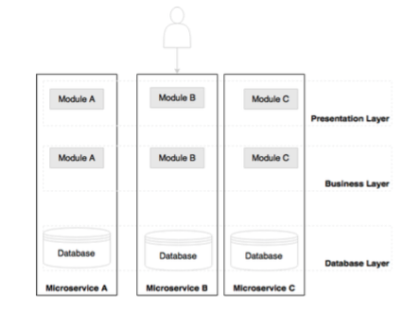
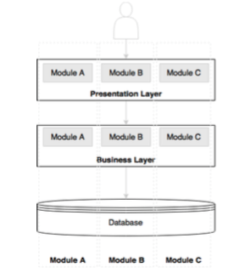
Monolithic vs Microservice

Slide 6
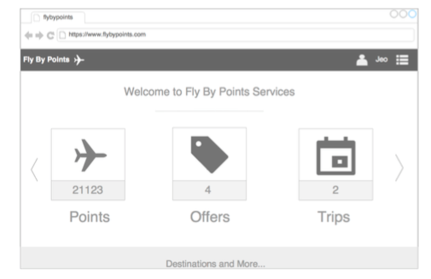
Monolithic vs Microservice

Slide 7
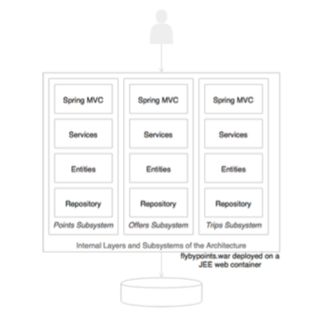
Monolithic

Slide 8
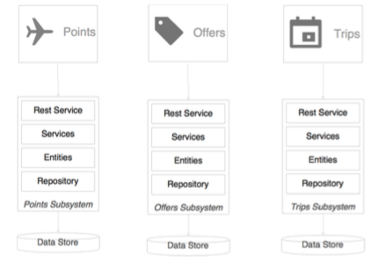
Microservice

Slide 9
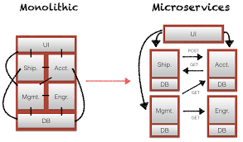
Monolithic vs Microservices

Slide 10
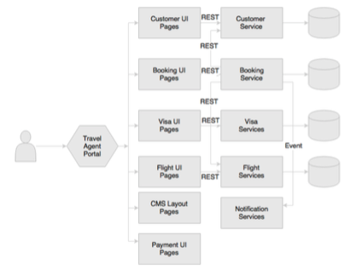
Microservice

Slide 11
Microservice vs Monolithic
Advantages of microservices over monoliths include:
Support for scaling
Support for change
Support for reuse
Support for separate team development
Support for failure

Slide 12
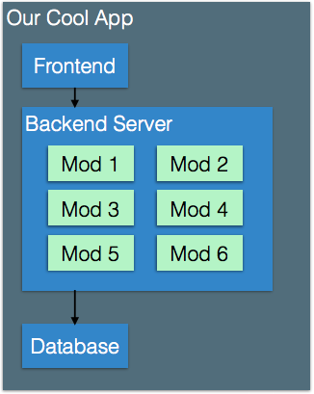
Support for Scaling

Slide 13
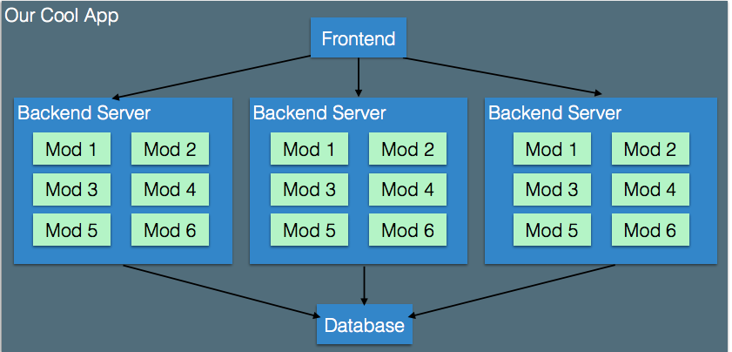
Now, how do we scale it?
We run multiple copies of the backend, each with each of the modules

Slide 14
What’s wrong with this?
If we need 100 servers ?
Each server will have to run EACH module
What if we need more of some modules than others?

Slide 15
Support for change
In a large organization e.g. Amazon, Facebook, Uber etc, will constantly have new features being finished and rolled out to production
Traditional model : releases
Web enables frequent updates
Could update every night or every hour
But, if updating every hour, we don’t want the website to be down

Slide 16
Support for reuse
In a large organization (e.g. Facebook, Amazon etc), may have many internal products that all depend on a similar core service.
Would like to:
Build functionality once, reuse in many places
Swap out an old implementation with new implementation
Swap out an internal service with the new external service

Slide 17
Conway’s Law
The structure of an organization mirrors the structure of a
product.
• Building a car.
• Have a team for tires
• Have a team for drivetrain
• Have a team for seating
• Have a team for paint
• Have a team for ...
• Could pick a product structure and design team around it.
• Or could pick a desired team structure and design product
around it.

Slide 18
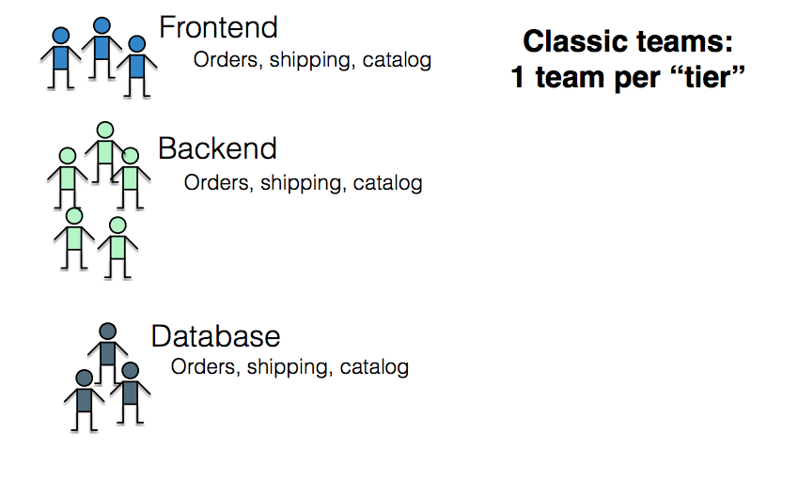
Organization in Monolith

Slide 19
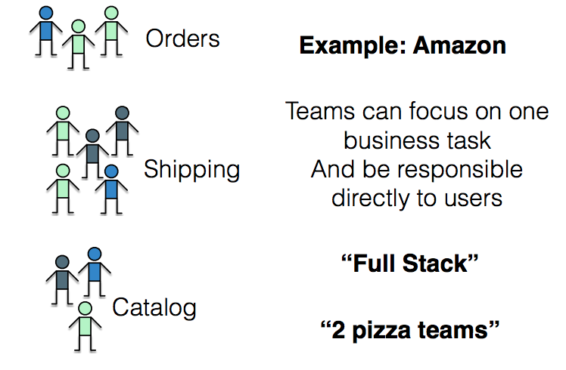
Organization around business capabilities in microservices

Slide 20
How big is a microservice
Metaphor: Building a stereo system
• Components are independently replaceable
• Components are independently updatable
• This means that they can be also independently
developed, tested, etc
• Components can be built as:
• Library (e.g. module)
• Service (e.g. web service)

Slide 21
Design for Failure
Each of the many microservices might fail
Services might have bugs
Services might be slow to respond
Entire servers might go down
If I have 60,000 hard disks, 3 fail a day
The more microservices there are, the higher the
likelihood at least one is currently failing
Key: design every service assuming that at some
point, everything it depends on might disappear -
must fail “gracefully”
Netflix simulates this constantly with “ChaosMonkey”

Slide 22
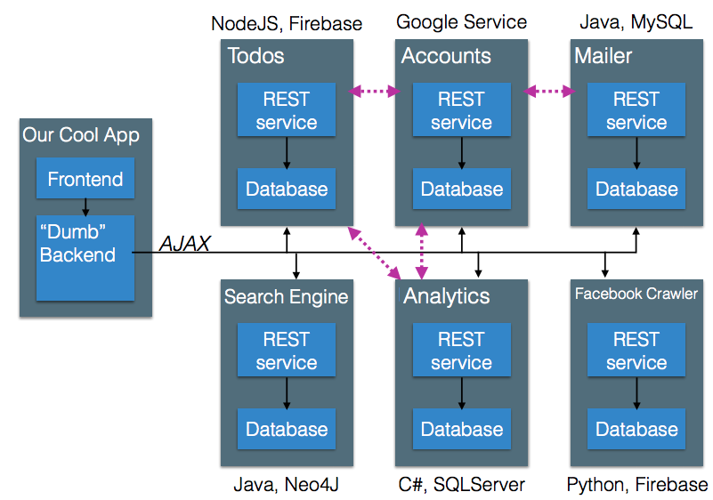
What’s the consequence of this situation?

Slide 23
Consistency
One of our rules was “no shared database”
But surely some state will be shared
Updates are sent via HTTP request
No guarantee that those updates occur immediately
Instead, guarantee that they occur eventually
Can force some ordering, but that’s expensive

Slide 24
We have seen some characteristics of microservices. What is the difference with SOA?

Slide 25
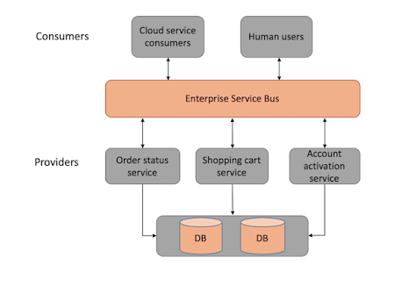
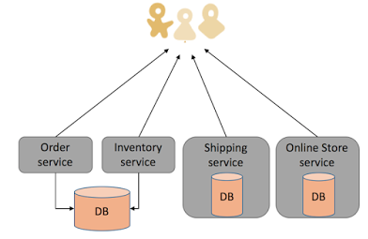
Microservices vs SOA
Notes:
Communications between services?
How about unit testing?
How about deployment?
Size and scope?

Slide 26
Summary
Microservices
Characteristics of Microservices

Slide 27
Demo
SpringBoot Microservices

Slide 28
References
https://cs.gmu.edu/~tlatoza/teaching/swe432f17/Lecture%2011%20-%20Microservices.pdf
https://blogs.oracle.com/developers/getting-started-with-microservices-part-two
https://martinfowler.com/articles/microservices.html#MicroservicesAndSoa

Slide 29
Application Security
Denny, Bayu, Alfan, Samuel

Slide 30
Outline
Major Security Layers
Key Concepts
General Concepts
Kinds of Encryption Algorithms

Slide 31
Three Major Security Layers
The Network Security Layer
firewalls: filter network packets addressed to certain ports in certain machines in the network
web applications: the use of Secure Sockets Layer (SSL) to encode all sensitive information sent along the wire
The Operating System Layer
This layer is probably the most important in the whole security schema, as a properly secured operating system (OS) environment could at least prevent a whole host machine from going down if a particular application is compromised.
The Application Layer
Notes:
Network Security Layer: the use of Secure Sockets Layer (SSL) to encode all sensitive information sent along the wire, but this is related more to the network protocol at the application level than to the network physical level at which firewalls operate
https vs http
OS Layer: attacker can do from spreading viruses to stealing passwords or deleting your whole server’s data and making it unusable.

Slide 32
The Application Layer
Goal: to make sure that only the right people can do only the right things when working through the application
Risks:
allow an attacker to steal information from the application, impersonate other users,
execute restricted operations,
corrupt data,
gain access to operating system level, and
perform many other malicious acts

Slide 33
Key Concepts
Authentication
Authorization
Access control lists (ACLs)

Slide 34
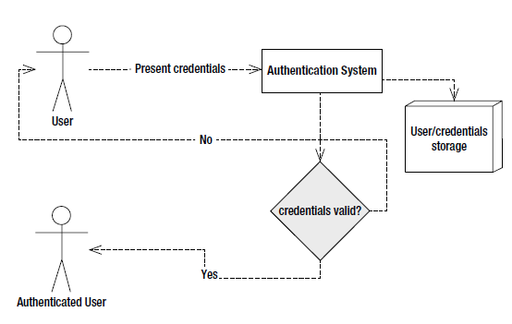
Authentication
Objective: validate that a particular user is who she claims she is
how?
Standard mechanism:
Notes:
Authentication: username-password, public-private key, smart card, biometric
storage: a database or LDAP (Lightweight Directory Access Protocol) server

Slide 35
Credential storage: LDAP
ldapsearch -x uid=a.b
# extended LDIF
# LDAPv3
# base <o=Universitas Indonesia,c=ID> (default) with scope subtree
# filter: uid=a.b
dn: uid=a.b,ou=Mahasiswa,ou=Users,ou=Fakultas Ilmu Komputer,o=Universitas Indonesia,c=ID
objectClass: top
objectClass: person
cn: NAMA USER
sn: NAMA USER
uid: a.b
rid: 166068
uidNumber: 166068
gidNumber: 2200
mail: a.b@ui.ac.id
homeDirectory: /home/fasilkom/mahasiswa/k/a.b
role: mahasiswa
kodeIdentitas: 1207111111
kodeFakultas: 12
kodeOrg: xx.xx.01.00.12.01:mahasiswa
hasAccessTo: mail.ui.ac.id
access12: kawung
loginShell: /bin/bash
shadowMax: 99999
shadowExpire: 17249

Slide 36
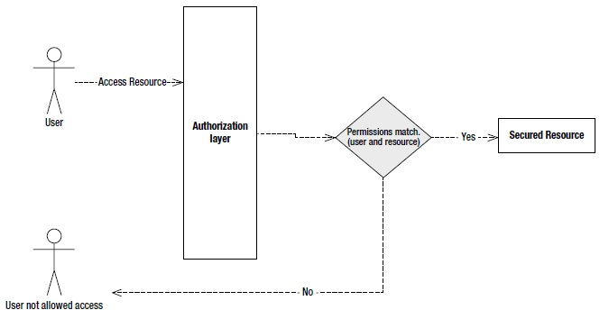
Authorization
Objectives:
determine which actions that user is allowed to perform,
determine which resources she has access to, and
make sure that if the user doesn’t have the proper permissions she cannot carry out that particular action
Simple authorization process:

Slide 37
Access control lists (ACLs)
part of the authorization process
a collection of mappings between resources, users, and permissions.
Examples:
User John has administrative permission on the blog post X
User Luis has read permission on blog post X
three elements in ACL:
user, permission, and resource.
Notes:
The key difference is that ACLs normally work at a finer grained level in the application.

Slide 38
General Concepts
User
Credentials: are the way that a user proves who he is
Role: can be seen as a logical grouping of users
the grouped users share a set of permissions in the application to access certain resources
Resource: any part of the application that we want to access and that needs to be properly secured against unauthorized access
a URL, a business method, or a particular business object.
Notes:
User The first step in securing a system from malicious attackers is to identify legitimate
users and allow access to them alone. User abstractions are created in the system and given
their own identity. These are the users that will later be allowed to use the system.
• Credentials Credentials are the way that a user proves who he is. Normally, in the shape of
passwords (certificates are also a common way of presenting credentials), they are data that
only the owner of it knows.
• Role In an application security context, a role can be seen as a logical grouping of users.
This logical grouping is normally done so the grouped users share a set of permissions in
the application to access certain resources. For example, all users with the role “admin” will
have the same access and permissions to the same resources. Roles serve simply as a way to
group permissions to execute determined actions, making users with those Roles inherit such
permissions.
• Resource By a resource, I mean, in this context, any part of the application that we want to
access and that needs to be properly secured against unauthorized access—for example,
a URL, a business method, or a particular business object.

Slide 39
General Concepts
Permissions: refer to the access level needed to access a particular resource.
For example, two users may be allowed to read a particular document, but only one of them is allowed to write to it.
Permissions can apply either to individual users or to users that share a particular role.
Encryption: allows you to encrypt sensible information so as to make it incomprehensible to attackers even if they get access to the encrypted version.
The idea is that you never store the plain text version of a password, but instead store an encrypted version so that nobody but the owner of such a password knows the original one.
Notes:
• Permissions Permissions refer to the access level needed to access a particular resource.
For example, two users may be allowed to read a particular document, but only one of them is
allowed to write to it. Permissions can apply either to individual users or to users that share a
particular role.
• Encryption This allows you to encrypt sensible information (normally passwords, but it can
be something else, like cookies) so as to make it incomprehensible to attackers even if they
get access to the encrypted version. The idea is that you never store the plain text version of
a password, but instead store an encrypted version so that nobody but the owner of such a
password knows the original one.

Slide 40
HTTPS
HTTPS = HTTP + SSL (Secure Socket Layer)
Using cryptographic mechanism such as:
Encryption
Hashes
Checksum

Slide 41
Twitter/Google API – REST Security
Using token/API key

Slide 42
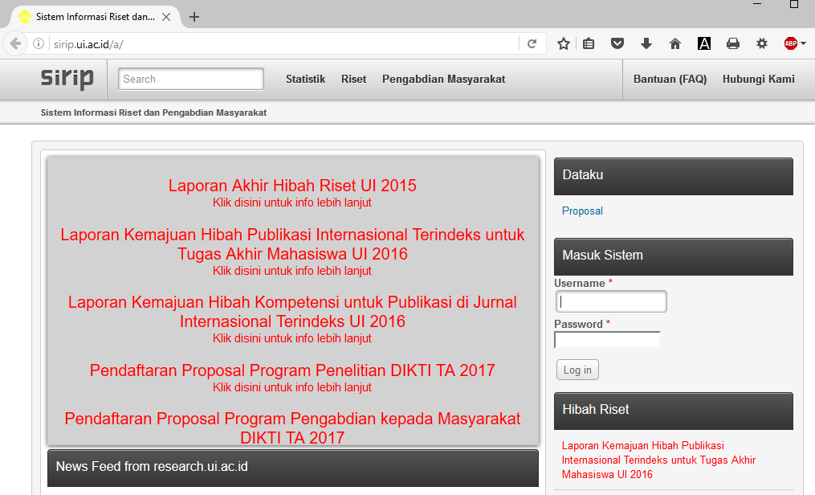
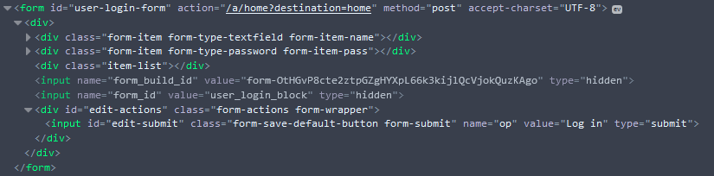
Notes:
Case study: pengembang tidak memahami konsep security

Slide 43

Spring Boot Security

Slide 44
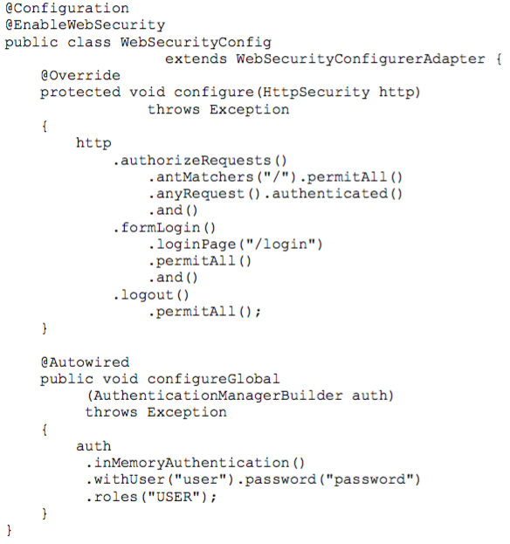
Spring Security

Slide 45
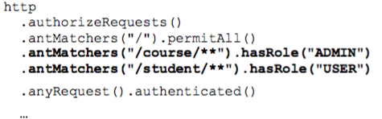
Spring Security

Slide 46
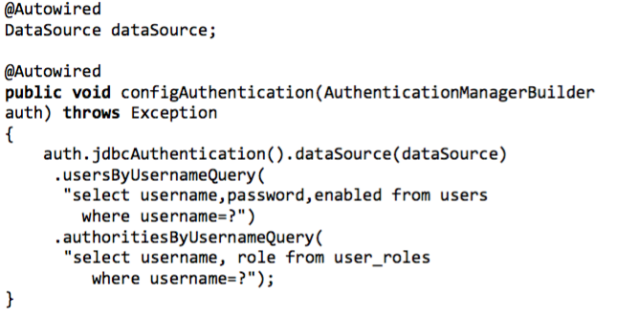
Spring Security

