Slide 1
IBM University Engagement Project Submission
“Exploring the Power of Agentic AI with IBM Granite and IBM Bob”

Slide 2

Project Tile – 18 AI Grant And Funding Finder For Startups
Domain of Project – Generative AI
Student Name | Recent Passport Photo | Email ID | Mobile number [WhatsApp]
Rushika Ramadugu |  | Registered Email: rushikaramadugu@gmail.com IBM Cloud : rushika0289@gmail.com | 9556364007

Slide 3
Problem Statement & Proposed Solution
The Challenge
Startups struggle to discover relevant grants, government schemes, and funding opportunities.
Funding information is scattered across multiple platforms with different formats, eligibility criteria, and deadlines.
Manually comparing opportunities with a startup's stage, domain, location, and funding needs is time-consuming.
Preparing customized funding applications requires significant effort and careful validation.
Proposed Solution — FundFlow AI
FundFlow AI is an Agentic AI-powered Grant & Funding Intelligence Assistant built using IBM Granite and RAG.
It:
Retrieves relevant funding opportunities from a curated knowledge base.
Analyzes startup–funding eligibility.
Ranks opportunities using personalized matching.
Verifies information against available sources.
Generates customized application drafts for human review.
Goal: Right Opportunities. Smarter Decisions. Stronger Startups.

Slide 4
Technology Used
IBM Granite
Core LLM for reasoning, analysis, and content generation.
Processes startup profiles and funding information.
IBM Cloud Lite
IBM cloud services used for AI application development and integration.
Agentic AI
Multiple specialized agents collaborate to complete the funding discovery workflow.
Retrieval-Augmented Generation (RAG)
Retrieves relevant funding information before generating responses.
Helps reduce hallucination and keeps answers grounded in available sources.
Python
Backend logic, AI orchestration, data processing, and API integration.
HTML + CSS
Responsive frontend and professional funding intelligence dashboard.
JSON Knowledge Base
Structured representation of funding opportunities and their eligibility information.
Environment Variables
API credentials and IBM configuration are securely loaded through “.env”.

Slide 5
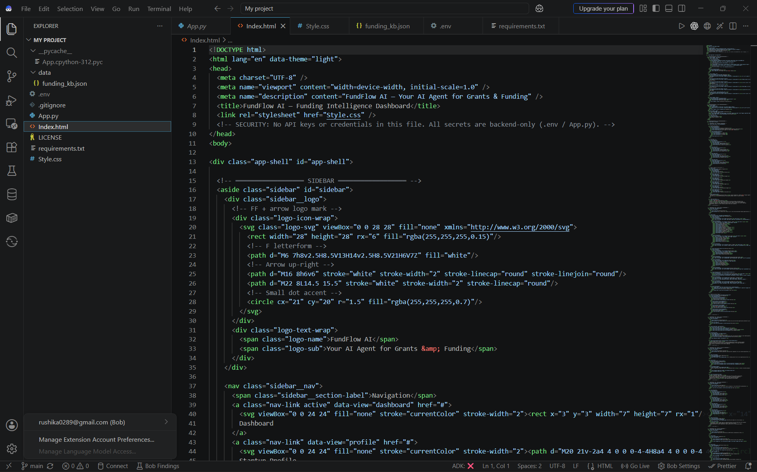
Required Files created using IBM bob -
File | Purpose
App.py | Main application, IBM Granite integration, RAG pipeline, agent orchestration and backend logic
Index.html | Frontend structure and dashboard interface
Style.css | UI styling, responsive design and light/dark themes
Requirements.txt | Python libraries and project dependencies
.env | Secure storage of IBM API credentials and configuration

Slide 6
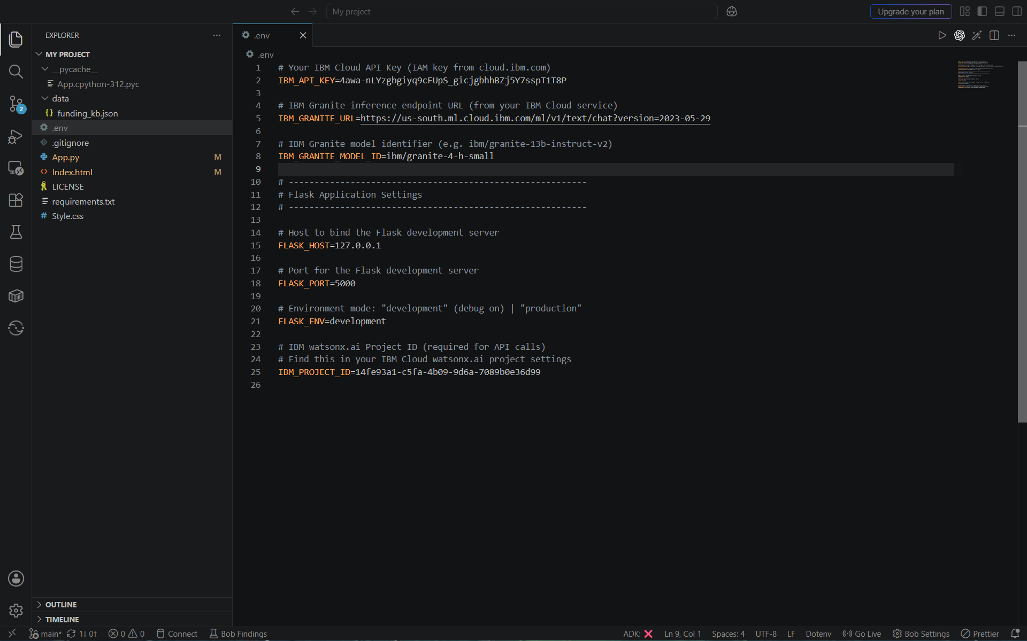
IBM Bob Screenshots:

Slide 7
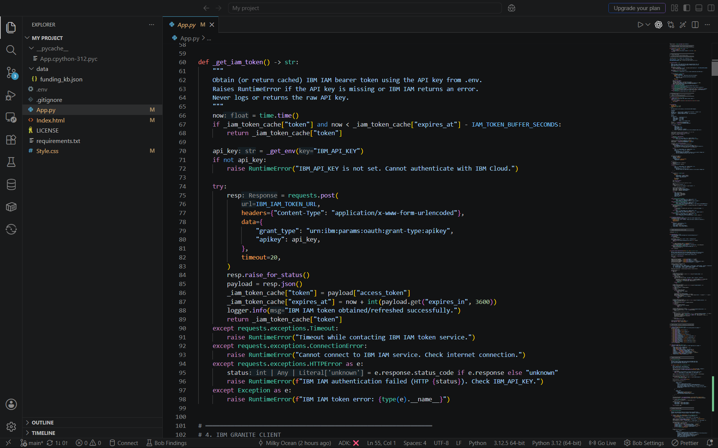

Slide 8
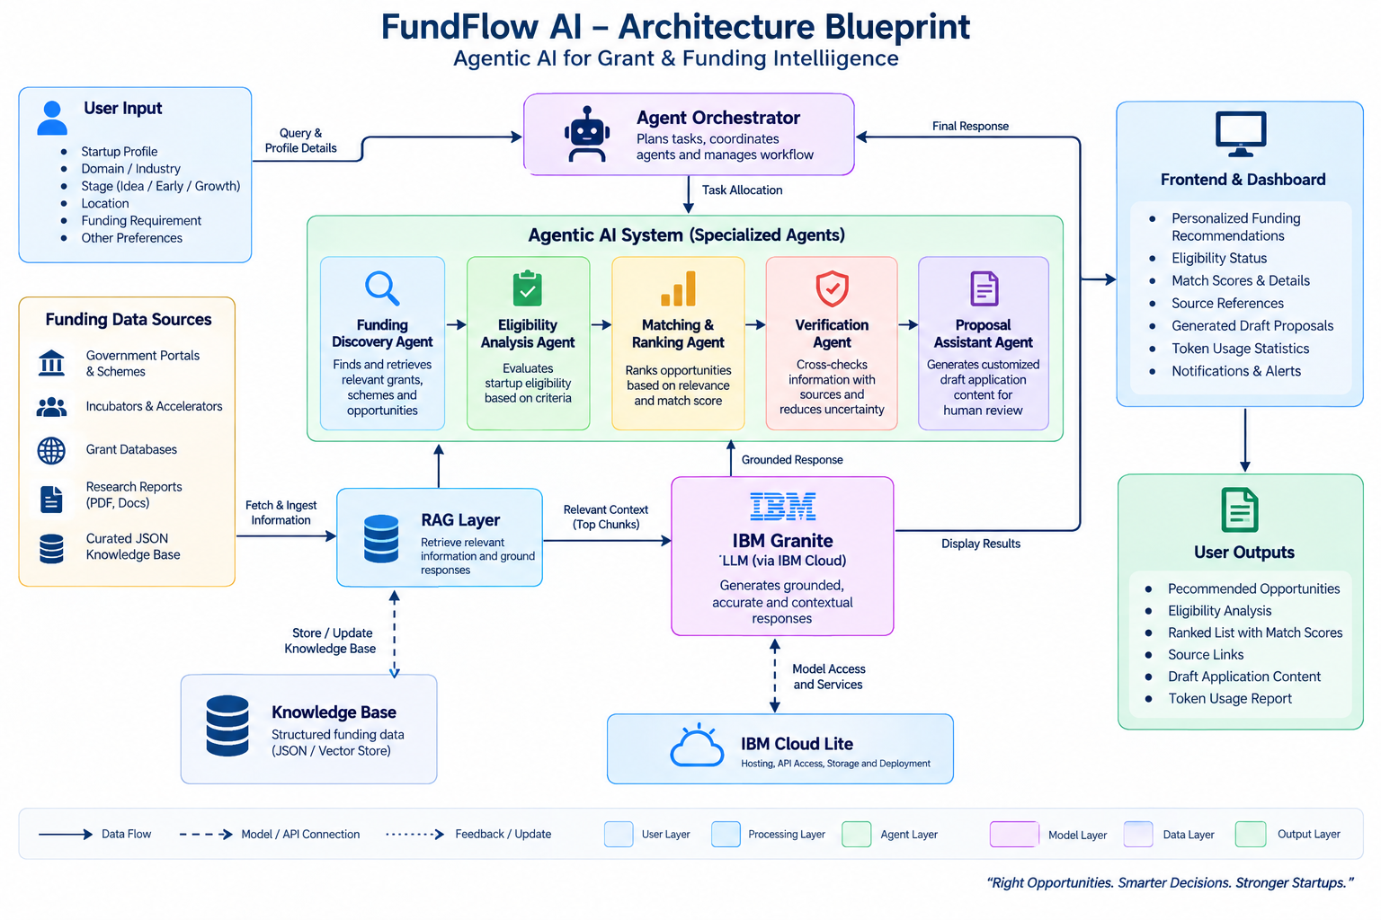
Architecture blueprint for IBM bob:

Slide 9

Role of Agentic AI in the solution
Specialized Agents Working Together
🔎 Funding Discovery Agent Finds and extracts relevant grants, schemes, and funding opportunities.
✅ Eligibility Analysis Agent Compares startup information with funding eligibility criteria and explains the result.
📊 Matching & Ranking Agent Ranks opportunities according to startup stage, domain, location, funding requirements, and relevance.
🛡️ Verification Agent Cross-checks retrieved information and identifies unsupported or uncertain claims.
📝 Proposal Assistant Agent Generates customized application drafts including the problem, solution, impact, funding requirement, and utilization plan.
Agentic Workflow
Startup Profile → Discovery → Eligibility → Ranking → Verification → Proposal
Instead of one general chatbot, specialized agents collaborate to perform an end-to-end funding intelligence workflow.

Slide 10
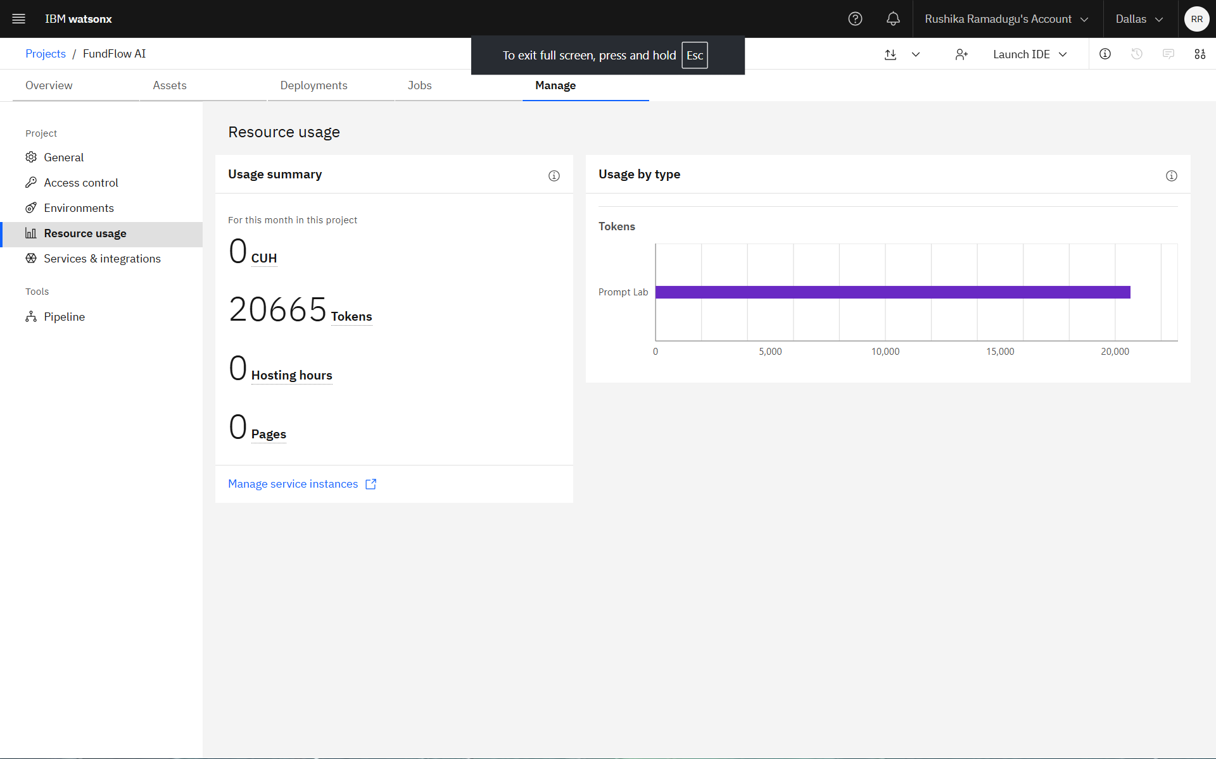
Token Usage
·
·

Slide 11
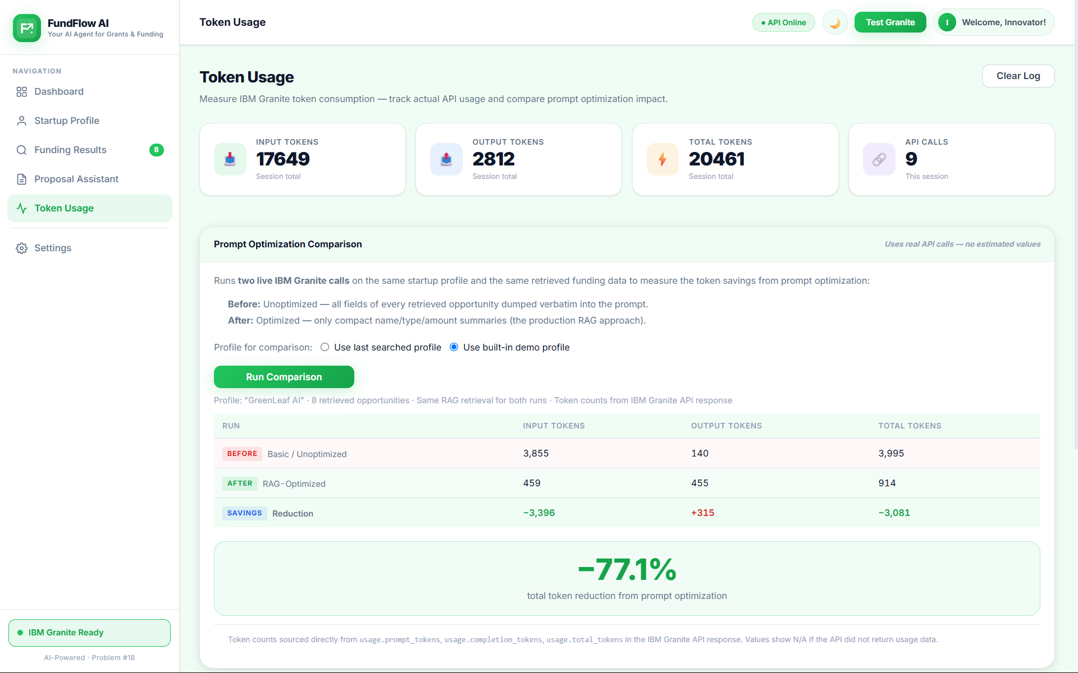
Token Usage
·
·

Slide 12
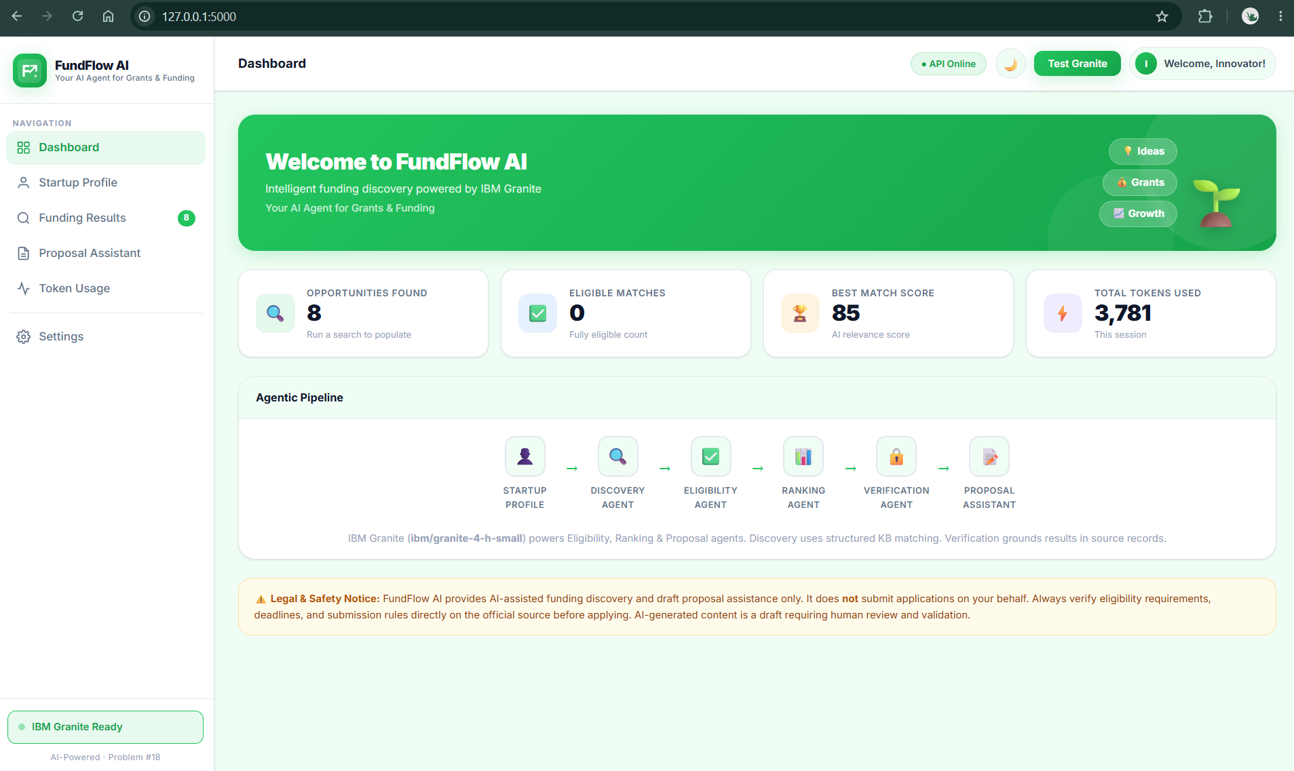
Project Output Screenshot

Slide 13
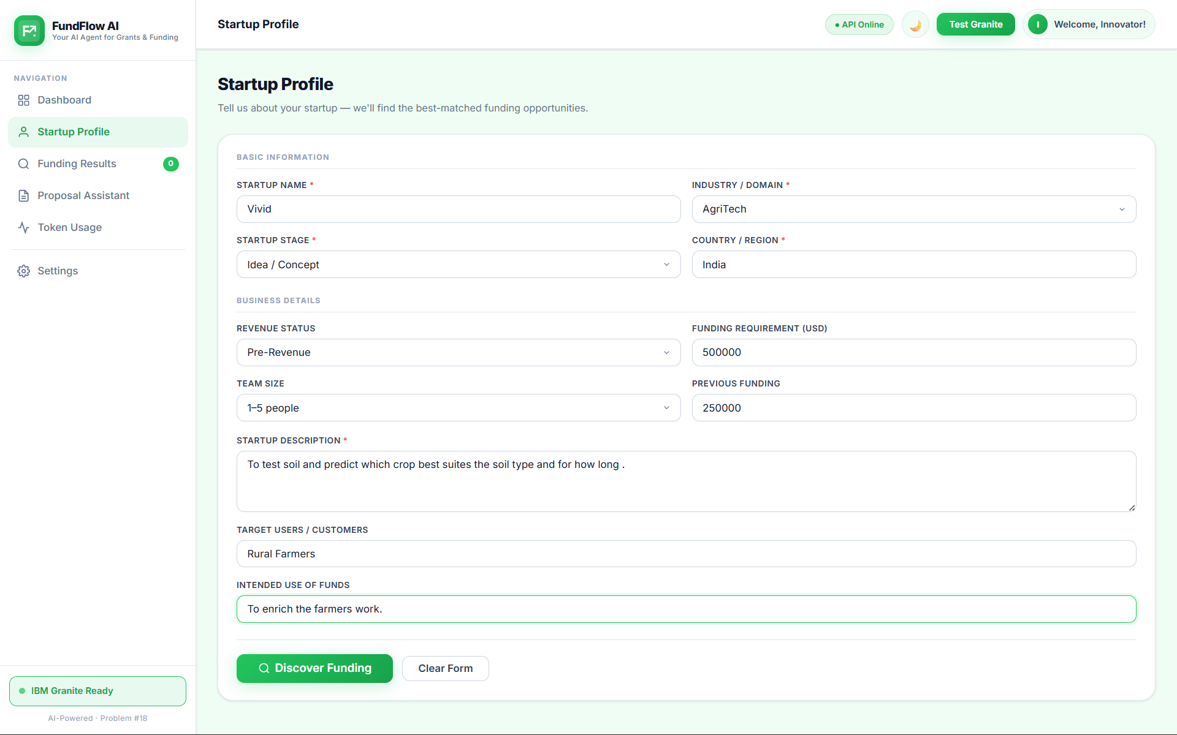
Project Output Screenshot

Slide 14
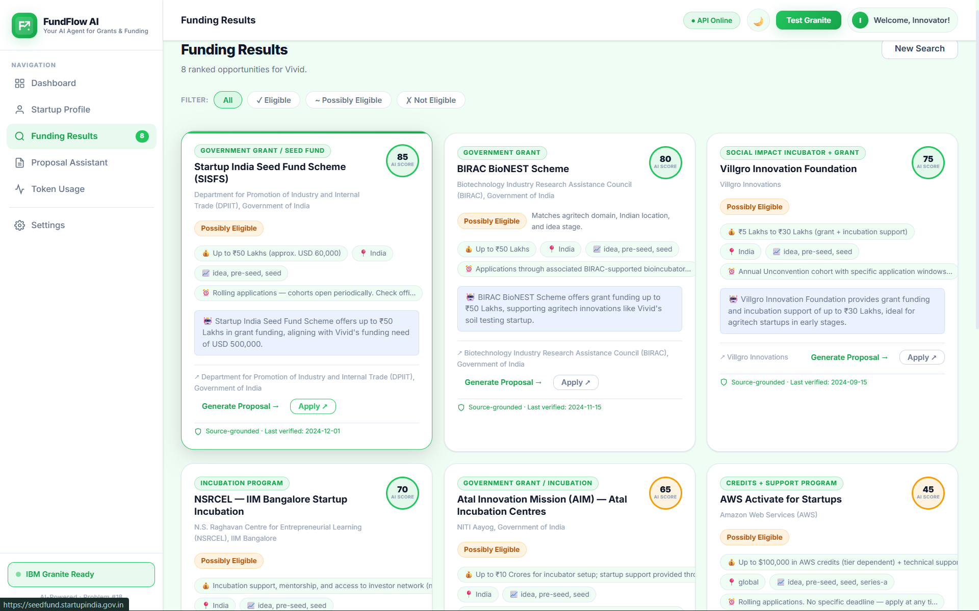
Project Output Screenshot

Slide 15
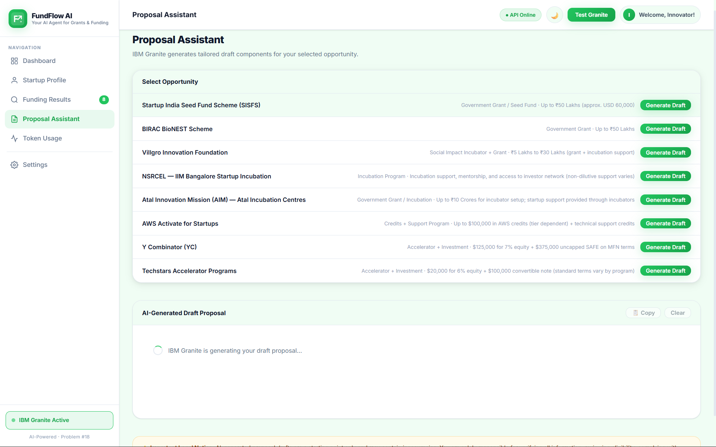
Project Output Screenshot

Slide 16
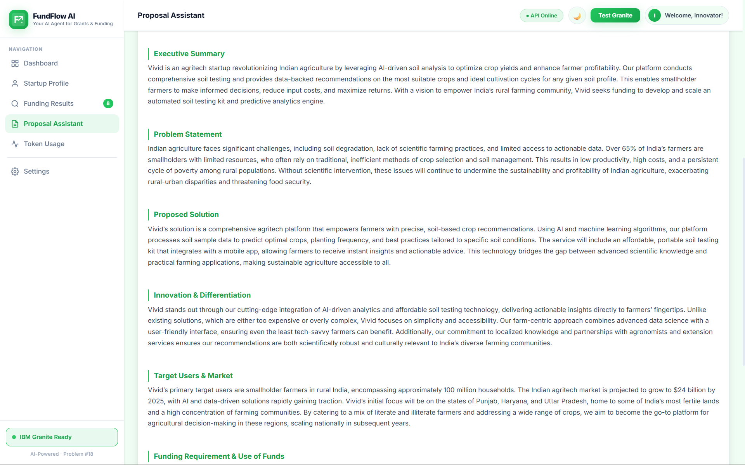
Project Output Screenshot

Slide 17
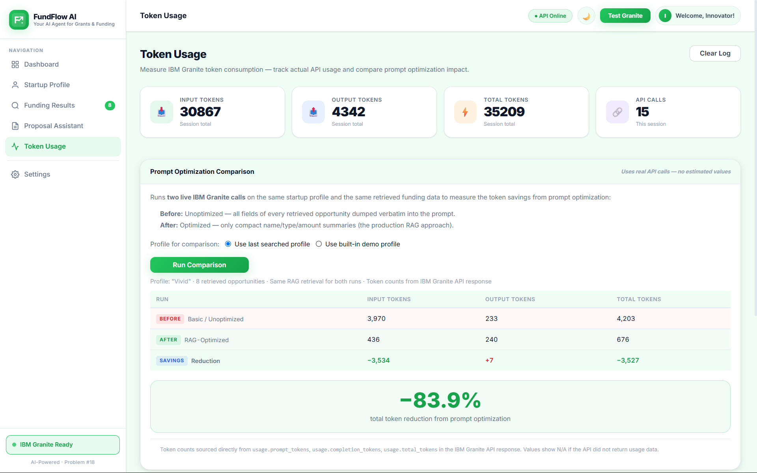
Project Output Screenshot

Slide 18
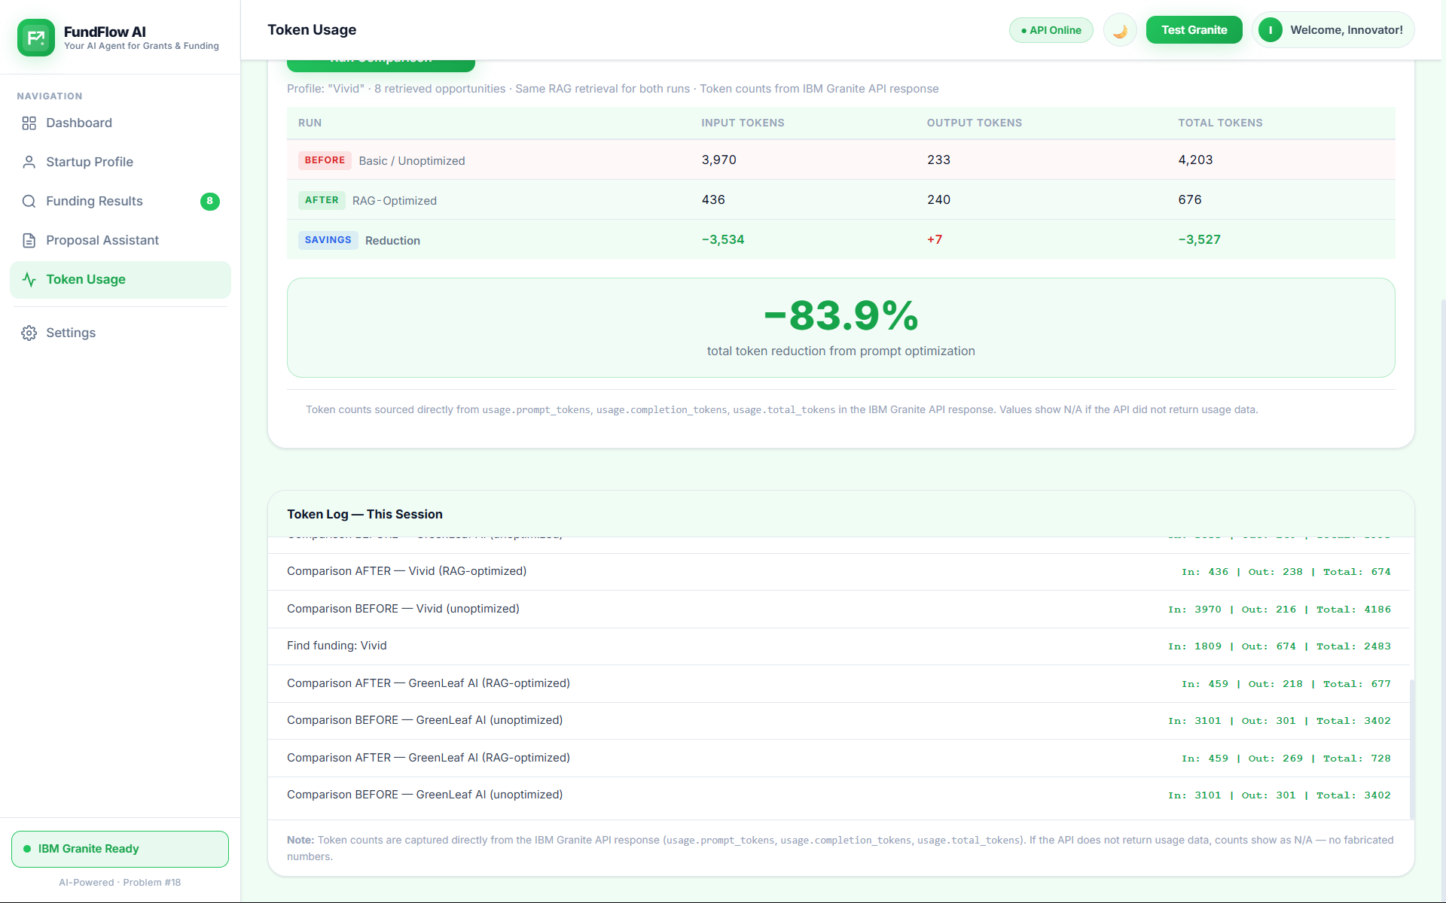
Project Output Screenshot

Slide 19
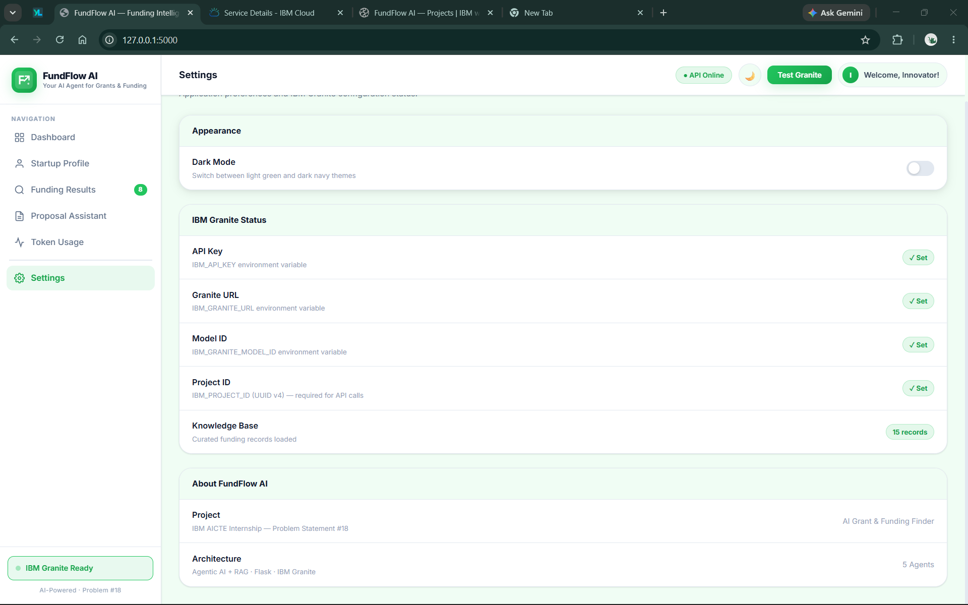
Project Output Screenshot

Slide 20
Novelty and Uniqueness
What Makes FundFlow AI Different?
🤖 Agentic Funding Intelligence Uses specialized agents for discovery, eligibility, ranking, verification, and proposal assistance.
🎯 Personalized Matching Recommendations are based on the individual startup's stage, domain, location, and funding requirements.
📚 Grounded with RAG Funding information is retrieved from the knowledge base before AI-generated analysis.
🔍 Explainable Recommendations Users can understand why an opportunity matches their startup rather than receiving unexplained recommendations.
🛡️ Verification & Human-in-the-Loop Important information and generated proposals are presented for user validation instead of treating AI output as authoritative.
🔗 End-to-End Workflow Moves beyond simply finding grants—from opportunity discovery to eligibility analysis and application preparation.
FundFlow AI transforms scattered funding information into actionable, personalized funding intelligence.

Slide 21
Git Hub Link
FundFlow-AI

Slide 22
Future Scope
Real-Time & Advanced Funding Intelligence:
FundFlow AI can be enhanced to continuously retrieve newly published funding opportunities and expand its coverage to global grants, accelerators, and startup programs. Future versions can also analyse pitch decks, business models, and financial information to provide deeper and more accurate funding recommendations.
Complete Startup Funding Companion:
The platform can evolve with application tracking, personalized deadline alerts, multilingual support, mobile accessibility, and integration with incubators, accelerators, mentors, and investors. The long-term vision is to create a complete AI-powered funding companion that helps startups discover, evaluate, prepare, track, and manage funding opportunities from a single intelligent platform.

Slide 23
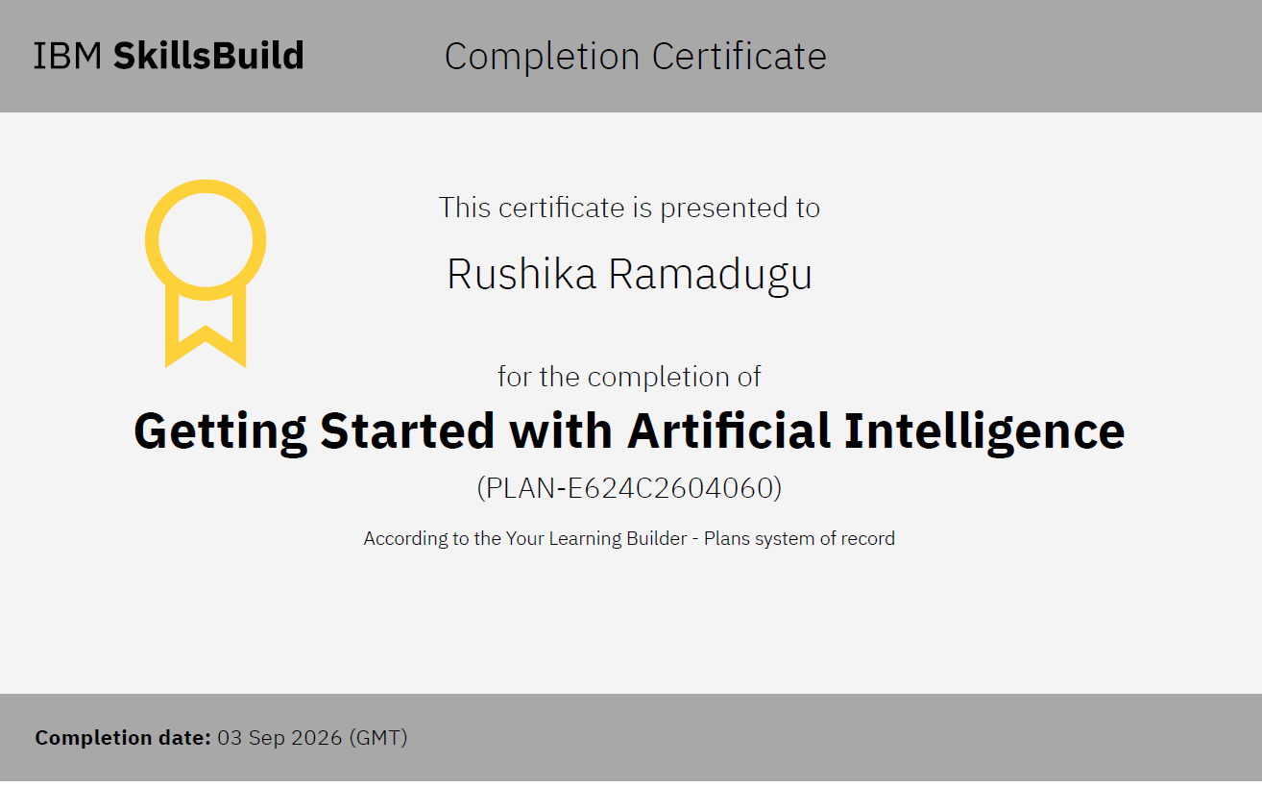
Certificates Earned:
Getting Started with Artificial Intelligence

Slide 24
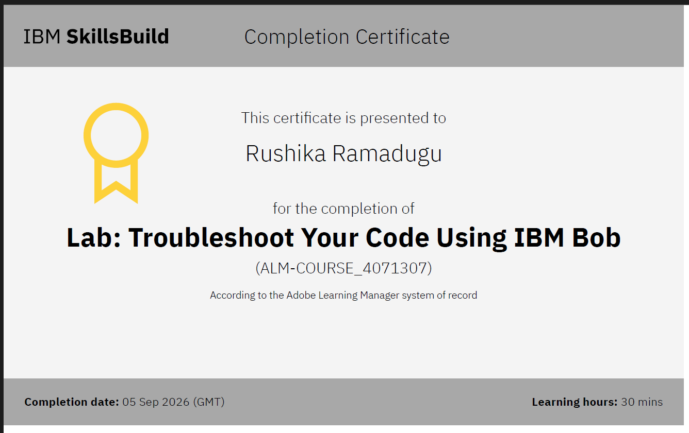
Certificates Earned:​
IBM BOB Certificate

Slide 25


