Slide 1
Tux Tuner
FFT Implementation in C++
Bill Indelicato

Slide 2
Goals
Portable
Cross-platform
Simple interface
Responsive and reliable

Slide 3
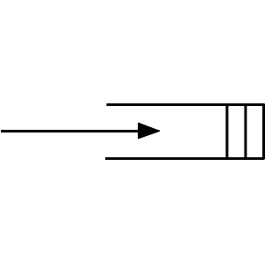

Approach
Mic Input Buffer FFT

Slide 4
RtAudio API
Fast and simple audio API (app programing interface)
Written in C++
Detects default I/O devices
Cross-platform
Basic algorithm:

Slide 5
DFT Implementation in C
for(int f = 0; f < num_samples; f++)
{
for(int n = 0; n < num_samples; n++)
{
X[f] += x[n] * exp( f );
}
}

Slide 6
FFT Implementation in C
Radix-2 “Cooley – Tukey” Recursive Algorithm

Slide 7
Cooley – Tukey in C++

Slide 8
DFT vs FFT Complexity & Speed

Slide 9
Data Analysis
Normalize frequency by
Find fundamental frequency

Slide 10
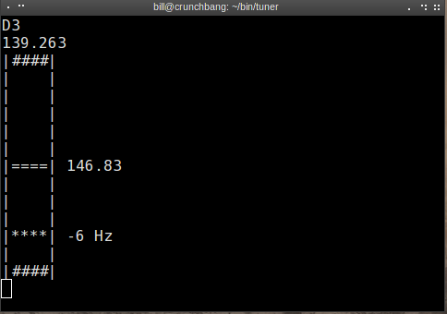
Tune!
+ / - 8 Hz scale
10 frequency steps

Slide 11
Success?
Portable
Cross-platform
Simple interface
Responsive and reliable

Slide 12
Improvements
GUI using Qt framework
Threading
I/O options menu

