Slide 1

2 Thessalonians
Introducton
Chapter 1

Slide 3
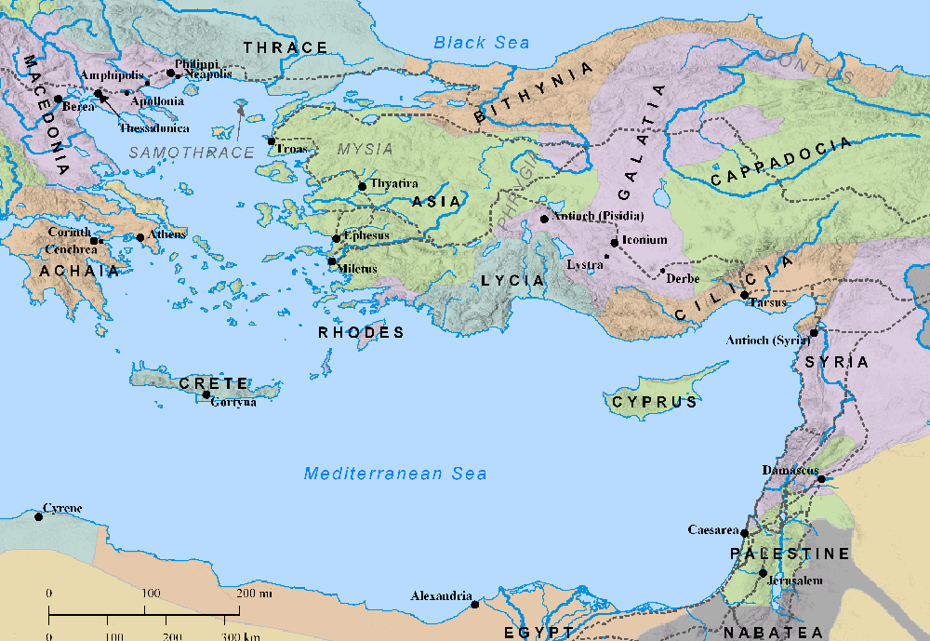
Paul’s 2nd Journey
began at Antioch

Slide 4
Paul wanted to go into Asia but was forbidden
At Lystra – Timothy joins the Journey

Slide 5
The Spirit didn’t allow him to go into Bithynia
Paul wanted to go into Asia but was forbidden

Slide 6
The Spirit didn’t allow him to go into Bithynia
In Troas, a vision calls Paul into Macedonia

Slide 7
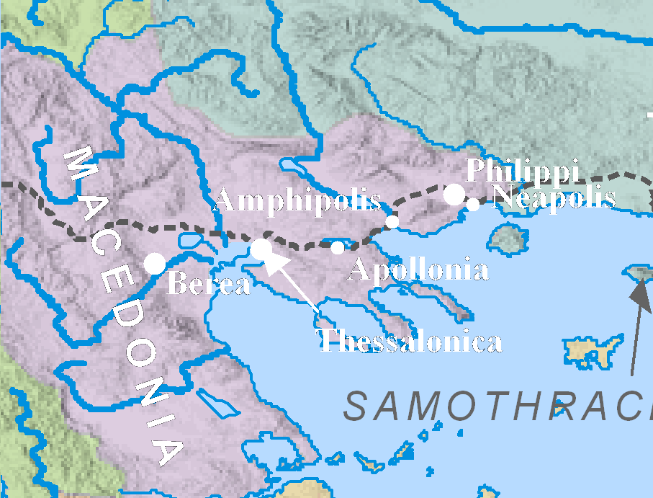

Slide 9
Paul's stay at Corinth involved some 18 months, ca AD 51-52
Acts 18:11

Slide 10
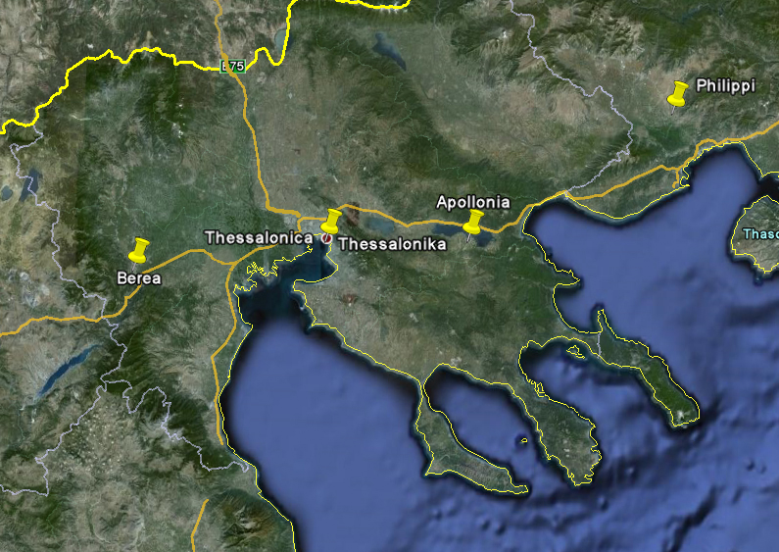

Slide 12
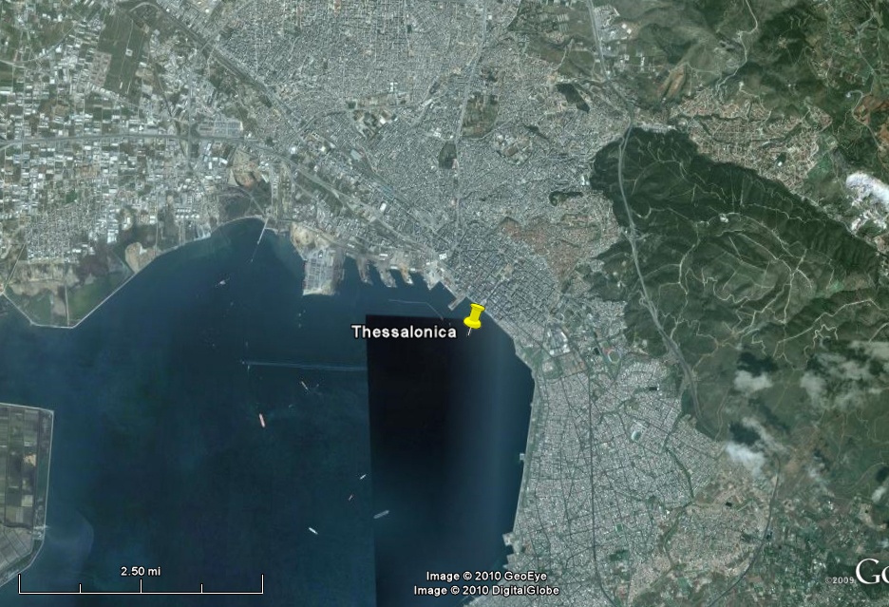

Slide 13
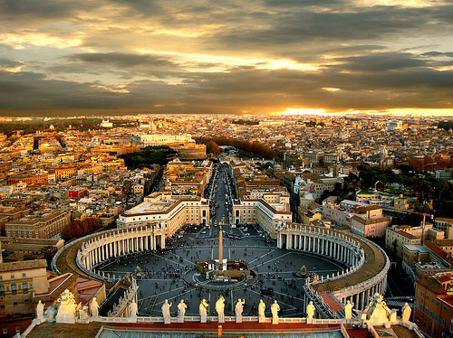
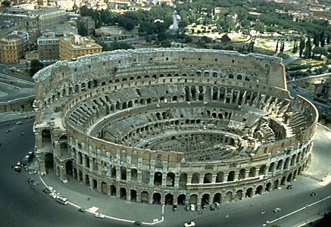

Rome

Slide 14
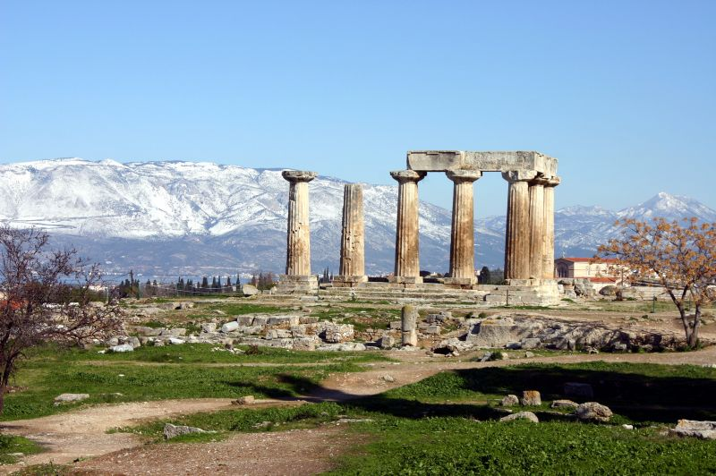

Corinth

Slide 15
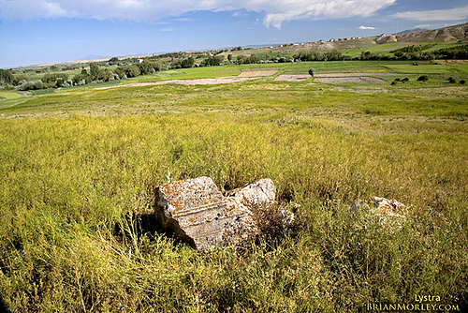
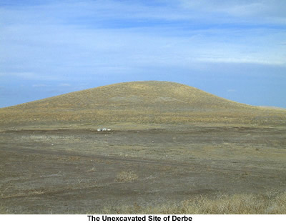

Lystra
Derby
Galatians

Slide 16
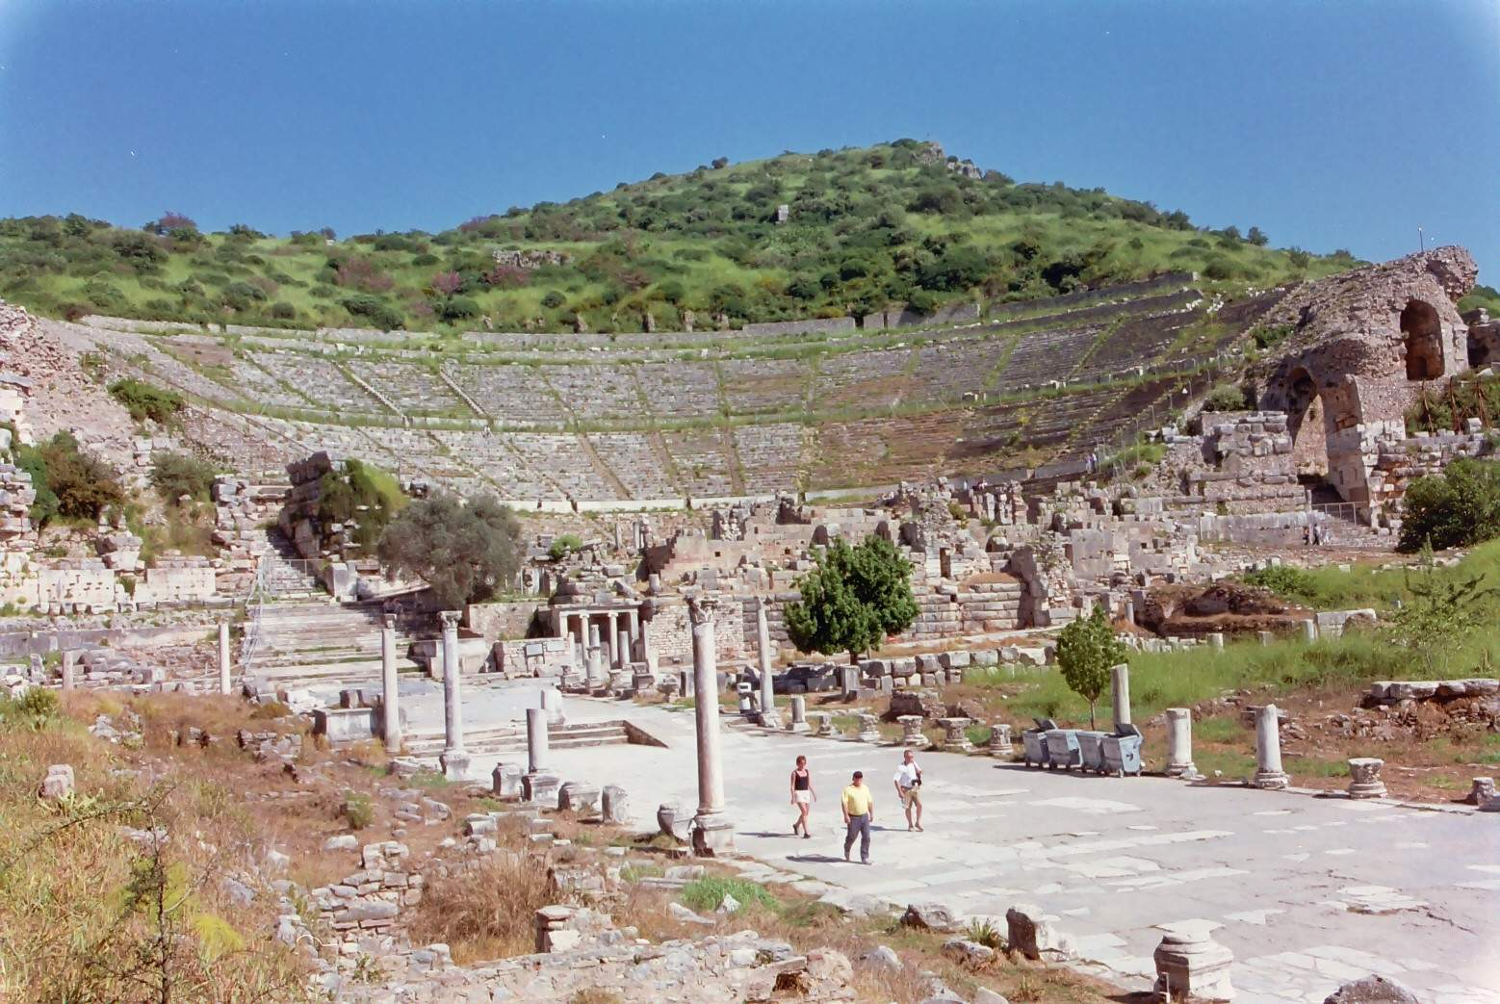

Ephesus

Slide 17
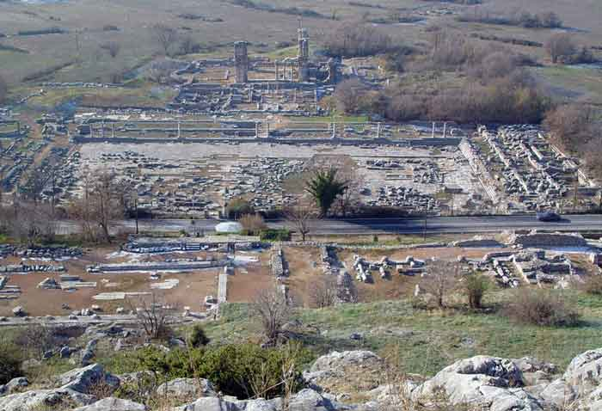

Philippi

Slide 18
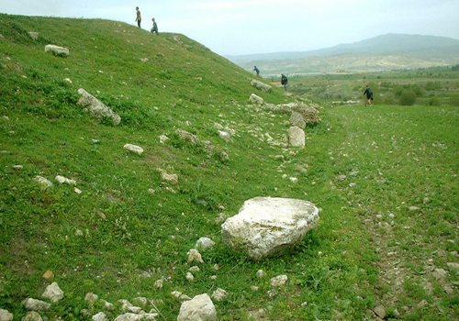

Colossea

Slide 19
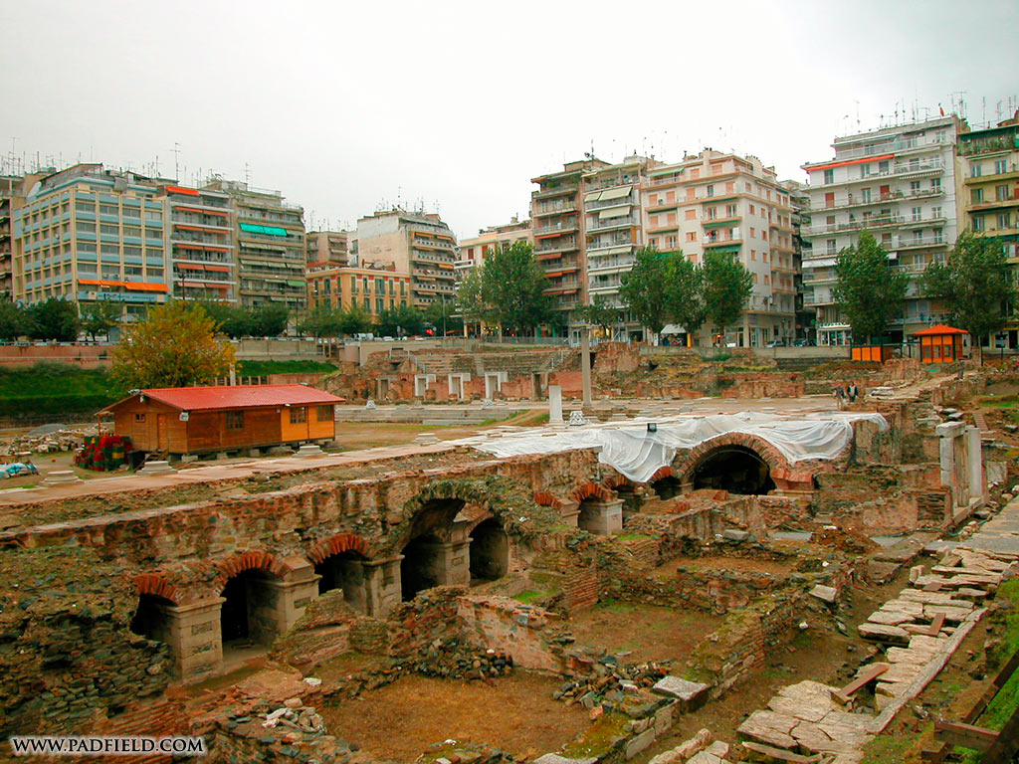

Thessalonica

Slide 20
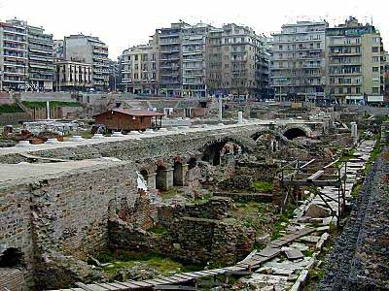
Thessalonica

Slide 21
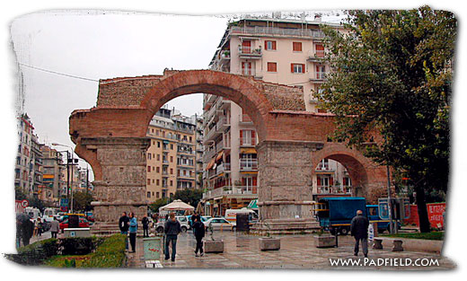
The famous city gate at Thessalonica
Thessalonica

Slide 23
2 Thessalonians was apparently prompted by three main developments.
1. The persecution of the Christians there had grown worse and was leaving some at the point of despair.
2. A letter and/or other representations falsely claiming to be from Paul were on the verge of convincing the Christians there that the end-time was imminent.
3. The nearness of Christ's return was being misused as a basis for shirking vocational responsibility.

Slide 24
PAUL'S PURPOSE: 2 Thessalonians
To meet the needs that prompted the Epistle, Paul pursued three broad purposes:
1. He provides an incentive for the Thessalonians to persevere a little longer by describing the reward and retribution that God would be handing out to their persecutors.

Slide 25
PAUL'S PURPOSE: 2 Thessalonians
To meet the needs that prompted the Epistle, Paul pursued three broad purposes:
2. Paul wants to make clear that they understand that certain things must happen before the "Day of the Lord" came and thus to prove false the claims that the "day" had already arrived (2:1-12)

Slide 26
PAUL'S PURPOSE: 2 Thessalonians
To meet the needs that prompted the Epistle, Paul pursued three broad purposes:
3. Paul issues detailed instructions covering disciplinary steps the church should take in correcting those who refuse to work (3:6-15)

Slide 27

Outline of 2nd Thessalonians
1. Paul deals with some personal matters -- 1:1-12
2. Concerning the Day of the Lord -- 2:1-12
3. Paul's appeal to them - 2:13 - 3:15
4. Concluding benediction and greeting - 3:6-15

Slide 28
Outline of 2nd Thessalonians
1. Paul deals with some personal matters -- 1:1-12
A. Paul extends a brief salutation - 1:1-2
B. Paul's thanksgiving over their spiritual progress - 1:3-4
C. Encourages continued faithfulness amid suffering - 1:5-10
D. Prays for God to strengthen their lives - 1:11-12
2. Concerning the Day of the Lord -- 2:1-12
3. Paul's appeal to them - 2:13 - 3:15

Slide 29
Outline of 2nd Thessalonians
1. Paul deals with some personal matters -- 1:1-12
2. Concerning the Day of the Lord -- 2:1-12
A. Paul disclaims teaching that the Lord's coming is imminent - 2:1-2
B. The Lord's coming nor
the Day of the Lord will come till:
1) An apostasy ("rebellion") ensues - 2:3
2) The man of sin be revealed - 2:3-12
3. Paul's appeal to them - 2:13 - 3:15

Slide 30
Outline of 2nd Thessalonians
1. Paul deals with some personal matters -- 1:1-12
2. Concerning the Day of the Lord -- 12:1-12
3. Paul's appeal to them - 2:13 - 3:15
A. Paul appeals for their firmness in the faith
- 2:13-17
B. He appeals for their prayers - 3:1-5
C. He appeals for discipline toward those walking disorderly - 3:6-15
4. Concluding benediction and greeting - 3:6-15

Slide 32
Paul’s 2nd Missionary Journey

Slide 33
