Slide 1
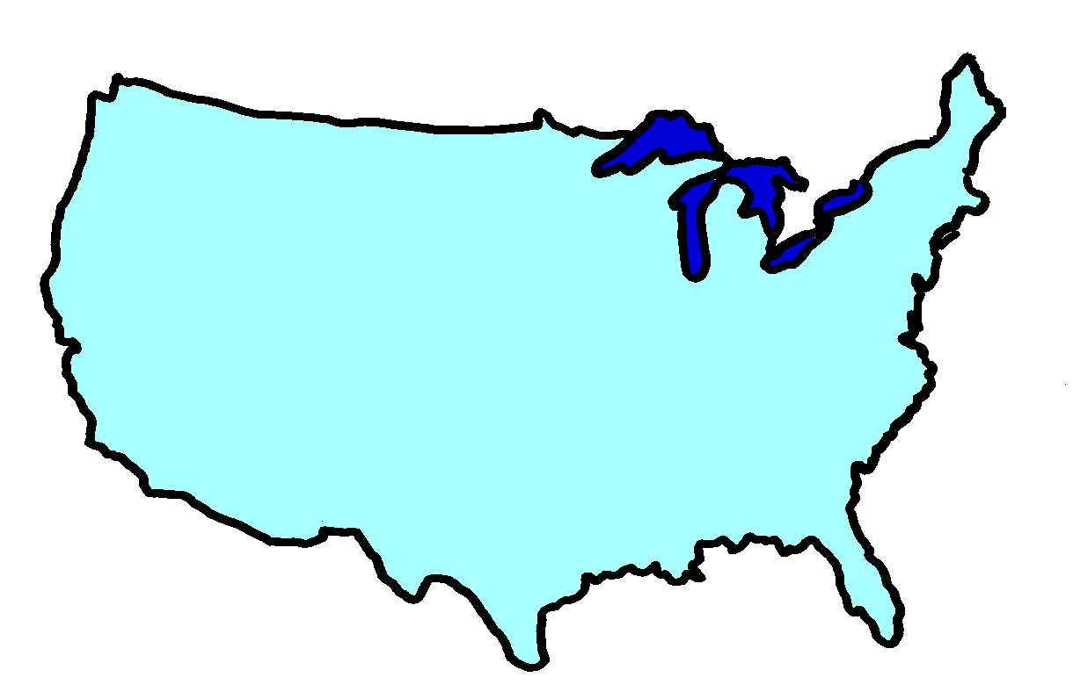

Divorce
In
America

Slide 2
Divorce
In
America

Slide 3

TRAGIC REALITY
TRAGIC REASONS
TRAGIC RESULTS
GOD’S REMEDY
Part 1

Slide 4

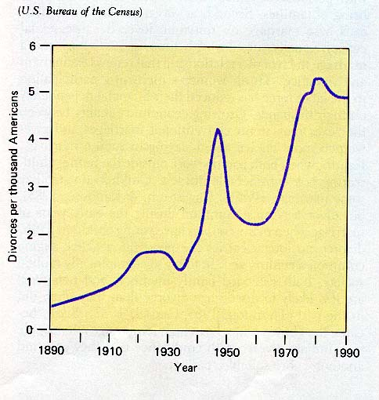
THE GROWING TOLL OF
AMERICA’S “BROKEN HOMES”
Tragic Reality
DIVORCES ARE INCREASING AGAIN, AFTER A LULL

Slide 5



Every Day In America
Married
  13,000
  Weddings
Divorced
  6,300

