Slide 1

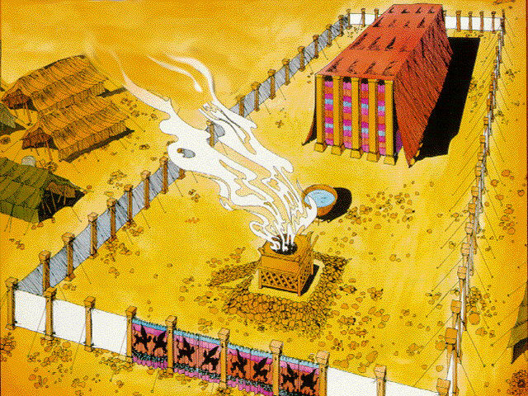
Old Testament Patterns
It was “According to” that Moses built the Tabernacle -- Exodus 25:8-9

Slide 2
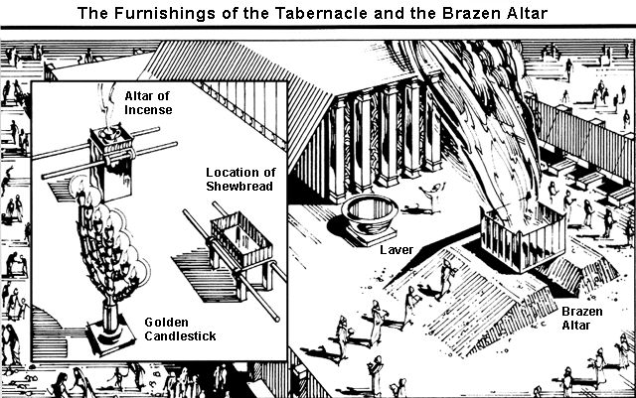
Old Testament Patterns
It was “According to” that Moses built the Tabernacle -- Exodus 25:8-9
Exodus 25:9 According to all that I show you, that is, the pattern of the tabernacle and the pattern of all its furnishings, just so you shall make it.

Slide 3
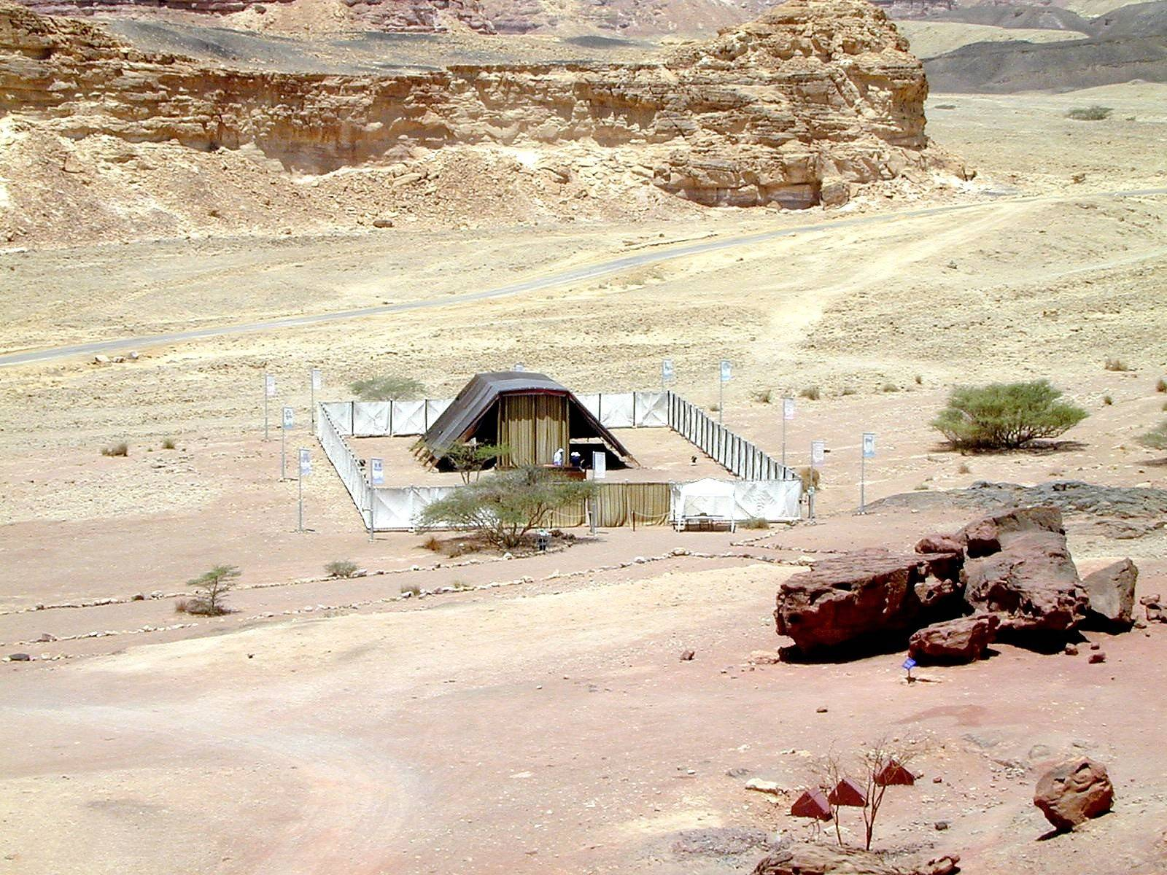
Tabernacle in the Wilderness
Exodus 40:16 “Thus did Moses; according to all that the Lord commanded him, so did he.”

Slide 4
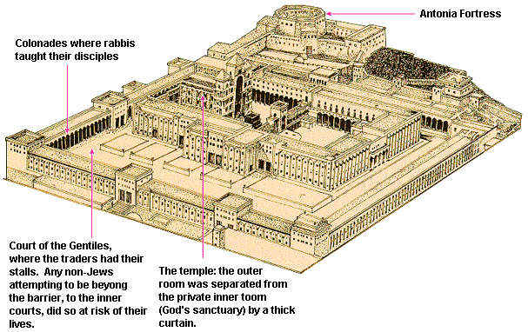
Old Testament Patterns
It was “According to” that Solomon constructed the Temple –
  1 Chronicles 28:11-12; 13-18

