Slide 1
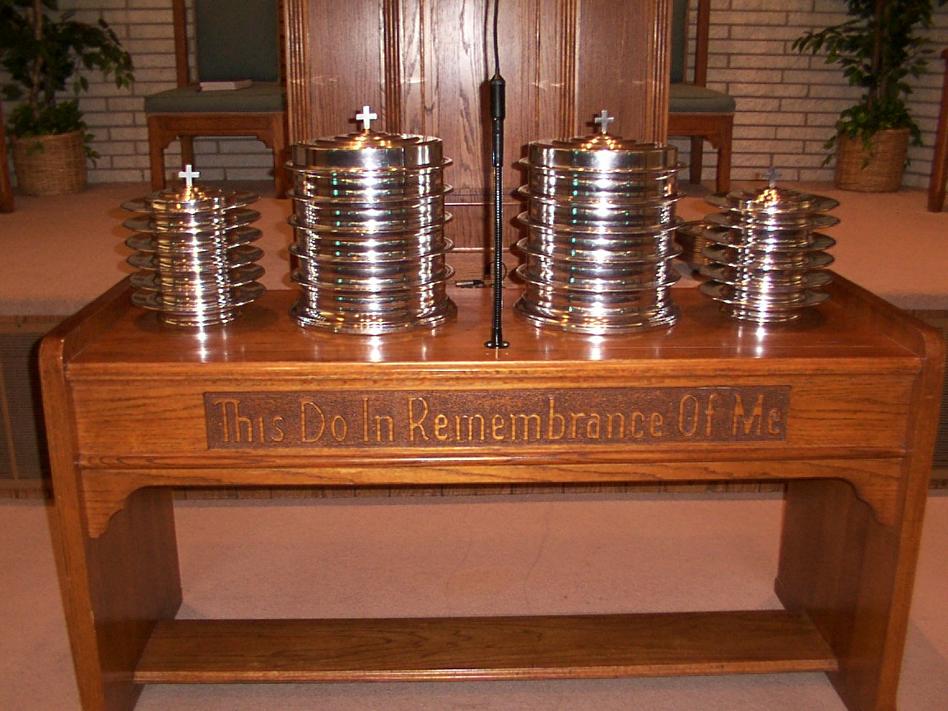
The Lord’s Supper is a . . .
1. MEMORIAL
2. COMMUNION
3. PROCLAMATION

Slide 2
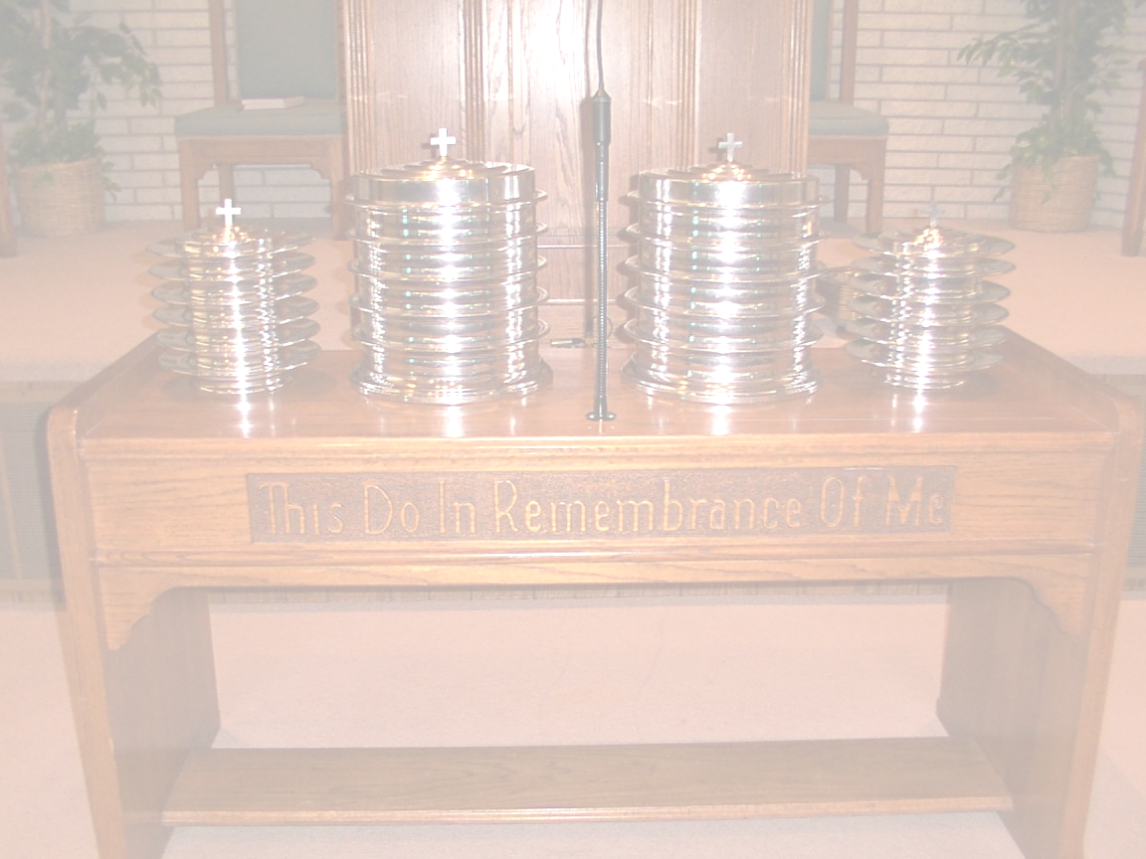
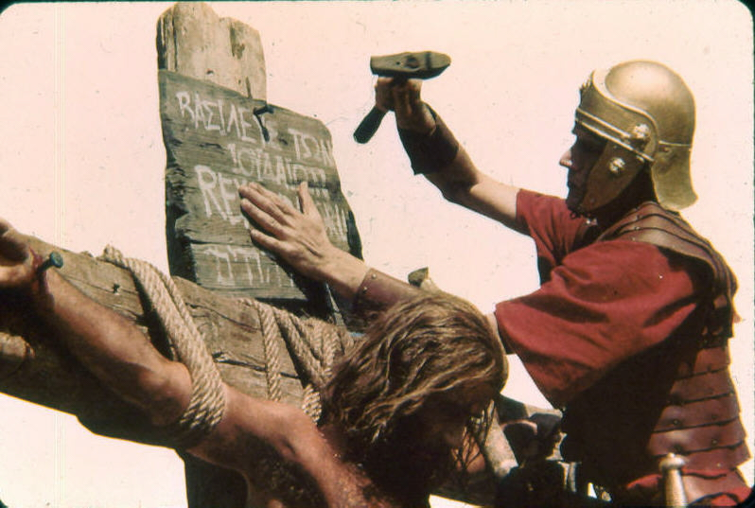
The Lord’s Supper is …
an announcement,
a publication,
a declaration
^{1 Corinthians 11:26}
²⁶ For as often as ye eat this bread, and drink this cup, ye do shew the Lord’s death till he come.
“proclaim” = NJKV, NASV, NIV

Slide 3
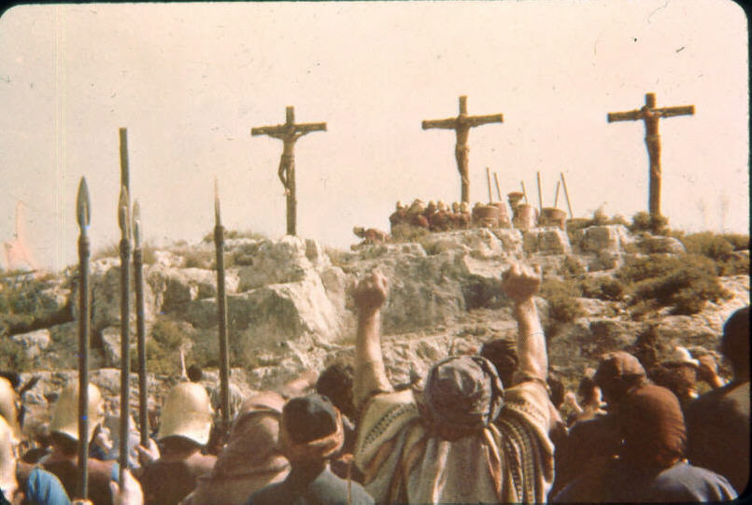
Gospel Proclaimed to the World
1 Corinthians 2:1
Acts 17:23
Mark 16:16

Slide 4
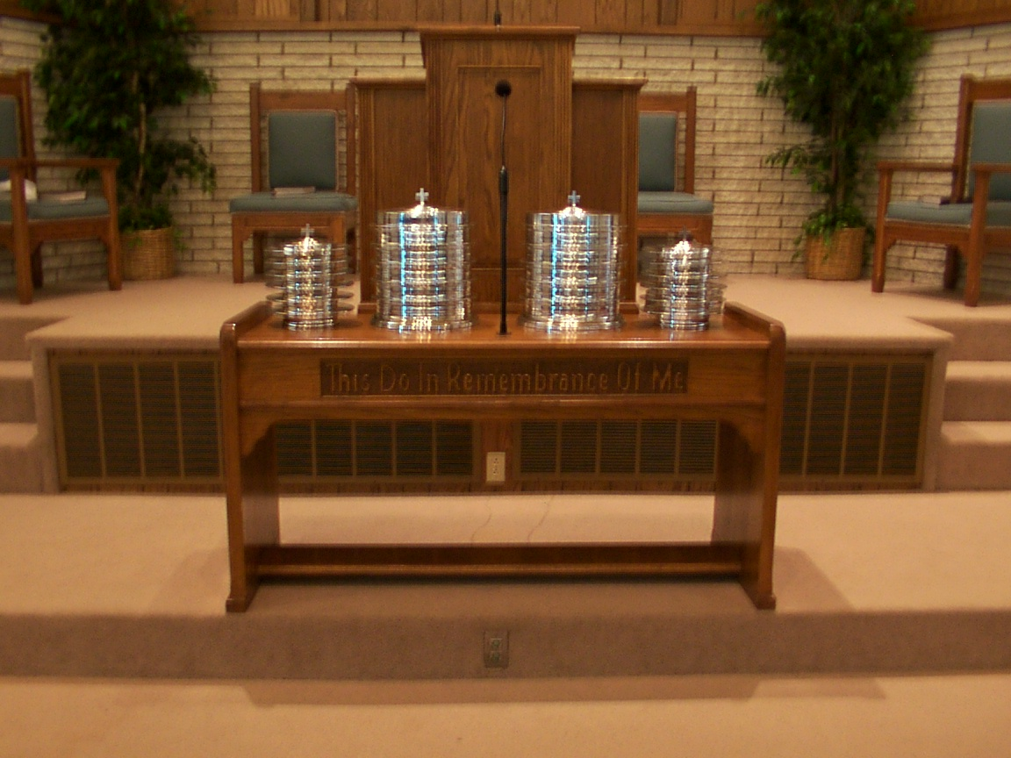
When a Christian deliberately forsakes the Lord’s Supper he is saying, ‘My faith and hope is in the world, not in Christ.”

Slide 5


The Lord’s Supper … a Proclamation
A sermon on God’s love, grace, and salvation, that every Christian can preach every week!

