Slide 1
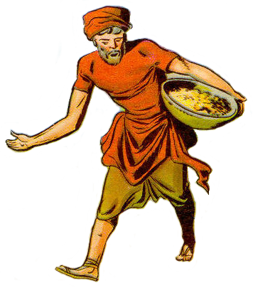
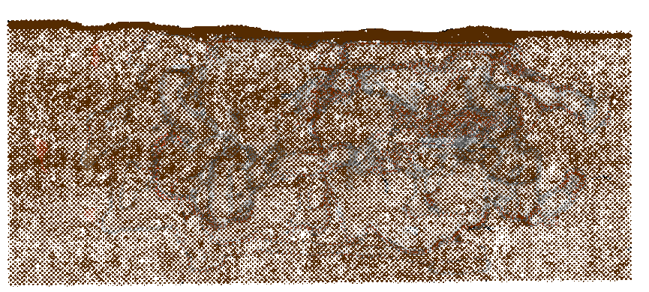

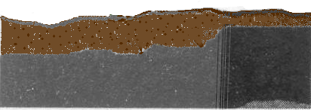

Parable of the Soils
Stony Soil:
Shallow
“Other seed fell on the rocky places, where they did not have much soil” (Matt 13:5)

Slide 2
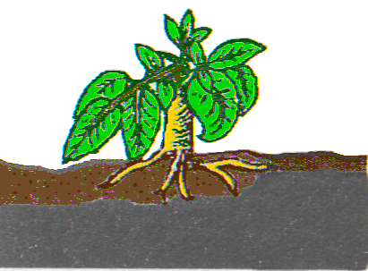
Parable of the Soils
Stony Soil:
Shallow
“And immediately they sprang up, because they had not depth of soil (Matt 13:5)

Slide 3
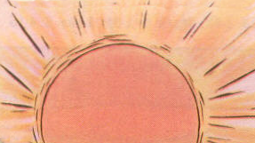
Parable of the Soils
Stony Soil:
Shallow
And the result was . . .

Slide 4
Parable of the Soils
Stony Soil:
Shallow
“…when the sun had risen, they were scorched…”

Slide 5
Parable of the Soils
Stony Soil:
Shallow
“… and because they had no root …”

Slide 6
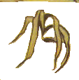

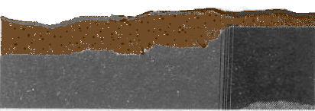
Parable of the Soils
Stony Soil:
Shallow
[and “no moisture” Lk 8:6] “they withered away” (Matt 13:6)

Slide 7

Parable of the Soils
Stony Soil:
Shallow

Slide 8
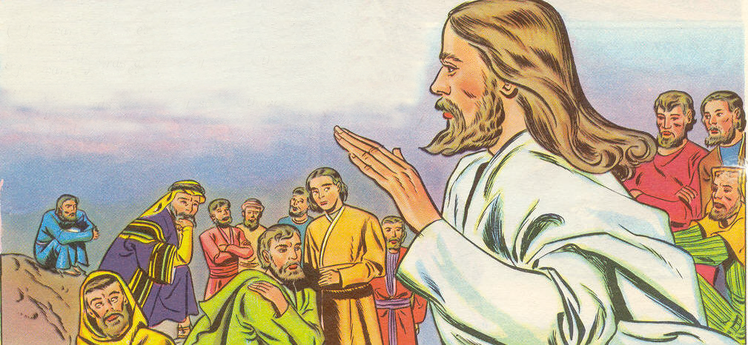
Parable of the Soils
“His disciples asked him what this parable meant.” (Lk 8:9)
“Hear then the parable of the sower” (Matt 13:18)

Slide 9
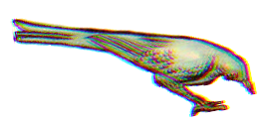

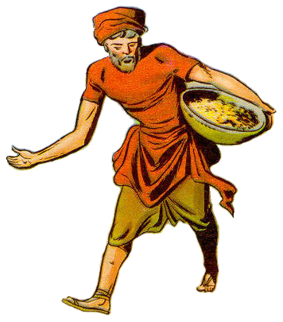
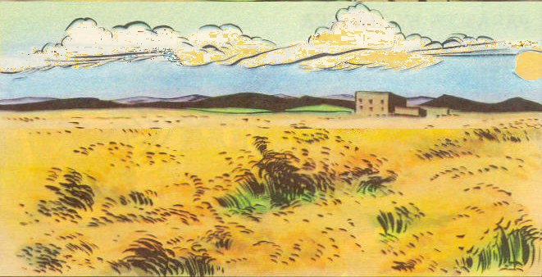
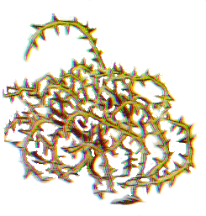
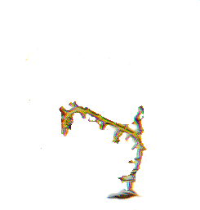
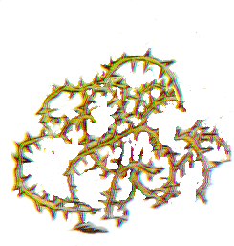
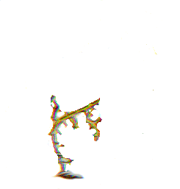
“Hear . . .the Parable of the Sower”
SOWER
SEED
WORD
“Now the parable is this: the seed is the word of God” (Lk 8:11)

Slide 10
“Hear . . . The Parable of the Sower”
TEACHER
SOWER
SEED
WORD
The “imperishable…word of God” (1Pet 1:23)
“…the sower sows the word” (Mk 4:14)

