Slide 1
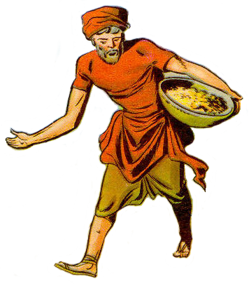
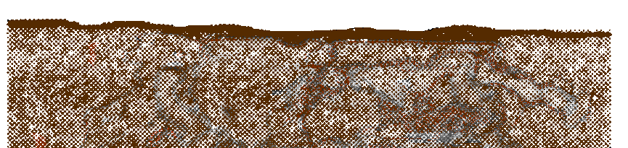

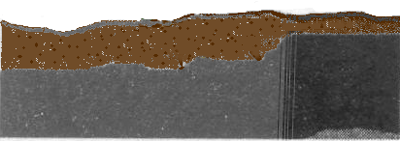

Parable of the Soils
Stony Soil:
Shallow
“Other seed fell on the rocky places, where they did not have much soil” (Matt 13:5)

Slide 2
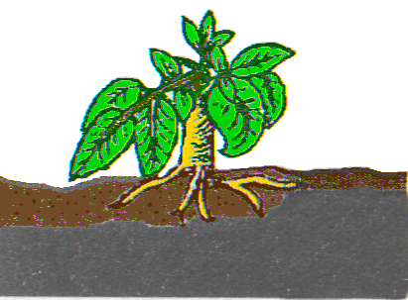
Parable of the Soils
Stony Soil:
Shallow
“And immediately they sprang up, because they had not depth of soil (Matt 13:5)

Slide 3
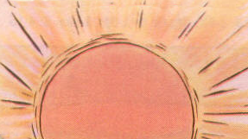
Parable of the Soils
Stony Soil:
Shallow
And the result was . . .

Slide 4
Parable of the Soils
Stony Soil:
Shallow
“…when the sun had risen, they were scorched…”

Slide 5
Parable of the Soils
Stony Soil:
Shallow
“… and because they had no root …”

Slide 6
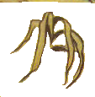

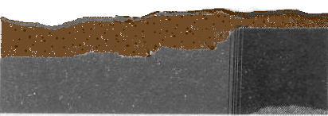
Parable of the Soils
Stony Soil:
Shallow
[and “no moisture” Lk 8:6] “they withered away” (Matt 13:6)

Slide 7

Parable of the Soils
Stony Soil:
Shallow

