Slide 1
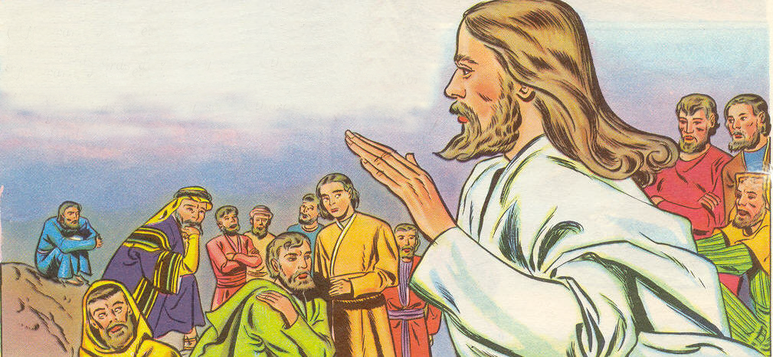
Parable of the Soils
“His disciples asked him what this parable meant.” (Lk 8:9)
“Hear then the parable of the sower” (Matt 13:18)

Slide 2





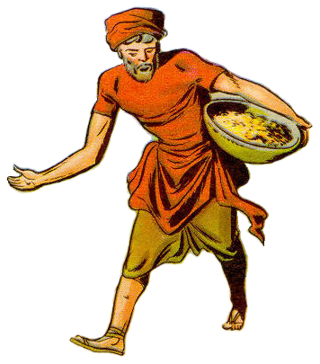
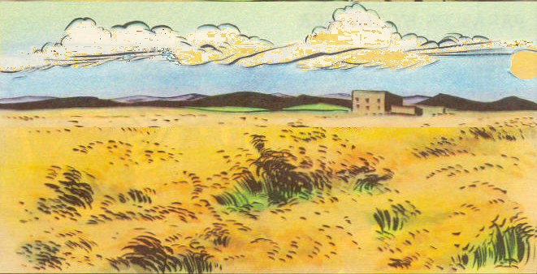
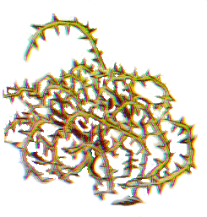
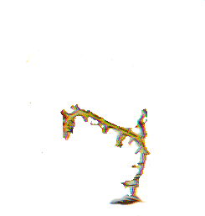
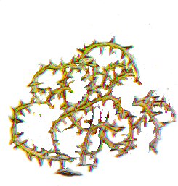
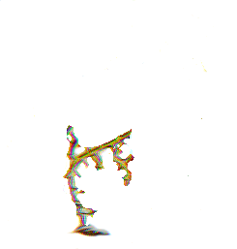
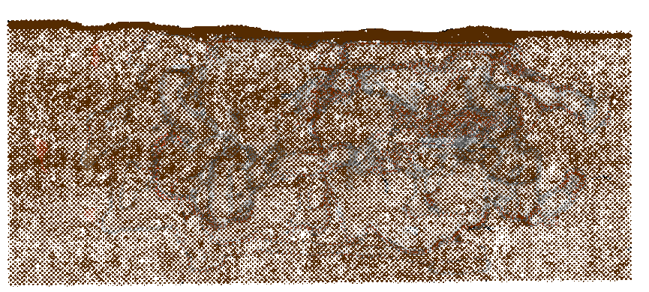
“Hear . . .the Parable of the Sower”
SOWER
SEED
WORD
“Now the parable is this: the seed is the word of God” (Lk 8:11)

Slide 3
“Hear . . . The Parable of the Sower”
TEACHER
SOWER
SEED
WORD
The “imperishable…word of God” (1Pet 1:23)
“…the sower sows the word” (Mk 4:14)

