Slide 1
Bible TimeLine
The New Testament

Slide 2

THE BIBLE
1 2 3 4 5 6 7 8 9 10 11 12 13

Slide 3
THE BIBLE
Old Testament
New Testament
1 2 3 4 5 6 7 8 9 10 11 12 13

Slide 4
A Sense of Time
A
M
D
Consumation
Creation
?
Abraham
2000 BC
Today
November 7, 2026
AD
David
1000 BC
Moses
1500 BC

Slide 5
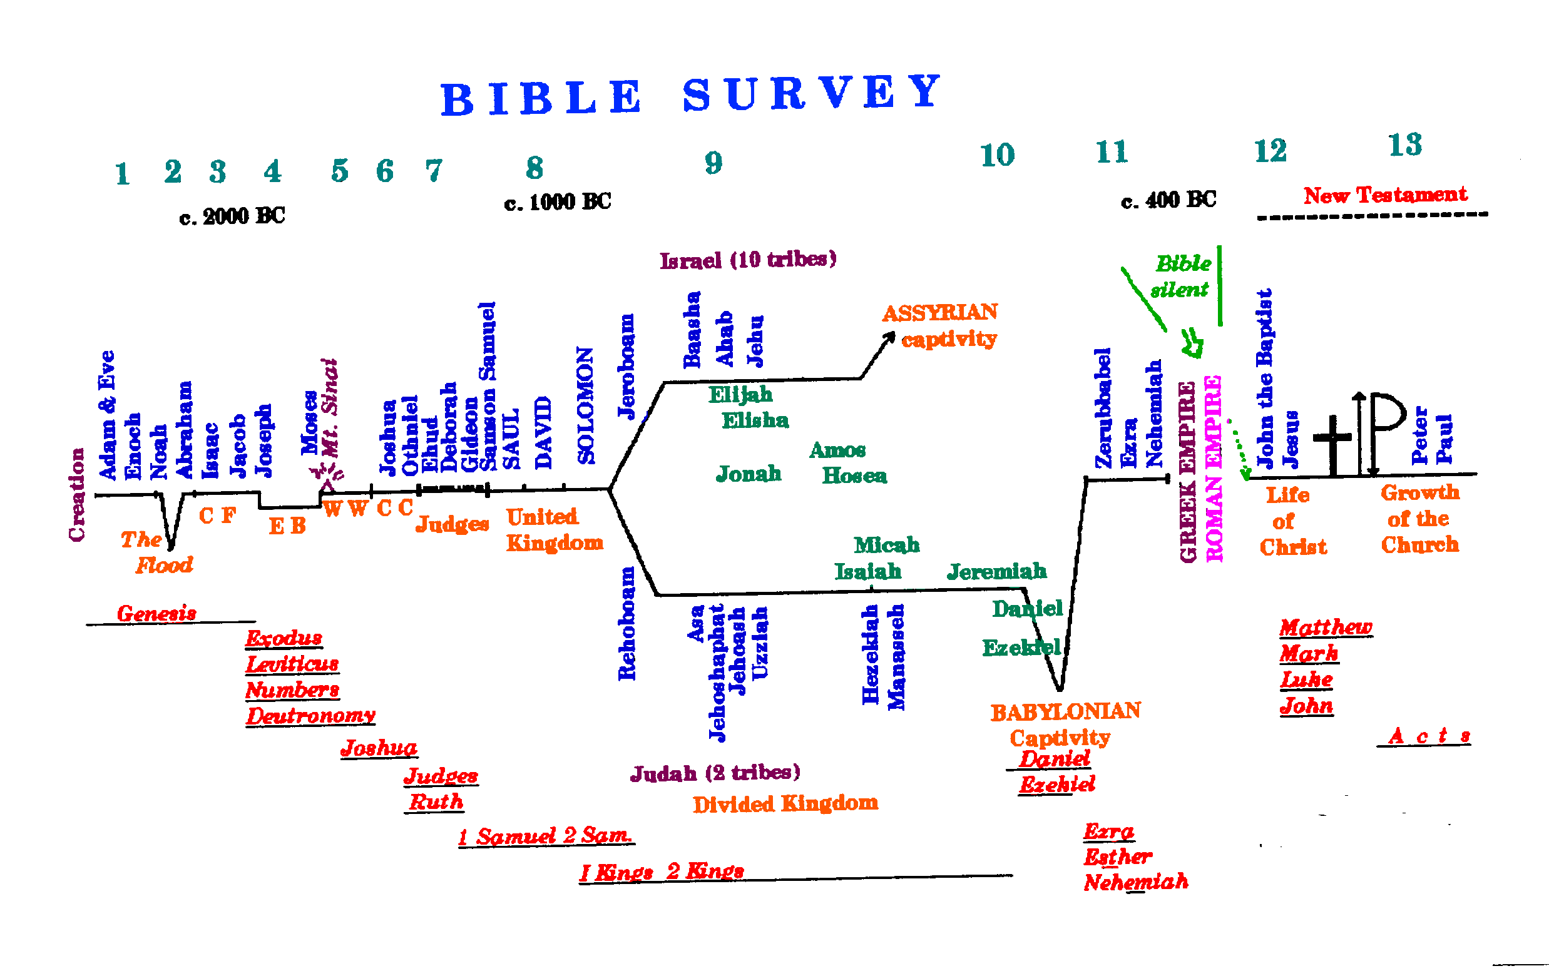

Slide 6
THE BIBLE
New Testament
12 13
The Gospels
The Church

Slide 7
- - -The New Testament - - -
12
13
Life of Christ

Slide 8
- - -The New Testament - - -
12
13
GREEK EMPIRE
ROMAN EMPIRE
Life of Christ

Slide 9
- - -The New Testament - - -
12
13
GREEK EMPIRE
ROMAN EMPIRE
Life of Christ
Incarnation
The Word made Flesh -- John 1:14

Slide 10
- - -The New Testament - - -
12
13
John the Baptist
GREEK EMPIRE
ROMAN EMPIRE
Life of Christ
Incarnation
The Word made Flesh -- John 1:14

Slide 11
- - -The New Testament - - -
12
13
John the Baptist
Jesus the Christ
GREEK EMPIRE
ROMAN EMPIRE
Life of Christ

Slide 12
- - -The New Testament - - -
12
13
John the Baptist
Jesus the Christ
GREEK EMPIRE
ROMAN EMPIRE
Life of Christ

Slide 13
- - -The New Testament - - -
12
13
John the Baptist
Jesus the Christ
GREEK EMPIRE
ROMAN EMPIRE
Life of Christ

Slide 14
- - -The New Testament - - -
12
13
John the Baptist
Jesus the Christ
GREEK EMPIRE
ROMAN EMPIRE
Life of Christ
Growth of the church

Slide 15
- - -The New Testament - - -
12
13
Holy
Spirit
John the Baptist
Jesus the Christ
GREEK EMPIRE
ROMAN EMPIRE
Life of Christ
Growth of the church

Slide 16
- - -The New Testament - - -
12
13
John the Baptist
Jesus the Christ
Holy
Spirit
GREEK EMPIRE
ROMAN EMPIRE
Life of Christ
Growth of the church

Slide 17
- - -The New Testament - - -
12
13
John the Baptist
Jesus the Christ
Holy
Spirit
Peter
Paul
GREEK EMPIRE
ROMAN EMPIRE
Life of Christ
Growth of the church

Slide 18
- - -The New Testament - - -
12
13
John the Baptist
Jesus the Christ
Holy
Spirit
Peter
Paul
GREEK EMPIRE
ROMAN EMPIRE
Life of Christ
Growth of the church

Slide 19
- - -The New Testament - - -
12
13
John the Baptist
Jesus the Christ
Holy
Spirit
Peter
Paul
GREEK EMPIRE
ROMAN EMPIRE
Life of Christ
Growth of the church
Matthew
Mark
Luke
John
A c t s

Slide 20
- - -The New Testament - - -
12
13
John the Baptist
Jesus the Christ
GREEK EMPIRE
ROMAN EMPIRE
Life of Christ

Slide 21
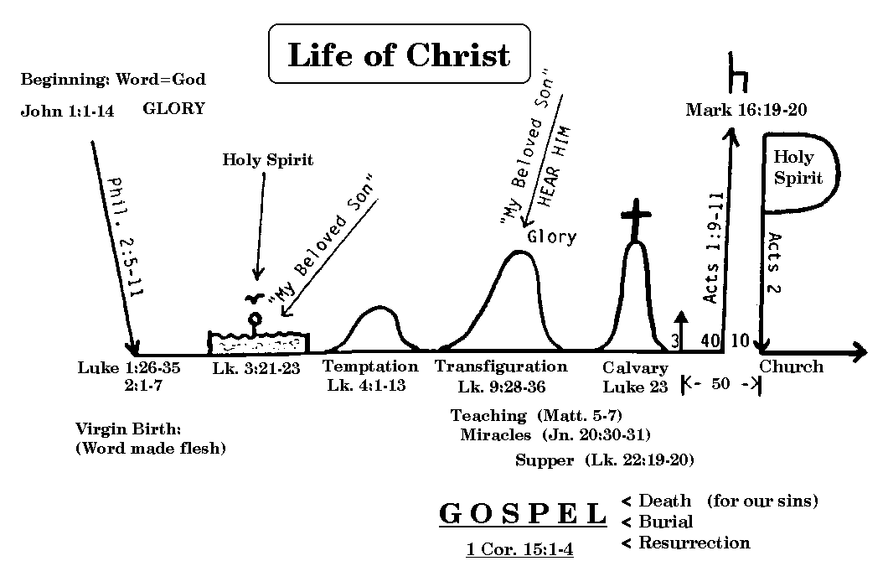

Slide 22
Beginning:
Word=God
John 1:1-14
Mark 16:19-20
“My Beloved Son”
HEAR YE HIM
Holy
Spirit
Holy
Spirit
“My Beloved Son”
Acts 1:9-11
Phil. 2:5-11
3
Acts 2
10
40
Lk 1:26-35
Lk 2:1-7
Lk 3
Lk 4
Lk 9:28-36
Lk 23
Baptism
Transfiguration
Calvary
Church
Virgin Birth:
(Word made
flesh)
Temptation
Teaching (Mt. 5 – 7)
Miracles (Jn. 20:30-32)
L. Supper (Lk 22:19-20)
GOSPEL
1Cor. 15:1-4
Death (for our sins)
Burial
Resurrection

Slide 23
Beginning:
Word=God
John 1:1-14
Phil. 2:5-11
Lk 1:26-35
Lk 2:1-7
Virgin Birth:
(Word made
flesh)

Slide 24
Beginning:
Word=God
John 1:1-14
Phil. 2:5-11
Lk 1:26-35
Lk 2:1-7
Virgin Birth:
(Word made
flesh)

Slide 25
Beginning:
Word=God
John 1:1-14
Holy
Spirit
“My Beloved Son”
Phil. 2:5-11
Lk 1:26-35
Lk 2:1-7
Lk 3
Baptism
Virgin Birth:
(Word made
flesh)

Slide 26
Beginning:
Word=God
John 1:1-14
Holy
Spirit
“My Beloved Son”
Phil. 2:5-11
Lk 1:26-35
Lk 2:1-7
Lk 3
Lk 4
Baptism
Virgin Birth:
(Word made
flesh)
Temptation

Slide 27
Beginning:
Word=God
John 1:1-14
“My Beloved Son”
HEAR YE HIM
Holy
Spirit
“My Beloved Son”
Phil. 2:5-11
Lk 1:26-35
Lk 2:1-7
Lk 3
Lk 4
Lk 9:28-36
Baptism
Transfiguration
Virgin Birth:
(Word made
flesh)
Temptation

Slide 28
Beginning:
Word=God
John 1:1-14
“My Beloved Son”
HEAR YE HIM
Holy
Spirit
“My Beloved Son”
Phil. 2:5-11
Lk 1:26-35
Lk 2:1-7
Lk 3
Lk 4
Lk 9:28-36
Lk 23
Baptism
Transfiguration
Calvary
Virgin Birth:
(Word made
flesh)
Temptation

Slide 29
Beginning:
Word=God
John 1:1-14
“My Beloved Son”
HEAR YE HIM
Holy
Spirit
“My Beloved Son”
Phil. 2:5-11
3
Lk 1:26-35
Lk 2:1-7
Lk 3
Lk 4
Lk 9:28-36
Lk 23
Baptism
Transfiguration
Calvary
Virgin Birth:
(Word made
flesh)
Temptation

Slide 30
Beginning:
Word=God
John 1:1-14
“My Beloved Son”
HEAR YE HIM
Holy
Spirit
“My Beloved Son”
Phil. 2:5-11
3
40
Lk 1:26-35
Lk 2:1-7
Lk 3
Lk 4
Lk 9:28-36
Lk 23
Baptism
Transfiguration
Calvary
Virgin Birth:
(Word made
flesh)
Temptation

Slide 31
Beginning:
Word=God
John 1:1-14
“My Beloved Son”
HEAR YE HIM
Holy
Spirit
“My Beloved Son”
Phil. 2:5-11
3
40
Lk 1:26-35
Lk 2:1-7
Lk 3
Lk 4
Lk 9:28-36
Lk 23
Baptism
Transfiguration
Calvary
Virgin Birth:
(Word made
flesh)
Temptation

Slide 32
Beginning:
Word=God
John 1:1-14
“My Beloved Son”
HEAR YE HIM
Holy
Spirit
“My Beloved Son”
Acts 1:9-11
Phil. 2:5-11
3
40
Lk 1:26-35
Lk 2:1-7
Lk 3
Lk 4
Lk 9:28-36
Lk 23
Baptism
Transfiguration
Calvary
Virgin Birth:
(Word made
flesh)
Temptation

Slide 33
Beginning:
Word=God
John 1:1-14
Mark 16:19-20
“My Beloved Son”
HEAR YE HIM
Holy
Spirit
“My Beloved Son”
Acts 1:9-11
Phil. 2:5-11
3
40
Lk 1:26-35
Lk 2:1-7
Lk 3
Lk 4
Lk 9:28-36
Lk 23
Baptism
Transfiguration
Calvary
Virgin Birth:
(Word made
flesh)
Temptation

Slide 34
Beginning:
Word=God
John 1:1-14
Mark 16:19-20
“My Beloved Son”
HEAR YE HIM
Holy
Spirit
“My Beloved Son”
Acts 1:9-11
Phil. 2:5-11
3
40
Lk 1:26-35
Lk 2:1-7
Lk 3
Lk 4
Lk 9:28-36
Lk 23
Baptism
Transfiguration
Calvary
Virgin Birth:
(Word made
flesh)
Temptation
Teaching (Mt. 5 – 7)
Miracles (Jn. 20:30-32)
L. Supper (Lk 22:19-20)

Slide 35
Beginning:
Word=God
John 1:1-14
Mark 16:19-20
“My Beloved Son”
HEAR YE HIM
Holy
Spirit
Holy
Spirit
“My Beloved Son”
Acts 1:9-11
Phil. 2:5-11
3
Acts 2
40
10
Lk 1:26-35
Lk 2:1-7
Lk 3
Lk 4
Lk 9:28-36
Lk 23
Baptism
Transfiguration
Calvary
Church
Virgin Birth:
(Word made
flesh)
Temptation
Teaching (Mt. 5 – 7)
Miracles (Jn. 20:30-32)
L. Supper (Lk 22:19-20)

Slide 36
Beginning:
Word=God
John 1:1-14
Mark 16:19-20
“My Beloved Son”
HEAR YE HIM
Holy
Spirit
Holy
Spirit
“My Beloved Son”
Acts 1:9-11
Phil. 2:5-11
3
Acts 2
40
10
Lk 1:26-35
Lk 2:1-7
Lk 3
Lk 4
Lk 9:28-36
Lk 23
Baptism
Transfiguration
Calvary
Church
Virgin Birth:
(Word made
flesh)
Temptation
Teaching (Mt. 5 – 7)
Miracles (Jn. 20:30-32)
L. Supper (Lk 22:19-20)
GOSPEL
1Cor. 15:1-4
Death (for our sins)
Burial
Resurrection

Slide 37
Beginning:
Word=God
John 1:1-14
Mark 16:19-20
“My Beloved Son”
HEAR YE HIM
Holy
Spirit
Holy
Spirit
“My Beloved Son”
Acts 1:9-11
Phil. 2:5-11
3
Acts 2
40
10
Lk 1:26-35
Lk 2:1-7
Lk 3
Lk 4
Lk 9:28-36
Lk 23
Baptism
Transfiguration
Calvary
Church
Virgin Birth:
(Word made
flesh)
Temptation
Teaching (Mt. 5 – 7)
Miracles (Jn. 20:30-32)
L. Supper (Lk 22:19-20)
GOSPEL
1Cor. 15:1-4
Death (for our sins)
Burial
Resurrection

Slide 38
- - -The New Testament - - -
12
13
Holy
Spirit
Peter
Paul
Growth of the church
GOSPELS
EP ISTLES
A Bridge
ACTS
Christ Church

Slide 39
THE BIBLE
New Testament
12 13
The Gospels
The Church

Slide 40
- - -The New Testament - - -
EPISTLES
GOSPELS
A Bridge
ACTS
Christ Church

Slide 41
Acts 1:8 . . . and ye shall be witnesses unto me both in Jerusalem, and in all Judaea, and in Samaria, and unto the uttermost part of the earth.
Uttermost part of the earth
Samaria
Judea
Jerusalem

Slide 42
Book of Acts
Jerusalem Peter Gospel to Jerusalem, Judea, Samaria Peter imprisoned | Antioch Paul Gospel to “uttermost part” Rome Paul imprisoned
Part 1 -- (Ch. 1 – 12)
Part 2 -- (Ch. 13 – 28)

Slide 43
Book of Acts
JERUSALEM
Ch.1
To the Jew first
Acts
of
Peter
JUDEA
SAMARIA
Ch.12
TO UTTERMOST
PARTS OF THE
WORLD
Ch.13
Acts
of
Paul
Then
Gentiles
ROME
Ch.28

Slide 44
- - -The New Testament - - -
12
13
John the Baptist
Jesus the Christ
Holy
Spirit
Peter
Paul
GREEK EMPIRE
ROMAN EMPIRE
Life of Christ
Growth of the church
Matthew
Mark
Luke
John
A c t s
And Epistles

Slide 45
- - -The New Testament - - -
12
13
John the Baptist
Jesus the Christ
Holy
Spirit
Peter
Paul
GREEK EMPIRE
ROMAN EMPIRE
Life of Christ
Growth of the church
GOSPELS
What to believe about Jesus the Christ -
ACTS
How to become a Christian –
EPISTLES
How to live as a Christian -

Slide 46
THE BIBLE
Old Testament
New Testament
1 2 3 4 5 6 7 8 9 10 11 12 13
Old Testament: “Someone is Coming!”
Gospels: “Someone has Come!”
Epistles: “Someone is Coming Back!”

Slide 47

How do we become a disciple of Jesus?

Slide 48

How do we become a disciple of Jesus?
Believe on Him as the Son of God

Slide 49
How do we become a disciple of Jesus?
Believe on Him as the Son of God
One must believe in God . . .
Heb. 11:6 But without faith it is impossible to please him: for he that cometh to God must believe that he is, and that he is a rewarder of them that diligently seek him.

Slide 50
How do we become a disciple of Jesus?
Believe on Him as the Son of God
And one must believe in Christ . . .
John 8:24 “ … for if ye believe not that I am he, ye shall die in your sins.”

Slide 51
How do we become a disciple of Jesus?
Believe on Him as the Son of God
Rom. 10:11 “ For the scripture saith, Whosoever believeth on him shall not be ashamed.”

Slide 52
How do we become a disciple of Jesus?
Believe on Him as the Son of God
Turn to Him in faith and repentance -

Slide 53
How do we become a disciple of Jesus?
Believe on Him as the Son of God
Turn to Him in faith and repentance -
Jesus taught the importance of repentance
Luke 13:3 “I tell you, Nay: but, except ye repent, ye shall all likewise perish.“

Slide 54
How do we become a disciple of Jesus?
Believe on Him as the Son of God
Turn to Him in faith and repentance -
The Apostles preached it
Acts 3:19 “Repent ye therefore, and be converted, that your sins may be blotted out, …”

Slide 55
How do we become a disciple of Jesus?
Believe on Him as the Son of God
Turn to Him in faith and repentance -
The Bible commands it . . .
Acts 17:30 “And the times of this ignorance God winked at; but now commandeth all men every where to repent:”

Slide 56
How do we become a disciple of Jesus?
Believe on Him as the Son of God
Turn to Him in faith and repentance –
Confess His name boldly before others -

Slide 57
How do we become a disciple of Jesus?
Believe on Him as the Son of God
Turn to Him in faith and repentance –
Confess His name boldly before others -
The Lord says . . .
Matthew 10:32 “Whosoever therefore shall confess me before men, him will I confess also before my Father which is in heaven.”

Slide 58
How do we become a disciple of Jesus?
Believe on Him as the Son of God
Turn to Him in faith and repentance –
Confess His name boldly before others -
The Apostles preached . . .
Romans 10:9 “That if thou shalt confess with thy mouth the Lord Jesus, and shalt believe in thine heart that God hath raised him from the dead, thou shalt be saved.”

Slide 59
How do we become a disciple of Jesus?
Believe on Him as the Son of God
Turn to Him in faith and repentance –
Confess His name boldly before others -
But “confession” alone does not save . . .
Matthew 7:21 “Not every one that saith unto me, Lord, Lord, shall enter into the kingdom of heaven; but he that doeth the will of my Father which is in heaven.”

Slide 60
How do we become a disciple of Jesus?
Believe on Him as the Son of God
Turn to Him in faith and repentance –
Confess His name boldly before others –
Be buried in baptism into a new
relationship with the Father, the Son
and the Holy Spirit -

Slide 61
How do we become a disciple of Jesus?
Be buried in baptism into a new
relationship with the Father, the Son
and the Holy Spirit -
Romans 6:4-5 “Therefore we are buried with him by baptism into death: that like as Christ was raised up from the dead by the glory of the Father, even so we also should walk in newness of life. 5 For if we have been planted together in the likeness of his death, we shall be also in the likeness of his resurrection:”

Slide 62
How do we become a disciple of Jesus?
Be buried in baptism into a new
relationship with the Father, the Son
and the Holy Spirit -
Romans 6:4-5 “Therefore we are buried with him by baptism into death: that like as Christ was raised up from the dead by the glory of the Father, even so we also should walk in newness of life. 5 For if we have been planted together in the likeness of his death, we shall be also in the likeness of his resurrection:”

Slide 63
How do we become a disciple of Jesus?
Be buried in baptism into a new
relationship with the Father, the Son
and the Holy Spirit -
Romans 6:4-5 “Therefore we are buried with him by baptism into death: that like as Christ was raised up from the dead by the glory of the Father, even so we also should walk in newness of life. 5 For if we have been planted together in the likeness of his death, we shall be also in the likeness of his resurrection:”

Slide 64
How do we become a disciple of Jesus?
Be buried in baptism into a new
relationship with the Father, the Son
and the Holy Spirit -
Baptism was commanded by the Apostles . . .
Acts 10:48 And he commanded them to be baptized in the name of the Lord. Then prayed they him to tarry certain days.

Slide 65
How do we become a disciple of Jesus?
Be buried in baptism into a new
relationship with the Father, the Son
and the Holy Spirit -
Baptism was commanded by the Lord . . .
Hebrews 5:9 “And being made perfect, he became the author of eternal salvation unto all them that obey him; “
Is there ANY command from Jesus that is “not necessary”?

Slide 66
Make that commitment!
Come to Jesus NOW!

Slide 67
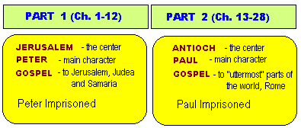

Slide 68
