Slide 1

WTWY: Street Team Placement
Group 2:
Adam Ariel
Summer Yuan
PK
Matias Beeck

Slide 2
Project Summary
1

Slide 3
Intro
With the annual gala happening in June 2018, we set out to analyze the optimal stations for you to send your street teams to in the month leading up to the event.

Slide 4
Datasets
MTA turnstile data from the month of May 2017
Income data from City-Data.com
Charitable donation data from Wolters Kluwer Tax & Accounting US, 2015
Notes:
We chose May because people wont come if you tell them early

Slide 5
Overview
Total station traffic
Weekday vs weekend activity
Morning vs afternoon
Income, Giving & Traffic

Slide 6
Initial Analysis
2

Slide 7
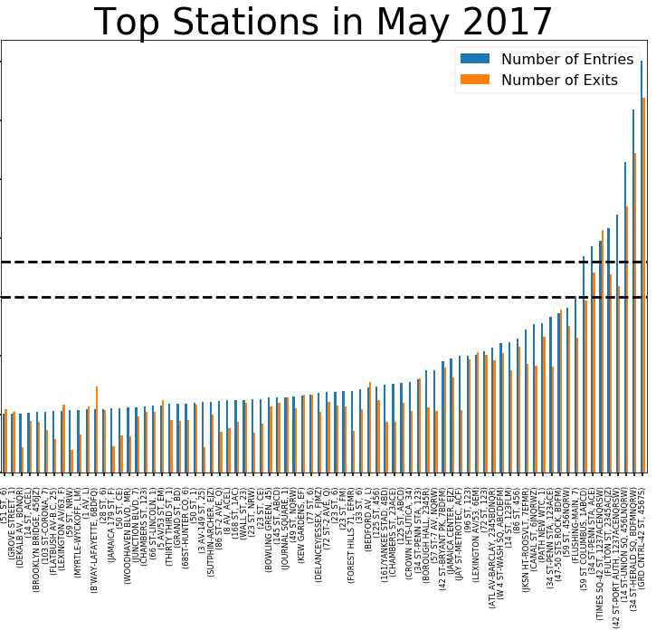

Slide 8
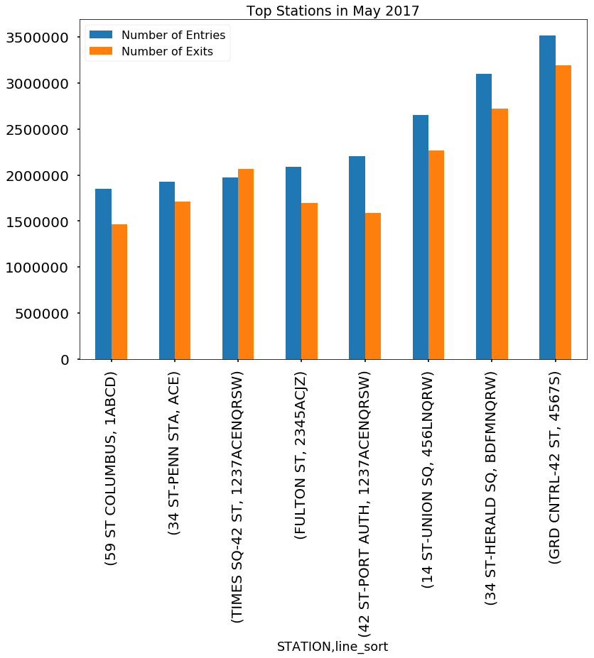
Top Stations
In May 2017, these stations had significantly higher traffic than the others
Five of these stations were located in the midtown area

Slide 9
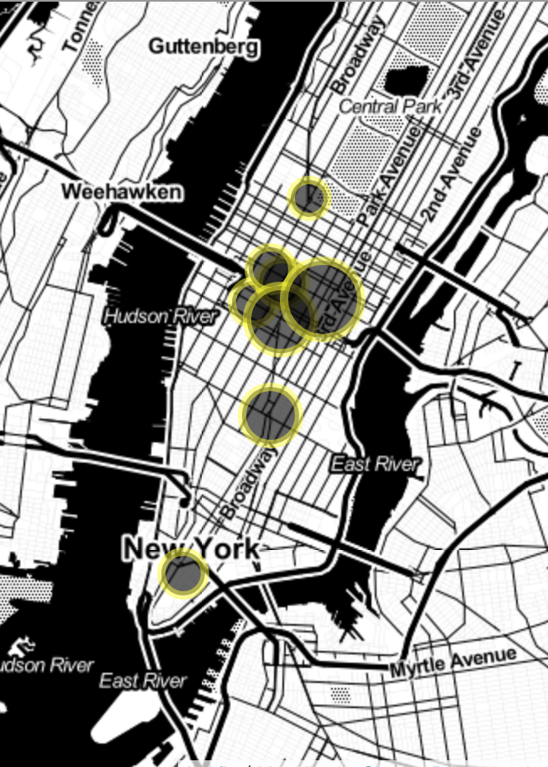
Stations By Traffic
GRD CNTRL-42 ST (10017)
34 ST-HERALD SQ (10001)
14 ST-UNION SQ (10003)
42 ST-PORT AUTH (10018)
FULTON ST (10038)
TIMES SQ-42 ST (10036)
34 ST-PENN STA (10001)
59 ST COLUMBUS (10023)

Slide 10
Time Period Analysis
3

Slide 11
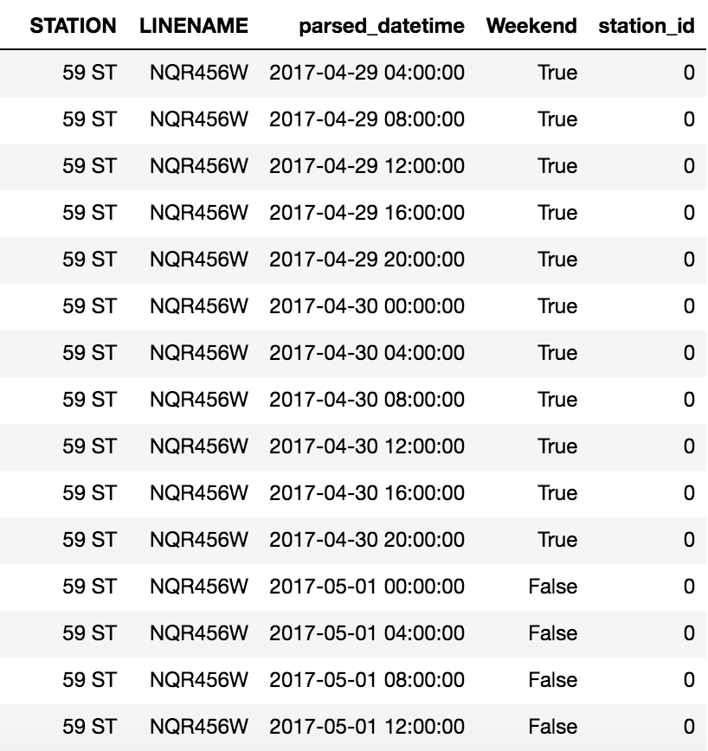
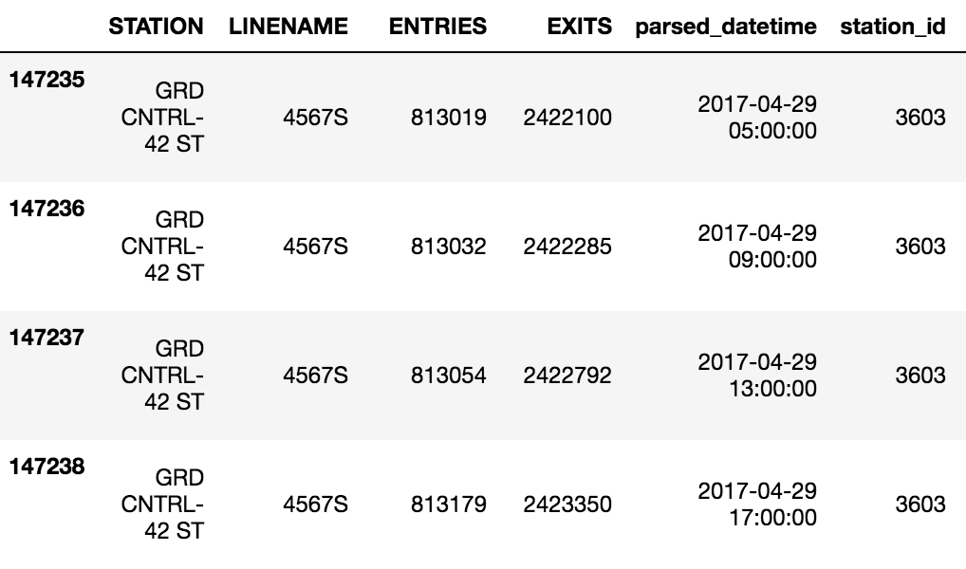
Data Prep
Created subsets of the top stations’ data filtered by weekday and weekend
Bucketed data by time of day
Morning: 6am - 1pm
Afternoon: 2pm – 10pm

Slide 12
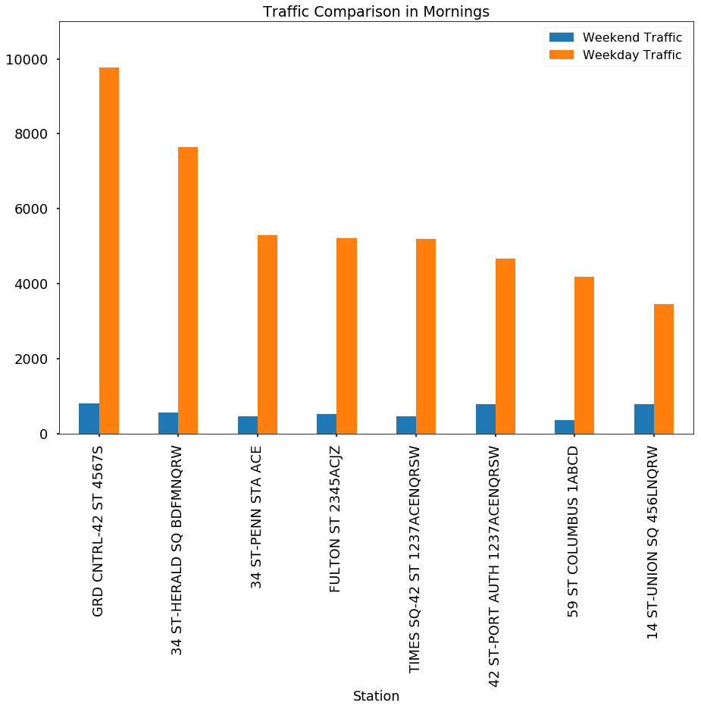
Wkday v Wknd: Morning
Morning Traffic By Station
Traffic numbers represent average station traffic per hour
For mornings, weekday traffic volume was found to be much higher than weekends, as expected
Street teams should not be sent out on weekend mornings

Slide 13
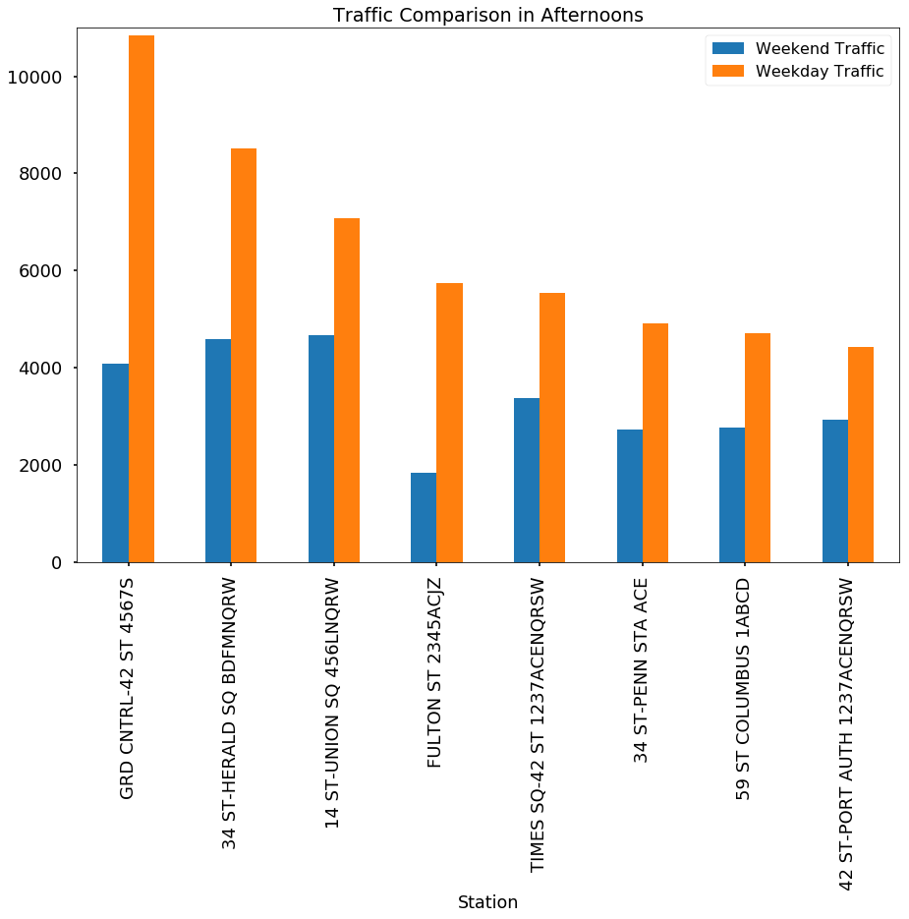
Wkday v Wknd: Afternoons
Afternoon Traffic By Station
For afternoons, the difference between weekday and weekend was not as significant
Street teams should be sent out on weekend afternoons, but priority should be on weekdays

Slide 14
Income Data
4

Slide 15
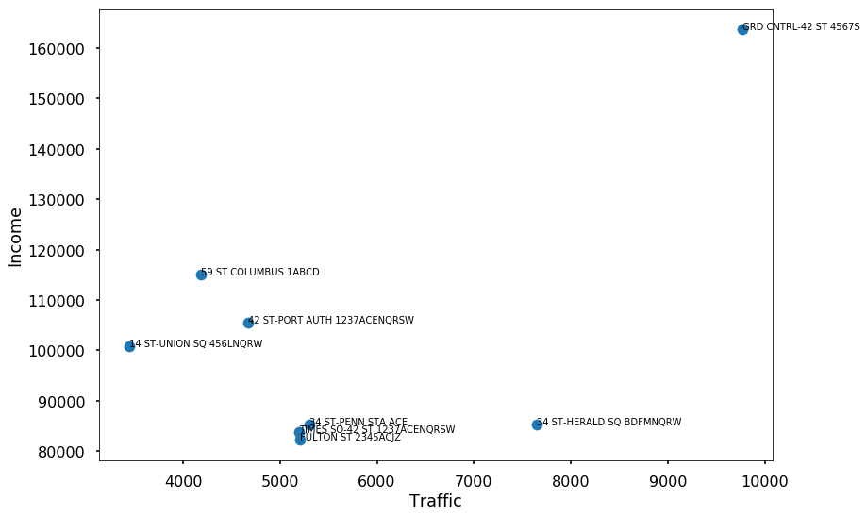
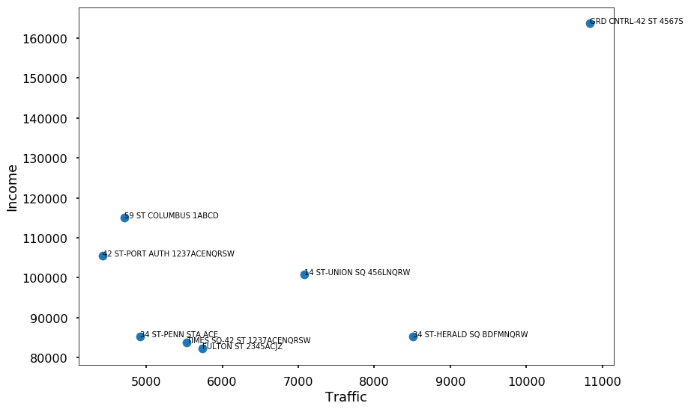
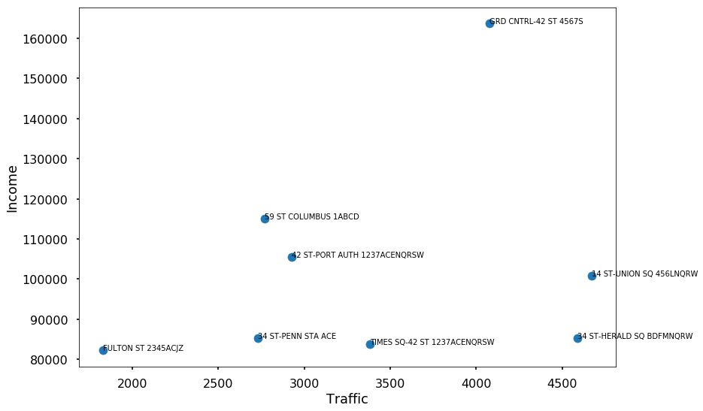
Weekday Morning
Weekday Afternoon
Weekend
Afternoon

Slide 16
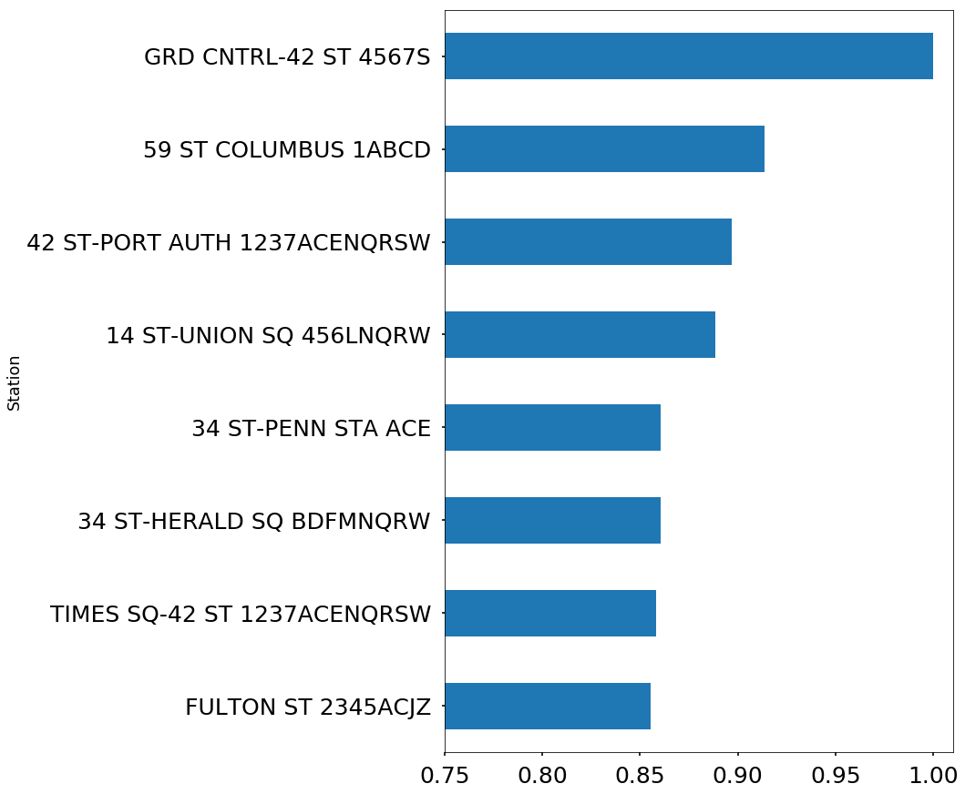
Charitable Donations
Our research showed that people making 50k were expected to give ¾ as much as people making 200k
Relative expected gift value for top stations

Slide 17
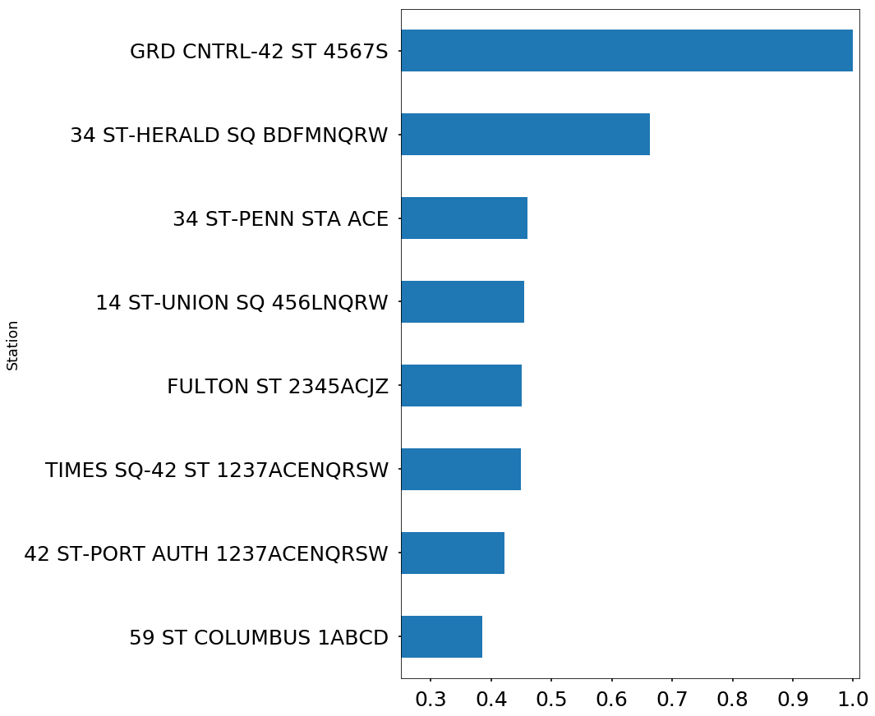
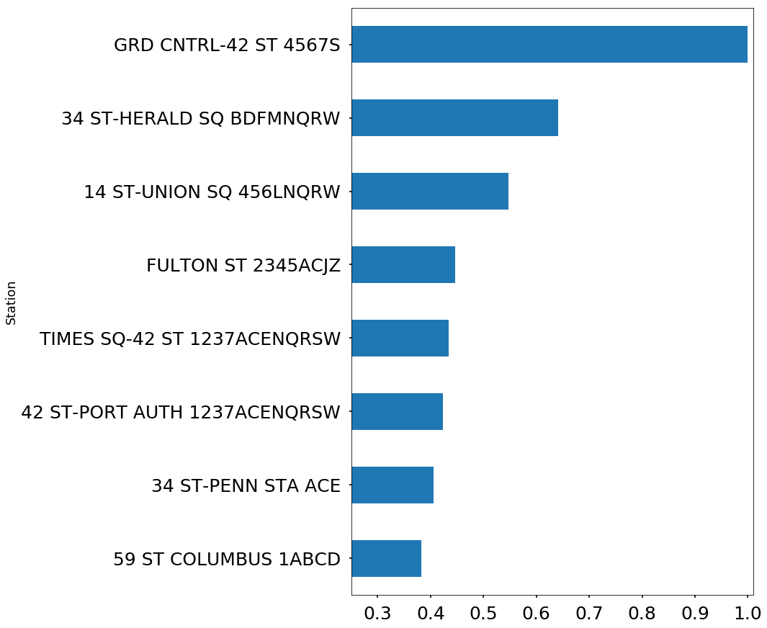
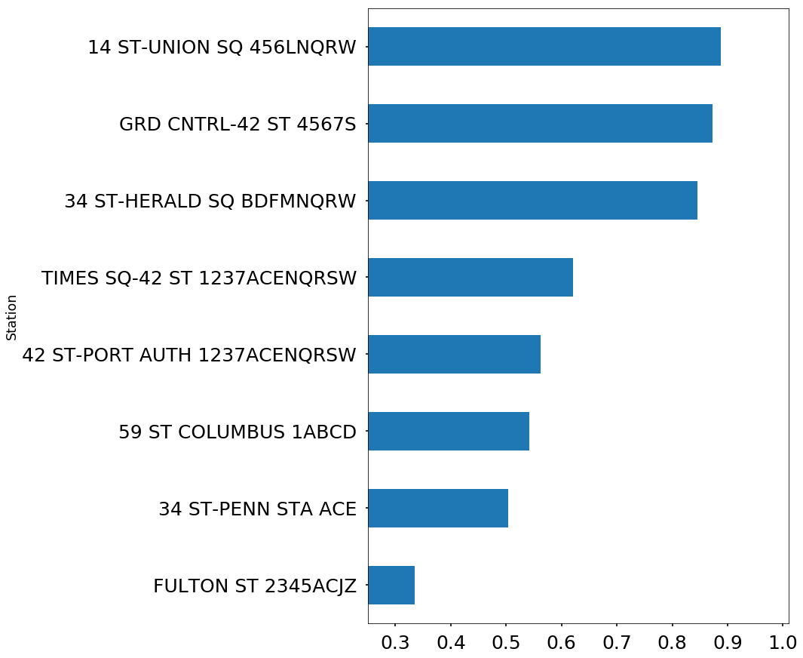
Weekday Morning
Weekday Afternoon
Weekend
Afternoon
Relative Expected Gift Value

Slide 18
Recommendation
Weekday Mornings (6am – 1pm)
Weekday Afternoons (2pm – 10pm)
Grand Central
Herald Square
Penn Station
Grand Central
Herald Square
Union Square
Weekend Mornings (6am – 1pm)
Weekend Afternoons (2pm – 10pm)
Rest ☺
Union Square
Grand Central
Herald Square

Slide 19
Questions?

Slide 20
Appendix
6

Slide 21
Data Cleaning
Parsed date and time into a datetime object ‘parsed_datetime
Assigned each station entrance a unique id by combining the ‘C/A’, ‘UNIT’, ‘SCP’ and ‘STATION’ variables
Calculated entries and exits between each audit by taking the absolute value of the differences from row to row
Created a boolean for if each entry was a weekday or weekend
Sorted ‘LINENAME’ so that we didn’t have any duplicate ‘LINENAME’ entries
Dropped audits that contained above 10,000 entries/exits since those were errant rows or where the entry/exit count was reset for the station or entrance

