Slide 1
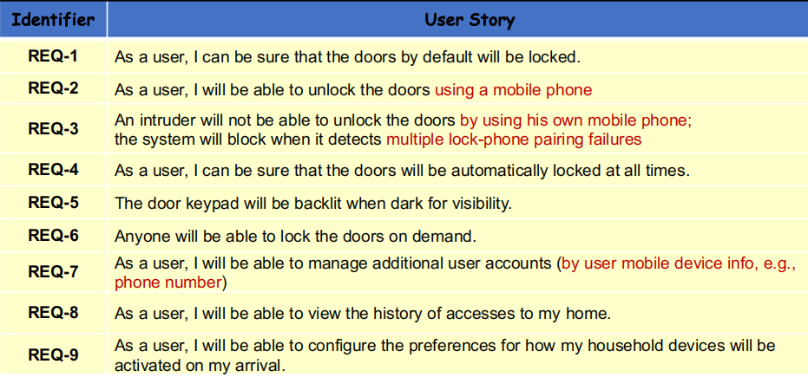
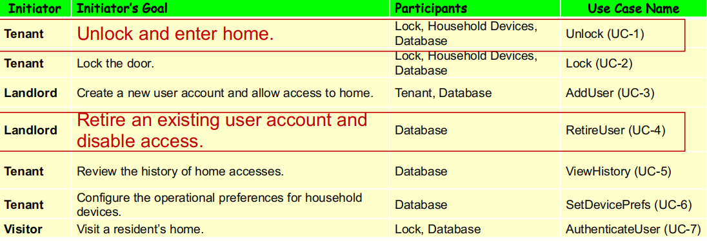
Lab3.1
Some Useful tables

Slide 2
Use Case UC-1: |  |  | Unlock
Related Requirements: |  |  | REQ1, REQ2, REQ3, REQ4, REQ5 and REQ8 stated in the table of REQs
Initiating Actor: |  |  | Any of: Tenant, Landlord
Actor’s Goal: |  |  | To disarm the lock by bluetooth and enter, and get household devices worked automatically.
Participating Actors: |  |  | LockDevice, Household Devices, Database, Timer
Preconditions: |  |  | • The set of valid account(or phone) stored in the system database is non-empty. • The system displays the menu of available functions; at the door keypad the menu choices are “Lock” and “Unlock by bluetooth pairing”. • Bluetooth network is available for both lock system and user’s phone.
Postconditions: |  |  | • The auto-lock timer has started countdown from autoLockInterval. • The system records information in access history.
Flow of Events for Main Success Scenario:
→ | 1. | Tenant/Landlord arrives at the door and selects the menu item “Unlock by bluetooth pairing” and turn on bluetooth on their phone
 | 2. | include::AuthenticateUser (UC-7)
← | 3. | System (a) signals to the Tenant/Landlord the lock status, e.g., “disarmed,” (b) signals to LockDevice to disarm the lock, and (c) signals to Household Device to turn them on
← | 4. | System signals to the Timer to start the auto-lock timer countdown
→ | 5. | Tenant/Landlord opens the door, enters the home [and shuts the door and locks]
← | 6. | System signals to the Database to add to the access history
Flow of Events for Extensions (Alternate Scenarios):
→ | 2a. System cannot capture any bluetooth signal from user’s phone.
← | 1. System notifies the user to check whether Bluetooth is on and retry.
→ | 2b. System detects a lock-phone pairing failures
← | 1. System (a) detects error, (b) marks a failed attempt, and (c) signals to the actor
← | 1a. System (a) detects that the count of lock-phone pairing failures exceeds the maximum allowed number, (b) signals to sound AlarmBell, and (c) notifies the Police actor of a possible break-in
→ | 2. Tenant/Landlord uses a phone with legitimate bluetooth network
 | 3. Same as in Step 3 above

Slide 3
Test-case Identifier: | TC-1
Use Case Tested: | UC-1, main success scenario, and UC-7
Pass/fail Criteria: | The test passes if the user uses a phone whose information is contained in the database, with less than a maximum allowed number of unsuccessful attempts
Input Data: | Phone information transfered by bluetooth, door identifier
Test Procedure: |  | Expected Result:
Step 1. Connect an invalid phone to a valid door identifier through an available bluetooth network |  | System beeps to indicate failure; records unsuccessful attempt in the database; prompts the user to try another device.
Step 2. Connect a valid phone to a valid door identifier through an available bluetooth network |  | System flashes a green light to indicate success; records successful access in the database; disarms the lock device.

Slide 4
Use Case UC-4: |  |  | RetireUser
Related Requirements: |  |  | REQ7 stated in the table of REQs
Initiating Actor: |  |  | Landlord
Actor’s Goal: |  |  | To retire an existing user account and disable access.
Participating Actors: |  |  | Tenant, Database
Preconditions: |  |  | • The set of valid account(or phone) stored in the system database is non-empty. • The system displays the menu of available functions; on the remote main computer which manages user account, the menu choices are “AddUser” and “RetireUser”.
Postconditions: |  |  | • The specified data is deleted from the database.
Flow of Events for Main Success Scenario:
→ | 1. | Landlord selects the menu item “RetireUser”
 | 2. | Landlord identification: include::Login (UC-8)
← | 3. | System prompts for the search criteria(e.g., phone number, device number, etc.) in order to determining the identifier of the user account being retired
→ | 4. | Landlord specifies the search criteria and submits
← | 5. | System (a) retrieve the records meeting Landlord’s criteria from database; (b) renders the records for display; and (c) shows the result for Landlord’s consideration
→ | 6. | Landlord browses, selects the user account he wants to retire (if any), submits the retire request and finally confirms it
← | 7. | System (a) delete the specific user account info from database; (b) signals completion
Flow of Events for Extensions (Alternate Scenarios):
→ | 2a. System detects a login failure
← | 1. System notifies the user to check whether id and password is correct and retry
→ | 5b. System obtains no specific user information from database
← | 1. System (a) signals to the actor, (b) notifies the actor to retry

Slide 5
Test-case Identifier: | TC-4
Use Case Tested: | UC-4, main success scenario, and UC-8
Pass/fail Criteria: | The test passes if the user login with a valid identity and submit a valid user account information which will be retired for search
Input Data: | User login information(e.g., username and password), specific user accounts
Test Procedure: |  | Expected Result:
Step 1. Type in an incorrect login information and valid user accounts |  | System pops a window to indicate login failure; prompts the user to try again.
Step 2. Type in a correct login information and invalid user accounts |  | login success; System failed to retrieve any available information from DB; shows nothing to the user prompts the user to search again.
Step 3. Type in a correct login information and valid user accounts |  | login success; System pops a window to indicate success; records successfully modified in the database;

