Slide 1

WiX
Windows Installer XML - WiX
Rainer Stropek
software architects gmbh
Web
Mail
Twitter
http://www.timecockpit.com
rainer@timecockpit.com
@rstropek
Windows Installer XML

Slide 2
Agenda

Slide 3
Einführung in WiX
Allgemeines zum Windows Installer
Einführung in WiX, Zusammenhang mit MSI
Vorstellung von WiX Tools inkl. Visual Studio Integration
Der WiX-Buildprozess
Grundaufbau einer WiX-Datei
Product, Package, Directories, Files, Shortcuts, Features
Erklärung anhand von live gezeigten Beispielen, bei denen die Teilnehmer mitmachen können
Erstes, eigenständiges Hands-on-Lab

Slide 4
Weiterführende Themen
Aufteilen größerer WiX-Dateien in Fragmente
Generieren von WiX-Dateien über Harvesting
Eigenschaften und Suchen
Grundprinzip von Eigenschaften
DirectorySearch, FileSearch, ComponentSearch, RegistrySearch
Einführung in Conditions
Erklärung anhand von live gezeigten Beispielen, bei denen die Teilnehmer mitmachen können
Conditions
Launch Conditions
Feature Conditions
Action/Installed States
Erklärung anhand von live gezeigten Beispielen, bei denen die Teilnehmer mitmachen können
Zweites, eigenständiges Hands-on-Lab

Slide 5
WiX Aufbauwissen
Installationssequenz (Sequenztabellen)
Benutzerdefinierte Aktionen/Custom Actions
Standard Custom Actions anhand von Beispielen (z.B. WixNetFxExtension, WiXSqlExtension)
Eigene Custom Actions
Erklärung anhand von live gezeigten Beispielen, bei denen die Teilnehmer mitmachen können
Einführung in WiX UI
Standard UI-Sequenzen
Grober Überblick über Anpassungsmöglichkeiten
Erklärung anhand von live gezeigten Beispielen, bei denen die Teilnehmer mitmachen können
WiX Preprozessor, Compiler- und Binder-Variablen
Upgrading und Patching (sehr wichtig)
Best Practices, Unterschiede
Support für 64 Bit (Eigenheiten bzw. Unterschiede einer x64/x86 Installation).
Installation eines x86 Pakets auf einem x64 System (Registry-Einträge, „Program Files“ – Ordner, etc.).
WOW Themen.
Überblick über Burn (ohne inidividuelle Burn UIs mit WPF)
Drittes, eigenständiges Hands-on-Lab

Slide 6
Organisation
9:00 bis ca. 16:30 Uhr
Pausen
10:30 – 10:45
12:15 – 13:00
14:30 – 15:00
Ca. 20% Übungsanteil
Technik: Arbeitsplätze, Visual Studio, WiX, MSI Tools

Slide 7
Introduction
XML-based DSL for creating Windows Installer packages
Aka MSI packages = relational DB controlling installation tasks in Windows
Originally provided by Microsoft, today open source
Alternatives: Manually create MSIs – not practicable for everyday work
Commercial products like InstallShield
Source: http://wixtoolset.org/
Current stable version: 3.9 R2
Visual Studio 2013 support has been added in 3.8

Slide 8

Resources
Homepage of the WiX Toolset
http://wixtoolset.org/
WiX Docs (v3.x)
http://wixtoolset.org/documentation/manual/v3/
Windows Installer Docs on MSDN
http://msdn.microsoft.com/en-us/library/cc185688.aspx
Book: Ramirez, Nick: WiX 3.6: A Developer's Guide to Windows Installer XML, Packt Publishing
Amazon Link
Some samples in this deck are taken from there

Slide 9
Resources
Windows Dev Center (Desktop Development)
http://msdn.microsoft.com/en-US/windows/desktop/aa904949.aspx

Slide 10
Windows Installer
Introduction

Slide 11
Installation Options on Windows
XCOPY deployment
See Wikipedia
ClickOnce deployment
Self-updating applications
No shared components (best practice for MSI, too), non-administrative install (possible with MSI, too)
Need a demo?
For details see MSDN
Windows Store apps
Deployment managed by Microsoft (Windows Store)
For details see MSDN
Windows Installer (MSI)
This is what we are here for

Slide 12
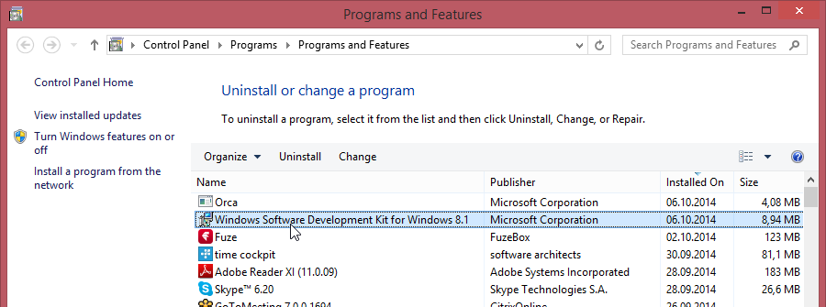
What is Windows Installer?
Installation and configuration service for Windows
Available Windows Installer versions per Windows version
Manages Add/Remove Programs (ARP) of Windows
Declarative programming approach
Installation and installer UI are driven by entries in a relational database
Process
Identify features for end users
Organize application into components
Create installation database (WiX)
Validate installation package

Slide 13
Important Concepts
Installation process
Acquisition: Interactive part, generate installation script
Execution: Run installation script
Rollback: Undo system changes in case of an error
Installation types
Install, Maintain, Repair, and Uninstall
Installation On-Demand and Advertisement (JIT installation)
Patches and Upgrades
Administrative installation

Slide 14
Important Concepts
Features
Part of the application’s functionality
Can be installed independently
Visible to end users
Components
Features consist of components
Unit of installation
Hidden from the user
Guidelines for organizing applications into components
See MSDN

Slide 15
Important Concepts
Installation context
Per-Machine
Per-User
Installation sources
Local MSI file
Install from server
Download from Internet

Slide 16
Rather old Concepts (not covered here)
Concurrent installations
Deprecated
External cabinet (.cab) files
Originates in times where installation consisted of multiple media (e.g. diskettes)

Slide 17
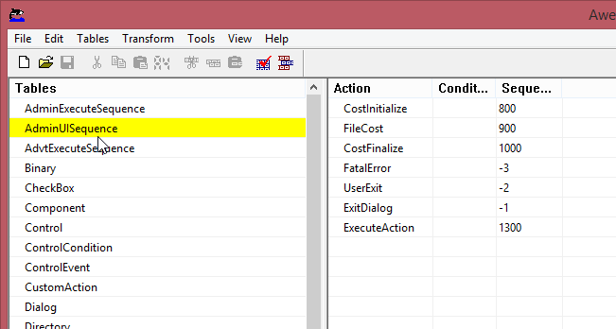
MSI Databases
View simple MSI in Orca tool
AwesomeSoftware.msi
Walk through installer DB

Slide 18
Tools
Important tools for working with WiX

Slide 19
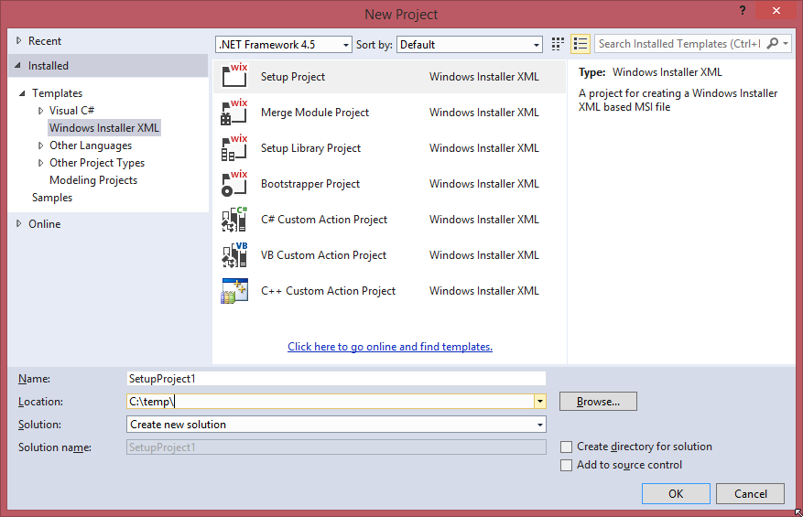
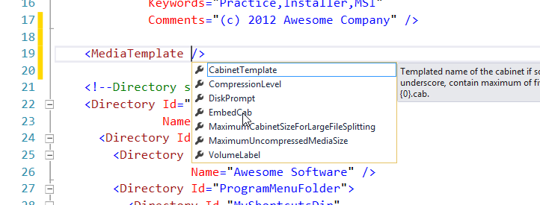
Visual Studio
Project templates
Schemas for XML IntelliSense
Build tasks

Slide 20
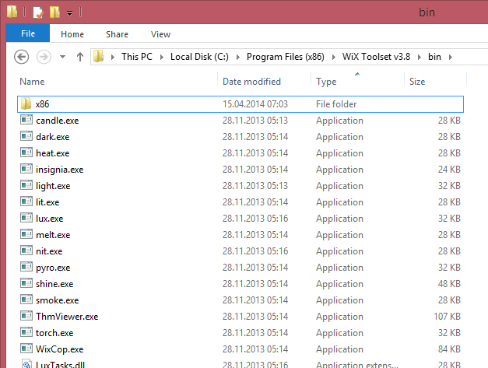
WiX Tools
Command Line
candle.exe
WiX Compiler (.wxs → .wixobj)
light.exe
WiX Linker (.wixobj/lib → .msi)
lit.exe
WiX Libraries (.wxs → .wixlib)
torch.exe, pyro.exe
Patches (.msp)

Slide 21
WiX Tools
Compile Process
*.wixlib
lit.exe
*.wxs
*.wixobj
*.msi/msm
candle.exe
light.exe

Slide 22
Command Line
The following statement generates Product.wixobj
candle Product.wxs
Now we can generate the MSI from the .wixobj file
Note that this examples uses an installer UI (details later)
light Product.wixobj -ext WixUIExtension
Building MSI on command line

Slide 23
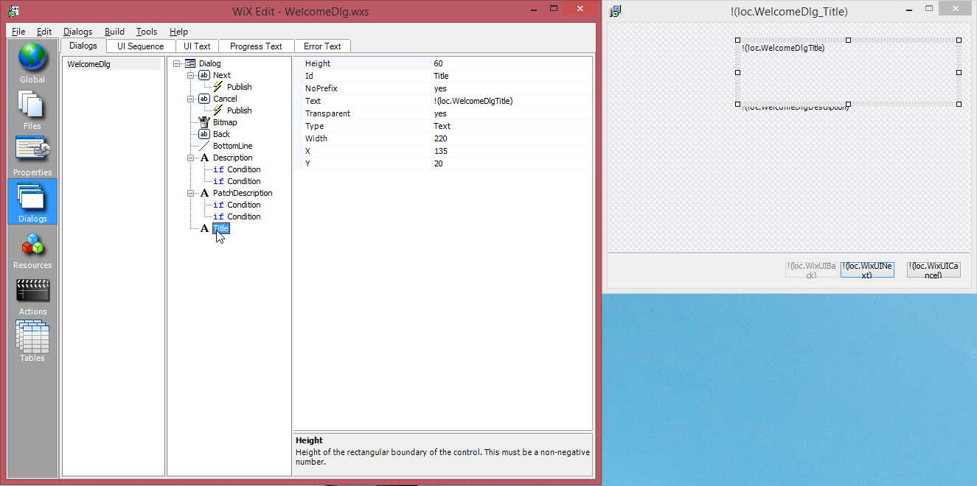
WiXEdit
http://wixedit.sourceforge.net/
Dialog editor for WiX

Slide 24
msiexec
msiexec /Option <Required Parameter> [Optional Parameter]
Install Options
</package | /i> <Product.msi>
Installs or configures a product
</uninstall | /x> <Product.msi | ProductCode>
Uninstalls the product
Logging Options
/l[i|w|e|a|r|u|c|m|o|p|v|x|+|!|*] <LogFile>
* - Log all information, except for v and x options
/log <LogFile>
Equivalent of /l* <LogFile>
Setting Public Properties
[PROPERTY=PropertyValue]
Windows Installer
Important command line arguments
Get full list of arguments with msiexec /?

Slide 25
WiX Basics
Anatomy of a WiX file

Slide 26

WiX XML Format
<?xml version="1.0" encoding="UTF-8"?>
<Wix xmlns="http://schemas.microsoft.com/wix/2006/wi">
<Product …>
…
</Product>
</Wix>
Schema installed in VS for IntelliSense
Well-formed XML
“Toolable”
Can be version controlled, merged, diff‘ed, etc.
RequiredVersion
Minimum WiX toolset version
Important in the team
Can be found in Codeplex

Slide 27
Product Element (doc)
Similar to main method in C#
Describes the product that is inside the installer package
Only one Product element is allowed
Id: Product code of your software
Specific Guid used to identify the product (not the package!)
Do you all know Guids?
“*” → generated during build; recommended for most cases
UpgradeCode: Identifies product across releases
Best practice: Always specify an upgrade code

Slide 28
Product Element (doc)
Version: Version string
[MajorVersion].[MinorVersion].[Build].[Revision]
See also Semantic Versioning
Best practice: Build server
Description of your product
Name, Manufacturer
Language, Codepage: Locale ID and codepage
Used for status messages, progress information, etc.
Details about multi-language installers later

Slide 29
Product
<?xml version="1.0" encoding="UTF-8"?>
<Wix xmlns="http://schemas.microsoft.com/wix/2006/wi">
<Product Id="E4C7B77B-39C6-4836-B63B-D6F940AD61E0"
Name="time cockpit"
Language="1033"
Version="1.0.0.0"
Manufacturer="software architects"
UpgradeCode="EBCACD7E-C8CE-464E-9D33-7EC7A370F227">
</Product>
</Wix>
Example

Slide 30
Package Element (doc)
Describes the installer package
Id: Can be omitted
WiX will pick one for you
Compressed: If yes, puts installation files into CAB files
Recommendation: Set it to yes
InstallerVersion: Minimum required version of MS installer
Major version * 100 + minor version
301 = 3.1, 405 = 4.5

Slide 31
Package Element (doc)
InstallScope: perMachine or perUser
Recommendation: perMachine
For details see doc
Set ALLUSERS property as an alternative
Descriptions
Manufacturer, Description, Keywords, etc.

Slide 32
Package
<?xml version="1.0" encoding="UTF-8"?>
<Wix xmlns="http://schemas.microsoft.com/wix/2006/wi">
<Product …>
<Package InstallerVersion="301"
Compressed="yes"
InstallScope="perMachine"
Manufacturer="software architects"
Description="time cockpit Installer"
Keywords="time,cockpit,Installer,MSI"
Comments="(c) software architects" />
<MediaTemplate EmbedCab="yes" />
…
</Product>
</Wix>
Example
Use MediaTemplate (doc) to embed CAB files into MSI
Use Media (doc) element if you want to separate CAB files from MSI (not covered here)

Slide 33
Directory Element (doc)
Defines the directory layout used to install the product
Id: Key used to identify the directory
Root Directory element must have ID=„TARGETDIR“ and Name=„SourceDir“
Predefined folder IDs see MSDN
Name: Name of the new folder
Don‘t specify it if you use a predefined name

Slide 34
Directory Structure
<?xml version="1.0" encoding="UTF-8"?>
<Wix xmlns="http://schemas.microsoft.com/wix/2006/wi">
<Product …>
<Package … />
<MediaTemplate … />
<!--Directory structure-->
<Directory Id="TARGETDIR" Name="SourceDir">
<Directory Id="ProgramFilesFolder">
<Directory Id="MyProgramDir" Name="timecockpit" />
<Directory Id="ProgramMenuFolder">
<Directory Id="MyShortcutsDir“
Name="software architects" />
</Directory>
</Directory>
</Directory>
…
</Product>
</Wix>
Example

Slide 35
Handling Files
Recommendation: Wrap each File (doc) into its own Component (doc) element
Component (doc) element
Identified by Windows using its Guid
Identified in the MSI using its Id
Recommendation: Prefix component IDs with CMP_
Optionally group Component elements into ComponentGroup (doc)
Use ComponentGroupRef (doc) instead of ComponentRef in features in this case
File (doc) element inside Component
Identified in the MSI using its Id
Source (mandatory): relative to location of WiX source file or absolute
Recommendation: Prefix file IDs with FILE_
Recommendation: Always set KeyPath="yes" (triggers file replace during repair)

Slide 36
Components, Files
<?xml version="1.0" encoding="UTF-8"?>
<Wix xmlns="http://schemas.microsoft.com/wix/2006/wi">
<Product …>
…
<Directory Id="TARGETDIR" Name="SourceDir">
<Directory Id="ProgramFilesFolder">
<Directory Id="MyProgramDir" Name="timecockpit" />
<Directory Id="ProgramMenuFolder">
<Directory Id="MyShortcutsDir" Name="software architects" />
</Directory>
</Directory>
</Directory>
<DirectoryRef Id="MyProgramDir">
<Component Id="CMP_InstallMeTXT"
Guid="09ECC668-063A-4CB6-97AD-C0D1A2674CE1">
<File Id="FILE_InstallMeTXT“ Source="InstallMe.txt"
KeyPath="yes" />
</Component>
</DirectoryRef>
<DirectoryRef Id="MyShortcutsDir">
<Component Id="CMP_DocumentationShortcut"
Guid="6C005B90-2818-407B-9958-DE0578F60000">
<Shortcut Id="DocumentationStartMenuShortcut" …
Target="[MyProgramDir]InstallMe.txt" />
</Component>
</DirectoryRef>
…
</Product>
</Wix>
Example
Use DirectoryRef (doc) to separate directory structure from content
Use Shortcut (doc) to create a shortcut on the Start menu
More details later

Slide 37
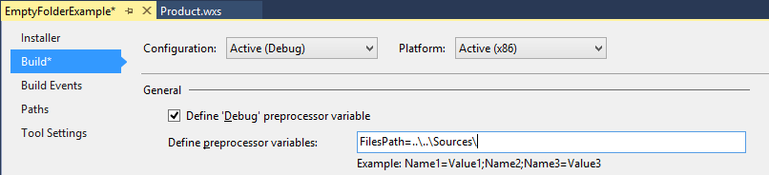
Handling Files
<Component Id="CMP_MyProgramEXE„
Guid="4A626372-1FA8-4F37-B6AA-13FC7A7C6228">
<File
Id="FILE_MyProgramEXE„
Source="$(var.FilesPath)MyProgram.exe"
KeyPath="yes" />
</Component>
Use $(var.VarName) to access preprocessor variables
Use $(var.ProjectName. TargetDir) to reference other projects in your solution (doc)

Slide 38
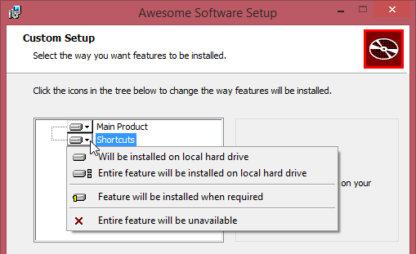
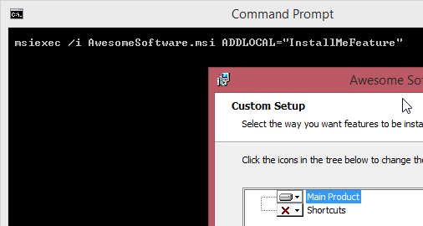
Feature (doc) Element
Features are groups of components that can be installed together
Drives the content of the feature tree in the installation wizard
Features can be nested if necessary
Id: Identifies feature in MSI
Can be used to include features in command line (comma-separated list of IDs in ADDLOCAL property)
Can be used to remove features in command line
(comma-separated list of IDs in REMOVE property)
Level: Default include behavior
1 = included by default, 0 = excluded by default
Details later
Absent: Can be used to disallow excluding

Slide 39
Features
<?xml version="1.0" encoding="UTF-8"?>
<Wix xmlns="http://schemas.microsoft.com/wix/2006/wi">
<Product …>
<Package …/>
…
<DirectoryRef Id="MyProgramDir">
<Component Id="CMP_InstallMeTXT" …>…</Component>
</DirectoryRef>
<DirectoryRef Id="MyShortcutsDir">
<Component Id="CMP_DocumentationShortcut" …>…</Component>
</DirectoryRef>
<!--Features-->
<Feature Id="InstallMeFeature" Title="Main Product"
Level="1">
<ComponentRef Id="CMP_InstallMeTXT" />
</Feature>
<Feature Id="ShortcutsFeature" Title="Shortcuts" Level="1">
<ComponentRef Id="CMP_DocumentationShortcut" />
</Feature>
<UIRef Id="WixUI_FeatureTree"/>
</Product>
</Wix>
Example

Slide 40
Additional File Handling Tips
CopyFile (doc) element
Copy (=duplicate) files using CopyFile as child of File
Use DestinationDirectory attribute to reference the ID of a Directory element
Use DestinationProperty attribute to reference directory name in a property
Copy existing files using CopyFile as child of Component
DestinationDirectory/Property/Name
SourceDirectory/Property/Name
Move file instead of copying it by specifying Delete="yes" (not undone during uninstall)

Slide 41
Additional File Handling Tips
Add assemblies to the GAC
Set Assembly property of File element to ".net"
Installing TrueType fonts
Set TrueType property of File element to "yes"
For detailed information see Attributes section of File element in WiX doc

Slide 42
Additional File Handling Tips
Installing 64bit assemblies
Use ProgramFiles64Folder instead of ProgramFilesFolder
Creating 32 and 64bit installer from single source is possible (see also StackOverflow, tip 2)

Slide 43
Shortcuts
Use ProgramMenuFolder as the target
Use Shortcut (doc) element to create shortcut
Always add a RemoveFolder (doc) element for removing Start menu subdirectory
Always add a RegistryValue (doc) element to have an element for KeyPath="yes“
Add an Icon (doc) element to get an icon for the shortcut

Slide 44
Shortcuts
<Directory Id="TARGETDIR" Name="SourceDir">
<Directory Id="ProgramFilesFolder">
<Directory Id="MyProgramDir" Name="Awesome Software" />
<Directory Id="ProgramMenuFolder">
<Directory Id="MyShortcutsDir" Name="Awesome Software" />
</Directory>
</Directory>
</Directory>
…
<Icon Id="icon.ico" SourceFile="myIcon.ico"/>
<DirectoryRef Id="MyShortcutsDir">
<Component Id="CMP_DocumentationShortcut"
Guid="33741C82-30BF-41AF-8246-44A5DCFCF953">
<Shortcut Id="DocumentationStartMenuShortcut"
Name="Awesome Software Documentation"
Description="Read Awesome Software Documentation"
Target="[MyProgramDir]InstallMe.txt“
Icon="icon.ico" />
<Shortcut Id="UninstallShortcut"
Name="Uninstall InstallPractice"
Description="Uninstalls Awesome Software"
Target="[System64Folder]msiexec.exe"
Arguments="/x [ProductCode]" />
<RemoveFolder Id="RemoveMyShortcutsDir" On="uninstall" />
<RegistryValue Root="HKCU"
Key="Software\Microsoft\AwesomeSoftware"
Name="installed" Type="integer"
Value="1" KeyPath="yes" />
</Component>
</DirectoryRef>
Example

Slide 45
WiX Basics
Example
Create WiX project
Install a simple text file
Create shortcuts
Open installed file
Uninstall
See GitHub

Slide 46
Fragments
Used to structure large projects into multiple .wxs files
Main source file: Product element acts as the root
All other source files: Fragment (doc) element acts as the root
Use references to pull in external elements
Component → ComponentRef, Property → PropertyRef, etc.
A single reference to any item in a fragment pulls in all elements of this fragment
Fragment files can be combined into WiX libraries
.wixlib
Recommendation: Prefer WiX libraries over Merge Modules (.msm; see Merge (doc) and MergeRef (doc))

Slide 47
Shortcuts
<?xml version="1.0" encoding="UTF-8"?>
<Wix xmlns="http://schemas.microsoft.com/wix/2006/wi">
<Fragment>
<ComponentGroup Id="ComponentGroup1"
Directory="INSTALLLOCATION">
…
</ComponentGroup>
</Fragment>
</Wix>
<Feature Id="ProductFeature“
Title="My Product“
Level="1">
<ComponentGroupRef Id="ComponentGroup1" />
</Feature>
Example

Slide 48
Harvesting
Auto-generates .wxs from various sources
Sources include directories, IIS websites, Visual Studio projects, etc.
heat.exe (doc)
Important switches
Guid generation (-ag for Guid=“*”, -gg for letting heat generate Guids)
-pog for selecting output groups of VS project (e.g. Binaries, Symbols, etc.)
Integrate harvesting in .wixproj files (doc)

Slide 49
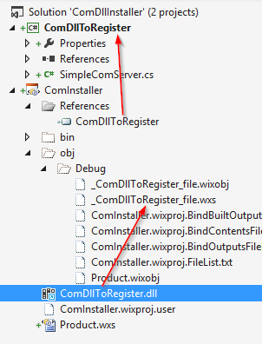
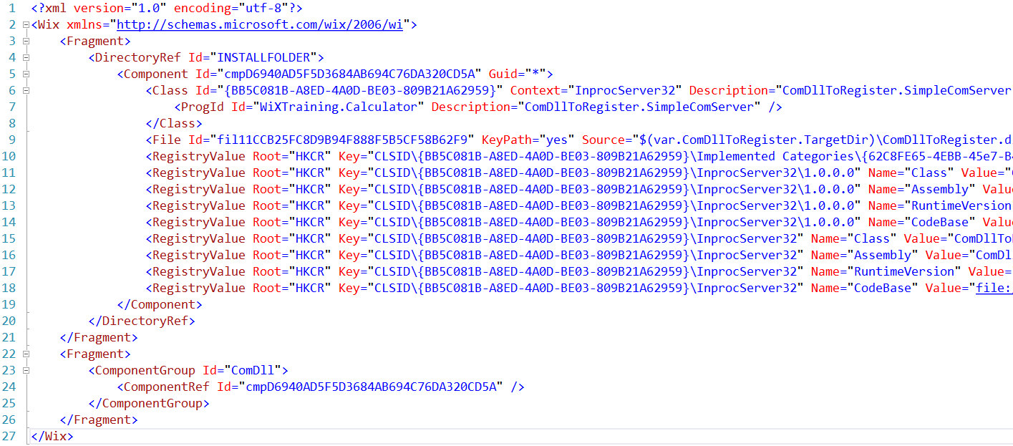
Harvesting
<ItemGroup>
<HarvestFile
Include="$(ProjectDir)..\ComDllToRegister\bin\
$(Configuration)\ComDllToRegister.dll">
<ComponentGroupName>ComDll</ComponentGroupName>
<DirectoryRefId>INSTALLFOLDER</DirectoryRefId>
<Link>ComDllToRegister.dll</Link>
<PreprocessorVariable>
var.ComDllToRegister.TargetDir</PreprocessorVariable>
<SuppressRootDirectory>true</SuppressRootDirectory>
</HarvestFile>
</ItemGroup>
.wixproj Targets
VS Targets (doc)

Slide 50
Properties and Searches

Slide 51
What are Properties?
Variables storing temporary data during install
E.g. store user input, transfer information from one task to another
Store results of searching the computer for files, directories, registry keys, and settings
No type system
Commonly used in expressions
See WiX Tutorial for description of expression syntax
See MSI Property Reference for built-in properties
ARPxxx properties control Add/Remove Programs experience
See WinNetfxExtension for .NET-related properties

Slide 52
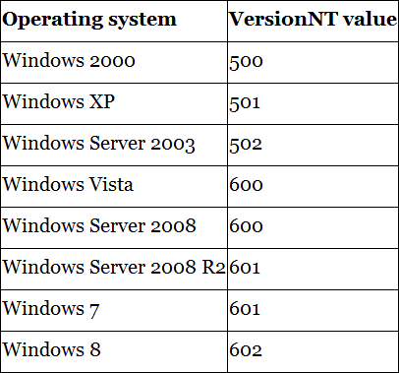
What are Properties?
Use built-in VersionNT, VersionNT64, and ServicePackLevel properties to check Windows Version
Source: [1], Chapter 4, see also MSDN

Slide 53
Declaring Properties
<Property Id="myProperty"
Value="my value" />
<Property Id="myProperty"
Value='Do you see the "quotes"?' />
<Property Id="myProperty"
Value="Do you see the &quot;quotes&quot;?" />
<Property Id="myProperty">my value</Property>
msiexec /i myInstaller.msi PROPERTY1=100 PROPERTY2="my value“
<Product ... >
...
<PropertyRef Id="myProperty" />
</Product>
<Fragment>
<Property Id="myProperty" Value="my value" />
</Fragment>
Property element (doc)
Note that Id is case sensitive
Specify property value in command line
Property name must not contain lowercase letters
Use PropertyRef (doc) to reference property in external file

Slide 54
Referencing Properties
<Condition Message=
"Value of myProperty is [myProperty]. Should be 1">
<WixLocalization Culture="en-US“
xmlns="http://schemas.microsoft.com/wix/2006/localization">
<String Id="WelcomeDlgTitle">
Welcome to the [ProductName] [ProductVersion] Setup Wizard
</String>
</WixLocalization>
<Control Id="OptionalCheckBox" Type="CheckBox" X="135" Y="190"
Width="220" Height="40" Hidden="yes"
Property="WIXUI_EXITDIALOGOPTIONALCHECKBOX" CheckBoxValue="1"
Text="[WIXUI_EXITDIALOGOPTIONALCHECKBOXTEXT]">
User Interface
Access properties in UI-related attributes using square brackets

Slide 55
Referencing Properties
<Property Id="myProperty“ Value="0" />
<!-- Display error message if myProperty is not 1 -->
<Condition Message=
"Value of myProperty is [myProperty]. Should be 1">
<![CDATA[Installed OR myProperty = "1"]]>
</Condition>
Launch Conditions
Display error message if condition is not fulfilled
Use built-in property Installed (MSDN) to find out if product is already installed
Later more about conditions

Slide 56
What are Searches?
Searches for specific files, directories, and settings
DirectorySearch (doc)
FileSearch (doc)
ComponentSearch (doc)
RegistrySearch (doc)
IniFileSearch (doc)
Property will contain search result
Searches can be nested
E.g. Look for a directory in a directory, look for a file in a directory, look for a file based on a path from the registry

Slide 57
Directory Search
<Property Id="NPP_PATH">
<DirectorySearch
Path=" C:\Program Files (x86)\Notepad++“
Depth="0“
AssignToProperty="yes“
Id="NppFolderSearch"/>
</Property>
<Property Id="NPP_PATH">
<DirectorySearch Path="[ProgramFilesFolder]“
Depth="0" AssignToProperty="no“
Id="ProgramFilesFolderSearch">
<DirectorySearch Path="Notepad++“
Depth="0" AssignToProperty="yes“
Id="NppFolderSearch"/>
</DirectorySearch>
</Property>
Example
Use nested FileSearch (doc) element if looking for a specific file

Slide 58
Component Search
<Property Id="ORCA_PATH">
<ComponentSearch Id="orcaSearch“
Guid="{BE928E10-272A-11D2-B2E4-006097C99860}" />
</Property>
Example
Used to find a component with a specified GUID
Risk: Relying on GUID to stay the same
Good for your own software, risky for external software
Returns the full path to the file with KeyPath=“yes”
Can be used to find out where software is installed

Slide 59
Registry Search
<Property Id="NETFRAMEWORK4">
<RegistrySearch Id="NetFramework4"
Root="HKLM"
Key="Software\Microsoft\NET Framework Setup\NDP\v4\Full“
Name="Install"
Type="raw" />
</Property>
Example
Find out if full .NET Framework 4 is installed

Slide 60
Registry Search
Example
Search for Sync Framework in the registry
Display the version number

Slide 61
Installing a Service
<Component Id="CMP_Service" Directory="INSTALLFOLDER">
<!-- Install service executable -->
<File Id="FILE_EventLoggingService"
Source="$(var.ServiceToInstall.TargetPath)"
KeyPath="yes" />
<!-- Install service -->
<ServiceInstall Id="InstallELS"
Name="WiXEventLoggingService"
Description="WiX EventLoggingService Sample"
Start="auto"
ErrorControl="normal"
Type="ownProcess"/>
<!-- Set start/stop/remove options -->
<ServiceControl Id="ControllELS"
Name="WiXEventLoggingService"
Start="install"
Stop="both"
Remove="uninstall"
Wait="yes" />
</Component>
Use ServiceInstall (doc) to install service
Use ServiceControl (doc) to uninstall service
Use ServiceConfig (doc) to configure service
Optional
Available MSI >= 5.0

Slide 62
Conditions
Launch, Feature, and Component Conditions

Slide 63
Conditions
Launch conditions
Condition (doc) inside of Product (doc) element
Check prerequisites at the beginning of the installation
Prevent from continuing if requirements are not met
Feature and Component conditions
Condition (doc) inside of Feature (doc) and Component (doc) element
Prevent feature or component from being installed if a condition is not met
Note that Conditions are evaluated at runtime

Slide 64
Condition Syntax
MyProperty
→ True, if MyProperty has been set to any value
MyProperty < MySecondProperty
→ Comparison; other comparison operators >, <=, >=, =, <>
MyProperty AND MySecondProperty
→ Logical operator; other logical operators OR, NOT
MyProperty >< "NET"
→ True, if MyProperty contains „NET“
MyProperty << "NET"
→ True, if MyProperty start with „NET“
MyProperty >> "NET"
→ True, if MyProperty ends with „NET“
<Condition ... >
<![CDATA[Installed OR MyProperty >< "NET"]]>
</Condition>
Recommendation: Always put condition into CDATA tag

Slide 65
Launch Conditions
<?xml version="1.0" encoding="UTF-8"?>
<Wix xmlns="http://schemas.microsoft.com/wix/2006/wi">
<Fragment>
<Property Id="LaunchConditionsFile"
Value="1" />
<Condition Message=
"OS must be Windows Vista, Server 2008, or higher.">
<![CDATA[Installed OR VersionNT >= 600]]>
</Condition>
</Fragment>
</Wix>
<PropertyRef Id="LaunchConditionsFile" />
If launch conditions are complex, consider putting them into a separate file
Single PropertyRef pulls in all launch conditions

Slide 66
Feature/Component Conditions
INSTALLLEVEL built-in property
Default: 1
Can be changed if necessary
Feature level = 0 → Feature is not installed
Feature is completely removed from feature tree in the UI
Feature level <= INSTALLLEVEL AND > 0 → Feature is enabled
Feature level > INSTALLLEVEL → Feature is disabled
Setting the feature level
Level property of Feature element
Level property in Condition element

Slide 67
Feature Condition
<Feature Id="MainFeature„
Title="Main Feature"
Level="1">
<ComponentRef Id="CMP_InstallMeTXT" />
<Condition Level="0">
<![CDATA[NOT REMOVE = "ALL" AND MyProperty = "some value"]]> </Condition>
</Feature>
<Feature Id="MainFeature„
Title="Main Feature"
Level="0">
<ComponentRef Id="CMP_InstallMeTXT" />
<Condition Level="1">
<![CDATA[REMOVE = "ALL" OR MyProperty <> "some value"]]> </Condition>
</Feature>
Examples
Condition changes feature level if the condition evaluates to true
NOT REMOVE = “ALL”
Enable feature during uninstall to remove it

Slide 68
Component Condition
<Property Id="MyProperty"
Value="1" />
<Component Id="CMP_InstallMeTXT"
Guid="7AB5216B-2DB5-4A8A-9293-F6711FFAAA83">
<File Id="FILE_InstallMeTXT"
Source="InstallMe.txt"
KeyPath="yes" />
<Condition>MyProperty = 1</Condition>
</Component>
Examples

Slide 69
Action/Installed State
Action State: What will be installed?
-1 → Unknown
1 → Advertised (install on-demand)
2 → Absent
3 → Local install
4 → Run from source
Get Action State
Features: &MyFeature = 3
Components: $MyComp = 3
Installed State: What is installed?
-1 → Unknown
1 → Was installed advertised
2 → Not installed
3 → Installed locally
4 → Installed as run from source
Get Installed State
Features: !MyFeature = 3
Components: ?MyComp = 3

Slide 70
Installation Sequence

Slide 71
Installation Sequence
InstallUISequence
FindRelatedProducts
AppSearch
LaunchConditions
ValidateProductID
CostInitialize
FileCost
CostFinalize
MigrateFeatureStates
ExecuteAction
InstallExecuteSequence
AppSearch
LaunchConditions
ValidateProductId
CostInitialize
FileCost
CostFinalize
InstallValidate
InstallInitialize
ProcessComponents
UnpublishFeatures
RemoveRegistryValues
RemoveShortcuts
RemoveFiles
InstallFiles
CreateShortcuts
WriteRegistryValues
RegisterUser
RegisterProduct
PublishFeatures
PublishProduct
InstallFinalize
Same as UI; skipped if already run (msiexec … /quiet)
Deferred Stage with rollback protection (changes are done)

Slide 72
Custom Actions

Slide 73
Custom Actions
<?xml version="1.0" encoding="UTF-8"?>
<Wix xmlns="http://schemas.microsoft.com/wix/2006/wi">
<Product ... >
<Package ... />
<Media ... />
<CustomAction Id="MyAction" Execute="deferred"
Return="check" ... />
<InstallExecuteSequence>
<Custom Action="MyAction" After="InstallInitialize" />
</InstallExecuteSequence>
<Property Id="myProperty" Value="0" />
<CustomAction Id="ErrorCA"
Error="Ends the installation!" />
<InstallUISequence>
<Custom Action="ErrorCA„
Before="ExecuteAction">
<![CDATA[myProperty <> 1]]>
</Custom>
</InstallUISequence>
</Product>
</Wix>
Syntax

Slide 74
Custom Action Types (MSDN)
Task | Properties of CustomAction (doc)
Setting a Windows Installer property | Property, Value
Setting the location of a directory | Directory, Value
Running embedded VBScript or JScript code | Script, script source as element‘s content
Calling an external VBScript or JScript file | BinaryKey*, VBScriptCall
Calling a method from a dynamic-link library | BinaryKey*, DllEntry
Running an executable | BinaryKey* or FileKey, ExeCommand
Sending an error that stops the installation | Error
*) Reference script source or DLL using the Binary (doc) element

Slide 75
CustomAction (doc)
Execute
commit → run after successful completion
deferred → runs during deferred stage (rollback protection)
firstSequence/secondSequence → only run in first/second sequence
immediate → normal processing (not deferred stage)
rollback → only runs in rollback sequence
Return
asyncNoWait → async, may continue after installer completes
asyncWait → async but installer waits at the end
check → synchronous, installer check return value
ignore → synchronous, installer ignores return value

Slide 76
Custom (doc)
After/Before
Sequence after/before custom action should be scheduled
Content
Condition of the action

Slide 77
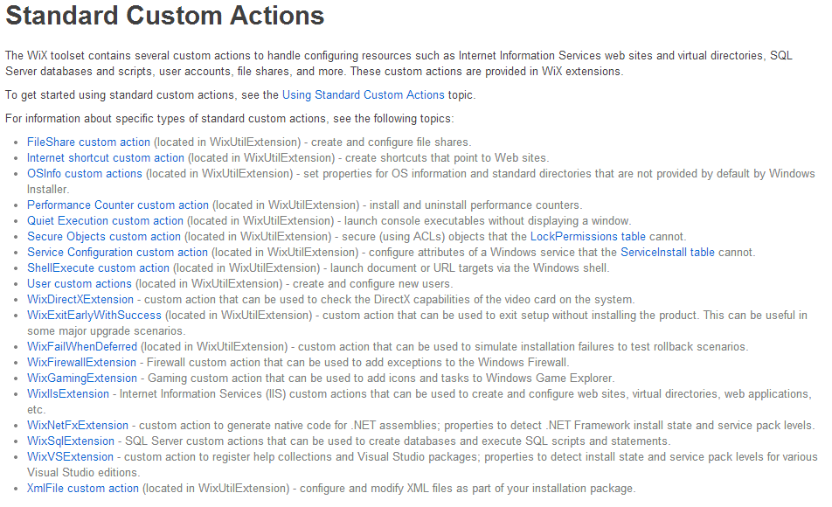
Custom Actions
See also doc

Slide 78
WiX UI
Referencing built-in dialog sequences

Slide 79
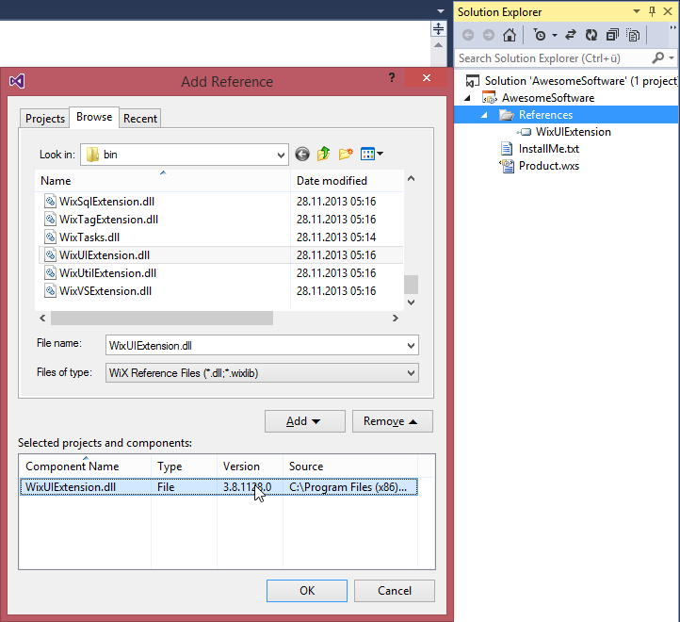
WixUIExtension.dll
Reference for built-in dialog sequences

Slide 80
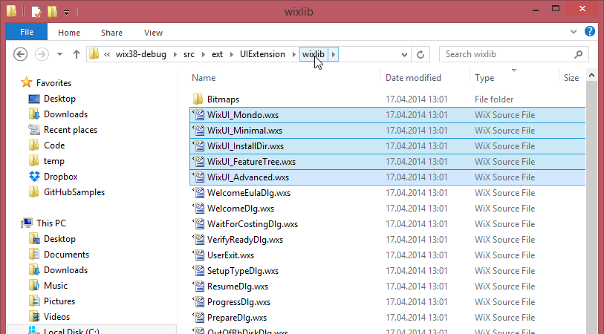
Build-In UIs

Slide 81
Built-in UI Sequences
WixUI_Minimal | WixUI_FeatureTree | WixUI_InstallDir | WixUI_Mondo | WixUI_Advanced
First-time install dialog sequence: - WixUI_WelcomeEulaDlg Maintenance dialog sequence: WixUI_MaintenanceWelcomeDlg - WixUI_MaintenanceTypeDlg - WixUI_VerifyReadyDlg Patch dialog sequence: - WixUI_WelcomeDlg - WixUI_VerifyReadyDlg | First-time install dialog sequence: - WixUI_WelcomeDlg - WixUI_LicenseAgreementDlg - WixUI_CustomizeDlg - WixUI_VerifyReadyDlg - WixUI_DiskCostDlg Maintenance dialog sequence: - WixUI_MaintenanceWelcomeDlg - WixUI_MaintenanceTypeDlg - WixUI_CustomizeDlg - WixUI_VerifyReadyDlg Patch dialog sequence: - WixUI_WelcomeDlg - WixUI_VerifyReadyDlg | First-time install dialog sequence: - WixUI_WelcomeDlg - WixUI_LicenseAgreementDlg - WixUI_InstallDirDlg - WixUI_VerifyReadyDlg - WixUI_DiskCostDlg Maintenance dialog sequence: - WixUI_MaintenanceWelcomeDlg - WixUI_MaintenanceTypeDlg - WixUI_InstallDirDlg - WixUI_VerifyReadyDlg Patch dialog sequence: - WixUI_WelcomeDlg - WixUI_VerifyReadyDlg | First-time install dialog sequence: - WixUI_WelcomeDlg - WixUI_LicenseAgreementDlg - WixUI_SetupTypeDlg - WixUI_VerifyReadyDlg - WixUI_CustomizeDlg - WixUI_DiskCostDlg - WixUI_BrowseDlg Maintenance dialog sequence: - WixUI_MaintenanceWelcomeDlg - WixUI_MaintenanceTypeDlg - WixUI_CustomizeDlg - WixUI_VerifyReadyDlg Patch dialog sequence: - WixUI_WelcomeDlg - WixUI_VerifyReadyDlg | WixUI_Advanced offers a two-click install (EULA checkbox and Install button) and offers an Advanced button that lets users choose per-machine or per-user installs, install path, and features.

Slide 82
WiX Preprocessor

Slide 83
Compiler Variables
<?define UpgradeCode = "{89CC…}" ?>
<?xml version="1.0" encoding="utf-8"?>
<Include>
<?define Config = "Debug" ?>
<?define ProductId =
"{89CC4C03-1059-4523-8670-50DEA04B9892}" ?>
<?define UpgradeCode =
"{49D09A05-12D9-461E-8DEE-9DD5615AF9FE}" ?>
<?define Version = "1.0.0.0" ?>
</Include>
<?include MyVariables.wxi ?>
<Product Id="$(var.ProductId)"
Name="Amazing Software"
Language="1033"
Version="$(var.Version)"
Manufacturer="Amazing Software Inc."
UpgradeCode="$(var.UpgradeCode)">
Recommendation: Put variables into .wxi file
You can also specify variables in the command line for candle.exe:
-dVersion="1.0.0.0"

Slide 84
Compiler Variables
Environment variables
$(env.MyEnvVariable)
System variables
$(sys.CURRENTDIR)
$(sys.SOURCEFILEDIR)
$(sys.SOURCEFILEPATH)
$(sys.PLATFORM) (arch flag from candle.exe)

Slide 85
Preprocessor
<?if $(var.ProcessorArchitecture)=x64 ?>
<Property Id="KB2160841INSTALLED">
<!-- security update for .net framework, CLR bug! -->
<DirectorySearch Id="Windows" Path="[WindowsFolder]">
<DirectorySearch Id="MS.NET" Path="Microsoft.NET">
<DirectorySearch Id="clrjitDir" Depth="3"
AssignToProperty="yes">
<FileSearch Id="clrjit" Name="clrjit.dll"
MinVersion="4.0.30319.201" />
</DirectorySearch>
</DirectorySearch>
</DirectorySearch>
</Property>
<Condition Message="!(loc.ErrorKB2160841NotInstalled)">
<![CDATA[Installed OR KB2160841INSTALLED]]>
</Condition>
<?endif?>
<?ifdef myVar ?>
<Property Id="newProperty" Value="1" />
<?endif?>
<?ifndef myVar ?>
<Property Id="newProperty" Value="1" />
<?endif?>
Doc
Other preprocessor statements
<?foreach …?>
<?error …?>

Slide 86
Localization Variables
<WixLocalization Culture="de-DE"
xmlns="http://schemas.microsoft.com/wix/2006/localization">
<String Id="LANG" Overridable="yes">1031</String>
<String Id="LicenseRtf">\Lang\de-de\License_de-DE.rtf</String>
<String Id="Error32BitOn64BitMachine" Overridable="yes">…</String>
<String Id="ErrorKB2160841NotInstalled"
Overridable="yes">…</String>
</WixLocalization>
<CustomAction Id="CA_ErrorKB2160841NotInstalled"
Error="!(loc.ErrorKB2160841NotInstalled)" />
<Control Id="LicenseText" Type="ScrollableText" X="20" Y="60„
Width="330" Height="140" Sunken="yes" TabSkip="no">
<Text SourceFile="$(var.ProjectDir)\!(loc.LicenseRtf)" />
</Control>

Slide 87
Binder Variables
Grabbing information off from incoming files
E.g. file‘s version → Product.Version
Available binder variables
!(bind.fileLanguage.MyFile)
!(bind.fileVersion.MyFile)
!(bind.assemblyCulture.MyAssembly)
!(bind.assemblyFileVersion.MyAssembly)
!(bind.assemblyFullName.MyAssembly)
!(bind.assemblyName.MyAssembly)
!(bind.assemblyProcessorArchitecture.MyAssembly)
!(bind.assemblyPublicKeyToken.MyAssembly)
!(bind.assemblyType.MyAssembly)
!(bind.assemblyVersion.MyAssembly)

Slide 88
Localization Variables
<Component Id="CMP_MyApplicationEXE"
Guid="28FC0A8D-3E8A-4414-9413-E12B98DE668E">
<File Id="MyApplicationEXE" Source="MyApplication.exe" />
</Component>
<Product Id="*"
Name="PracticeWix"
Language="1033"
Version="!(bind.fileVersion.MyApplicationEXE)"
Manufacturer="Awesome Company"
UpgradeCode="3c1789e3-5b3d-4cb5-9c73-a03f2cc09c26">

Slide 89
Upgrading and Patching

Slide 90
Upgrades
Upgrade types
Major upgrades
Minor upgrades
Small updates
For details see also MSDN
Recommendation: Use major upgrades
Keeps things much simpler
Recommendation: Use per-machine installation
Original install and upgrade have to use same installation type
Recommendation: Always add <Property Id="ALLUSERS" Value="1" />

Slide 91
Checklist for Major Upgrades
Change Product.Id
Or use „*“ to auto-generate product ID during build
Increment Product.Version
Recommendation: Automate version numbering in build process
Add a MajorUpgrade (doc) element
Disallow downgrades using DowngradeErrorMessage
Disallow upgrades using Disallow
Use Schedule to control what’s happening in case of errors (see doc for details)

Slide 92
Minor and Small Upgrades
Can be done like a major upgrade using full MSI
More efficient method: Patch files (MSP)
No uninstall of old version
Contains only changes → smaller
Small Upgrades
Like minor upgrades, smaller in scope
No changes in ProductCode and Version
For details see MSDN

Slide 93
Patch Creation
Old.msi/.wixpdb
Compare old/new .wixpdb using torch
Result: .wixmst transform file
Combine transform file with .wixmsp patch file using pyro
Result: .msp patch file
torch.exe
Delta.wixmst
pyro.exe
Path.msp
New.msi/.wixpdb
Patch.wixmsp

Slide 94
.wixmsp File
<?xml version="1.0" encoding="UTF-8"?>
<Wix xmlns="http://schemas.microsoft.com/wix/2006/wi">
<Patch
AllowRemoval="yes"
Manufacturer="software architects"
MoreInfoURL="http://www.timecockpit.com/"
DisplayName="Sample Patch"
Description="Small Update Patch"
Classification="Update">
<Media Id="5000" Cabinet="RTM.cab">
<PatchBaseline Id="RTM"/>
</Media>
<PatchFamily Id='SamplePatchFamily'
Version='0.0.1.0'
Supersede='yes'>
</PatchFamily>
</Patch>
</Wix>
Classifications
Critical Update, Hotfix, Security Rollup, Security Update, Service Pack, Update, and Update Rollup
Media ID must be > media IDs of .MSI

Slide 95
Building .msp
set wixDir="C:\Program Files (x86)\WiX Toolset v3.8\bin\"
%wixDir%candle Old\Product.wxs -out Old\
%wixDir%light Old\Product.wixobj -out Output\Product1_0_0_0.msi
%wixDir%candle New\Product.wxs -out New\
%wixDir%light New\Product.wixobj -out Output\Product1_0_1_0.msi
%wixDir%candle Patch\Patch.wxs -out Patch\
%wixDir%light Patch\Patch.wixobj -out Output\Patch.wixmsp
%wixDir%torch -p -xi Output\Product1_0_0_0.wixpdb
Output\Product1_0_1_0.wixpdb -out Output\Diff.wixmst
%wixDir%pyro Output\Patch.wixmsp -t RTM Output\Diff.wixmst
-out Output\Patch.msp
Here: based on .wixpdb
Option: based on .wixout
Advantage: Does not need original sources

Slide 96
Burn
Bootstrapper, MSI Chaining

Slide 97
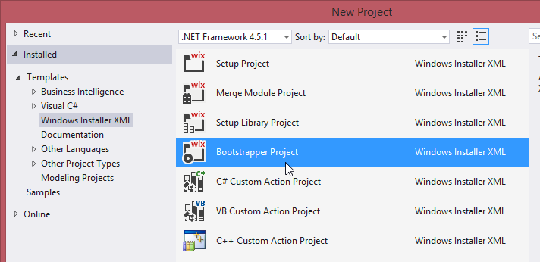
Goals
Install prerequisites instead of launch condition
E.g. .NET Framework, SQL Server, JRE
Install multiple MSI that are part of a software suite
Patch Slipstreaming
Single installer experience
One entry in ARP (configurable)
Single transaction (configurable)
Single progress bar
Fancy installer UI
Standard bootstrapper UI (doc) or
Custom UI based on Windows Presentation Foundation (XAML)

Slide 98
Boostrapper
<?xml version="1.0" encoding="UTF-8"?>
<Wix xmlns="http://schemas.microsoft.com/wix/2006/wi"
xmlns:bal="http://schemas.microsoft.com/wix/BalExtension">
<Bundle Name="Composite App (with Bootstrapper)"
Version="1.0.0.0"
Manufacturer="software architects"
UpgradeCode="1df9e3b2-d6a5-4e06-b289-078c5a0720ac">
<!-- Bundle can only be installed on Windows >= 7 -->
<bal:Condition Message="Requires Windows >= 7">
<![CDATA[VersionNT >= v6.1]]>
</bal:Condition>
<BootstrapperApplicationRef
Id="WixStandardBootstrapperApplication.RtfLicense">
<bal:WixStandardBootstrapperApplication
LicenseFile="License.rtf"/>
</BootstrapperApplicationRef>
<Chain>
<MsiPackage Id="Shell" SourceFile="$(var.Shell.TargetDir)Shell.msi">
<!-- Pass a property to Shell installer to install SDK, too -->
<MsiProperty Name="INSTALLSDK" Value="1" />
</MsiPackage>
<RollbackBoundary />
<MsiPackage Id="Extension"
After="Shell"
SourceFile="$(var.Extension.TargetDir)Extension.msi" />
</Chain>
</Bundle>
</Wix>
Example
For details see WiX docs
VersionNT
Burn built-in variables (doc)

Slide 99
Boostrapper Tips
Localizable just like MSIs (doc)
Upgrades
Higher version in the same UpgradeCode → newer MSIs are upgraded
Install EXE with ExePackage element (doc)
E.g. Java Runtime Environment
Use DetectCondition together with e.g. RegistrySearch (doc)

Slide 100
Q&A
Time cockpit eLearning Library
Rainer Stropek
software architects gmbh
Mail Web Twitter
rainer@timecockpit.com http://www.timecockpit.com @rstropek
Thank your for coming!

